Slide 1
KMP’s Framework
By:
Kyle Sheeley
Matendo Reguma
Patrick McCardle

Slide 2
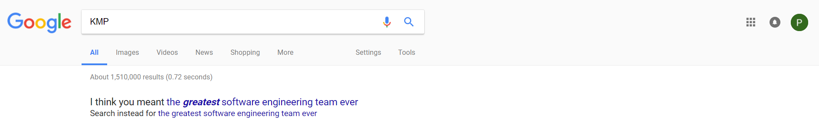
Introductions
Hello! We are team KMP, we are a group of Computer Science seniors at The College of Charleston. We are a 3 person team made up of 2 seniors, Patrick McCardle and Matendo Reguma, and 1 junior, Kyle Sheeley. We were given the task of creating a 25 test case automatic testing framework for an open-source humanitarianism project of our choosing, with a list of possible candidates given to us by Dr Bowring. We are to record our progress along the way and break each record up into chapters that specify what exactly our goals were to have done for the project at the time. The chapters go in chronological order, starting from picking a project all the way up through injecting faults in the fully automated testing framework.

Slide 3

Picking a project
As was the case with many of our fellow classmates, we had a difficult time deciding on a project at the beginning of the semester.
The first thing we thought was that we should try to find a project that is written in a language or at least uses a language that we were all comfortable with, however after the first couple of projects we looked at, we could tell that what language it is written in would not be the only obstacle we would face in finding the right project.

Slide 4
Sahana Eden
We originally had gone with the Sahana Eden project, an open source disaster relief project that was written in python. Eden is a flexible humanitarian platform with a rich feature set which can be rapidly customized to adapt to existing processes and integrate with existing systems to provide effective solutions for critical humanitarian needs management either prior to or during a crisis.
Sahana Eden’s features are designed to help Disaster and Emergency Management practitioners to better prepare for, respond to and recover from disasters more effectively and efficiently. Sahana Eden can provide valuable solutions for practitioners in Emergency Management, Humanitarian Relief and Social Development domains.

Slide 5

Picking a project cont....
However shortly after getting our hands dirty with Sahana Eden, we quickly ran into some very frustrating errors. The dependencies installations were more difficult than the actual projects installation, as they were often out of order, some things were left things out, or things were out of date and had very little updates within the last 2 years.

Slide 6
So close yet so far
We got about as far as being able to successfully launch the web2py web server, which hosts the Sahana Eden application, and populate the database with test data. But when it came time to run the tests it seemed we hit a brick wall. We were met with mostly administration or authentication privileges, but we were led to believe that it was an error with the web2py server that was not allowing us access to run the tests, even though we had created an account for Sahana Eden and had been given administration rights.

Slide 7

Changing it up
After we threw in the towel with the previous project, we decided to look elsewhere for projects. We came across a humanitarian project that stemmed from the KoboToolbox project, which some of you may be aware of. KoBoToolbox is a free open-source tool for mobile data collection, available to all. It allows you to collect data in the field using mobile devices such as mobile phones or tablets, as well as with paper or computers. It is being continuously improved and optimised particularly for the use of humanitarian actors in emergencies and difficult field environments, in support of needs assessments, monitoring and other data collection activities.

Slide 8
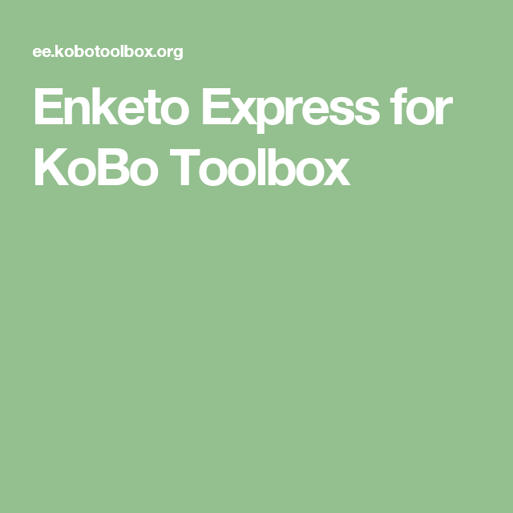
Enketo Express
Basically, Enketo Express is a service that serves as a prime component in data collection, data storage, and data transfer. Enketo has been used all around the world for a wide range of uses from needs assessments in humanitarian aid, to raising historical awareness, to clinical research, and election monitoring. Enketo can be combined with other tools to flexibly create a full-fledged information management system. This has resulted in the adoption of Enketo into many systems. It also means that Enketo can focus on just data collection and do this collection in the best way possible.

Slide 9
Features
What makes Enketo better than it’s competition?
Surveys deployed with Enketo:
work offline
have beautiful themes and widgets
are printer-friendly
can use very powerful skip and validation logic
run on any device, mobile or desktop, as long as it has a fairly modern browser

Slide 10
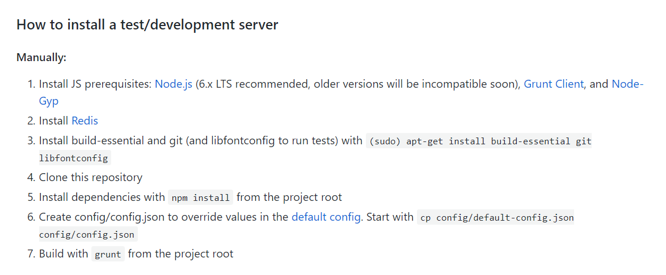
Installation
The main reason we chose this project was because of the installation process, and wanting to learn more about containers. There are 3 different ways to install and run the project, the first is manually.

Slide 11

The new kid way
Docker, Docker containers and Docker compose
What is a container?
A container image is a lightweight, stand-alone, executable package of a piece of software that includes everything needed to run it: code, runtime, system tools, system libraries, settings. Available for both Linux and Windows based apps, containerized software will always run the same, regardless of the environment. Containers isolate software from its surroundings, for example differences between development and staging environments and help reduce conflicts between teams running different software on the same infrastructure.

Slide 12
Docker compose
Compose is a tool for defining and running multi-container Docker applications. With Compose, you use a YAML file to configure your application’s services. Then, with a single command, you create and start all the services from your configuration.
Compose works in all environments: production, staging, development, testing, as well as CI workflows.
Using Compose is basically a three-step process:
Define your app’s environment with a Dockerfile so it can be reproduced anywhere.
Define the services that make up your app in docker-compose.yml so they can be run together in an isolated environment.
Lastly, run docker-compose up and Compose will start and run your entire app.

Slide 13
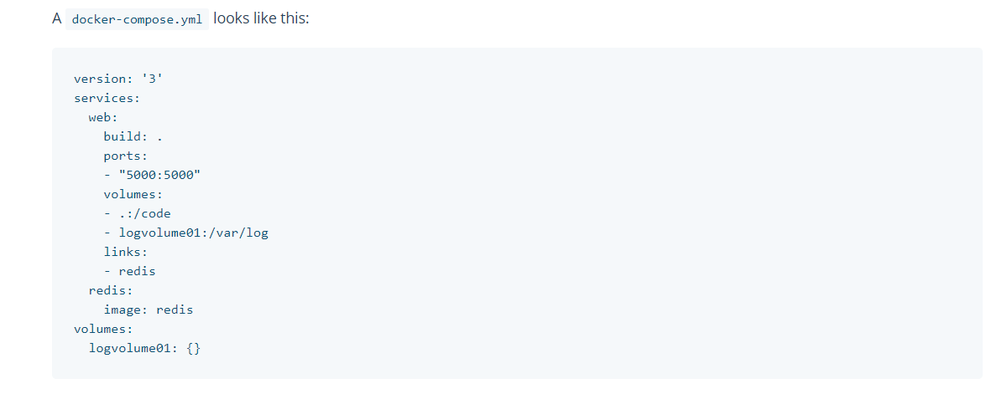
Docker compose example

Slide 14
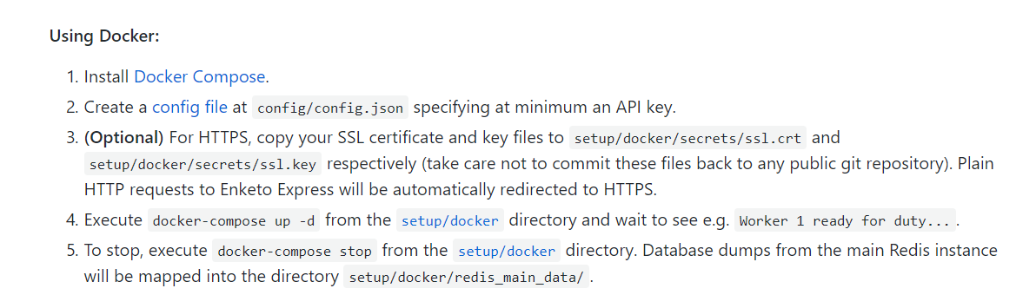
Docker installation

Slide 15
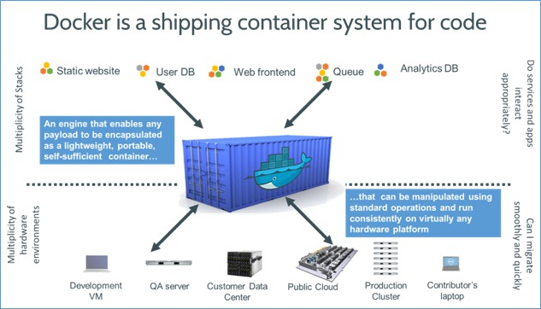
Scripting
Because docker commands are executed via the command line, it is simple and easy to script docker commands in a bash script. For our github we have provided a Readme with detailed instructions on how to download and install Docker & Docker compose. After that a single bash script will start a Docker container, run docker compose, and launch the redis and nginx servers needed to run and develop on Enketo Express, then our tests will be run inside the project.

Slide 16
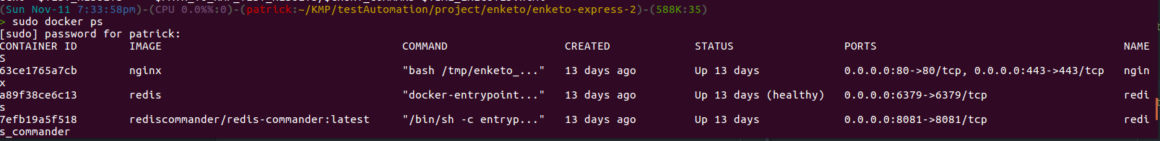
Docker ps (show running containers)
This is what should appear on the screen after the docker run script has been executed, this gives information about the container, as well as its status.

Slide 17


Project components
We began diving into the code and looking for provided test cases. It is a good thing that Enketo is so organized and came with nice comments, as it didn’t take us long to locate the tests. We discovered that since the project is written in NodeJS, there are many components to running the tests, such as :
Grunt
Mocha
Chai

Slide 18

Brief Descriptions : Grunt
Built on top of Node.js, Grunt is a task-based command-line tool that speeds up workflows by reducing the effort required to prepare assets for production. It does this by wrapping up jobs into tasks that are compiled automatically as you go along. Basically, you can use Grunt on most tasks that you consider to be “grunt” work, things that would normally have to be manually configured and run yourself. Grunt can handle most things you want to have within your JavaScript workflow, from minifying to concatenating JavaScript as well as running Mocha tests automatically.

Slide 19

Brief Descriptions : Mocha
Mocha is a feature-rich JavaScript test framework running on Node.js and the browser, which makes asynchronous testing simple, flexible and fun. It does just about everything a JavaScript developer needs, and yet remains customisable enough to support both behaviour-driven and test-driven development styles. Mocha tests run serially, allowing for accurate reporting, with the ability to map uncaught exceptions to the correct test cases.

Slide 20

Brief Descriptions : Chai
Chai is a BDD / TDD assertion library for node and the browser that can be delightfully paired with any javascript testing framework.
Chai aims to be an expressive and easily approachable way to write assertions for JavaScript project testing. Developers have already started expanding on Chai’s available language through plugins such as spies, mocks/stubs, and jQuery support.
Fun fact is that the motivation for Chai came about with the release of Mocha. At the time, there was no apparent assertion library to pair with it that would allow for the same assertions to be used on both server and client with the inherent simplicity that Mocha provides.

Slide 21
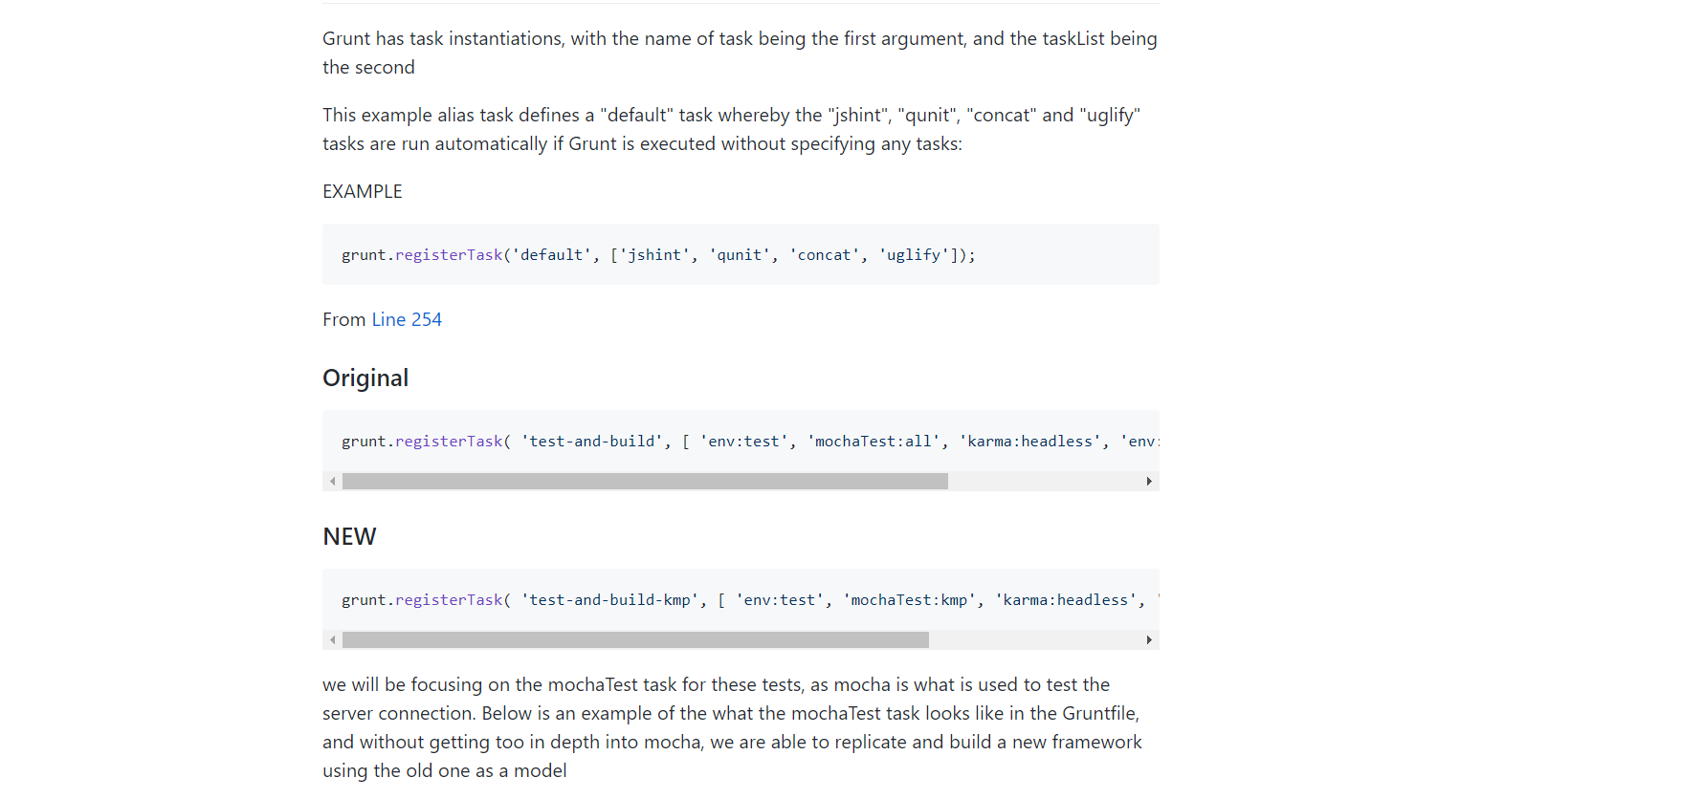
Grunt example

Slide 22
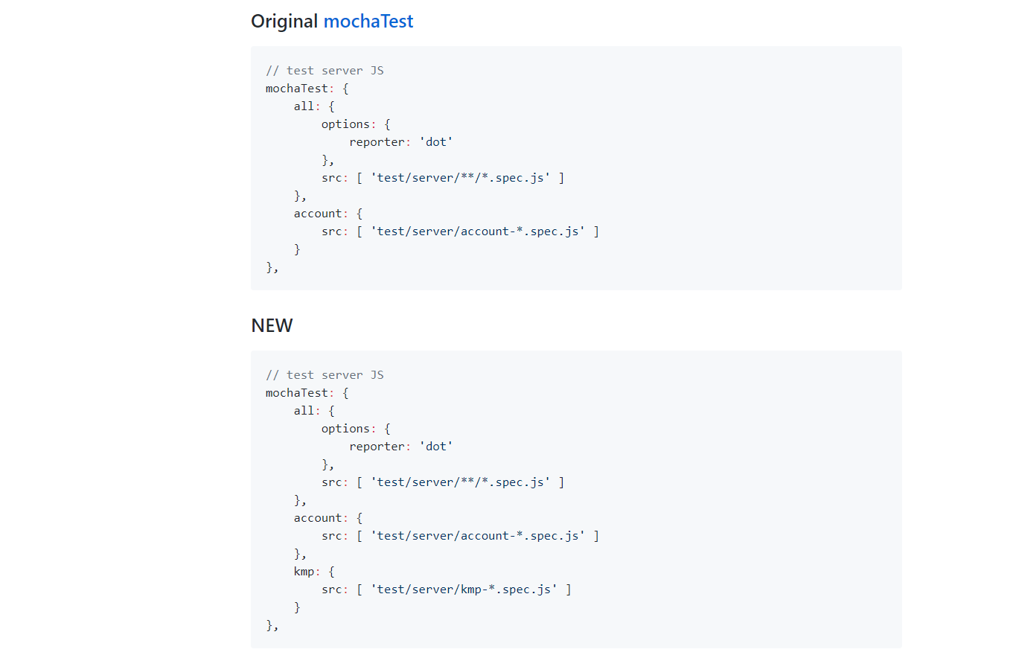
Mocha example

Slide 23
Our Testing Framework
Testing framework :
As specified in the instructions, we have all 25 of our test cases written in in the testCases folder that have the component being tested, the inputs to the test, the method being tested, and the expected output. As well as a working script that reads through the test cases txt files, generates the appropriate tests, runs the test case, pipes the output into an html file and displays the test results in a web browser.

Slide 24
Methods tested
IsNewSubmission() (Id component)
IsNewSubmission() (InstanceId component)
GetRequest() (for existing Enketo ID’s)
StoreNewSurvey()
CacheInstance()
ObtainCachedInstance()

Slide 25
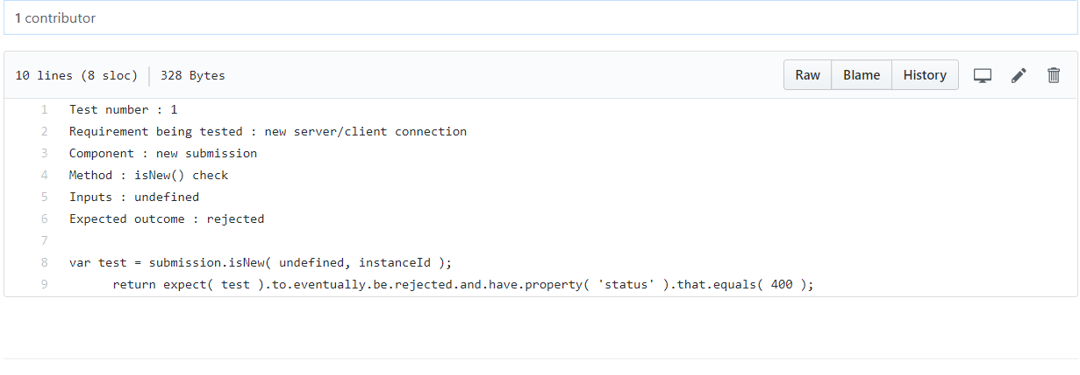
TestCases
In our testcase.txt file, we can see a model of what the method being tested will look like to give someone who is unfamiliar with the project a better understanding of how to write a test case if they wish to. From this testcase.txt file, we found a good way to extract information using the ‘grep’ command.

Slide 26
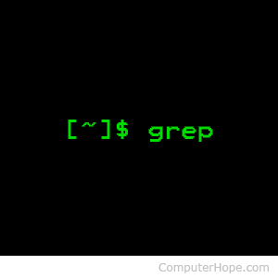
Grep
In the simplest terms, grep (global regular expression print) will search input files for a search string, and print the lines that match it. Beginning at the first line in the file, grep copies a line into a buffer, compares it against the search string, and if the comparison passes, prints the line to the screen. Grep will repeat this process until the file runs out of lines. Notice that nowhere in this process does grep store lines or change lines.

Slide 27
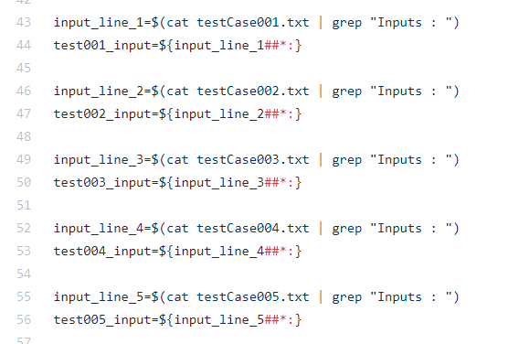
Getting inputs
This picture shows how we used grep to read the inputs line and put the results in a variable. Note, this can be done in a loop instead of individually as shown

Slide 28
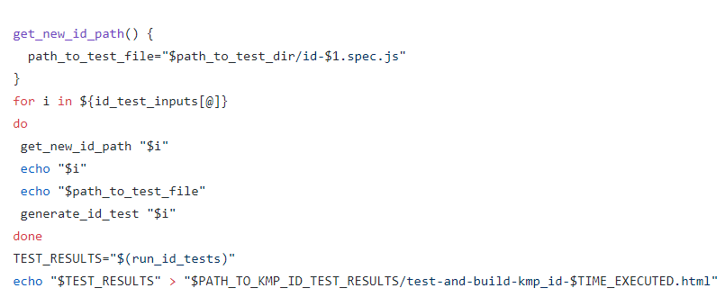
What to do with inputs
After all the test inputs are parsed and grouped a for loop iterates through the specified array, calls the function ‘get_new_id_path’ at the beginning of each iteration. This self-created function gives a brand new path to where the eventual test cases will be located. The function takes an already declared variable ‘path_to_test_dir’ and creates a unique file/path that is named after the test input when called, this makes it easy to separate tests by name and see what the input is without having to actually go into the file. Once each input has it’s own unique file path we are ready to generate the tests.

Slide 29
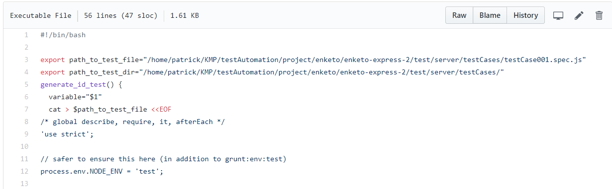
Generate tests
Each component being tested requires a whole slew of (different) global variables, assertions, requirements and such. Since these are necessary to keep in the testing files we found a very useful use of the ‘cat’ command here, by using cat > name_of_file <<EOF. Doing this allows for everything underneath the cat command (and before the 2nd EOF) to be copied and pasted into a new file in a completely different directory. This made it easy to create new test files with all the required global variables and such. The ‘generate_id_test’ “$i” creates the new file and inside the method being tested, replaces a $variable parameter, with the “$i” parameter that is passed in from the id_inputs array.

Slide 30
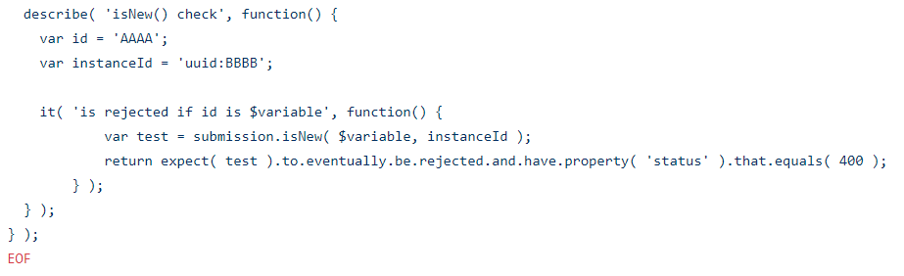
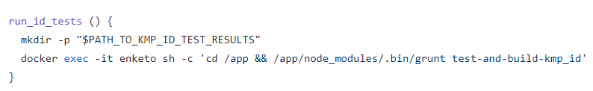
EOF
Here you can see that the method in the “id” testCase.txt files matches the method created in the file, with the $variable in place of the “$i” which is in place of the id_test inputs array. The 2nd EOF stop the creation of the new file. The new/overwritten test files will sit patiently after being created, until a variable named TEST_RESULTS will call the command to the run the newly created tests, and store the output of the test results into a time-stamped html file.

Slide 31
Repetition is key
This procedure of ....
1) parse inputs line of testCase.txt
2) collect inputs and store into groups (arrays)
3) Iterate through the groups, and with each iteration it creates a new path for the given input by name, and runs the ‘generate_x_tests’ script that creates the new files and puts them in the correct path.
4) run the new tests, and store the results in a time-stamped html file.
… is repeated throughout the script for each method being tested. With each new ‘generate_x_tests’ script containing the correct global variables and requirements, it is easy to keep all requirements for the different tests and it is easy to create different test files within the same script.

Slide 32
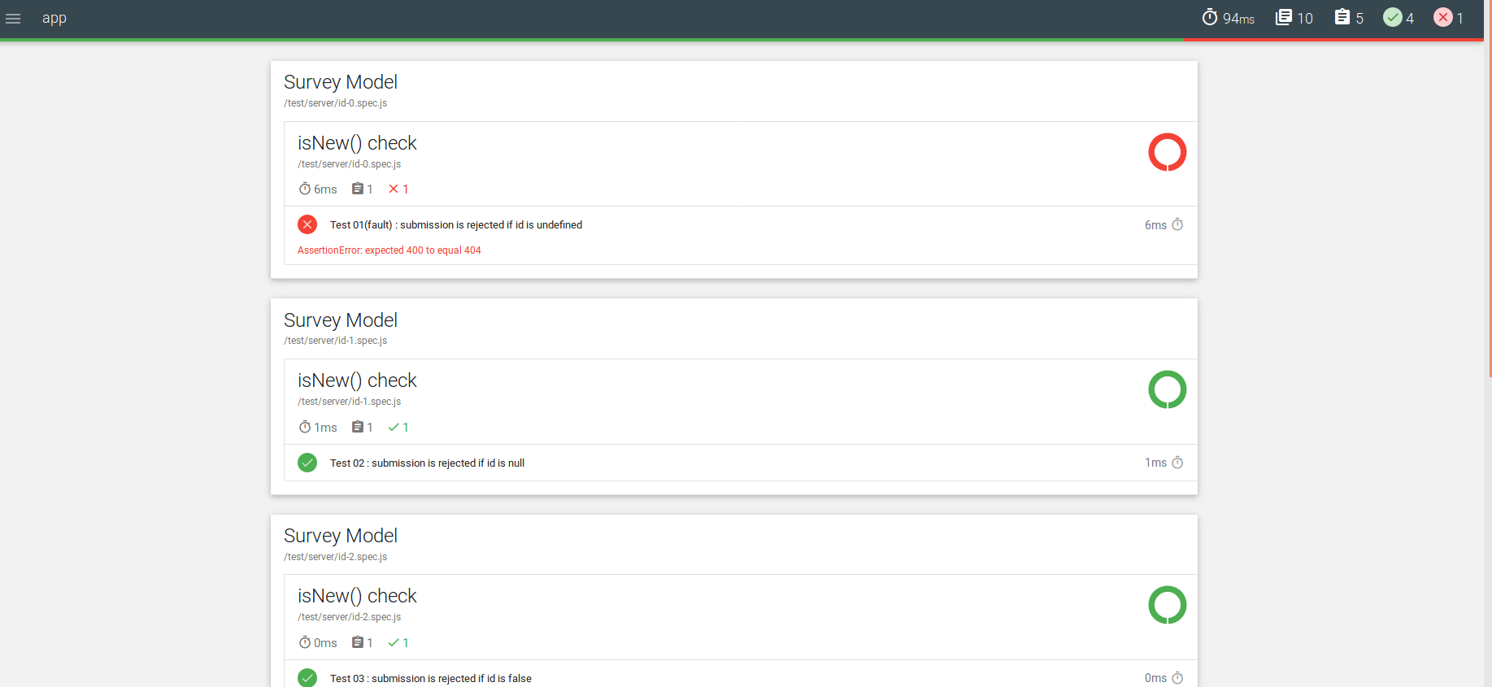
Fault Injection Example

Slide 33
Lessons learned
We feel that this semester-long project has taught us many things. None of us had dealt with a project like this before, so it took us a while to just be comfortable with the file structure of the project. We were able to learn about many things that are very real-world applicable, like docker, grunt, and mocha. We learned about containers which we talked about in class, and saw examples of good software engineering, i.e a lot of tests, good comments and clear directions. We probably learned the most about bash scripting, as the most major component of the project was the script.

Slide 34
Works Cited
https://www.docker.com/what-container
https://docs.docker.com/compose/overview/
https://www.cyberciti.biz/faq/howto-use-grep-command-in-linux-unix/
https://www.humanitarianresponse.info/en/applications/kobotoolbox
https://gruntjs.com/
https://mochajs.org/

