Slide 1
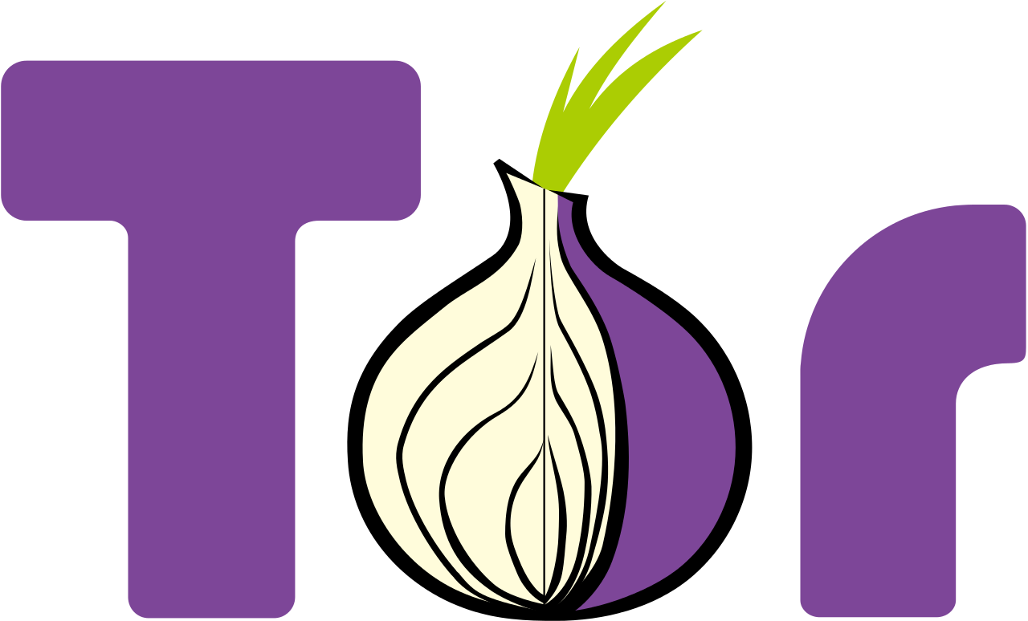
Testing
theMonkeyCatfishCoalition

Slide 2
What is ?
Tor is an anonymous network
Allows users to communicate privately on public networks
Encrypts user information to ensure privacy
A tool for bypassing censorship
Used by civilians and the military

Slide 3
Why Did We Choose ?
Fairly well-documented
Easy to access
Large Active Community
Interesting and Noble Purpose

Slide 4
The Testing Process
Found several useful and easily testable methods in utils.c and address.c
First tested round_to_next_multiple_of and tor_strndup_
Then tested round_to_power_of_2, digit_to_num, tor_strisnoupper, and tor_llround

Slide 5
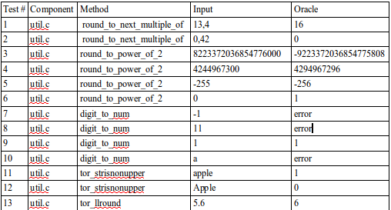
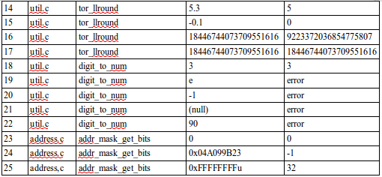
Test Cases

Slide 6
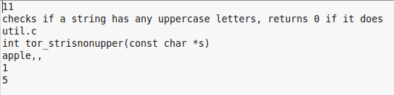
Structure of Test Case .txt Files
Line 1 - The number of the test case (1st, 2nd, etc.)
Line 2 - The purpose of the tested method
Line 3 - The location of the method to be tested
Line 4 - The name of the method to be tested
Line 5 - The input parameters
Line 6 - The expected output
Line 7 - A number to indicate the driver being used

Slide 7
Our Framework
Run by a Python script
Used by calling Python /.../runAllTests.py
Performs tests by reading information from .txt files
Methods specified by .txt file are run by driver
Driver is part of a modified main in the Tor files
Outputs are compared against expected results

Slide 8
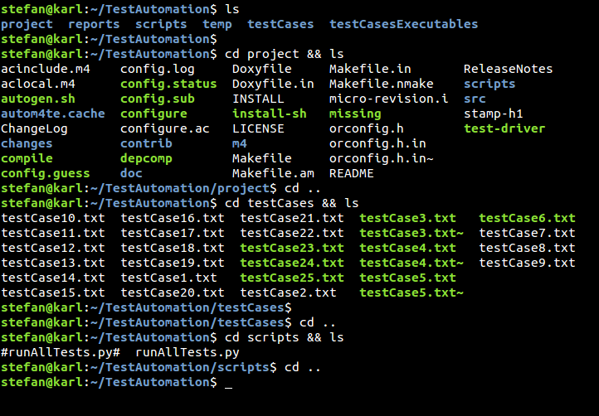
Directory Architecture

Slide 9
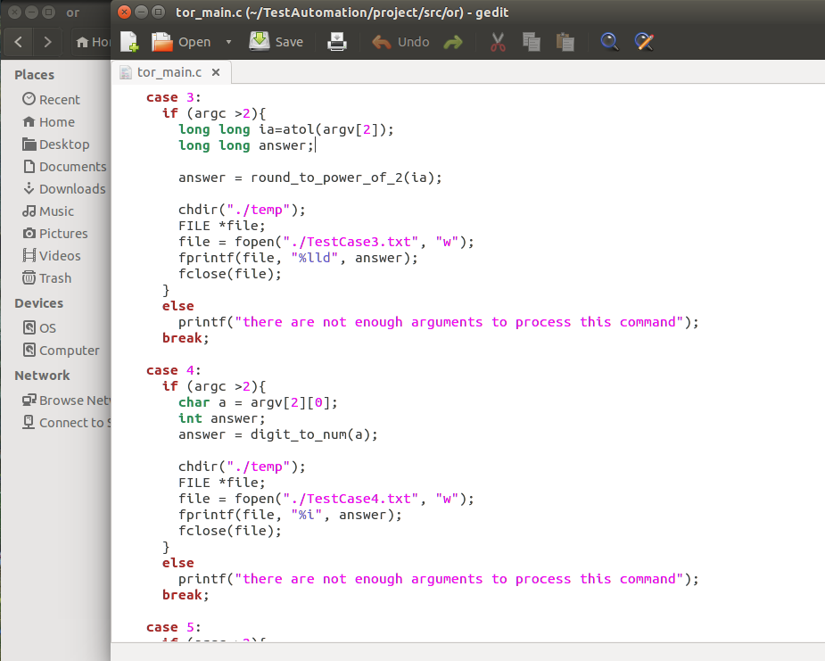
The Modified Main (Driver)

Slide 10
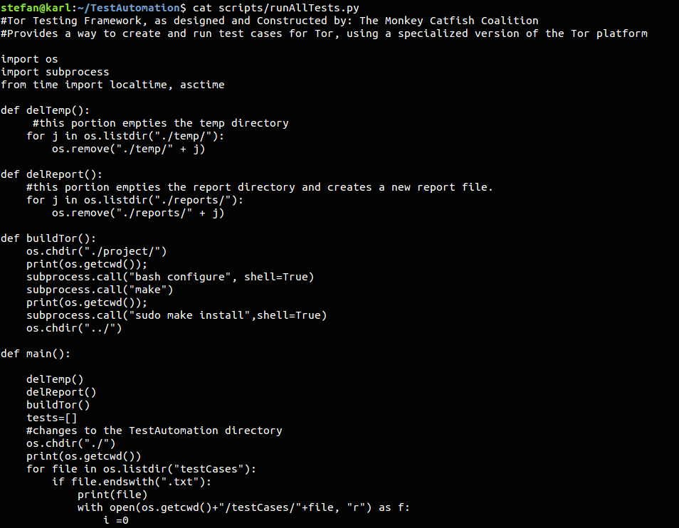
runAllTests Script

Slide 11
How To Run Our Framework
1. Clone the 'TorTestPlatform' branch of the framework repository:
2. Change to the 'theMonkeyCatfishCoalition/TestAutomation'
3. Run the following command
4. The script should generate a report and open it in your browser. If you need to access this report later, it saves to the ‘reports’ directory.

Slide 12
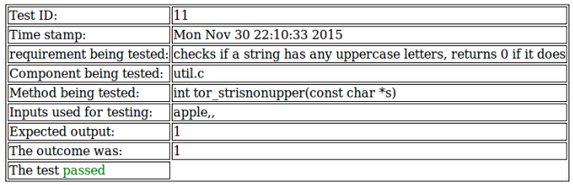
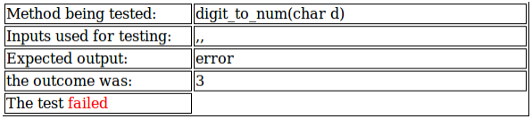
Test Reports
Examples of passed and failed tests from a generated test report.

Slide 13
Fault-Injection
Faults injected into round_to_next_multiple_of, round_to_power_of_2, and addr_mask_get_bits
Resulted in test cases 1, 3, 4, 23, and 25 failing, which had passed before

Slide 14
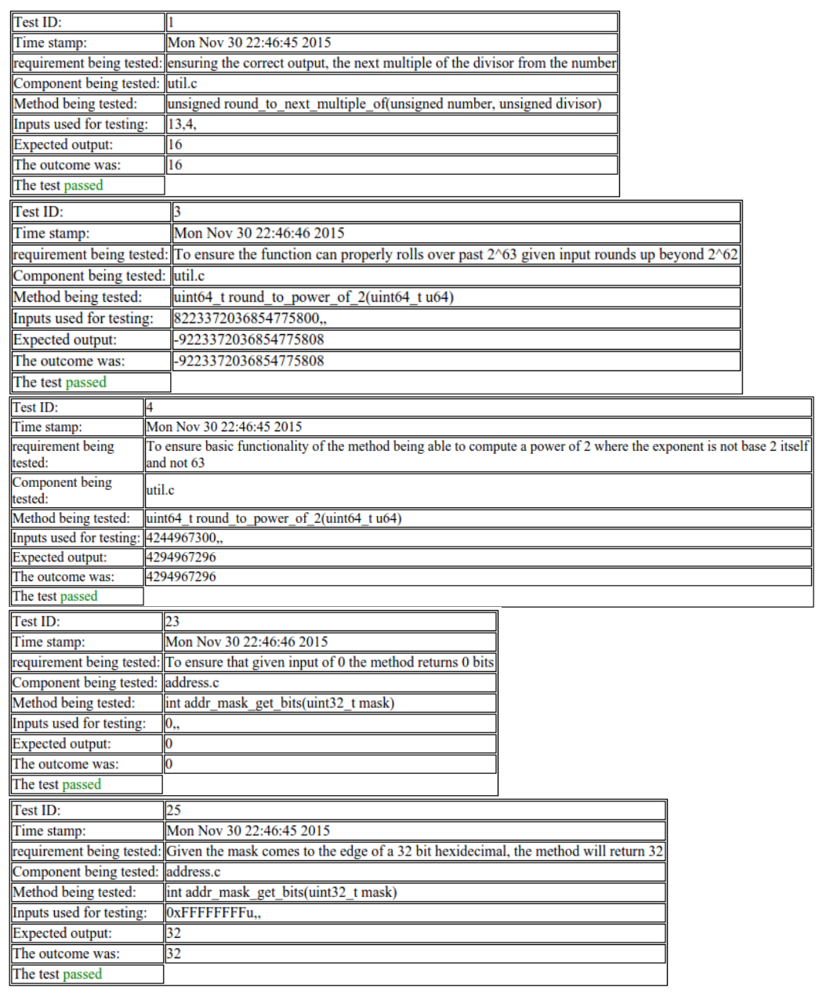
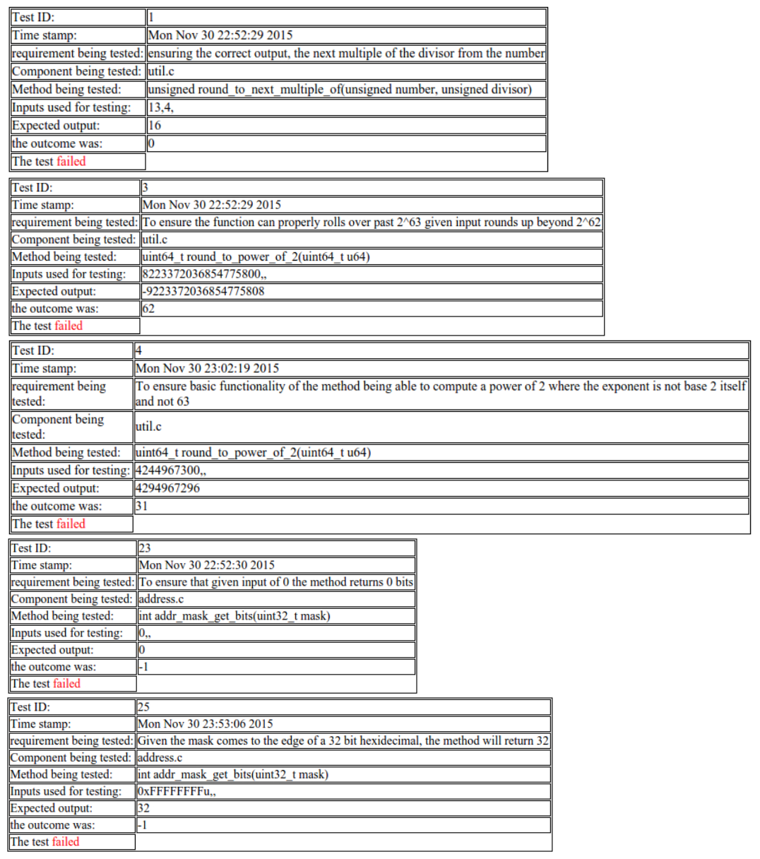
Injections Before and After

Slide 15
Lessons Learned
Though some of Tor’s code may be accessible, readable, and well-documented, sizable portions of it was not
C is a much more difficult language for new users compared to other languages
Tor’s poor documentation and readability is likely a result of its open-source nature
It’s worth it to just stick with a project even if it seems difficult
Compromising is a must in order to get the job done

Slide 16
Questions?

