Slide 1
Team Too: owasp ende

Slide 2
Overview
Introduction
Lessons Learned
The Framework
Demo
Tests
Fault Injection
Q&A

Slide 3
Introduction to EnDe
EnDe is a project under OWASP that provides an encoder, decoder, converter, transformer, and calculator. It aims to meet the requirements for HTTP/HTML-based functionality.
EnDe only requires that you have a web browser installed and a single folder to install files into. It is run from its “index.html” file.

Slide 4
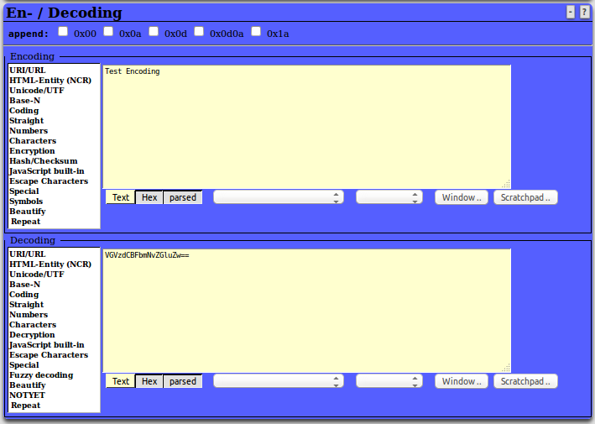
The EnDe GUI

Slide 5
Lessons Learned/Experiences
There were several times during our testing where certain issues had to be taken into account:
We ran into issues using Chrome, as it requires us to disable security features all together to work properly without considering the scripts malicious. Firefox needed to be used for our tests.
Some functions could not be tested in the browser, as they returned characters the browser did not recognize.
Other functions that returned non-UTF-8 encoded characters broke the reporting when writing to our results.html files. For example, the AES-128 encoding caused issues and had to be avoided for the time being.

Slide 6
The Framework: Architecture
/TestAutomation
/project
/src
/bin
/scripts
runAllTests.py
/testCases
testCase1.txt
testCase2.txt
testCase3.txt
/testCasesExecutables
/temp
results.html
/oracles
/docs
README.txt
/opt
/reports
testReport.html

Slide 7
The Framework: How It Works
runAllTests.py reads through all files in testCases directory
All values in each file in the testCases directory is added to a dictionary
Each dictionary is added to a list, which contains all dictionaries for all test cases
We no longer require files under the testCaseExecutables directory, all required information is in the test case files. This avoids repeated code in individual executable files.
runAllTests.py will execute the method being tested based on the language noted in the file
Python files test the GUI using Selenium to simulate mouse clicks/keyboard input
JavaScript files test the functions directly
JavaScript tests use QUnit, a JavaScript testing framework

Slide 8
Demo
Please join us for a demo of our automated testing framework.

Slide 9
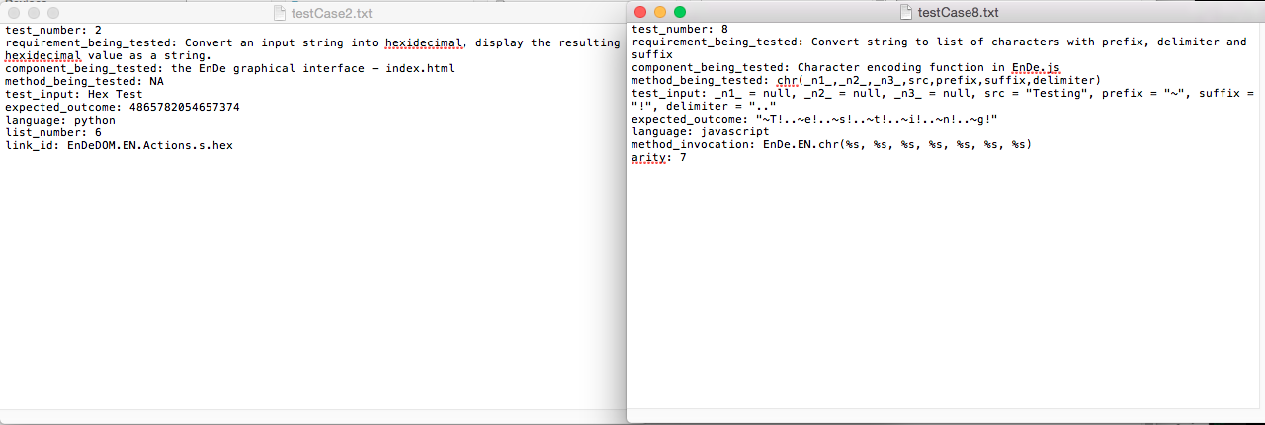
The Framework: The Test Case Files

Slide 10
Tests
Tests passed or failed by comparing the EnDe output (from the GUI or straight from the function) to an oracle we obtained through outside sources (Python built-in methods, websites, by hand, other programs, etc)
To add a new test, a new file in the testCases directory can be added with the appropriate information
For JavaScript tests, a file must include: test_number, requirement_being_tested, component_being_tested, method_being_tested, test_input, expected_outcome, language, method_invocation, and arity
For Python tests, a file must include: test_number, requirement_being_tested, component_being_tested, method_being_tested, test_input, expected_outcome, language, list_number, and link_id
For JavaScript tests, the income and outcome must be in quotes to denote a string
For Python tests, the income and outcome should not be in quotes, as they are read from the file as a string already

Slide 11
Fault Injection
To add and remove faults from the code, we have add_faults.sh and remove_faults.sh, which swap out the original code with faulty code
The tests that now fail due to fault injection are 10, 11, 12, 15, and 18
To run only these tests, runAllTests.py can be run with additional arguments to isolate the failed tests. The command to run only the failed tests is: “python ./scripts/runAllTests.py 10 11 12 15 18”

Slide 12
Fault Injection: Modifications
Test 10: Modified the reverse function in EnDe.js to only go to length - 1
Changed line from:
var i = src.length;
Changed line to:
var i = src.length - 1;
Test 11: Modified the val2num function in EnDeCheck.js to replace non-digit characters with '-' instead of ''
Changed line from:
this.val2num = function(src) { return((src+='').replace(/[^0-9]/g,'')); };
Changed line to:
this.val2num = function(src) { return((src+='').replace(/[^0-9]/g,'-')); };
Test 12: Modified the atbash function in EnDe.js to change from -1 to -2
Changed line from:
bux += String.fromCharCode((((78-ccc)*2)-1+ccc));
Changed line to:
bux += String.fromCharCode((((78-ccc)*2)-2+ccc));
Test 15: Modified the DELwhite function in EnDeText.js to replace white space with '.' instead of ''
Changed line from:
case 'txtDELwhite': bux = bux.replace(/[\t \r\n]/g, ''); break;
Changed Line to:
case 'txtDELwhite': bux = bux.replace(/[\t \r\n]/g, '.'); break;
Test 18: Modified the stibitz function in EnDe.js to have incorrect value for case 1 from '0100' to '1111'
Changed line from:
case '1' : bux += '0100' + delimiter; break;
Changed line to:
case '1' : bux += '1111' + delimiter; break;

Slide 13
Q&A
Please take this time to ask any questions or make any comments!

