Slide 1
Team Too: owasp ende

Slide 2
Overview
Introduction
Lessons Learned
The Framework
Demo
Tests
Fault Injection
Q&A

Slide 3
Introduction to EnDe
EnDe is a project under OWASP that provides an encoder, decoder, converter, transformer, and calculator. It aims to meet the requirements for HTTP/HTML-based functionality.
EnDe requires that you have the Firefox web browser installed and a single folder to install files into. It is run from its “index.html” file. Besides that, all that is needed is python (version 2) and the selenium python package.

Slide 4
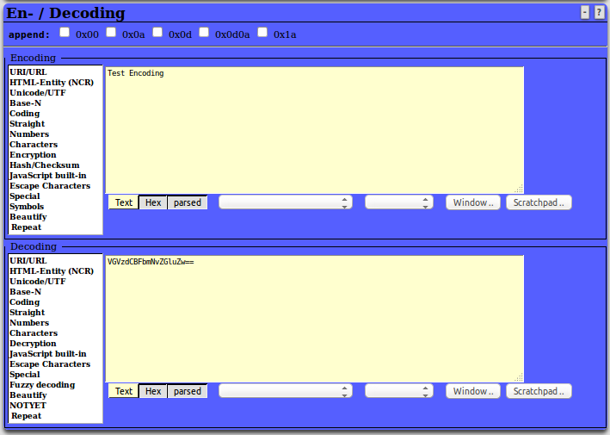
The EnDe GUI

Slide 5
Lessons Learned/Experiences
There were several times during our testing where certain issues had to be taken into account:
We ran into issues using Chrome, as it requires us to disable security features all together to work properly without considering the scripts malicious. Firefox needed to be used for our tests.
Other functions that returned non-UTF-8 encoded characters broke the reporting when writing to our results.html files. For example, the AES-128 encoding caused issues and had to be avoided for the time being.

Slide 6
Lessons Learned/Experiences
Each test creates a new selenium web driver. This was done to keep the test isolated from the effects of other tests. The cost of this is that running our tests on virtual machines with usually no more than half the memory of our actual computer and software-defined hardware, spawning and this killing off this many instances of Firefox can quickly slow the system. So while running the tests on a contemporary Macbook Pro with 4GB of RAM allocated to the VM can run all 25 tests in succession, computers with lower specs will often timeout as Firefox is loading.
In the end, with this being a hardware issue (i.e. not the a fault of the framework) coupled with the fact we wanted to keep are tests isolated, we have opted not to keep our tests isolated from one another in this manner.

Slide 7
The Framework: Architecture
/TestAutomation
/project
/src
/bin
/scripts
runAllTests.py
/testCases
testCase1.txt
testCase2.txt
testCase3.txt
/testCasesExecutables
/temp
/oracles
/docs
README.txt
/framework
/reports
report_<date>.html
/framework
/drivers
/assets
selenium_driver.py
qunit_driver.py
/assets
TestCase.py

Slide 8
The Framework: How It Works
runAllTests.py reads through all files in testCases directory
All values in each file in the testCases directory is added to a dictionary
Each dictionary is added to a list, which contains all dictionaries for all test cases
We no longer require files under the testCaseExecutables directory, all required information is in the test case files. This avoids repeated code in individual executable files.
runAllTests.py will execute the method being tested based on the language noted in the file
Python files test the GUI using Selenium to simulate mouse clicks/keyboard input
JavaScript files test the functions directly
JavaScript tests use QUnit, a JavaScript testing framework

Slide 9
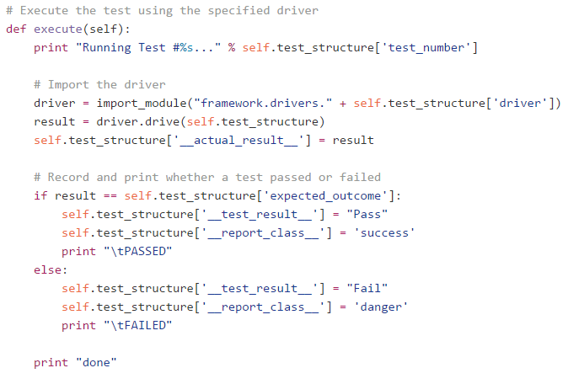
The Framework: How It Works
Each test case specifies a driver (the current framework has two drivers: selenium_driver and qunit_driver. The specified driver is imported during runtime and the generic ‘drive’ function within the driver is called with test_structure data structure from a specific test case object.
This lightweight generic driver interface allows the framework to be extended to add any number of drivers testing any number of different things.

Slide 10
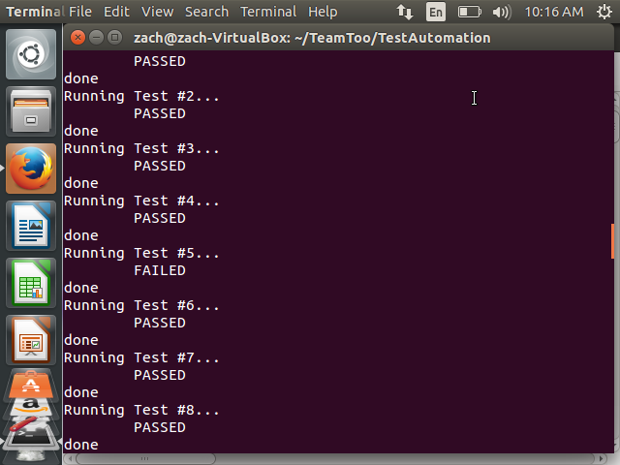
Framework: Terminal

Slide 11
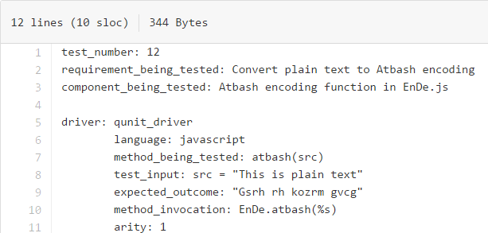
The Framework: The Test Case Files

Slide 12
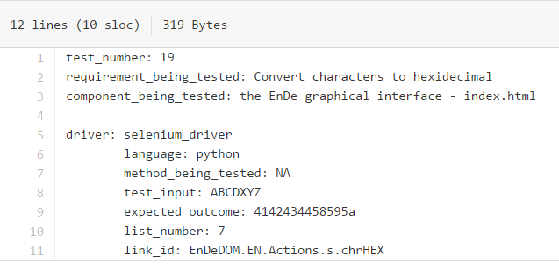
The Framework: The Test Case Files

Slide 13
Tests
Tests passed or failed by comparing the EnDe output (from the GUI or straight from the function) to an oracle we obtained through outside sources (Python built-in methods, websites, by hand, other programs, etc)
To add a new test, a new file in the testCases directory can be added with the appropriate information
For JavaScript tests, a file must include: test_number, requirement_being_tested, component_being_tested, method_being_tested, test_input, expected_outcome, language, method_invocation, and arity
For Python tests, a file must include: test_number, requirement_being_tested, component_being_tested, method_being_tested, test_input, expected_outcome, language, list_number, and link_id
For JavaScript tests, the income and outcome must be in quotes to denote a string
For Python tests, the income and outcome should not be in quotes, as they are read from the file as a string already

Slide 14
Fault Injection
To add and remove faults from the code, we have add_faults.sh and remove_faults.sh, which swap out the original code with faulty code (found in the scripts directory)
The tests that now fail due to fault injection are 10, 11, 12, 15, and 18
To run only these tests, runAllTests.py can be run with additional arguments to isolate the failed tests. The command to run only the failed tests is: “python ./scripts/runAllTests.py 10 11 12 15 18”

Slide 15
Fault Injection: Modifications
Test 10: Modified the reverse function in EnDe.js to only go to length - 1
Changed line from:
var i = src.length;
Changed line to:
var i = src.length - 1;
Test 11: Modified the val2num function in EnDeCheck.js to replace non-digit characters with '-' instead of ''
Changed line from:
this.val2num = function(src) { return((src+='').replace(/[^0-9]/g,'')); };
Changed line to:
this.val2num = function(src) { return((src+='').replace(/[^0-9]/g,'-')); };
Test 12: Modified the atbash function in EnDe.js to change from -1 to -2
Changed line from:
bux += String.fromCharCode((((78-ccc)*2)-1+ccc));
Changed line to:
bux += String.fromCharCode((((78-ccc)*2)-2+ccc));
Test 15: Modified the DELwhite function in EnDeText.js to replace white space with '.' instead of ''
Changed line from:
case 'txtDELwhite': bux = bux.replace(/[\t \r\n]/g, ''); break;
Changed Line to:
case 'txtDELwhite': bux = bux.replace(/[\t \r\n]/g, '.'); break;
Test 18: Modified the stibitz function in EnDe.js to have incorrect value for case 1 from '0100' to '1111'
Changed line from:
case '1' : bux += '0100' + delimiter; break;
Changed line to:
case '1' : bux += '1111' + delimiter; break;

Slide 16
Q&A
Please take this time to ask any questions or make any comments!

