Slide 1
Sahana Eden
Jeremy Butcheck, Steven Draugel, Aaron Monahan, Patrick Owens
TEAM 6

Slide 2
Our Project
About Eden
Framework Design
Demonstration
Results
Passing Tests
Fault-Injection
Lessons learned

Slide 3

About Eden
An open source humanitarian platform
Supported by the Sahana Software Foundation
Provides solutions and resources for disaster Management, Development, and Environmental sectors
List of deployments:
Nepal Earthquake Response
Taiwan (Preparedness for typhoons and earthquakes)
Timor-Liste Disaster Risk Management Portal
Community Resilience Mapping Tool for the Los Angeles County Public Health
NYC Prepared - “A network of disaster relief volunteers and professionals who share information and assistance.”

Slide 4
Framework Design
Our framework is made up of 5 parts:
Shell runner
Python Driver
Selenium Driver
Console Reporting
HTML Reporting

Slide 5
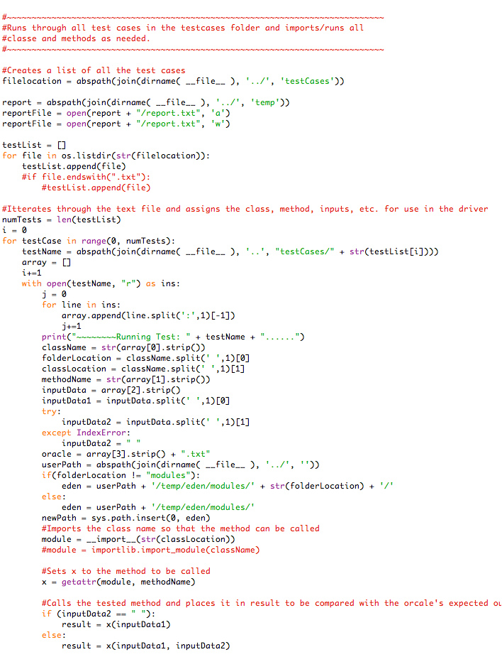
Python Driver and Shell Runner
Shell Runner
Located in Team6/scripts/runAllTests.sh
Executes the testing framework which access:
Python Driver
Web Report Builder
Python Driver
Parses the test cases
Calls the class and methods
Passes in parameters
Collects results

Slide 6
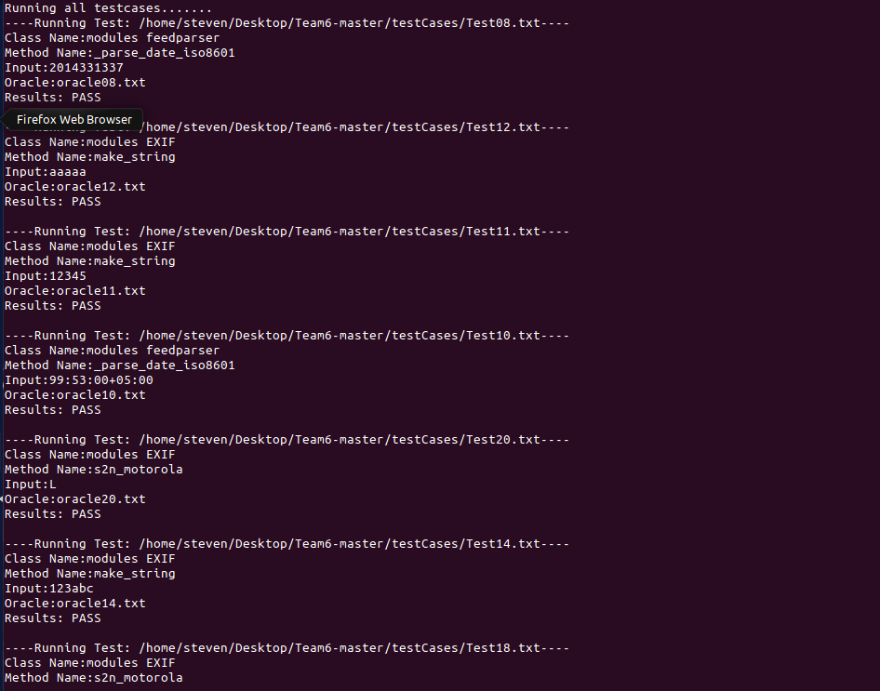
Reporting
Console Reporting
Output to the console:
Test name and location
Class name
Method name
Input given
Oracle
Test result
Pass/Fail

Slide 7
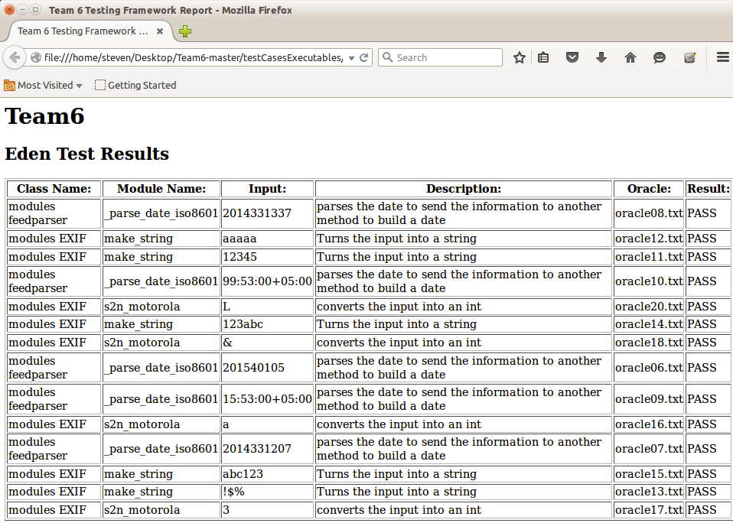
Reporting
HTML Reporting
Driver parses the reporting document and builds a web page to display results
Automatically opens a browser
Results:
Class Name
Method
Input
Description
Oracle
Pass/Fail

Slide 8
Test Case Examples
Test 01:05 - Finds the GCD between two inputs
Test 06:10 - Parses the date to send the information to another method to build a date
Test 11:15 - Converts the input into a string
Test 15:20 - Converts the input into an integer

Slide 9
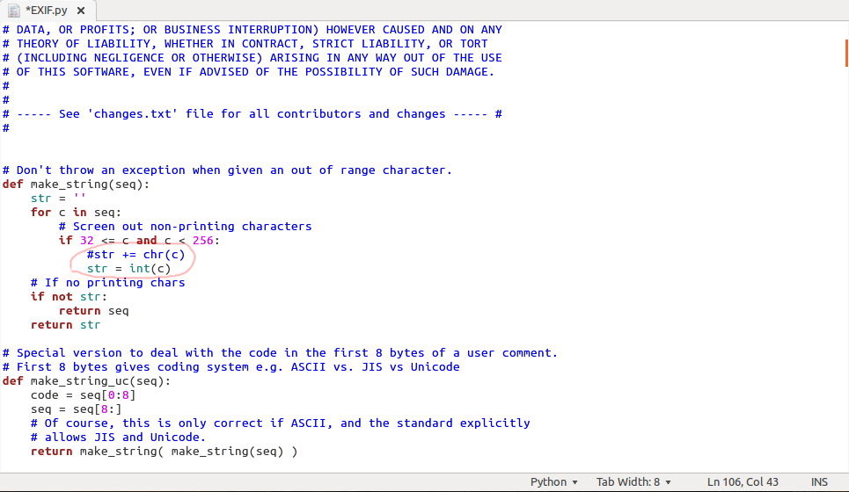
Fault-Injection
For test 14 we commented out a method that placed a chr in to a variable named str and placed an int there instead. This allowed the method to complete but caused the test to fail due to incorrect code.

Slide 10
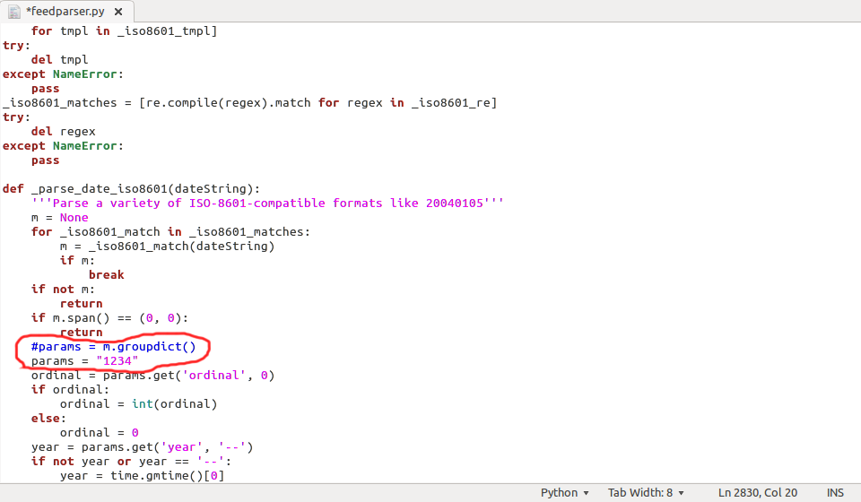
Fault-Injection
For test 10 we commented out a method that placed a specific string into params and instead replaced the string with “1234”. This allowed the method to run but still fail the test due to the oracle expected output and method output being different.

Slide 11
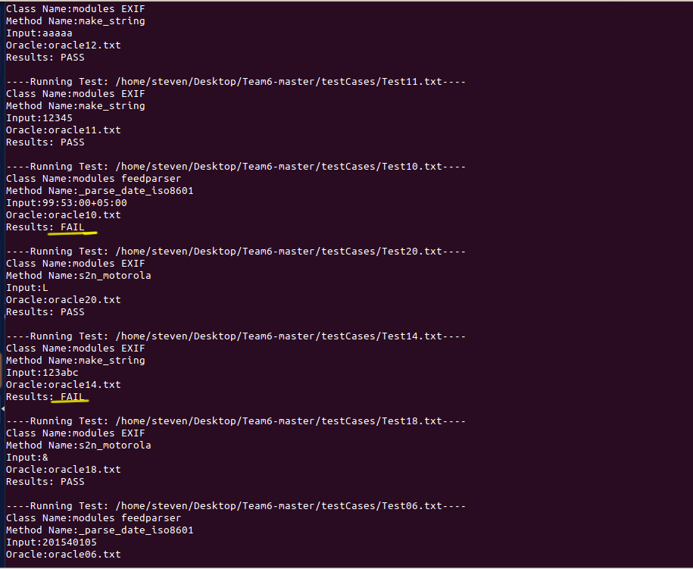
Fault-Injection Console Reporting
Here you can see the test for the method _parse_date_iso8601(dateString) and make_string have both failed due to our fault injection in the code.

Slide 12
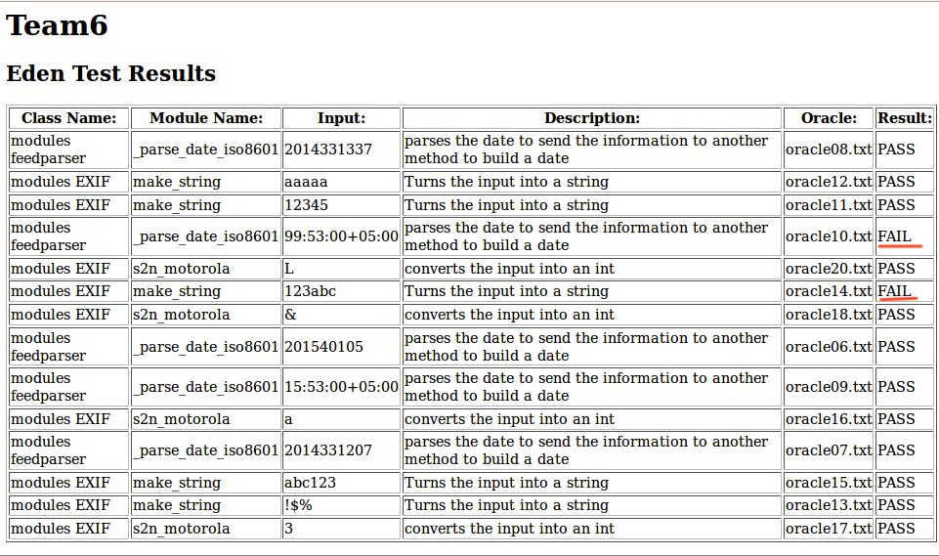
Fault-Injection Web Reporting
Again, here you can see the test for the method _parse_date_iso8601(dateString) and make_string have both failed due to our fault injection in the code. In this view the faults are easily displayed with an HTML5 document displayed in a web browser.

Slide 13
Lessons Learned
Repository Clashes
Different versions of software and installation locations
Remembering and learning languages
Importance of testing
No single framework design will fit every systems needs

