Slide 1

CSCI 362 – Software Engineering
Team Project
Trotting Giraffes
Steven Aldinger Michael Stenhouse
Marta Pancaldi Seth Stoudenmier

Slide 2
Summary
Project specifications
OWASP Java HTML Sanitizer – Overview
Testing Framework – Test Cases
Script
Driver
Fault Injections
Results & Output
Reflections

Slide 3
Project Specifications
Development of an automated testing framework for the software project “OWASP Java HTML Sanitizer”
25 test cases
Specification text file for each test case
Run all tests through a single script
Collect results and display testing report
Build and compile on a Linux distributions (in our case, RHEL and Ubuntu)

Slide 4
OWASP Java HTML Sanitizer
Overview
Java-based sanitization of untrusted HTML: prevent malicious HTML code from being injected into a web application
Organize poorly written code
Protection against XSS (Cross-site Scripting)
Extensive test suite

Slide 5
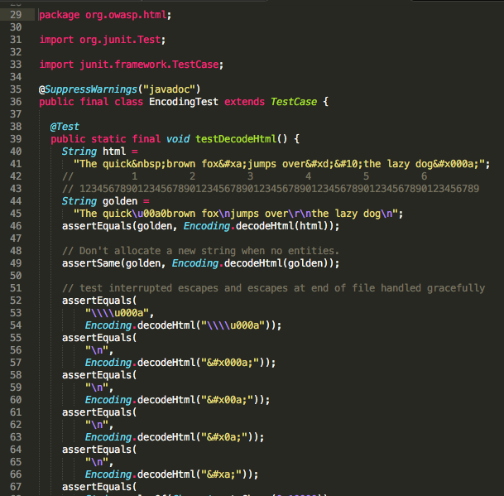
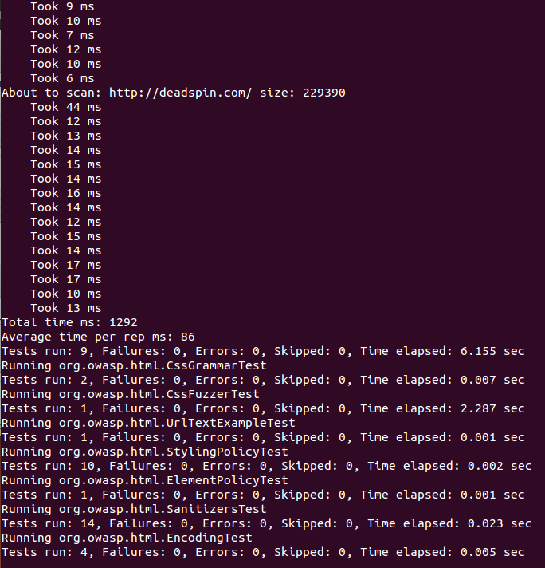
Sample code from one of
the OWASP existing tests →
← Successful output of
$ mvn clean install
to test and build the HTML sanitizer

Slide 6
Our test plan: Tested Items
Test if cssContent method can interpret '\\\\' correctly as \\
Test if decodeHtml can properly interpret a Unicode carriage return
Test if decodeHtml can properly interpret a String following a Unicode symbol
Test if sanitize can block any tag with the Blocks Policy
Test if sanitize will keep formatting tags with the FORMATTING Policy

Slide 7
Testing Framework – 1. Test Cases
/testCases directory includes all test case *.txt files
Sample Test case file:
1. 01 ##test number or ID
2. decodeHtml handles HTML entities to produce a string containing only valid unicode scalar values ##requirement being tested
3. orgowasphtmlEncoding ##component being tested
4. decodeHtml ##method being tested
5. "&#x000a;” ##command-line arguments: test input
6. \\n ##expected outcomes (\\n in Java means \n in the bash script)
runAllTest script reads each file and executes the testing driver, according to the information in the file

Slide 8
Examples of Test Cases
Test #01: decodeHtml(String)
Test #02: decodeHtml(String)
Test #08: cssContent(String)
Test #17: FORMATTING.sanitize(String)
Test #21: BLOCKS.sanitize(String)
Argument: &#x000a
Oracle: \n
Argument: &#xa
Oracle: \n
Argument: t\\61ser
Oracle: taser
Argument: Hello,World!
Oracle: Hello,World!
Argument: Hello,World!
Oracle: Hello,World!

Slide 9
Testing Framework – 2. Script
./runAllTests.sh script automatically runs all tests
TESTCASES="../testCases” #TestCases Directory
TESTCASESEXEC="../testCasesExecutables” #Driver Directory
The script compiles OWASP project files,
then iterates through each text file within /TestCases directory,
pulls information and runs the matching java driver

Slide 10
ls $TESTCASES | while read FILENAME
do
echo "Running testcase executable based off of $FILENAME specifications:”
#Iterate through the individual text files and grab the information line-by-line
COUNTER=0
cat "$TESTCASES"/"$FILENAME" | while read TESTCASESLINE
do
let COUNTER=(COUNTER + 1)
...
if [ $COUNTER -eq 1 ] #1st line indicates test number
then
TESTNUMBER=$CHOPPED
fi
...
if [ $COUNTER -eq 5 ] #5th line indicates the input value to be inserted into the method
then
TEST=$CHOPPED
fi
#If sixth line, this indicates the oracle, which is the expected result returned from the tested method. At this step we also run the driver
if [ $COUNTER -eq 6 ]
then
ORACLE=$CHOPPED
...

Slide 11
Testing Framework – 3. Driver
runAllTests calls the driver that matches the information pulled from test case files – test number (e.g. 01) ,
class (htmlEncoding) and method (decodeHtml):
public static void main(String[] args){
try{
String theOracle = args[1];
String theTest = args[0];
String result = org.owasp.html.Encoding.decodeHtml(theTest);
#Replace “\\n” with “\n”, since Java will interpret the HTML code as a line break
if(theOracle.contains("\\n")){
theOracle = theOracle.replace("\\n","\n");
}

Slide 12
if((result).equals(theOracle)){
try{
System.out.println("org.owasp.html.Encoding");
System.out.println("decodeHtml(String)");
System.out.println(args[0]);
System.out.println(args[1]);
System.out.println("passed\n");
}catch(Exception e){
e.printStackTrace();
}
}
else{
try{
...
System.out.println("failed\n");
}catch(Exception e){
e.printStackTrace();
}
}
If result equals theOracle the test has passed.
The results are saved to /reports directory

Slide 13
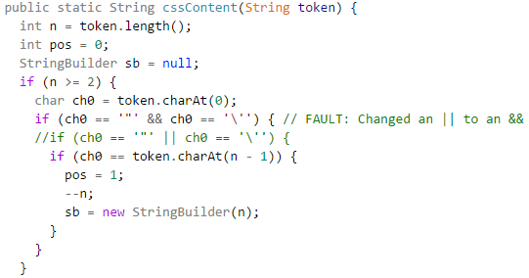
Testing Framework – 4. Faults Injection
Fault injection = modify the code we are testing to make some test fail and collect results → improve robustness

Slide 14
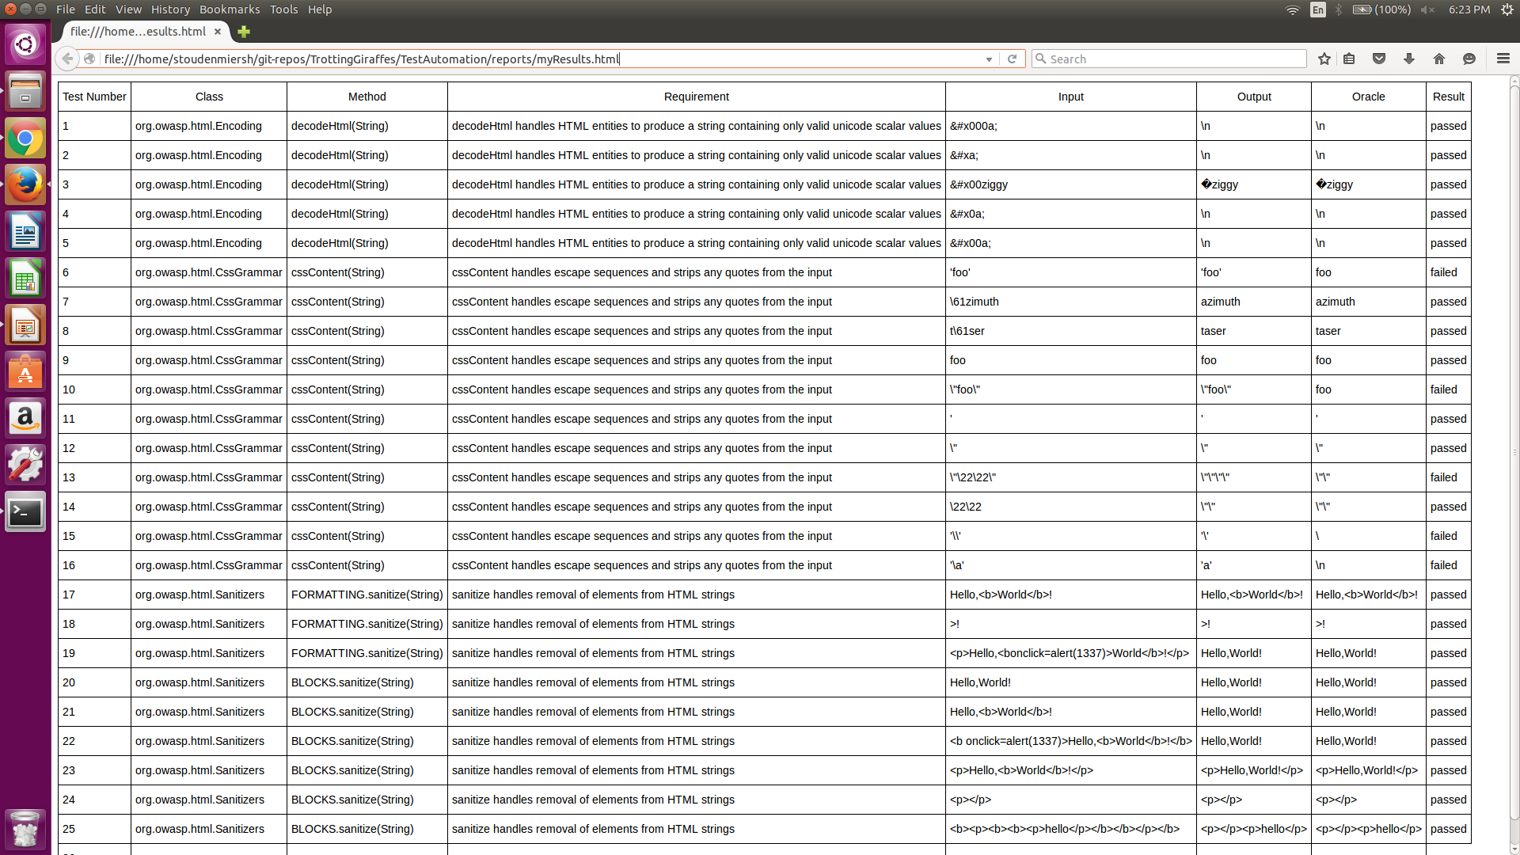

Slide 15
Testing Framework – 5. Results
Finally the script creates a HTML file with all test results, which is automatically displayed
HTMLOUTPUTFILE="../reports/myResults.html”
cd ../scripts
(./toCompiledHtmlWithCss.sh $HTMLOUTPUTFILE ../reports && firefox -new-tab ./$HTMLOUTPUTFILE)
Script toCompiledHtmlWithCss builds a table with result data from /reports directory
The table includes tested class and method, test input, oracle and actual result (passed/failed)

Slide 16
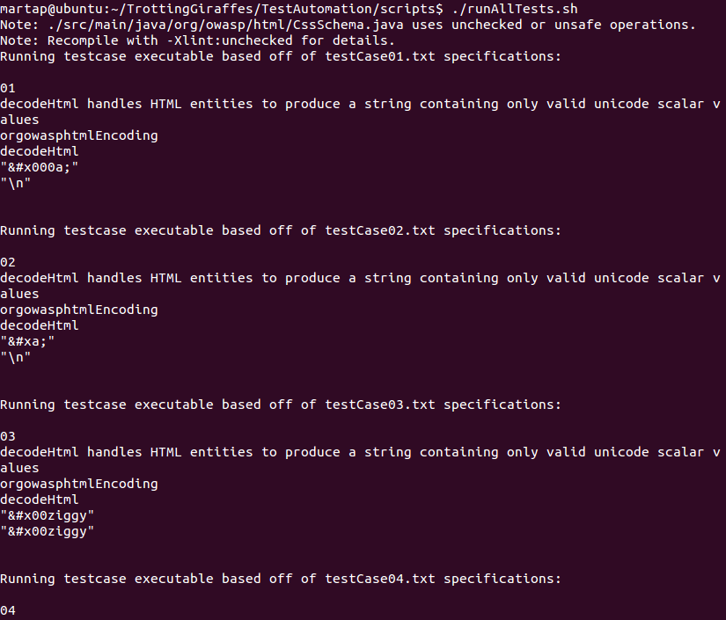
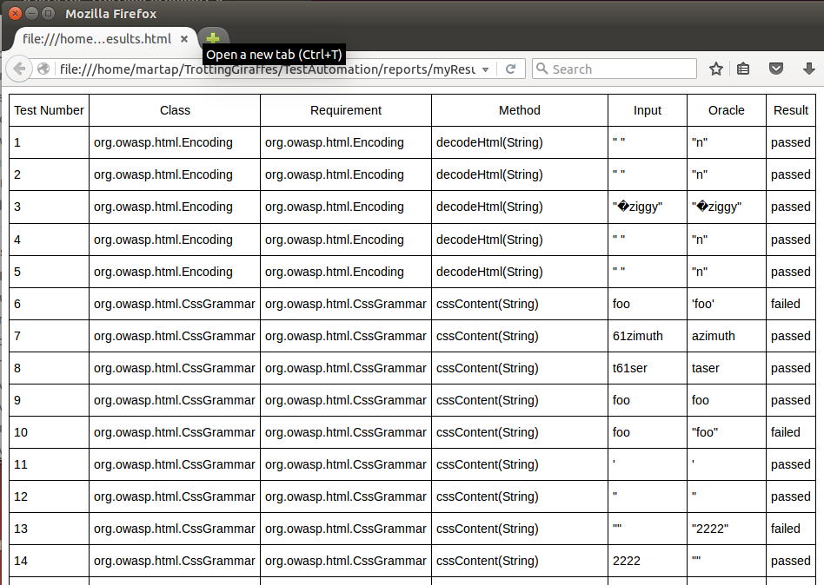
Output
← Terminal output
HTML file with results →

Slide 17
Reflections – Challenges we faced
Initial choice of the program to test
Getting familiar with Linux operating system
Design of the testing framework
Displaying the test results in a clear way
Organizing a coherent documentation
Meeting between people with different schedules

Slide 18
Reflections – What we learned
Sharing knowledge among team members
Understanding the structure of a test framework
Becoming familiar with new scripting languages

Slide 19
Thanks
for watching!

