Slide 1

CSCI 362 – Software Engineering
Team Project
Trotting Giraffes
Steven Aldinger Michael Stenhouse
Marta Pancaldi Seth Stoudenmier

Slide 2
Summary
Project specifications
OWASP Java HTML Sanitizer – Overview
Testing Framework – Test Cases
Script
Driver
Faults Injection
Results & Output
Reflections

Slide 3
Project Specifications
Development of an automated testing framework for the software project “OWASP Java HTML Sanitizer”
30 test cases
Specification text file for each test case
Run all test through a single script
Collect result and display testing report
OS: Ubuntu Linux

Slide 4
OWASP Java HTML Sanitizer
Overview
Java-based sanitization of untrusted HTML: prevent malicious HTML code from being injected into a web application
Organize poorly written code
Protection against XSS (Cross-site Scripting)
Extensive test suite

Slide 5
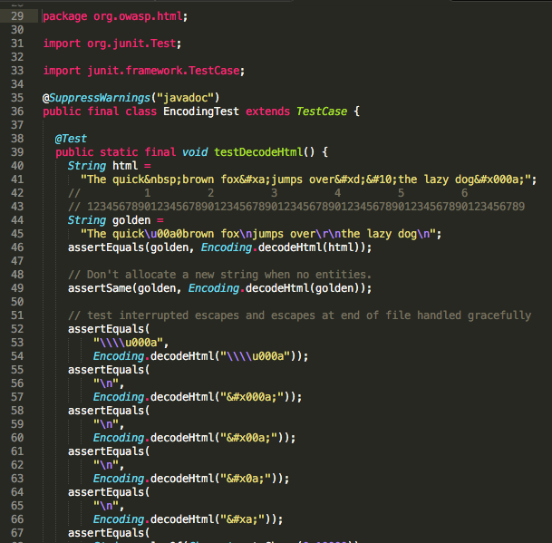
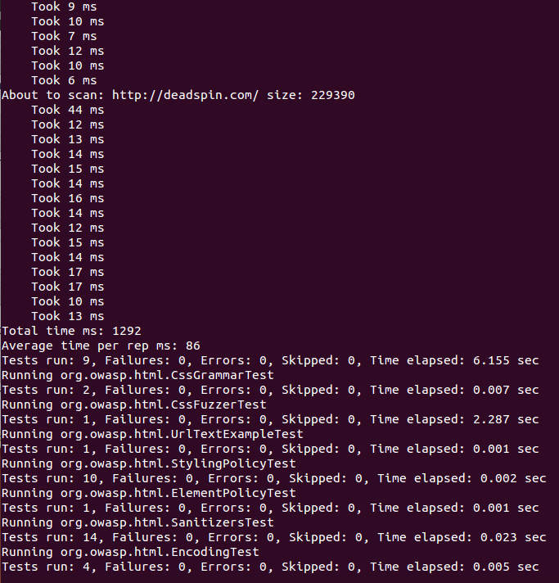
Sample code from one of
the OWASP existing tests →
← Successful output of
$ mvn clean install
to test and build the HTML sanitizer

Slide 6
Our test plan: Tested Items
HTML document with several HTML tags, which may lead to XSS.
HTML document with heavy amount of CSS styling. Ensure that web page is not broken following the test
Sanitizing the home page of a popular website (e.g. Yahoo)
Report all changes of HTML tags into a .txt file
XML document: the tester can define a new list of safe XML tags
Input HTML Tags
Output HTML Tags
<b>
<b>
<link>
<script>
System
<em>
<em>

Slide 7
Testing Framework – 1. Test Cases
/testCases directory includes all test case *.txt files
Sample Test case file:
1. 01 ##test number or ID
2. decodeHtml handles HTML entities to produce a string containing only valid unicode scalar values ##requirement being tested
3. orgowasphtmlEncoding ##component being tested
4. decodeHtml ##method being tested
5. "&#x000a;” ##command-line arguments: test input
6. \\n ##expected outcomes (\\n in Java means \n in the bash script)
runAllTest script reads each file and executes the testing driver, according to the information in the file

Slide 8
Examples of Test Cases
Test #01: decodeHtml(String)
Test #02: decodeHtml(String)
Test #08: cssContent(String)
Test #17: FORMATTING.sanitize(String)
Test #21: BLOCKS.sanitize(String)
Test #26: isHex(int)
Argument: &#x000a
Oracle: /n
Argument: &#xa
Oracle: /n
Argument: t61ser
Oracle: taser
Argument: Hello,World!
Oracle: Hello,World!
Argument: Hello,World!
Oracle: Hello,World!
Argument: 0x00A
Oracle: true

Slide 9
Testing Framework – 2. Script
./runAllTests.sh script automatically runs all tests
TESTCASES="../testCases” #TestCases Directory
TESTCASESEXEC="../testCasesExecutables” #Driver Directory
The script compiles OWASP project files,
then iterates through each text file within /TestCases directory,
pulls information and runs the matching java driver

Slide 10
ls $TESTCASES | while read FILENAME
do
echo "Running testcase executable based off of $FILENAME specifications:”
#Iterate through the individual text files and grab the information line-by-line
COUNTER=0
cat "$TESTCASES"/"$FILENAME" | while read TESTCASESLINE
do
let COUNTER=(COUNTER + 1)
...
if [ $COUNTER -eq 1 ] #1st line indicates test number
then
TESTNUMBER=$CHOPPED
fi
...
if [ $COUNTER -eq 5 ] #5th line indicates the input value to be inserted into the method
then
TEST=$CHOPPED
fi
#If sixth line, this indicates the oracle, which is the expected result returned from the tested method. At this step we also run the driver
if [ $COUNTER -eq 6 ]
then
ORACLE=$CHOPPED
...

Slide 11
Testing Framework – 3. Driver
runAllTests calls the driver that matches the information pulled from test case files – test number (e.g. 01) ,
class (htmlEncoding) and method (decodeHtml):
public static void main(String[] args){
try{
String theOracle = args[1];
String theTest = args[0];
String result = org.owasp.html.Encoding.decodeHtml(theTest);
#Replace “\\n” with “\n”, since Java will interpret the HTML code as a line break
if(theOracle.contains("\\n")){
theOracle = theOracle.replace("\\n","\n");
}

Slide 12
if((result).equals(theOracle)){
try{
System.out.println("org.owasp.html.Encoding");
System.out.println("decodeHtml(String)");
System.out.println(args[0]);
System.out.println(args[1]);
System.out.println("passed\n");
}catch(Exception e){
e.printStackTrace();
}
}
else{
try{
...
System.out.println("failed\n");
}catch(Exception e){
e.printStackTrace();
}
}
If result equals theOracle the test has passed.
The results are saved to /reports directory

Slide 13
Testing Framework – 4. Faults Injection
Fault injection = modify the code we are testing to make some test fail and collect results → improve robustness

Slide 15
Testing Framework – 5. Results
Finally the script creates a HTML file with all test results, which is automatically displayed
HTMLOUTPUTFILE="../reports/myResults.html”
cd ../scripts
(./toCompiledHtmlWithCss.sh $HTMLOUTPUTFILE ../reports && firefox -new-tab ./$HTMLOUTPUTFILE)
Script toCompiledHtmlWithCss builds a table with result data from /reports directory
The table includes tested class and method, test input, oracle and actual result (passed/failed)

Slide 16
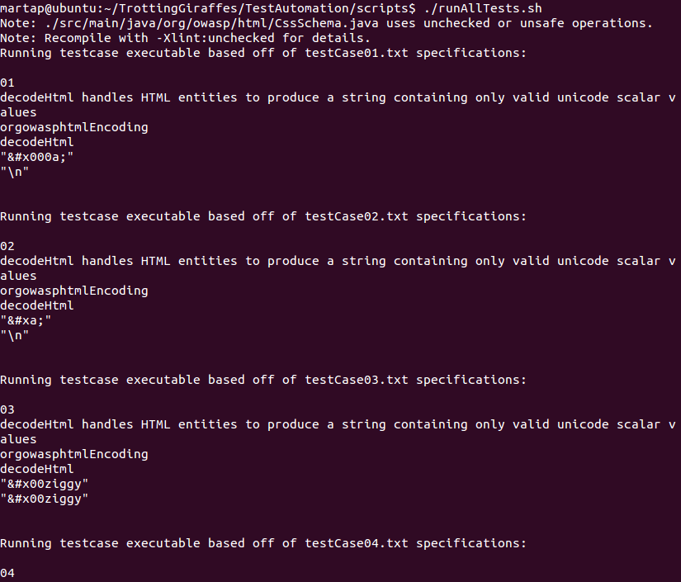
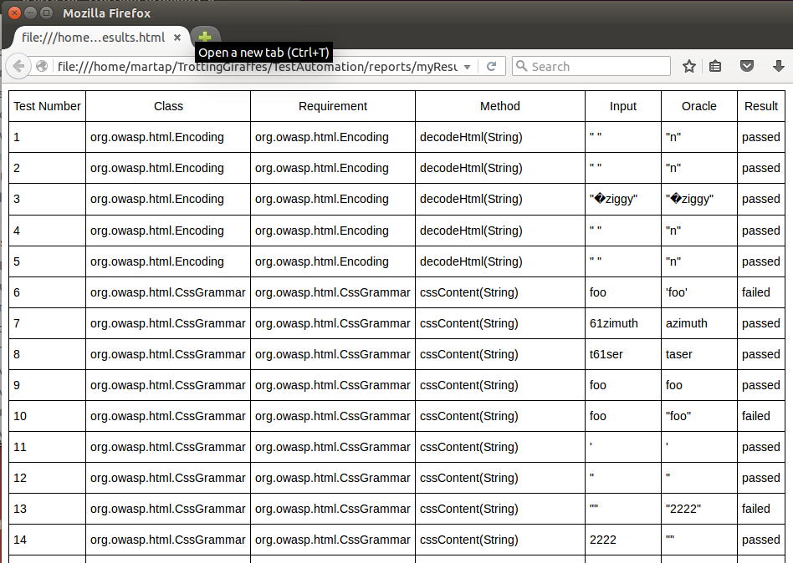
Output
← Terminal output
HTML file with results →

Slide 17
Reflections – Challenges we faced
Initial choice of the program to test
Getting familiar with Linux operating system
Design of the testing framework
Displaying the test results in a clear way
Organizing a coherent documentation
Meeting between people with different schedules

Slide 18
Reflections – What we learned
Sharing knowledge among team members
Understanding the structure of a test framework

Slide 19
Lessons for the future

Slide 20
Thanks
for watching!

