Slide 1
A Web Based Supply Chain Management System
OOAD Final project presentation Fall 2023

Slide 2


Team Members
Arnib Alam Farooqui
Grad Student in Computer Science dept
Daniel Hernandez
Undergrad computer science

Slide 3
Presentation Outline
Project Goals
Software and hardware components
Design Process developments
Architectural diagram – description of interactions
What did you learn and what would you do differently?

Slide 4


WBSCM : Web Based Supply Chain Management

Slide 5

Project Goals
Our project aimed to develop a robust and scalable Supply Chain Management system, enhanced with key functionalities like product management, order tracking, and efficient purchase processes. Applying OOAD patterns greatly contributed to the structure and maintainability of the system. With comprehensive customer information management and extended warranty benefits for specific product types, we ensured a premium user experience.

Slide 6

Design Components (Software/Hardware)
Spring Boot Framework: It's used to simplify the creation of stand-alone, production-grade Spring-based applications.
MySQL: A relational database management system used to store and retrieve data.
Spring Initializr: A quickstart generator that helps in setting up a project and pulls all necessary dependencies for the application.
Spring MVC: Used for designing the architecture of the application with integrated @RestController to handle HTTP requests and responses.
Postman: A handy tool used for testing REST API calls, useful in sending, receiving, and analysing HTTP (POST, GET or DELETE) requests to/from the server.
Java Development Kit (JDK): A must-have development environment to develop applications and applets that involve the Java programming language.

Slide 7
Design Process development
Back-End Development: Build a robust SCM system to ensure high performance.
Database Interaction: Seamlessly integrate the system with a MySQL database for efficient data management.
Functionalities Creation: Develop integral features such as product and order management, shopping cart functions, and order tracking.
OOAD Pattern Usage: Use Abstract Factory, Strategy, DAO, Observer, and Singleton patterns for a structured and maintainable system.
Scalability: Design the system to accommodate future growth with more suppliers, products, and customers.
Verify the system using tools like Postman to ensure its reliability.
User Interface: Establish an intuitive text-based UI prioritizing backend functionality.
Checkout Process: Facilitate a smooth customer checkout experience.
Customer Information Management: Store customer data to promote efficient service.

Slide 8
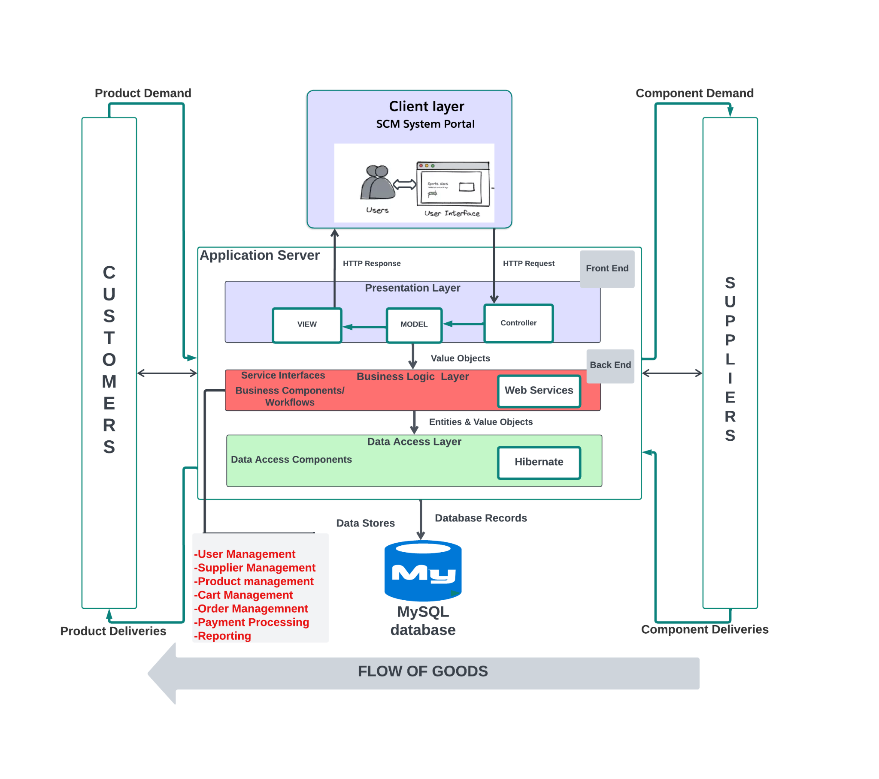
Architectural diagram

Slide 9

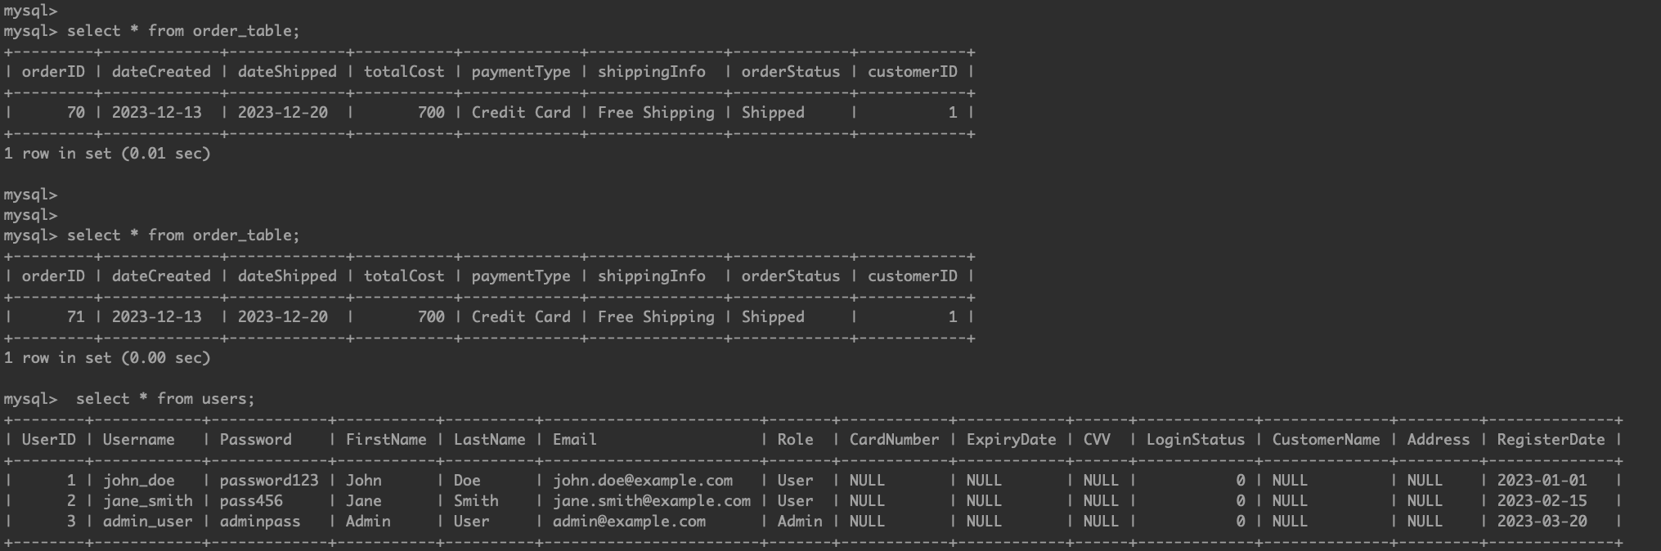
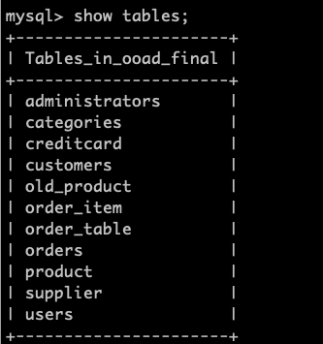
MySQL server
Usage of MySQL server for database creation and management. MySql server offers a relatively simple way to see and build and edit databases for projects.
Able to utilize built in SQL server to host database and run query responses from back end.
Ran into some issues with connection to database via IDE, however marketplace extensions for both IntelliJ and VScode allowed for simple database connection within the application.
Database: ooad_final

Slide 10
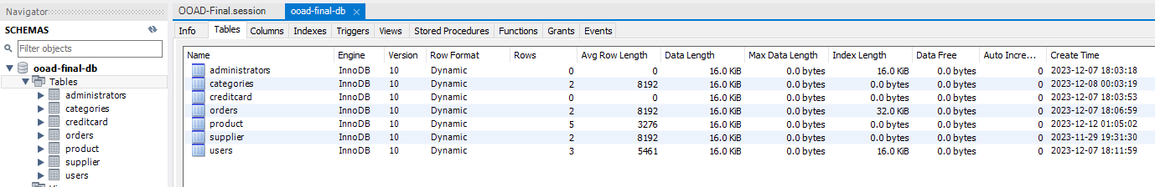
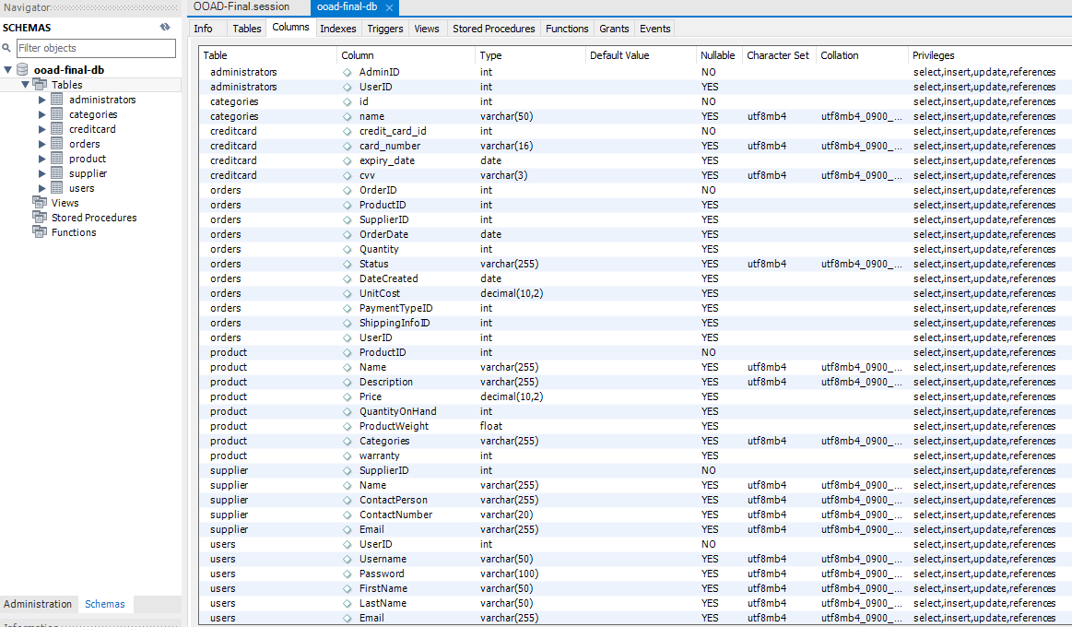
Database Schema via MySql Workbench

Slide 11
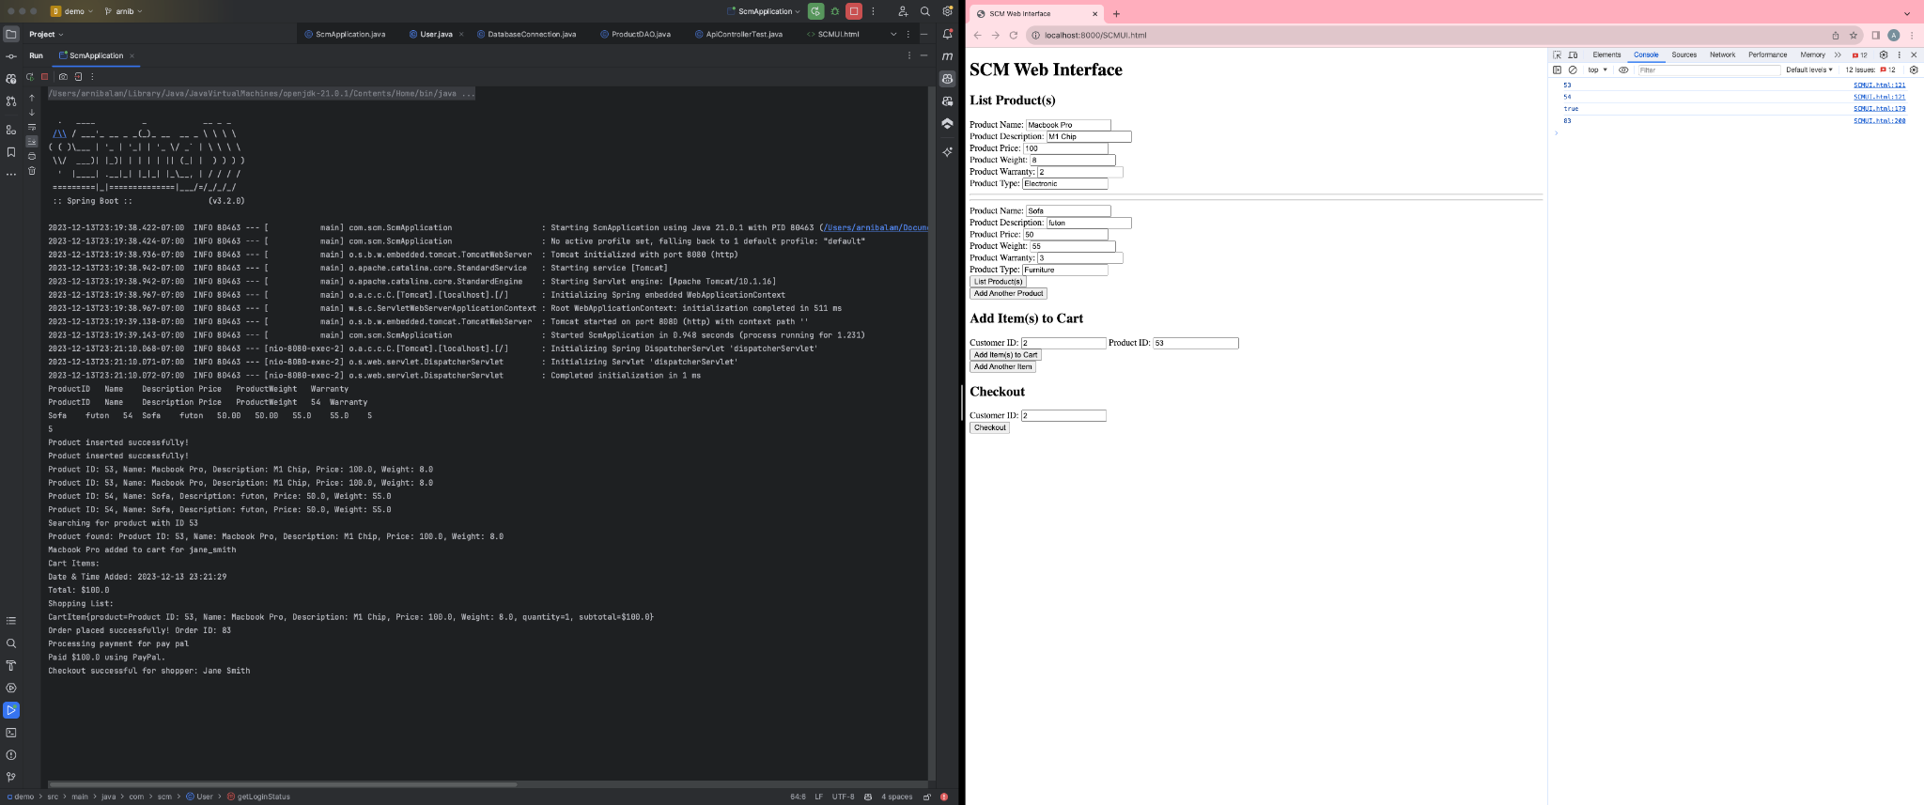
UI Component

Slide 12
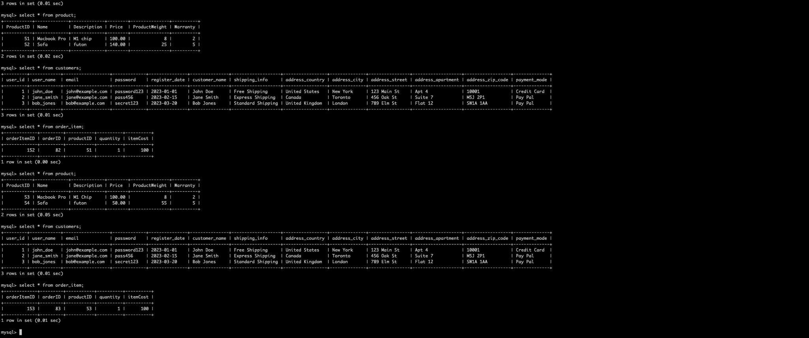
Database Management
Leveraging the power of MySQL, we have implemented a well-structured relational database model to store and organize diverse sets of information.
Additional warranty field set for different categories to replace with respect tp supplier product description!

Slide 13
Running SCM Application….

Slide 14
Reflection and Challenges
Integrating diverse components like back-end, front-end, and database was a significant challenge conquered over the course of the project.
Restructuring ambitions from full-stack to back-end focused development due to time constraints was unexpected.
Difficulties in establishing a connected front end, encountering machine compatibility issues, and prioritizing back-end functionality over implementing more advanced features due to time constraints.
Successful management of typical SCM with supplier products, detailed product display, and order tracking were key achievements.

Slide 15
Improvement and Learnings
While we efficiently implemented key functionalities, front-end development could have been more expanded, for the better user interface.
Further exploration into advanced front-end development tools for a more dynamic and interactive UI would be interesting.
Future endeavors could benefit from early scoping to allocate ample focus on detailed supply chain functionalities in the back-end development phase.
Strategically applied OOAD patterns for robust and maintainable system structure was a significant takeaway.

Slide 16
Understanding and Conclusion
This project allowed practical application of theoretical knowledge from class, specifically in using design patterns and database integration.
We successfully designed and implemented a robust web-based Supply Chain Management system. Our approach involved creating REST APIs, leveraging our skills in Java, MySQL, and software architecture. Additionally, we incorporated a user-friendly web interface to facilitate seamless user interactions.

Slide 17
Thank You! Have a great break!

