Slide 1
Sparc-request
Tim Maruhn, Robert Moody, and Tony Tang
CSCI 462
4/29/17

Slide 2

Sparc-request
SPARC is a web based research management system
SPARC stands for Services, Pricing, and Applications for Research Center
Sparc-request is written in Ruby on Rails which also includes HTML/HAML, CoffeeScript, and SCSS
It allows users to quickly browse and order services
It allows users to submit pricing requests that create a budget based on the research being done
Sparc-request is derived from the concept of online shopping
Some features of Sparc-request are:
Quick click budget template
Researcher dashboard and notification system
Lists to pre-populated fields

Slide 3
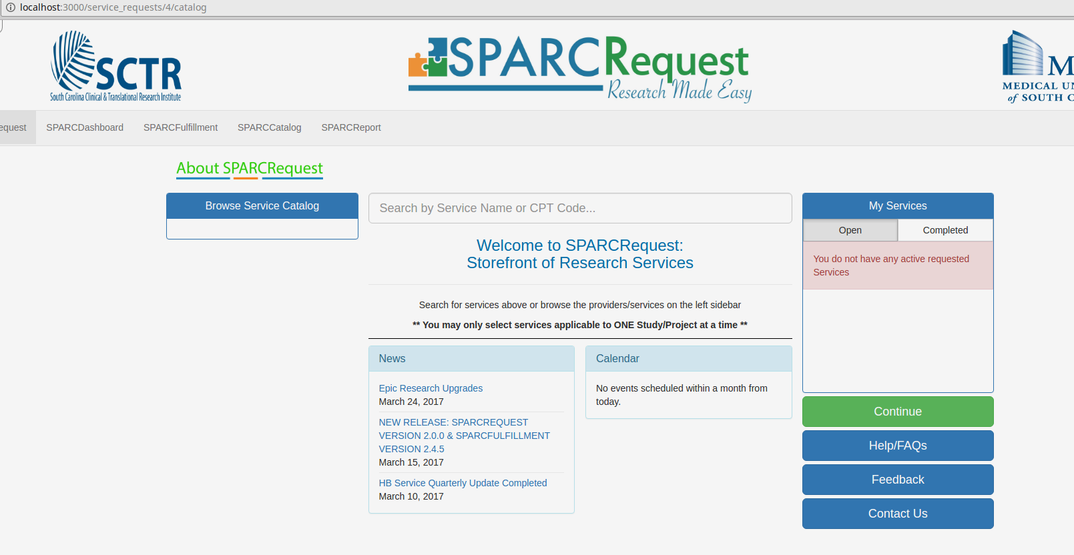

Slide 4
Rspec and Pivotal Tracker
Rspec is a testing library made for ruby that simplifies the process of writing thorough and expressive tests for an application
We used this tool when making a small refactor of how Protocols are displayed and when writing specs for the MultipleLineItems controller
Pivotal Tracker
Instead of using the default GitHub issues tracker to report and find bugs in the project, we used the Pivotal Tracker channel used by MUSC
All bugs, features, and other issues are assigned ‘stories’, which are picked up by developers like us
By coordinating with the team at MUSC, we were able to be assigned and complete a few stories through pivotal.

Slide 5
Building Sparc-request on Linux
Sparc-request is primarily built on Mac OS
We had to figure out how to build it on a Linux distribution
We used linuxbrew instead of homebrew
We used the setup instructions for Mac as a guide to figure out how to run the project on Linux
Thankfully, a number of issues that the Mac document had involving certain Ruby gems like rubyracer didn’t seem to affect our Linux systems
We made a simple How-to installation guide explaining step by step instructions on how to build Sparc-Request on Linux in hopes of broadening the community

Slide 6
Accomplishments
Spec for Multiple Line Items
Issue: the controller for multiple line items did not have any specs associated with it
Fix: We wrote up three different spec files
The spec files were named after one of the controller’s possible actions, like the create or edit action
Then, we tested each of the actions to ensure that they functioned correctly
After we finished this, we pushed our branch to the sparc-request master branch on GitHub
It was sent back with a couple of changes requested to the formatting of the tests, and we have finished a resubmission that follows the requested formatting changes
We are currently waiting on the specs for the multiple line items controller to be approved

Slide 7
Accomplishments
Refactoring
We also did some small refactoring involving two controllers for the same model named Protocols
We submitted a refactor of two controllers that had identical actions into a single action on one of the controllers, and then edited the routes to hit the same controller action
This task was rather simple because the two controllers represented the same model, just on different parts of the website
We focused most of our effort on following TDD on this story, writing the controller specs before writing the actual actions, and then writing the appropriate view specs
The work we did for the refactoring of the protocol has already been merged in

Slide 8
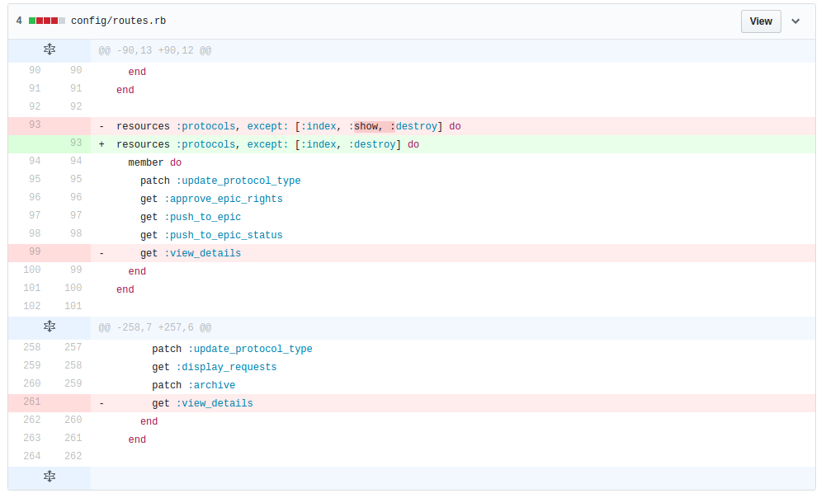
Accomplishments
Refactoring
We also did some small refactoring involving two controllers for the same model named Protocols
We submitted a refactor of two controllers that had identical actions into a single action on one of the controllers
This task was rather simple because the two controllers represented the same model, just on different parts of the website
The controllers were just located in different sections of the website
The work we did for the refactoring of the protocol has already been merged in

Slide 9
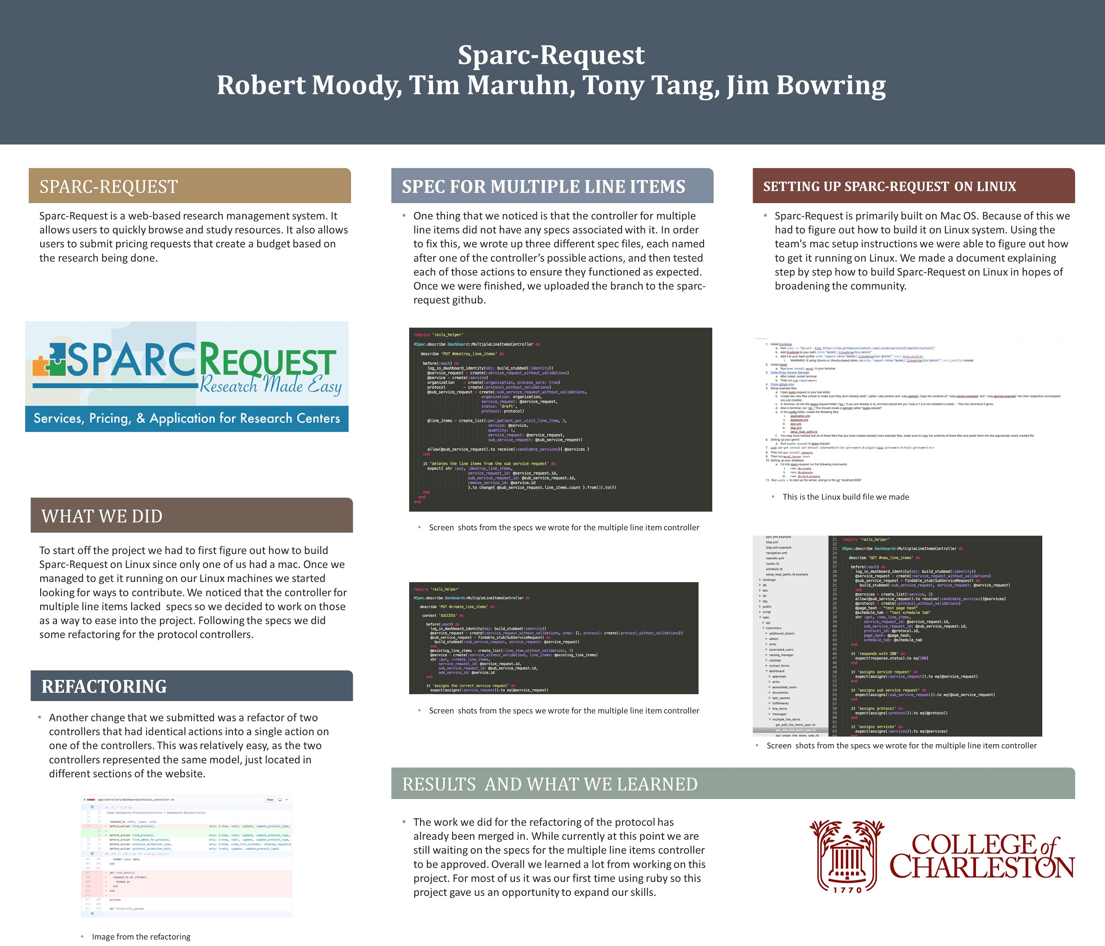
Final Poster

Slide 10
Issues
In our first project, Canvas-LMS, we ran into issues communicating with the development team and accessing the login credentials to the database
When building the sparc-request project, one team member had issues with setting up the mysql server
Getting the correct version of certain Ruby gems was also troublesome
For example, when running bundle install, if you had installed an older version of a gem called capybara then you need to install the latest version before you can run bundle install again

Slide 11
Issues
Adapting to TDD was also a bit of a hurdle, as nobody on the team was very experienced with it
Coordinating controller actions with the correct route was also a learning experience
Learning how the Sparc team formatted their specs
Adapting to the process of getting our fixes approved by an outside team

Slide 12
What We Learned
Ruby syntax
Installing and Using Ruby Gems
Using Ruby Version Manager
Installing a Linux distribution on Virtual Box and a removable disk
Initializing and Using MySQL
Using rake
Writing clear and concise documentation
Publishing progress on project using GitHub wiki pages

Slide 13
What We Learned
Using routes
Writing specs
Writing controller actions
Refactoring code redundancy
Coordinating with other teams

Slide 14
Things we would have done differently
Getting a better feel for how Canvas-LMS functioned would have probably made us switch projects sooner than we eventually did
Canvas-LMS had some problems with login credential authorization and we should have recognized these problems and switched projects sooner
We should have realized that the Canva-LMS community of open source developers did not respond as soon as we would have liked when we contacted them on Google groups which is another reason why we chose to switch to Sparc-request

Slide 15
Things we would have done differently
Being more on top of getting our changes approved by the managers of Sparc-Request
Interacting with the other developers to get a better feel for the normal styling of Sparc-Request specs
Being smarter about how we approached the controller refactor

Slide 16
References
https://sparc.musc.edu/service_requests/1450929/catalog
https://github.com/bmic-development/sparc-request
https://github.com/CSCI-462-01-2017/Team-Dai-Gurren/wiki

