Slide 1
The Actor Programming Model
CSCI 795 – Reactive Programming Hunter College, Fall 2020
Ye Paing, Alex Washburn

Slide 2
What makes an actor
It has a unique identity
It has a defined behavior
It communicates via asynchronous messages

Slide 3
Unique Identity
Required to know where a message originated
Required to know where to send a message

Slide 4
Defined Behavior
Actors’ behavior defines how they process messages
Behavior definition can change in response to a message
Actors can create other actors

Slide 5
Asynchronous Messaging
Non-blocking
Only uses messaging to communicate

Slide 6
Where do actors come from
Actors resemble human organization
Actors proposed usage for artificial intelligence

Slide 7
Why use actors
PROS
CONS
Simple API for multi-threading
Actors are easily created and easily removed
Automatically handle race conditions
No tight coupling
Actors are susceptible to deadlocks
Actor’s mailbox can overflow
Requires developer to be more diligent in handling multi-threading challenges

Slide 8
Example / Demo
Using Akka Actor Framework https://akka.io/ https://developer.lightbend.com/guides/akka-quickstart-scala/

Slide 9
akka.actor.Actor
https://doc.akka.io/api/akka/current/akka/actor/Actor.html
Actor base trait, intended to be extended by user defined actor classes.
Extended actor classes need to defined the `receive` method to determine how the actor will handle incoming messages
Contains useful `self` member variable that holds an `ActorRef`, a context/reference to the actor that can be passed by message to other actors.
Not to be confused with scala.actor.actor (deprecated).

Slide 10
akka.actor.ActorSystem
https://doc.akka.io/api/akka/current/akka/actor/ActorSystem.html
Organizes actors into a common group/actor hierarchy that shares configurations.
Acts as an entry point for creating actors. Creates new actors using `actorOf`
Contains 3 main actors by default:
“/” – root guardian actor, represents the root of the actor system hierarchy
“/user” – parent actor, root of all our user defined actors
“/system” – system actor, root of all actors defined by Akka

Slide 11
akka.actor.Props
https://doc.akka.io/api/akka/current/akka/actor/Props.html
Used to create a config object in the process of creating an Actor
It is immutable, thus making it thread-safe and shareable.
Passed along as one of the parameters for creating an Actor via the ActorSystem.actorOf() method.

Slide 12
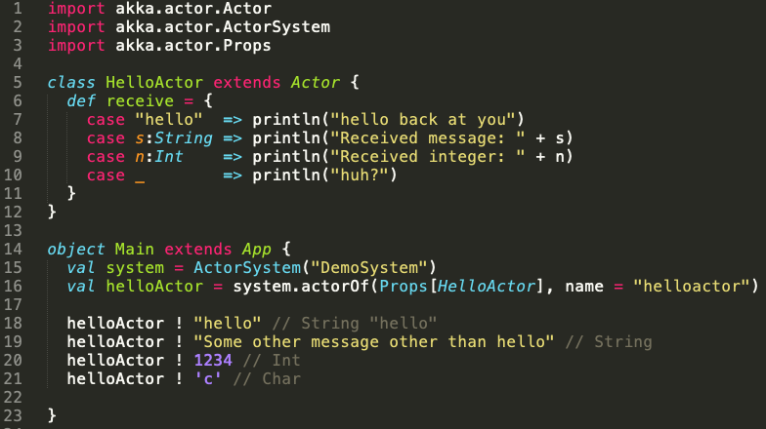
Sample Code

