Slide 1
The Actor Programming Model
CSCI 795 – Reactive Programming Hunter College, Fall 2020
Ye Paing, Alex Washburn

Slide 2
What makes an actor
It has a unique identity
It has a defined behavior
It communicates via asynchronous messages

Slide 3
Unique Identity
Required to know where a message originated
Required to know where to send a message

Slide 4
Defined Behavior
Actors’ behavior defines how they process messages
Behavior definition can change in response to a message
Actors can create other actors

Slide 5
Asynchronous Messaging
Non-blocking
Only uses messaging to communicate

Slide 6
Where do actors come from
Actors resemble human organization
Actors proposed usage for artificial intelligence

Slide 7
Why use actors
PROS
CONS
Simple API for multi-threading
Actors are easily created and easily removed
Automatically handle race conditions
No tight coupling
Actors are susceptible to deadlocks
Actor’s mailbox can overflow

Slide 8
Example / Demo
Using Akka Actor Framework https://akka.io/ https://developer.lightbend.com/guides/akka-quickstart-scala/

Slide 9
akka.actor.Actor
https://doc.akka.io/api/akka/current/akka/actor/Actor.html
Actor base trait, intended to be extended by user defined actor classes.
Extended actor classes need to defined the `receive` method to determine how the actor will handle incoming messages
Contains useful `self` member variable that holds an `ActorRef`, a context/reference to the actor that can be passed by message to other actors.
Not to be confused with scala.actor.actor (deprecated).

Slide 10
akka.actor.ActorSystem
https://doc.akka.io/api/akka/current/akka/actor/ActorSystem.html
Organizes actors into a common group/actor hierarchy that shares configurations.
Acts as an entry point for creating actors. Creates new actors using `actorOf`
Contains 3 main actors by default:
“/” – root guardian actor, represents the root of the actor system hierarchy
“/user” – parent actor, root of all our user defined actors
“/system” – system actor, root of all actors defined by Akka

Slide 11
akka.actor.Props
https://doc.akka.io/api/akka/current/akka/actor/Props.html
Used to create a config object in the process of creating an Actor
It is immutable, thus making it thread-safe and shareable.
Passed along as one of the parameters for creating an Actor via the ActorSystem.actorOf() method.

Slide 12
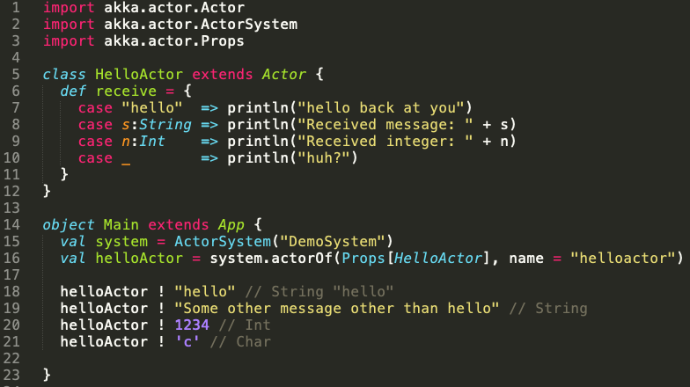
Sample Code

Slide 13
Questions?

