Slide 1
CSCI 513 Final Project
Jichao Fang
Department of Earth Atmosphere and Environment
2025/4/30

Slide 2
Game demo

Slide 3
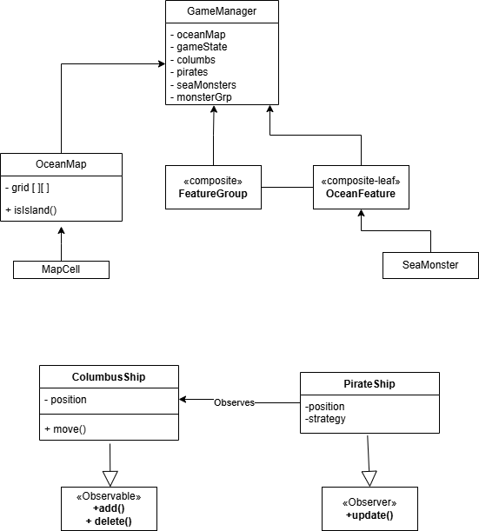

Slide 4
Design Patterns
Observer
public interface Observer {
void update(Observable observable);
}
public abstract class PirateShip extends GameCharacter implements Observer
public interface Observable {
void registerObserver(Observer observer);
void removeObserver(Observer observer);
void notifyObservers();
}
public class ColumbusShip extends GameCharacter implements Observable

Slide 5
Design Patterns
Singleton
public class OceanMap {
private static OceanMap instance;
private MapCell[][] grid;
private int width;
private int height;
private Position treasurePosition;
private List<Position> islandPositions = new ArrayList<>(); // Store island locations
private Random random = new Random();

Slide 6
Design Patterns
Factory Method
public abstract class PirateShipFactory {
// The abstract factory method.
// Subclasses will implement this to create specific pirate ship types.
public abstract PirateShip createPirateShip(String type, Position position);
public class StandardPirateShipFactory extends PirateShipFactory {
@Override
public PirateShip createPirateShip(String type, Position position) {
PirateShip pirateShip = null;

Slide 7
Design Patterns
Strategy
public class ChaseStrategy implements MovementStrategy
public PirateShip(int x, int y, MovementStrategy strategy) {
super(x, y);
this.movementStrategy = strategy;
}
public class PredictiveChaseStrategy implements MovementStrategy
public class PatrolStrategy implements MovementStrategy

Slide 8
Design Patterns
Composite
public interface OceanFeature {
public class FeatureGroup implements OceanFeature {
private List<OceanFeature> features = new ArrayList<>();
public class SeaMonster extends GameCharacter implements OceanFeature {

Slide 9
Backend Management
API
public class WebServer extends NanoHTTPD {
private GameManager gameManager;
try {
if (uri.equals("/state") && Method.GET.equals(method)) {
return getState();
} else if (uri.equals("/action/move") && Method.POST.equals(method)) {
return handleMoveAction(session);
} else if (uri.equals("/action/restart") && Method.POST.equals(method)) {
return handleRestartAction();
}

Slide 10
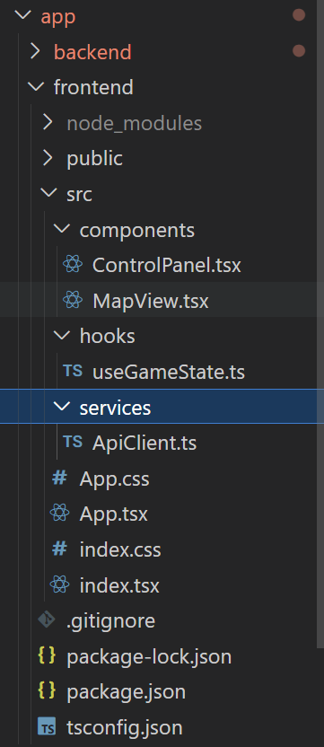
Frontend Design
Component:
Map
Control
Hooks
useGameState
Service:
ApiClient

Slide 11
Teammate: Claude 3.7 Sonnet, Gemini 2.5 Pro
AI helped in design project structure, ie, a maven project, helped me understand design proper packages (com.csci513.finalproject), setup react project.
AI helped debug when I get stuck
AI is extremely powerful in writing UI.

