Slide 1
Distributed Systems CS6421 Timing Worksheet
Prof. Roozbeh Haghnazar
Slides Credit:
Prof. Tim Wood and Prof. Roozbeh Haghnazar

Slide 2
Final Project
Questions?
Groups of 3-4 students
Research-focused: Reimplement or extend a research paper
Implementation-focused: Implement a simplified version of a real distributed system
Course website has sample ideas
But don’t feel limited by them!
You don’t have to use go!
Timeline
Milestone 0: Form a Team
Milestone 1: Select a Topic
Milestone 2: Literature Survey
Milestone 3: Design Document Milestone 4: Final Presentation

Slide 3
Last Time…
Advanced Resource Management
MapReduce / DevOps
Resource Optimization problems
NP Hardness
Many-objective Optimization
Migration
Code
Processes
VMs

Slide 4
This Week: Coordination
Clock Synchronization
Logical Clocks
Vector Clocks
Mutual Exclusion
Election Algorithms
How can distributed components coordinate and agree on the ordering of events?

Slide 5
Next Week: Fault Tolerance
How can we use coordination concepts to provide fault tolerance?
Raft – State Machine Replication
Centralized, crash fault tolerance
Blockchain / Crypto currency
Decentralized, byzantine fault tolerance
DynamoDB (Amazon’s Distributed Database)
Quorum replication, cloud scale fault tolerance

Slide 6
Challenges
Heterogeneity
Openness
Security
Failure Handling
Concurrency
Quality of Service
Scalability
Transparency

Slide 7


Problem and challenge ex.
Exec. Process1
Database
Exec. Process2
Concurrency challenge in a database
Lost update anomaly
$500
READ balance
$500
$500
READ balance
Time and clock!!!
Or
Lock
Solution ???
Add $100
$600
$700
Add $200
$600
$700

Slide 8

Clock and Time
Last Update 9:50
West
Database
East
Exec. Process1
Rec A
Rec A
Exec. Process2
9:40
12:40
We need to replicate the last update
Concurrent operation and replication conflict
READ
9:40
12:40
READ
12:41
Update Rec A
Update Rec A
9:44
EA
WA
East Time > West Time
EA
EA

Slide 9
Problem
In centralized management, all nodes can make agreement for a shared variable value under the master node control.
But what if that the system uses distributed management?
Notes:
What is the problem? We learned how our process can communicate with each other or how they can migrate from a place to another one. We learned in distributed system how the entities cooperate with each other to solve a problem.
They need to be synched.
For example Make program in linux to compile C file. Checking the input and output file of the compiler.

Slide 10
Clocks and Timing
Distributed systems often need to order events to help with consistency and coordination
Coordinating updates to a distributed file system
Managing distributed locks
Providing consistent updates in a distributed DB

Slide 11
Coordinating time?
How can we synchronize the clocks on two servers?
Physical
Logical
Clock Skew : the differences between the crystals speed
clock: 8:03
A
B
clock: 8:01
Notes:
How clocks work?

Slide 12
Physical clocks : Sundial
Sundial.
Solar Day varies due:
Core activities of earth
Rise & Tide of oceans
Gravity
Orbit around the sun, not a perfect circle
Notes:
Clock Skew : the differences between the crystals speed

Slide 13
Physical clocks : Atomic Clock
Accurate time regardless of earth movement and gravity
Since 1968, the International System of Units (SI) has defined the second as the duration of 9,192,631,770 cycles of radiation corresponding to the transition between two energy levels of the ground state of the caesium-133 atom. In 1997, the International Committee for Weights and Measures (CIPM) added that the preceding definition refers to a Caesium atom at rest at a temperature of absolute zero.
UTC sends pulses for the wwv receiver
Notes:
Clock Skew : the differences between the crystals speed

Slide 14
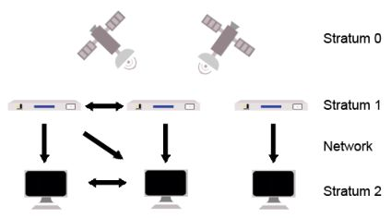
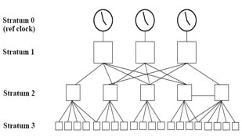
NTP Stratum Model
The NTP Stratum model is a representation of the hierarchy of time servers in an NTP network, where the Stratum level (0-15) indicates the device's distance to the reference clock.

Slide 15
Cristian’s Algorithm
Easy way to synchronize clock with a time server
Client sends a clock request to server
Measures the round trip time
Set clock to t + 1/2*RTT (8:01.505)
0.010 sec
A
B
clock t = 8:01.500

Slide 16
Cristian’s Algorithm
What will affect accuracy?
set to t + RTT/2
0.010 sec
A
no error!
B
t
0.010 sec
C
ahead or behind?
D
t

Slide 17
Cristian’s Algorithm
Suppose the minimum delay between A and B is X
0.010 sec
C
x
D
t
0.010 sec
E
x
F
t
Range: [t+x, t + RTT-x]

Slide 18
Ordering
Sometimes we don’t actually need clock time
We just care about the order of events!
What event happens before another event?
e → e’ means event e happens before event e’
Easy: we’ll just use counters in each process and update them when events happen!
Maybe not so easy…

Slide 19
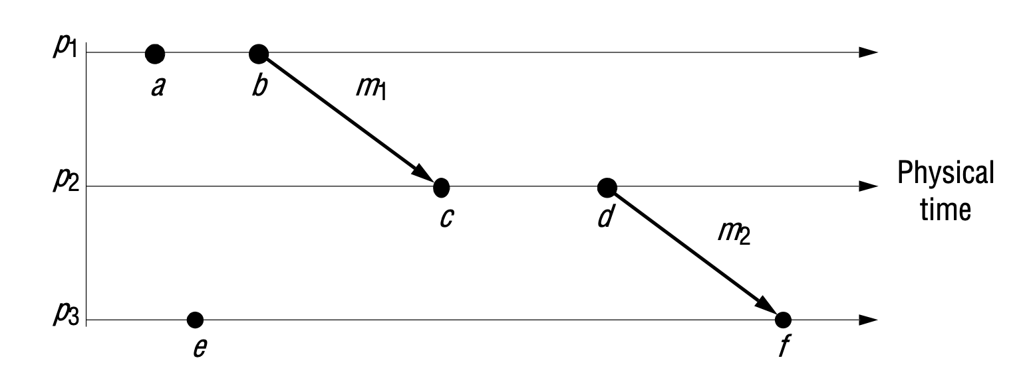
Ordering
An event is one of the following:
Action that occurs within a process
Sending a message
Receiving a message
What is true? What can’t we know?
g

Slide 20
Happens Before: →
What is true?
a->b, b->g, c->d, e->f (events in same process)
b->c, d->f (send is before receive)
What can’t we know?
e ?? a
e ?? c
g

Slide 21
Ordering
If we keep count of events at each process independently, are those counters meaningful?
1
2
3
g
1
2
1
2

Slide 22
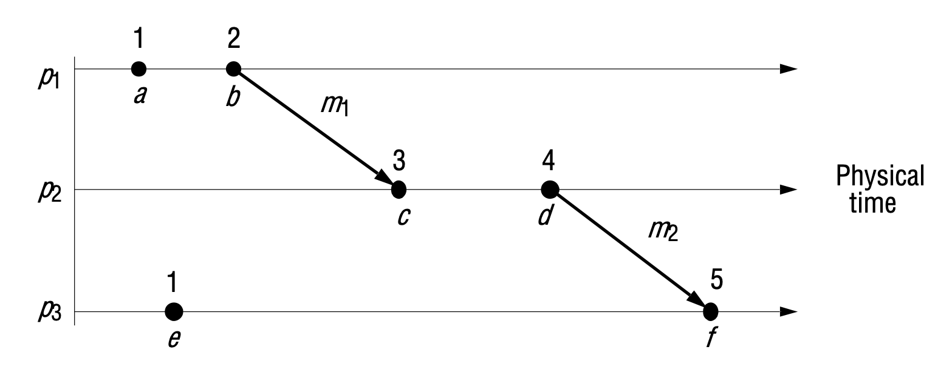
Logical Clock: Lamport Clock
Each process maintains a counter, L
Increment counter when an event happens
When receiving a message, take max of own and sender’s counter, then increment
1
2
3
3
g
?
3
?
4
1
2
3
4
5
6
?

Slide 23
Lamport Clock
Each process maintains a counter, L
Increment counter when an event happens
When receiving a message, take max of own and sender’s counter, then increment
3
g

Slide 24
Clock Comparison
Independent clocks
1
2
3
g
if e->e’, then:
C(e) ??? C(e’)
1
2
1
2
Lamport clocks
3
g
if e->e’, then:
L(e) < L(e’)

Slide 25
Clock Comparison
Is the opposite true?
if L(e) < L(e’) then do we know e->e’?
Lamport clocks
3
g
if e->e’, then:
L(e) < L(e’)

Slide 26
Clock Comparison
Is the opposite true? No!
Lamport clocks don’t actually let us compare two clocks to know how they are related :(
Lamport clocks
3
g
if e->e’, then:
L(e) < L(e’)

Slide 27
Lamport Clocks
Lamport clocks are better than nothing
but only let us make limited guarantees about how things are ordered
Ideally we want a clock value that indicates:
If an event happened before another event
If two events happened concurrently
P1 | P2 | P3
a:1 | c:3 | e:1
b:2 | d:4 | f:5
g:3
Lamport clocks
3
g

Slide 28
Vector Clocks
Each process keeps an array of counters: (p1, p2, p3)
When p_i has an event, increment V[p_i]
Send full vector clock with message
Update each entry to the maximum when receiving a clock
(1,0,0)
3
g

Slide 29
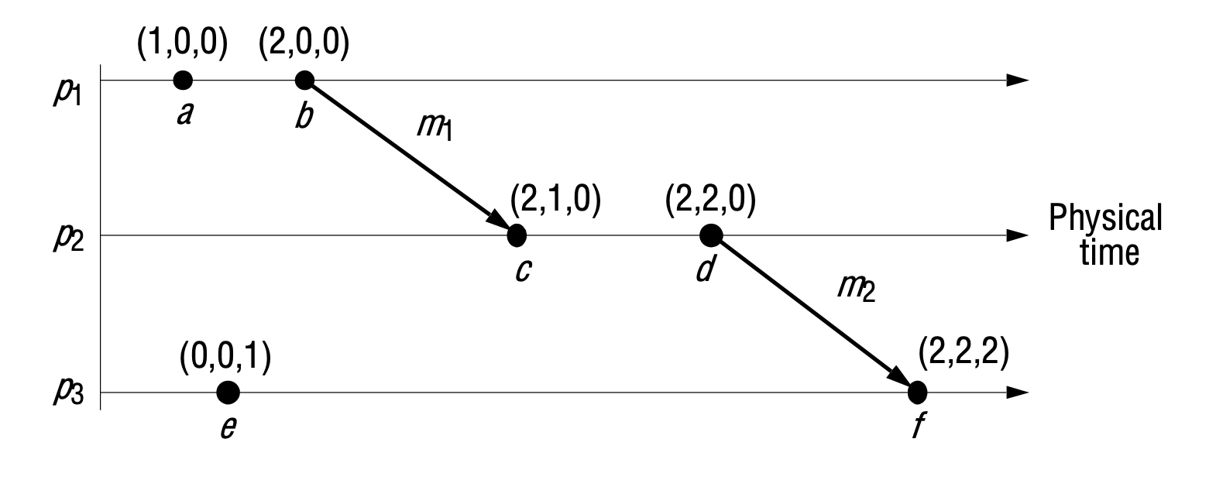
Vector Clocks
A C
A G
G F
G C
F C
E D
Now we can compare orderings!
if V(e) < V(e’) then e->e’
(a,b,c) < (d,e,f) if: a<d & b<e & c<f
If neither V(e) < V(e’) nor V(e’) < V(e) then e and e’ are concurrent events
(3,0,0)
P1 | P2 | P3
a: 1,0,0 | c: 2,1,0 | e: 0,0,1
b: 2,0,0 | d: 2,2,0 | f: 2,2,2
g: 3,0,0
g

Slide 30
Lamport vs Vector
Which clock is more useful when you can’t see the timing diagram?
Remember, your program will only see these counters!
P1 | P2 | P3
a:1 | c:3 | e:1
b:2 | d:4 | f:5
g:3
P1 | P2 | P3
a: 1,0,0 | c: 2,1,0 | e: 0,0,1
b: 2,0,0 | d: 2,2,0 | f: 2,2,2
g: 3,0,0

Slide 31
VC Example
VC Rules:
When p_i has an event, increment V[p_i]
Update each entry to the maximum when receiving a clock
Send full vector clock with message
What are the vector clocks at each event?
Assume all processes start with (0,0,0)
?
?
?
?
P1
a
c
g
j
P2
e
f
?
?
P3
b
d
h
i
?
?
?
?
Notes:
BB Quiz: What is the VC of j?
4,0,0
4,2,4

Slide 32
How to Compare VC?
Example Answer
1,0,0
2,0,0
3,0,0
4,2,4
P1
a
c
g
j
P2
e
f
2,1,0
2,2,0
P3
b
d
h
i
0,0,1
0,0,2
2,2,3
2,2,4

Slide 33
Vector Clocks
Allow us to compare clocks to determine a partial ordering of events
Example usage: versioning a document being edited by multiple users. How do you know the order edits were applied and who had what version when they edited?
Is there a drawback to vector clocks compared to Lamport clocks?

Slide 34
Clock Worksheet
https://expl.ai/ENAJBDHK
Do the worksheet in breakout rooms
When you finish, try this:
Draw the timeline for the four processes with vector clocks shown in problem 3. One of the clocks has an error – which one?
P1 | P2 | P3 | P4
a: 1,0,0,0 | e: 1,1,0,0 | i: 0,0,1,0 | l: 0,0,0,1
b: 2,0,0,0 | f: 1,2,0,1 | j: 0,0,2,2 | m: 0,0,0,2
c: 3,0,0,0 | g: 1,3,0,1 | k: 0,0,3,2 | n: 0,0,0,3
d: 4,2,0,1 | h: 1,4,3,2
Find the bug???

Slide 35
Version Vectors
Problem: If multiple servers allow the same key to be updated, its important to detect when the values are concurrently updated across a set of replicas.
We can apply the vector clock concept to versioning a piece of data
This is used in many distributed data stores (DynamoDB, Riak)
When a piece of data is updated:
Tag it with the actor who is modifying it and the version #
Treat the (actor: version) pairs like a vector clock
The version vectors can be used to determine a causal ordering of updates
Also can detect concurrent updates
Need to have a policy for resolving conflicts
If two versions are concurrent, they are “siblings”, return both!

Slide 36
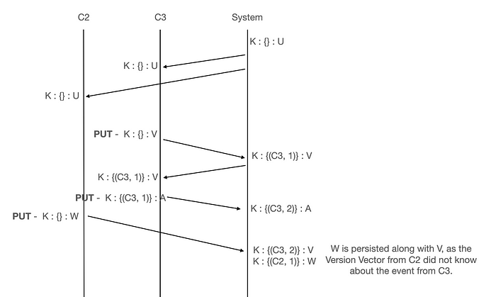
Example:
Let’s assume we have a key K, with value U. We’re assuming that we have an empty version vector to begin with. Client’s C2 and C3 sync the same state from the system that’s implementing Version Vectors.
C3 updates the value to V & sends a PUT command, with the local state of Version Vector it has(empty VV).
The System on receiving the Version Vector, compares it with its local state(again empty). So it creates a new Version Vector for this client(C3) and updates the value of key K to V.
C3 syncs the state from the server and again updates the value to A from V and sends a PUT command.
The System on receiving the Version Vector, compares it with its local state. This time the local state has an entry for C3, so it increments the counter to 2 & updates the value to A.
C2 updates the value to W & sends a PUT command, with the local state of Version Vector it has(empty VV).
The System on receiving the Version Vector, compares it with its local state((C3, 2)). Since there is no local state for C2, it creates a new state of (C2, 1). If we compare the 2 Version Vectors, {C3, 2} and {C2, 1}, based on what we’ve discussed before, they are concurrent. Since there is a conflict, the System stores both the version vectors(1 per client) as siblings.

Slide 37
Version Vectors
Alice tells everyone to meet on Wednesday
Dave and Cathy discuss and decide on Thursday
Ben and Dave exchange emails and decide Tuesday
Alice wants to know the final meeting time, but Dave is offline and Ben and Cathy disagree… what to do?
Order?
Alice
Ben
Cathy
Dave
Wednesday
Tuesday
Thursday
???

Slide 38
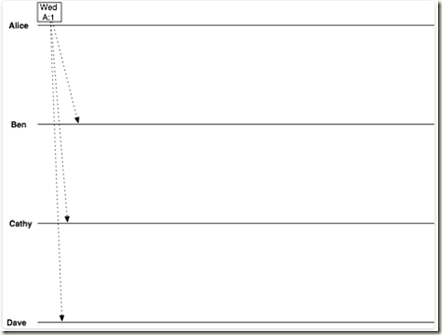
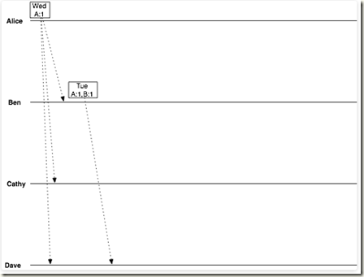
Version Vectors
Start with Alice's initial message: "Let's meet Wednesday,"
date = Wednesday
vclock = Alice:1
Ben suggests Tuesday:
date = Tuesday
vclock = Alice:1, Ben:1

Slide 39
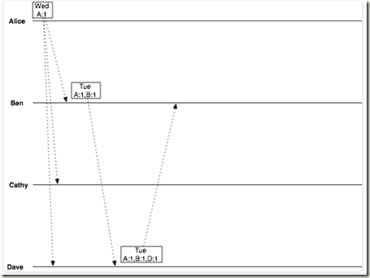
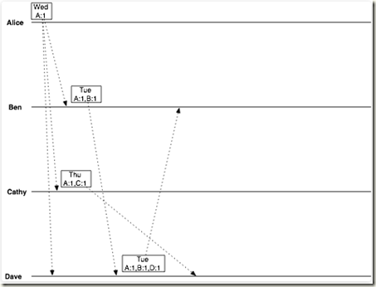
Version Vectors
Dave replies, confirming Tuesday:
date = Tuesday
vclock = Alice:1, Ben:1, Dave:1
Now Cathy gets into the act, suggesting Thursday:
date = Thursday
vclock = Alice:1, Cathy:1

Slide 40
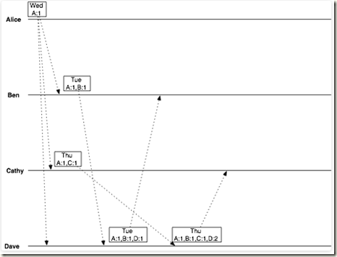
Version Vectors
Dave has two conflicting objects:
date = Tuesday
vclock = Alice:1, Ben:1, Dave:1
and
date = Thursday
vclock = Alice:1, Cathy:1
date = Thursday
vclock = Alice:1, Ben:1, Cathy:1, Dave:2

Slide 41
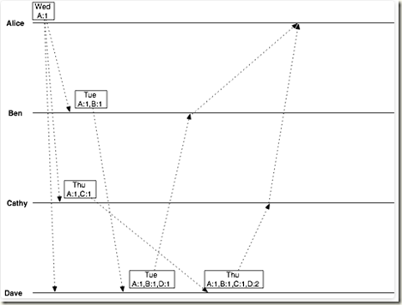
Version Vectors
So now when Alice asks Ben and Cathy for the latest decision, the replies she receives are, from Ben:
date = Tuesday
vclock = Alice:1, Ben:1, Dave:1
and from Cathy:
date = Thursday
vclock = Alice:1, Ben:1, Cathy:1, Dave:2

Slide 42
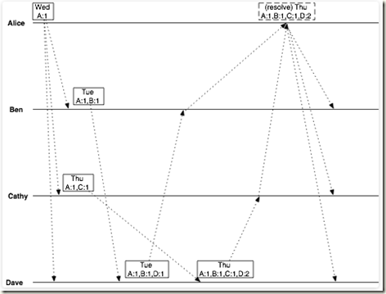
Version Vectors
From this, she can tell that Dave intended his correspondence with Cathy to override the decision he made with Ben. All Alice has to do is show Ben the vector clock from Cathy's message, and Ben will know that he has been overruled.

Slide 43
Dependencies
Vector clocks also help understand the dependency between different events and processes
Combination of DAG, and Vector Clocks or Version clock can be very powerful to solve the conflicts also
P1
a
c
g
j
P2
e
f
P3
b
d
h
i
P4
k
l
m
n

Slide 44
Time and Clocks
Synchronizing clocks is difficult
But often, knowing an order of events is more important than knowing the “wall clock” time!
Lamport and Vector Clocks provide ways of determining a consistent ordering of events
But some events might be treated as concurrent!
The concept of vector clocks or version vectors is commonly used in real distributed systems
Track ordering of events and dependencies between them

Slide 45
Distributed
Coordination
(Mutual Exclusion, Consensus)

Slide 46
Survey Feedback
Breadth vs Depth
Example Use Cases
Project Difficulty
Using cloud trial version – hybrid + on premise VMs
Programming Language - Go

Slide 47
This Week: Distributed Coordination
Distributed Locking
Consensus
Elections
State Machine Replication
Blockchain

Slide 48
Why Lock?
Exec. Process1
Database
Exec. Process2
Locks let us protect a shared resource
A database, values in shared memory, files on a shared file system, throttle control on a drone, etc
How to manage a lock in a distributed environment?
How do locks limit scalability?
$500
READ balance
$500
$500
READ balance
Add $100
$600
$700
Add $200
$600
$700

Slide 49
Centralized Approach
Lock Queue
B
C
Simplest approach: put one node in charge
Other nodes ask coordinator for each lock
Block until they are granted the lock
Send release message when done
Coordinator can decide what order to grant lock
Do we get:
Mutual exclusion?
Progress?
Resilience to failures?
Balanced load?
A
Lock
Lock
Grant
B
C
wants lock
wants lock

Slide 50
Distributed Lock
If you want the lock: Broadcast “I want the lock!”
On RX:
If we own the lock:
add this request to a queue
Reply: “wait a minute… you are # x in line”
Else:
do nothing
When done with lock:
Send “You now have the lock” to first entry in queue and send the queue
If nobody in the queue, then hold onto the lock until somebody else needs it or randomly send it to somebody else if we need to exit.
if nobody else has asked me for the lock: Reply “Sure”
1) else reply “no way”
2) else add this request to queue
Wait for a timeout…
If 50% say sure, then take the lock
else, “I no longer want the lock”

Slide 51
Distributed Approach
A 3
6 Lock
Use Lamport Clocks to order lock requests across nodes
Send Lock message with ++clock
Wait for OKs from all nodes
When receiving Lock msg:
Update clock following Lamport’s rules
Send OK if not interested
If I want the lock:
Send OK if request's clock is smaller than own
Else, put request in queue
When done with a lock:
Send OK to anybody in queue
B 5
C 15
6 Lock
A 6
OK B
B 6
OK B
C 15

Slide 52
Distributed Approach
A 3
6 Lock
16 Lock
Use Lamport Clocks to order lock requests across nodes
Send Lock message with ++clock
Wait for OKs from all nodes
When receiving Lock msg:
Update clock following Lamport’s rules
Send OK if not interested
If I want the lock:
Send OK if request's clock is smaller than own
Else, put request in queue
When done with a lock:
Send OK to anybody in queue
B 5
16 Lock
C 15
6 Lock
A
B
C
Notes:
Who gets the resource?

Slide 53
Distributed Approach
A 3
6 Lock
16 Lock
Use Lamport Clocks to order lock requests across nodes
Send Lock message with ++clock
Wait for OKs from all nodes
When receiving Lock msg:
Update clock following Lamport’s rules
Send OK if not interested
If I want the lock:
Send OK if request's clock is smaller than own
Else, put request in queue
When done with a lock:
Send OK to anybody in queue
B 5
16 Lock
C 15
6 Lock
A 16
OK B
OK C
B 16
OK B
C 16
Queue
C 16
waiting for OK from B...

Slide 54
Comparison
Messages per lock acquire and release
Centralized:
Distributed:
Delay before entry
Centralized:
Distributed:
Problems
Centralized:
Distributed:

Slide 55
Comparison
Messages per lock acquire and release
Centralized: 2+1=3
1 request to the coordinator
1 grant/reply from the coordinator
1 release back to the coordinator
Distributed: 2(n-1)
send request to all other n-1 processes
receive n-1 replies
no separate broadcast release message
total = 2(n-1)
Delay before entry
Centralized: 2
Distributed: 2(n-1) in parallel
Problems
Centralized: Coordinator crashes
Distributed: anybody crashes
Is the distributed approach better in any way?

Slide 56
Distributed Systems are Hard
Going from centralized to distributed can be..
Slower
If everyone needs to do more work
More error prone
10 nodes are 10x more likely to have a failure than one
Much more complicated
If you need a complex protocol
If nodes need to know about all others
Often we need more than just a way to lock a resource!

Slide 57
What is the meaning of Consensus
Consensus is defined by Merriam-Webster as,
general agreement,
group solidarity of belief or sentiment.

Slide 58
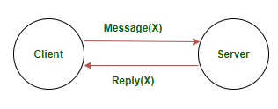
Why Consensus?
When you sent a request to a server it answers you easily
If server fails, there is no backup
If the number of requests increase dramatically the server won’t be able to respond
What are the challenges?

Slide 59
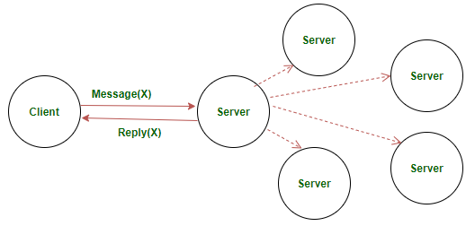
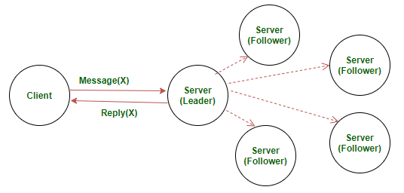
Why Consensus?
Symmetric :- Any of the multiple servers can respond to the client and all the other servers are supposed to sync up with the server that responded to the client’s request
Asymmetric :- Only the elected leader server can respond to the client. All other servers then sync up with the leader server.

Slide 60
Why Consensus?
While this creates a system that is devoid of corruption from a single source, it still creates a major problem.
How are any decisions made?
How does anything get done?

Slide 61
Consensus Objectives
Therefore, objectives of a consensus mechanism are:
Agreement seeking: A consensus mechanism should bring about as much agreement from the group as possible.
Collaborative: All the participants should aim to work together to achieve a result that puts the best interest of the group first.
Cooperative: All the participants shouldn’t put their own interests first and work as a team more than individuals.
Egalitarian: A group trying to achieve consensus should be as egalitarian as possible. What this basically means that each and every vote has equal weight. One person’s vote can’t be more important than another’s.
Inclusive: As many people as possible should be involved in the consensus process. It shouldn’t be like normal voting where people don’t really feel like voting because they believe that their vote won’t have any weight in the long run.
Participatory: The consensus mechanism should be such that everyone should actively participate in the the overall process.
Validity: the chosen value must be one that was actually proposed
Integrity: a node decides at most once
Termination / Liveness: nodes eventually decide, under the algorithm’s timing/failure assumptions

Slide 62
Distributed Architectures
Purely distributed / decentralized architectures are difficult to run correctly and efficiently (decentralized locking was pretty bad!)
Can we mix the two?
P4
P2
P4
P2
P3
P1
P3
P1
Decentralized
Centralized
Notes:
TIM starts

Slide 63
Elections
Appoint a central coordinator
But allow them to be replaced in a safe, distributed way
Must be able to handle simultaneous elections
Reach a consistent result
Who should win?
P8
P7
P2
P6
P3
P1
Notes:
Example for the final project

Slide 64
Bully Algorithm
P8
P1
The biggest (ID) wins
Any process P can initiate an election
P sends Election messages to all process with higher Ids and awaits OK messages
If it receives an OK, it drops out and waits for an I won
If a process receives an Election msg, it returns an OK...
P7
P2
Election!
P6
P3
P5
P4

Slide 65
Bully Algorithm
P8
P1
The biggest (ID) wins
Any process P can initiate an election
P sends Election messages to all process with higher Ids and awaits OK messages
If it receives an OK, it drops out and waits for an I won
If a process receives an Election msg, it returns an OK...
P7
P2
OK
OK
P6
P3
P5
P4

Slide 66
Bully Algorithm
P8
P1
The biggest (ID) wins
Any process P can initiate an election
P sends Election messages to all process with higher Ids and awaits OK messages
If it receives an OK, it drops out and waits for an I won
If a process receives an Election msg, it returns an OK and starts another election
If no OK messages, P becomes leader and sends I won to all process with lower Ids
If a process receives a I won, it treats sender as the leader
P7
I WON!!!
P2
Election!
P6
P3
P5
P4

Slide 67
Ring Algorithm
P8
P1
Elect <1>
Initiator sends an Election message around the ring
Add your ID to the message
When Initiator receives message again, it announces the winner
What happens if multiple elections occur at the same time?
P7
P2
Elect <1,2>
Elect <1,2,3>
P6
P3
Elect <1,2,3>
P5
P4

Slide 68
Ring Algorithm
Elect <1,2,3,6,8>
P8
P1
Initiator sends an Election message around the ring
Add your ID to the message
When Initiator receives message again, it announces the winner
What happens if multiple elections occur at the same time?
Elect <1,2,3,6>
Elect <1>
P7
P2
Elect <1,2>
Elect <1,2,3>
P6
P3
Elect <1,2,3>
P5
P4

Slide 69
Comparison
Number of messages sent to elect a leader:
Bully Algorithm
Worst case: lowest ID node initiates election
Triggers n-1 elections at every other node = O(n^2) messages
Best case: Immediate election after n-2 messages
Ring Algorithm
Always 2(n-1) messages
Around the ring, then notify all

Slide 70
More approaches
Raft leader election This is one of the most relevant modern answers. Servers are followers, candidates, or a leader. If followers stop hearing heartbeats, they start an election; a candidate that gets a majority becomes leader. Raft uses randomized election timeouts to reduce split votes.
ZooKeeper-style leader election ZooKeeper explicitly supports leader election as a coordination primitive, and internally it has leader-election mechanisms such as FastLeaderElection. After election, one server becomes leader and the others follow it as long as quorum conditions hold.
Lease-based leader election Very common in distributed systems today. A node becomes leader by acquiring and renewing a lease in a coordination store. If the lease expires, others may compete to become the new leader. This is conceptually simpler for students once they already understand locking and timeouts. ZooKeeper and similar systems are often used to build this pattern.
Paxos-family leader election / distinguished proposer In Paxos-like systems, there is often a practical notion of a stable leader or distinguished proposer to reduce contention, even though the core theory is about consensus rather than “election” as a standalone problem. I did not fetch a primary Paxos source in this turn, so I would mention this carefully as a practical note rather than a formal slide claim.

Slide 71
Elections + Centralized Locking
Elect a leader
Let them make all the decisions about locks
What kinds of failures can we handle?
Leader/non-leader?
Locked/unlocked?
During election?
P8
P1
P7
Lock
P2
Elect P8
P6
P3
This can be the basis for consensus-based distributed systems!
P5
P4

Slide 72
Chubby: Google’s Coordination and Lock Service
Google services are composed of many thousands of nodes
Need a way to coordinate data and access to shared resources!
Used by Google File System, BigTable, etc
Chubby: lock service for loosely coupled distributed systems
Focuses on availability and reliability (not performance)
Scales to ~10,000 servers per Chubby Cell
Chubby cell might serve ten thousand 4-processor machines, and that several Chubby instances handled a few tens of thousands of clients concurrently.
See paper at OSDI 2006 by Mike Burrows for full details!

Slide 73
State Machine Replication (SMR)
We can think of an application as a state machine
A program is just data that is updated based on operations -> state
Consensus means that all distributed nodes should be in the same state!
If a node fails, it should not disrupt the system
When a node recovers it should be able to “catch up”
Primary
Backup

Slide 74

Distributed Video Editing SMR
Client
Sometimes data is big!
Replicate the operation to be performed, not the data!
Treat like a state machine
Incoming requests just perform some operation on that data
If all replicas perform same operations, they will end in the same state
If Primary fails, switch to Backup
trimVideo(v1, 1sec)
Primary
v1.mp4 10gb
trimVideo(v1, 1sec)
Backup
v1.mp4 10gb

Slide 75
Hash Table SMR
In SMR, a hash is usually a compact fingerprint of state or log content, and it can be used for several purposes.
SMR creates a replicated log of actions to be performed
E.g., updates to the value stored by a key
Primary orders incoming requests to form the log
Actions must be deterministic
We can keep adding more backup replicas to improve fault tolerance
C-1
C-2
C-3
set(x=3)
inc(x)
set(x=99)
Log
Primary
Hash Table x=
set(x=3)
set(x=99)
inc(x)
Order ???
Log
Backup
Hash Table x=

Slide 76
SMR Failures?
What to do on a failure?
How many failures can we handle?
In SMR, replicas are supposed to execute the same ordered commands and end in the same state.
If one replica has:
a bug,
a missing operation,
a different operation order,
nondeterministic execution,
then its hash may differ from the others.
So hash helps detect:
replica drift
log/state inconsistency
corruption
C-1
C-2
C-3
set(x=3)
inc(x)
set(x=99)
Log
Primary
Hash Table x=
set(x=3)
set(x=99)
inc(x)
Log
Backup
Hash Table x=

Slide 77
Handling Failures
F = number of nodes which can crash at one time
# of nodes needed must depend on f!
What failure scenarios can happen?
Backup fails (no impact, client doesn’t know). BUT, we should add a log at the Primary so that the backup can catch up if it comes back!
Primary fails (client needs a way to redirect to backup and resync log later)
Flip flop who is failed! If node Oh no we can’t catch back up :(
(we don’t care if client fails)
f=1, f+1=2 replicas
Log
1: Primary
Client
2: Backup
Log
Notes:
Backup fails (no impact, client doesn’t know). BUT, we should add a log at the Primary so that the backup can catch up if it comes back!
Primary fails (client needs a way to redirect to backup and resync log later)
Flip flop who is failed! If node Oh no we can’t catch back up :(
(we don’t care if client fails)

Slide 78
Handling Failures
F = number of nodes which can crash at one time
# of nodes needed must depend on f!
f=1, f+2 = 3 replicas
f=1, f+1 replicas
Log
Log
1: Primary
1: Primary
Client
2: Backup
Log
2: Backup
Log
3: Backup
Log
Can’t resync state if failure “flip flops” between nodes!
Fixed?
Notes:
Backup fails (no impact, client doesn’t know). BUT, we should add a log at the Primary so that the backup can catch up if it comes back!
Primary fails (client needs a way to redirect to backup and resync log later)
Flip flop who is failed! If node Oh no we can’t catch back up :(
(we don’t care if client fails)

Slide 79
Handling Failures
F = number of nodes which can crash at one time
# of nodes needed must depend on f!
f=1, f+2 = 3 replicas
f=2, f+2 = 4 replicas
1: Primary
Log
1: Primary
2: Backup
Client
2: Backup
Log
3: Backup
4: Backup
3: Backup
Log
Fixed for f=2?
Notes:
Backup fails (no impact, client doesn’t know). BUT, we should add a log at the Primary so that the backup can catch up if it comes back!
Primary fails (client needs a way to redirect to backup and resync log later)
Flip flop who is failed! If node Oh no we can’t catch back up :(
(we don’t care if client fails)

Slide 80
Handling Failures
F = number of nodes which can crash at one time
# of nodes needed must depend on f!
f=1, f+2 = 3 replicas
f=2, f+2 = 4 replicas
1: Primary
Log
1: Primary
2: Backup
Client
2: Backup
Log
3: Backup
4: Backup
3: Backup
Log
Can’t resync state if failure “flip flops” between 2 nodes!
Fixed for f=2? No!
Notes:
Backup fails (no impact, client doesn’t know). BUT, we should add a log at the Primary so that the backup can catch up if it comes back!
Primary fails (client needs a way to redirect to backup and resync log later)
Flip flop who is failed! If node Oh no we can’t catch back up :(
(we don’t care if client fails)

Slide 81
Handling Failures
F = number of nodes which can crash at one time
# of nodes needed must depend on f!
f=2, 2f+1 = 5 replicas
f=2, f+2 replicas
Use 2f+1 replicas!
Insight: Always need a majority of nodes to stay alive!
Primary
1: Primary
Backup
2: Backup
Client
Backup
3: Backup
Backup
4: Backup
Backup
Can’t resync state if failure “flip flops” between 2 nodes!
Notes:
Backup fails (no impact, client doesn’t know). BUT, we should add a log at the Primary so that the backup can catch up if it comes back!
Primary fails (client needs a way to redirect to backup and resync log later)
Flip flop who is failed! If node Oh no we can’t catch back up :(
(we don’t care if client fails)

Slide 82
State Machine Replication Overview
Provides a generic fault tolerance mechanism
Application just needs to have well defined operations and a way to avoid non-determinism
Primary orders requests into log
Backups execute log in order
Log allows out of date replicas to recover
Need 2f+1 replicas to tolerate f failures
But how do we pick who should be primary…?
Use an election algorithm!
Optional : Example for your project

Slide 83
Case Study
Two important challenges in BlockChain
How are any decisions made?
How does anything get done?
Notes:
We will talk more about this case study later
All the decisions are taken by the leader or a board of decision makers. This isn’t possible in a blockchain because a blockchain has no “leader”. For the blockchain to make decisions, they need to come to a consensus using “consensus mechanisms”.
Usages:
Crypto currency
Insurance
Medical records
Digital documentation

Slide 84
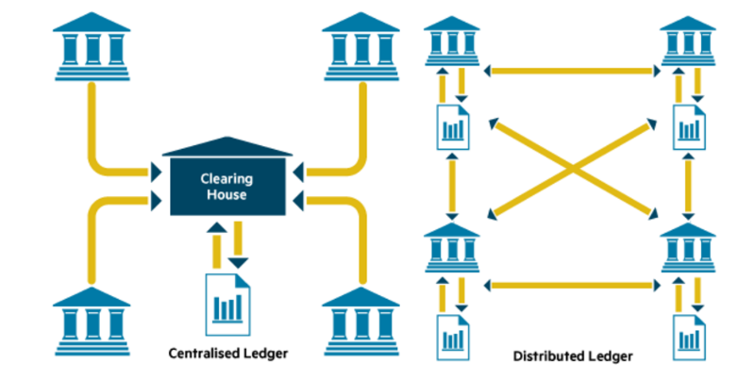
Distributed Ledger Tech

Slide 85
Different types of DLT
Blockchain
Hashgraph
DAG
Holochain
Tangle
Radix (Tempo)
https://www.researchgate.net/publication/328475892_A_Review_of_Distributed_Ledger_Technologies/figures?lo=1
Notes:
Can be used and applied to your final project
https://www.researchgate.net/publication/328475892_A_Review_of_Distributed_Ledger_Technologies/figures?lo=1

Slide 86
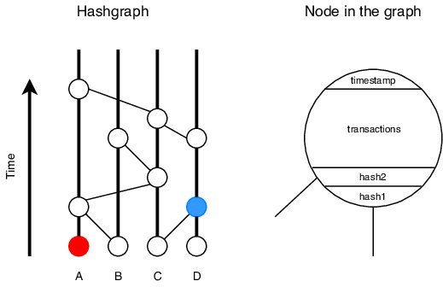
HashGraph
It’s so fast – 250000 transaction per second (Scalability characteristics in Distributed Systems)
Being Time-Based and using Gossip protocol for consensus reduces the process and math complexity.
Time-based increases the justice. Each transaction who obtained 2/3 of the votes has the most priority and it can be a weakness
In the level of security it is evaluating in the banking system level and it means it is a Byzantine Fault Tolerance system.
Controlled Network (Consensus is easier)
Hashgraph Data Structure
Notes:
Transaction number means the scalability
Time-based increases the justice. Each transaction who obtained 2/3 of the votes has the most priority and it can be a weakness
Blockchain is controlled and uncontrolled. BitCoin & Ethereum 10Trans/sec

Slide 87
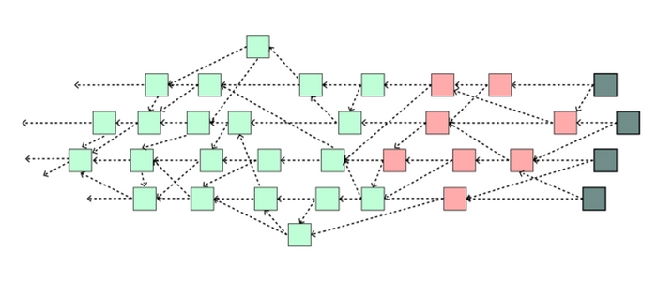
Tangle (IOTA)
IOTA is an open-source distributed ledger and cryptocurrency designed for the Internet of things.
Uses DAG to store transactions on its ledger, motivated by a potentially higher scalability over blockchain based distributed ledgers for nano-Transactions between IOT devices.
There are categories of participants,
Transaction creators
Transaction verifiers
Notes:
It’s a kind of blockchain without blocks

Slide 88
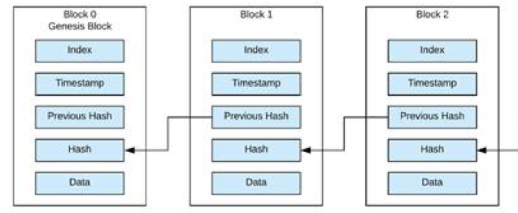
BlockChain
Unofficial definition: A blockchain is an unchangeable and sequence of records and transactions which is called BLOCK
The blocks connects to each other with Hash Codes
Each block contains an index, time stamp, list of transactions, evidence, and last block hash (which guarantees the unchangeability of the chain)
Notes:
Transactions (Sender, Receiver, Amount)
If a hacker changes a block all the next blocks should be changed

Slide 89
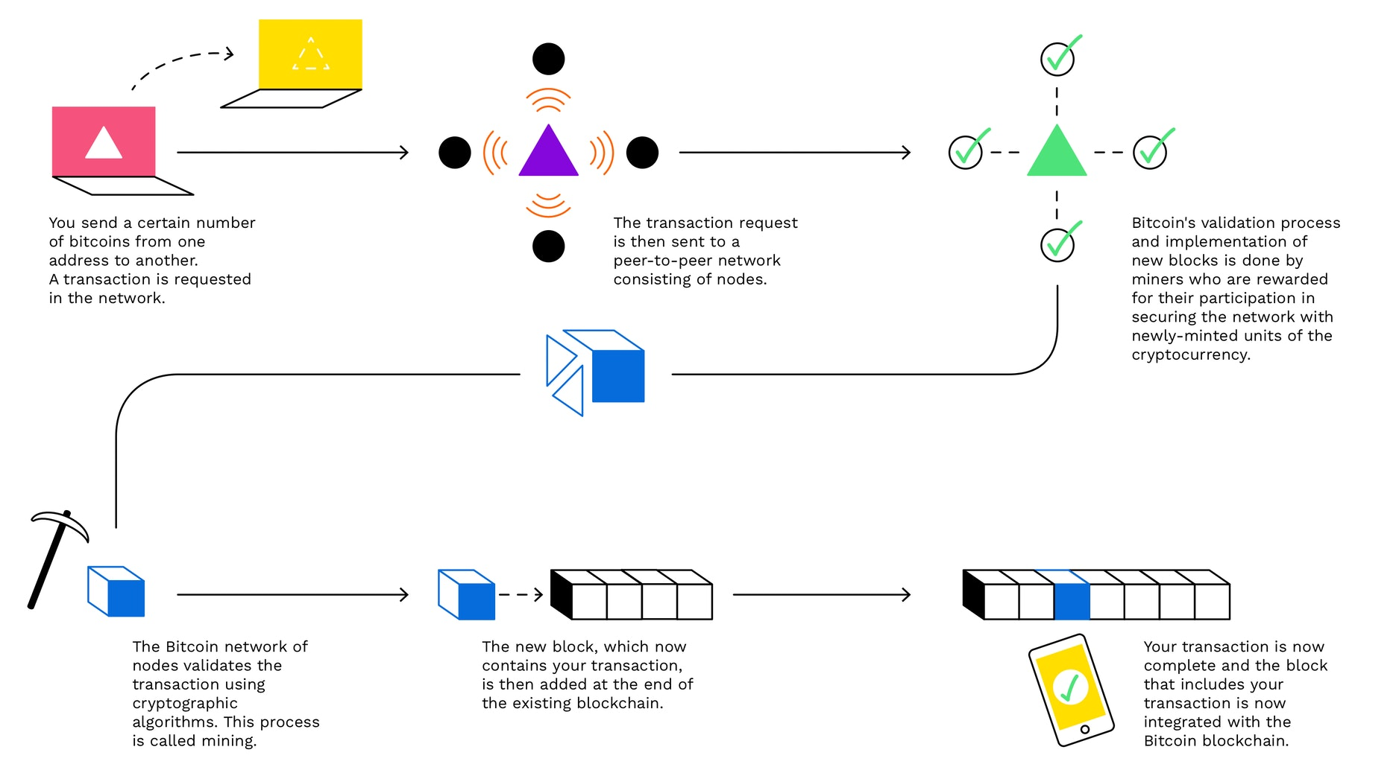
How does it work? Ex. Bitcoin

Slide 90
Consensus in BlockChain
A consensus mechanism enables the blockchain network to attain reliability and build a level of trust between different nodes, while ensuring security in the environment.
Proof of Work (PoW)
Proof of Stake (PoS)
Delegated Proof of Stake (DPoS)
Leased Proof of Stake (LPoS)
Direct Acyclic Graph (DAG)
Byzantine Fault Tolerance (BFT)
Practical Byzantine Fault Tolerance (PBFT)
Delegated Byzantine Fault Tolerance (DBFT)
Proof of Capacity (PoC)
Etc.

