Slide 1
MacroHard
Alister Lawson
Bruce Fernandes
Jamie Mano
Marek Bettzig
Nick Balgioni

Slide 2
Table of Contents
Game overview
Target Audience
Motivations
Game flow, Objectives
Key Features, with detailed requirement for each

Slide 3
Table of Contents cont.
Game interface, screens, and menus
Known issues/omissions
Feature prioritization
Non-functional requirements

Slide 4
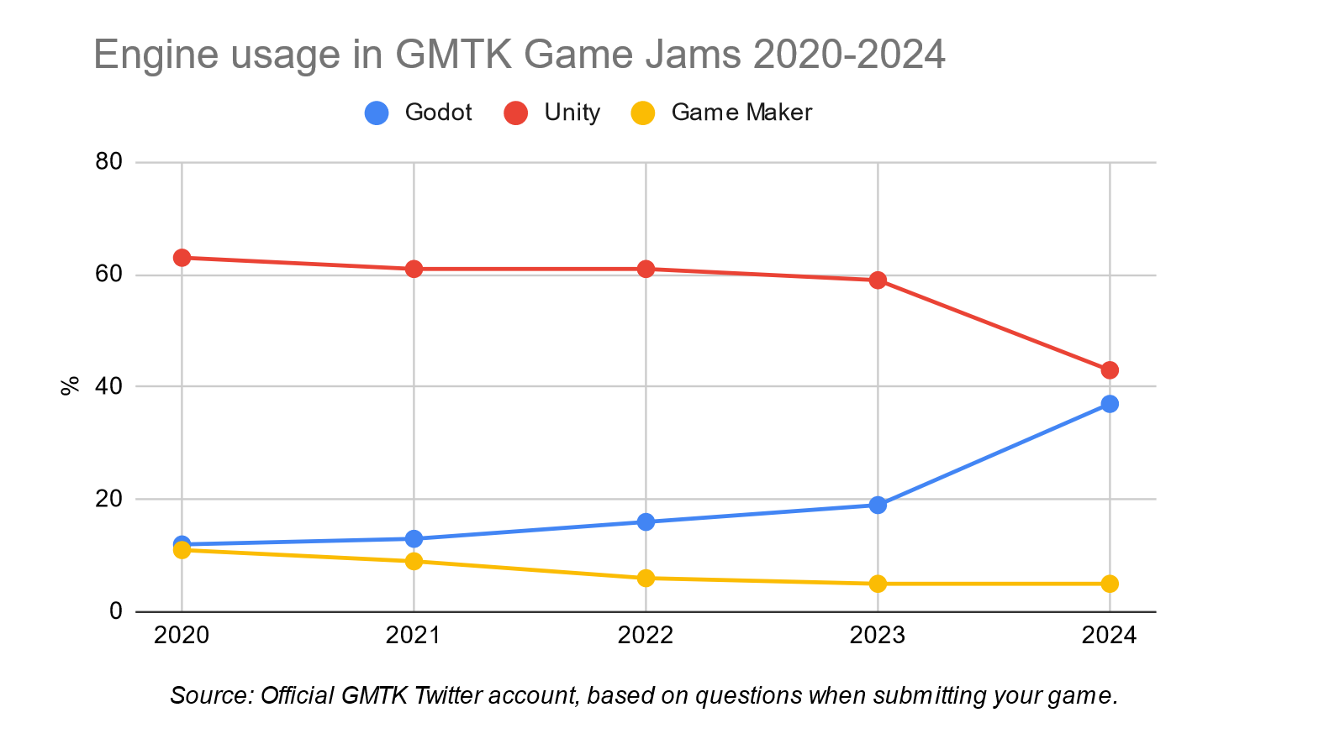
Overview: Why Godot? (Nick)
Godot Toolkit:
GDScript Language.
Node-based asset creation.
Git integration.
Resources for learning:
Built in documentation navigating.
Lack of immediate solutions online means implementation more thoroughly learned .
Market Growth:
Sizeable intrigue and growth in the hobbyist and indie developer communities (graph above).
Corporate Game studios also starting to show intrigue, largest I know of being Marvel Snap, which was the highest grossing digital card game in 2023, and announced its planned departure from Unity to Godot August 2024.^{2, 1.}

Slide 5
Overview: Gameplay & Loop (Nick)
Cyber Cyber City is a first person arcade simulation where players can enjoy classic-style games while earning tickets based on performance.
Some core features for the arcade include:
Ticket shop and arcade cabinets
NPCs (non-player characters)
High score leaderboards
Immersive sounds and music
Intuitive controls and game control manuals/explanations.
Physical interaction based UI elements
Basic Gameplay loop breakdown:
Player starts a new game, entering the arcade with a set amount of token.
Player uses tokens to play a arcade game, rewarding tickets.
Player uses tickets at the ticket/prize shop for rewards and unlocks.
Repeat until out of tokens.
Player can replenish tokens with specific token awarding minigame, events, or NPCs.

Slide 6
Overview: Player Objectives (Nick)
The over-arching objective for our players may be to try unlocking/collecting everything available at the ticket shop.
However, motivating players to just have fun and diversly explore/play all the games available is our objective as developers.
We've identified two variations on the base gameplay loop that achieve this:
Have the player unlock new arcade cabinets through the ticket store, or through other progression based means.
Or entice the player to try different games with something like bonuses for getting a certain high score for the first time on each cabinet.
Both variants have pros & cons, and can be explored with testing in the late stages of the project.

Slide 7
Overview: Target Audiences (Nick)
Two main audiences for this project:
The players(users) of the game itself,
The developers(clients) of the games featured within Cyber Cyber City.
For the players, CyberCyber City presents an opportunity to tap into 80s/90s/00s nostalgia, while enjoying some 'charming' takes on classic video games.
For developers, the arcade environment creates a space where rudimentary game projects can be hosted, highlighted, and recontextualized into a more appealing experience.

Slide 8
Overview: Motivations (why this project) (Nick)
Everyone in our group is interested in game development in some capacity.
The arcade project design offers a unique opportunity for member to experiment outside of the main branch of the project, working individually or in sub-groups.
Allows for increased scope modularity in case we end up with extra or limited development time.
Nostalgia focused projects and design aspects have become increasingly trendy, and are typically easier to implement.

Slide 9
Key features with requirements
Arcade Machines for the end user
Arcade Machines for game developers
NPCs
Audio and music
Ticket Shop/progression
Movement and controls
Arcade environment/map

Slide 10
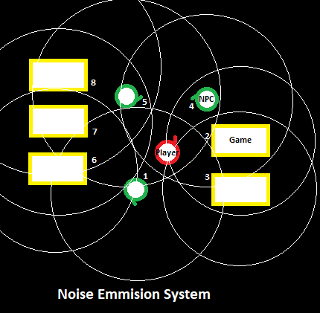
Enviromental Audio System (Nick)
Chaotic environmental sounds are a pivotal part of arcade experiences.
To replicate this, Cyber Cyber City uses a proximity based sound system.
Any noise emitting object within the scene will have a detection radius that plays sound louder as the player gets closer.
To keep this effect from becoming overwhelming/disorientating, only the absolute closest emitter of any given type can output at max (emulating sensory focus on a single object), and linear interpolation will be used to smooth out transitioning between sounds within the space.
If such environmental/directional audio system proves too much, we will use static ambience.

Slide 11
Arcade machines for end user
The Arcade machines will be a simple 3D cabinet.
The will be designed keeping in mind the 80's and 90's style.
Each cabinet will be interactable and will take you to the appropriate game.

Slide 12
Arcade machines for game developers
The Arcade machines will be a window to each game.
For every game there will be a different number of tokens used to play.
The score attained in each game will reflect a number of tokens paid out.

Slide 13
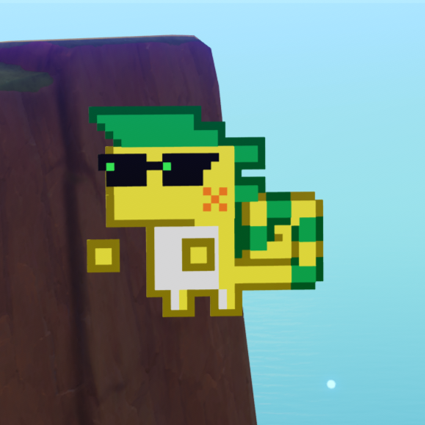
Non-Player Characters
The non-player Characters, Henceforth referred to as NPC's will be 2-D.
As shown below they will be in such a form but considering they will inhabit a 3-D world they will have a rotation mechanic.
NPC's will have a different purposes.
Shop, The shop will have a shop-keeper NPC to interact with who will sell items.
World, Regular world NPC's will congratulate you on a new high score or help you by donating a few tokens to you if you are too broke.

Slide 14
Non-functional Requirements (Nick)
Client/arcade cabinet game standards:
Games have and return a form of score keeping.
Adhere to a set size/memory limit (TBD)
Meet performance/optimization thresholds(TBD) on key variables as measured by the Godot Performance class.
System streamlining the implementation of Performance monitor and stress testing tools will be needed. Test Examples:
Testing how many enemies can be on screen at once.
Collision behavior at max speed
Game physics consistency at different frame rates
Other things to keep within consistent range:
Texture sizes, 3d model complexity, sound file sizes

Slide 15
Maps and Movement
The arcade itself is a 3D room filled with arcade machines.
The walls have collision so that users bump into them instead of walking through them.
Ambient sounds will play from the arcade machines and from the NPCs and jukebox.
Users are placed directly into the 3D environment.
The controls within the arcade will be WASD to move forward, back and strafe left and right with the mouse to look around and left click to interact.
There will also be an alternative control scheme for if the user has a controller connected.

Slide 16
Known issues/omissions
Actual interface of the booth is not yet defined.
What games are being implemented to the arcade.
Lack of visual power
Godot coding haven’t explored yet.
The group notes about blame, pull, and push on git.

Slide 17
Feature Prioritization
As assets are accessible online, there are still uncertainty to what elements are able to complete in just a 4-month duration are still a problem
Priority Features:
At least 3-4 games
A working booth for ticket exchange
Juke box
Game progress are saved
A workable arcade environment (3D)
NPCs

Slide 18
Feature Prioritization contd.
Secondary Features:
more NPCs that could interact,
more games,
3D arcade environment (this is being working progress already but a falldown for a 2D is applicable),
a good UX for the game and booth, and
higher detailed character visuals for games (the group was thinking of lower bit).

Slide 19
Feature Prioritization contd.
Stretch Features:
multiplayer
developers can add their games
rankings
more prizes
chat box

Slide 20
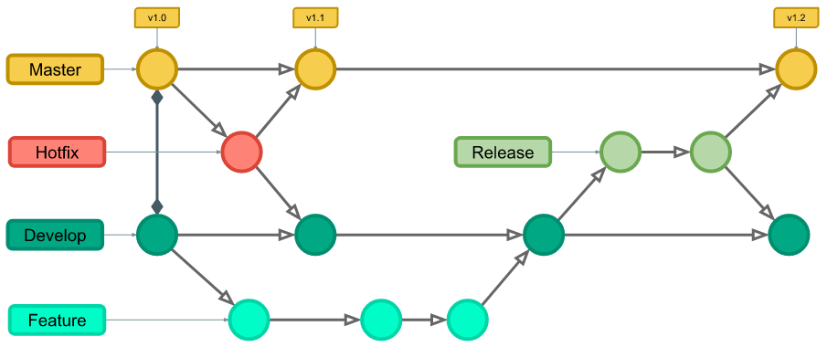
Branch Strategy(Version Control)
v2.0

Slide 21
Works Cited
Roeloffs, Mary Whitfill. "Marvel Snap Becomes Top-Grossing Digital Trading Card Game — Beating 'Yu-Gi-Oh!' And 'Magic: The Gathering Arena,' Forbes, Sept 1, 2023. Accessed Oct 1, 2024 at https://www.forbes.com/sites/maryroeloffs/2023/09/01/marvel-snap-becomes-top-grossing-digital-trading-card-game--beating-yu-gi-oh-and-magicthe-gathering-arena/
GameFromScratch.com.. "Marvel Snap Developer Moving to Godot Engine." August 7, 2024. Accessed Oct. 1 2024 at https://gamefromscratch.com/marvel-snap-developer-moving-to-godot-engine/#:~:text=studio%20behind%20the%20hit%20game,most%20ambitious%20Godot%20game%20yet.

