Slide 1
MacroHard
Alister Lawson
Bruce Fernandes
Jamie Mano
Marek Bettzig
Nick Biagioni

Slide 2
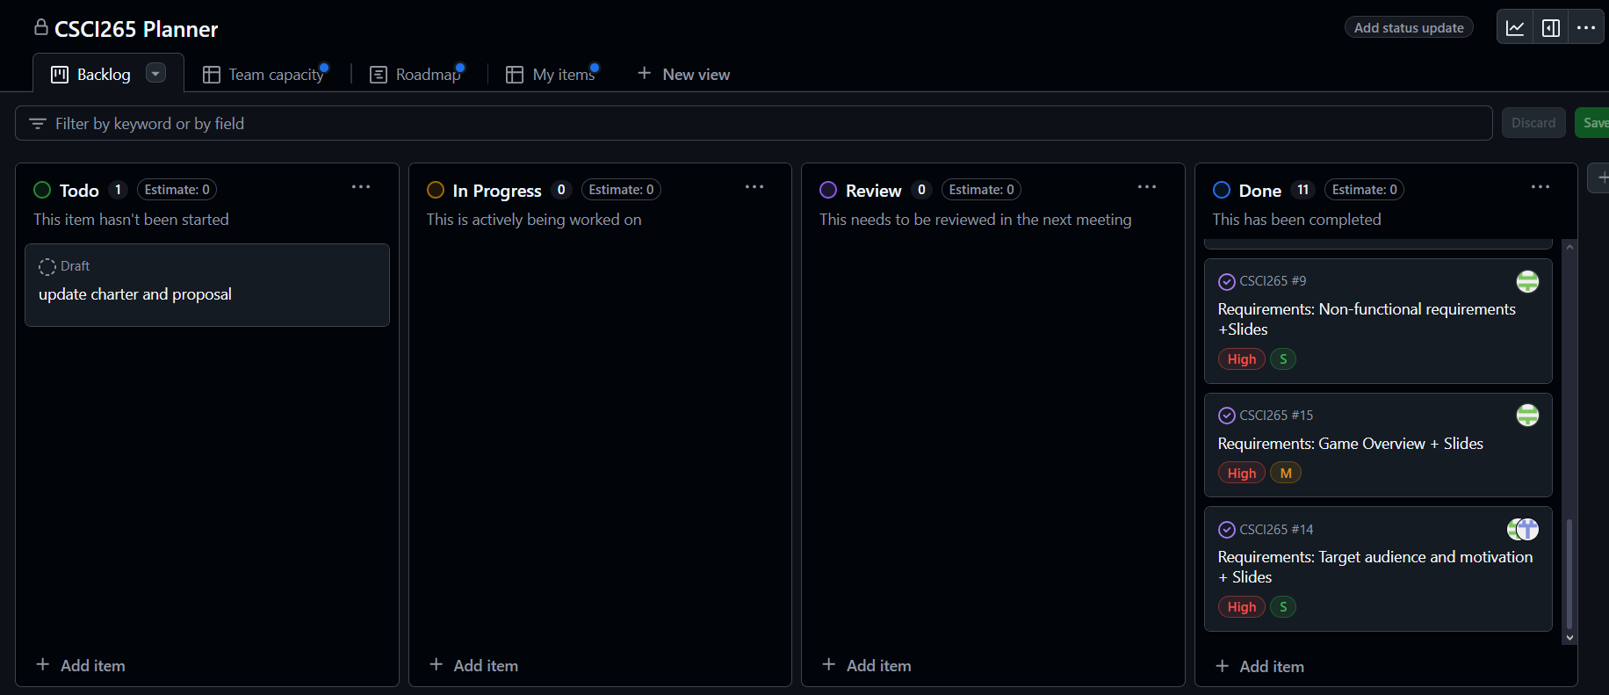
Project Update

Slide 3
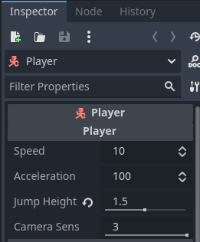
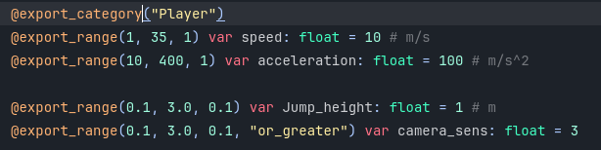
Addition to coding standards: Exported Properties
Labeled variables
Defines minimums and maximums
Don't have to open scripts
Can store most data types
Can store paths to nodes or files

Slide 4
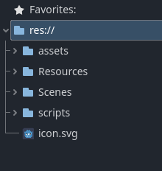
File Structure
Prototype sorted by file type
Instead of having all scripts, scenes, assets, and resources in their own folders for each game, we would be having all of those in their own folders for all games in the arcade.
Full version sorted by feature for easy version control and editing
Games stored externally but will go into detail later

Slide 5
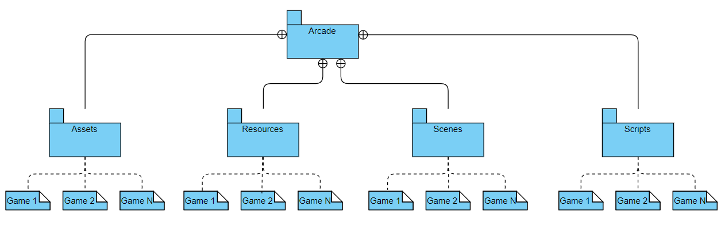
File Structure contd.
Graph of game structure
Prototype

Slide 6
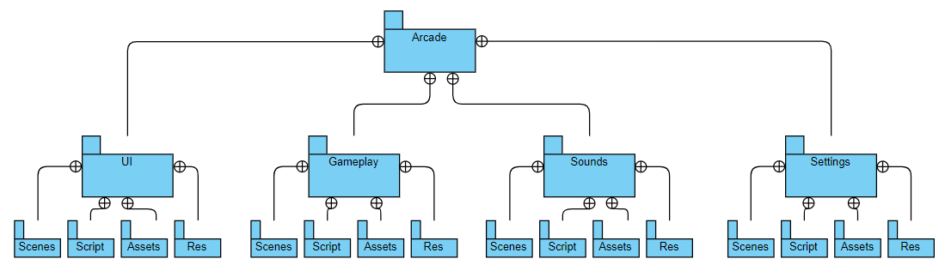
File Structure contd.
Graph of game structure
Full Version

Slide 7
Adding Games to the Arcade
External Folder Within the same directory as the main arcade executable
Folder will be scanned for assets to import upon launch of the main application
Arcade environment will be altered to accommodate new game machines
Documentation on what assets developers need to provide for their game to be automatically imported

Slide 8
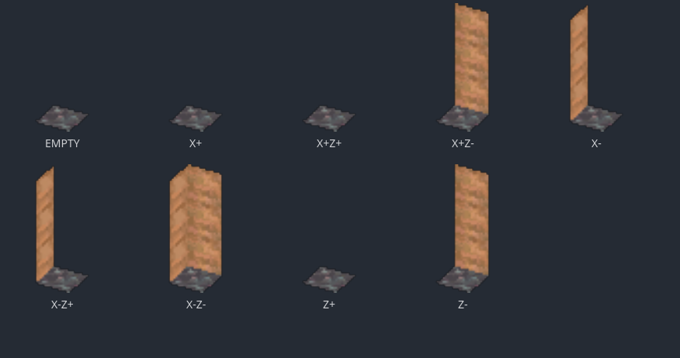
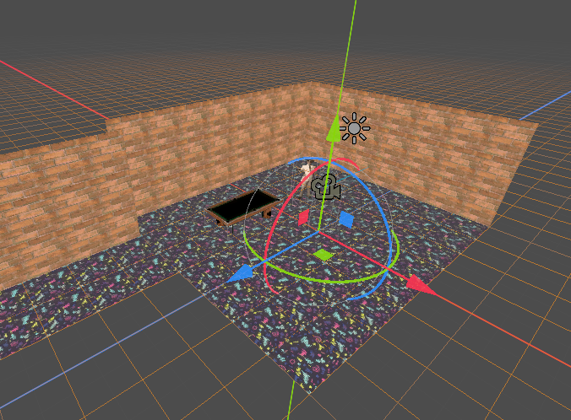
Automation of game importing
Generate floor layout as a matrix of positions, extending the floor plan as needed to accommodate all arcade games
Converting matrix to Godot's gridmap node to generate the arcade environment.
Importing arcade machine skins provided by developers and linking arcade machines to their respective games.

Slide 9
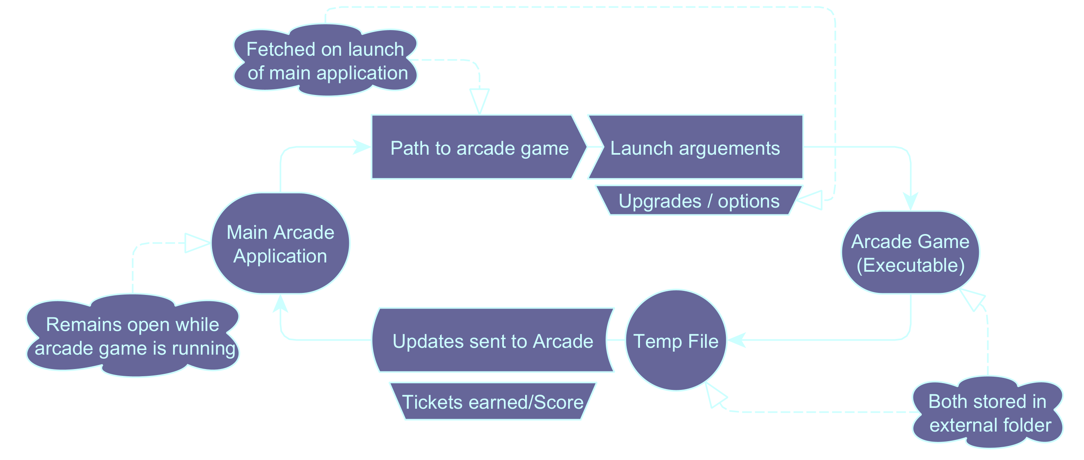

Slide 10
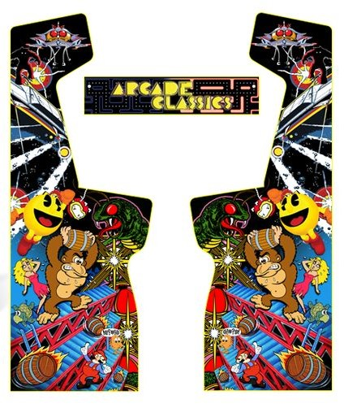
Dev Requirements
Score counter
Game executable
Box skin

Slide 11
Score
Lives
Token Cost

Slide 12
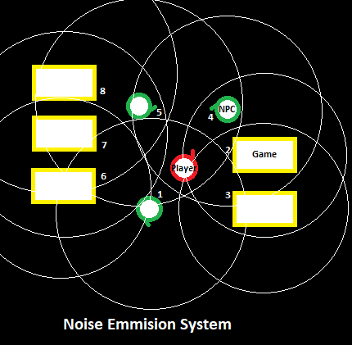
Video Preview + Audio System (Nick)
Incorporating video previews into the environment completely changes the scope/design of the audio system.
Ideally, we have multiple arcade machines playing previews on their screens, with synced SFX and music, all within the same environment at once.
Requiring optimization and culling functionality of some form.
Videos culled via proximity and/or player line of sight. (similar to initial system)
Culling could be lowering fps, resolution, or pausing/stopping preview.
The audio would follow the same logic as before: loudness scales with proximity, and only so many sound sources/emitters play at once.

Slide 13
Design Attempt 1: VideoStreamPlayer
Initially, I thought that Godot's VideoStreamPlayer class may have the required functionality to reach our ideal.
Unfortunately, that is not the case, as VideoStreamPlayer:
Lacks Fps or resolution downscaling functionality
Lacks playback functionality: no video seeking, no changing playback speed (Engine.time_scale won't work)
Only supports ogv video format and reported plays them poorly
The only functionality relevant to project are pause/play and volume
TO BE TESTED: use low resolution video, basic pause culling, proximity volume:
While unlikely, result may be within desired for environment and optimization.

Slide 14
Design Alternatives: Addons, Animations
Expand or replace video player via addons:
Gives access to expanded functionality. Namely, playback features
System where a lower fidelity version of videos can be called in at the same time position potentially possible.
Time position counter tied to audio. (prioritize audio sync over visual)
Potential Problems:
Undocumented errors and inconsistencies w/ addon
Optimization w/ stopping and loading video files at specific linked times (probably not great)
Another alternative: use built in animation player system.
How:
Record video previews at a low fps and resolution, creating a base video file.
Create an audio file from the video.
Use software to convert the frames of the video into ordered sprites.
Sync audio and animation in the player (if possible)
Pros:
Better culling functionality with animations
Probably most efficient
Cons:
A lot of potential manual work for each preview
May end up with non-synced audio implementation
Less work in this case

