Slide 1
Triple C ('Cyber' Cyber City)
team project for CSCI 265
team: MacroHard
members: Alister, Bruce, Jamie, Marek and Nick (Nate)
1st-Person 3D Immersive Arcade.
Classic 90's Style Arcade in a virtual land.
Tons of games!

Slide 2
Team strengths and weaknesses
Strengths
Nick and Alister are both good Godot programmers.
Bruce is a well-driven mathematical solver and is good at programming.
Alister and Marek is well programmer and organizational manager
Jamie has decent visual and artistic skills and is currently taking CSCI 310 alongside Marek
Weaknesses
not everyone has decent experience in game development or Godot
lacking of artistic power
Communication

Slide 3
Preliminary roles
Alister:
game design head
programmer
version control
Bruce:
programming head
Jamie:
visual lead
user interface
Nick:
programmer
Godot lead
Marek:
programmer
project organization

Slide 4
Meetings and conflict resolution
Group meetings are twice a week
one for talking about the current status of the project, assignments, presantation
one for focus on programming, Godot, assets
To resolve conflicts in regards of the design Alister can overrule the group unless the rest of the group agrees on something else

Slide 5
AI Policy
None of the projects code or assets are to be generated with AI.
Using AI for non-generative purposes, investigatory, learning, etc., is each individuals prerogative.

Slide 6
The Concept
A simulation of an immersive 90's Arcade Experience
Interactive features including:
-Arcade Machines
-Non-player Arcade-goers
-Ticket store to buy neat things
●
●

Slide 7
Target Audience
Players who want to go to an arcade but there are none nearby
Anyone Curious about history
Players who are nostalgic for the 90s
–
–
–
●
●
●

Slide 8
Movement and Playing
simple WASD movement, F to interact
●
●
Interaction will be with arcade machines and games
You will be able to gain tickets from winning games
You will be able to spend tickets on unlocking new games and powerups or you can accumulate tickets to be the highest on the leaderboard
●
●

Slide 9
Sound
We hope for headphones to make it a more immersive experience
There will be background music for the arcade keeping in mind the 90's
Each game will be having it's own music and ambient sound
Our music will be designed by Nate with help from Bruce
Nate is doing a course in audio development and so is collaborating with our group for his project
●
●
●
●
●

Slide 10
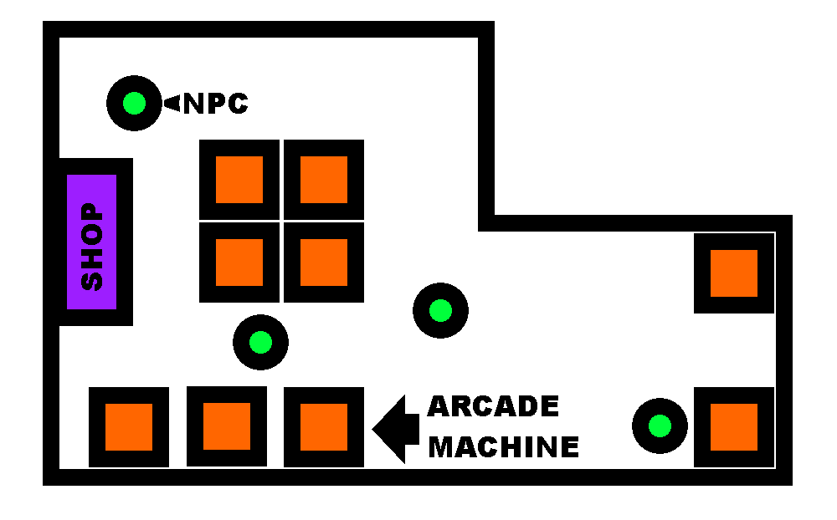
Map
The arcade machines, ticket shop booth, other games (if have time), and NPCs are shown on the map.
It is basically a floor plan of the arcade itself.
●
●

Slide 11
Scaling options
Implement a 2D hub world in which the player may control a character from a top-down view (if implementation of a 3D world fails)
Increase or decrease the number of games in the arcade
Add features to the hubworld
Implimentation of NPCs
Add gameplay-loop by providing different uses for the tickets

Slide 12
Risks and Potential Issues
The scope for making a 3D environment is quite large for a 4-month development cycle, specifically the time needed for the visual and audio design.
Integrating separate instances of game scenes into our main arcade environment, introduces extra layers of complexity and potential for bugs.
Keeping team members on track with so many different types of work/tasks.
Balancing work on the arcade game projects and the main arcade environment, and figuring out how to evaluate contribution.
General inexperience within the team with game development and team organizing/planning.

