Slide 1
B.A.D.A.S.S.
Bluetooth-Assisted Device Aid & Search Service

Slide 2
Members
Jasmine Bascom
Chloe Pradeau
Adam Tammariello
Mark Wilmes

Slide 3
Motivation
During natural disasters cell phone towers are often destroyed, down, or overloaded
Wanted to create an app that allows users to communicate during disasters without relying on cell phone towers or wifi
Allows for coordination of rescue services without cellular infrastructure
Implemented via bluetooth chaining

Slide 4
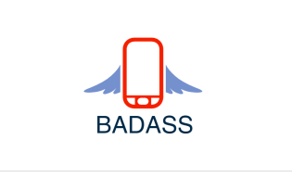

Slide 5
Tools
Agile Methodology
Trello
GitHub
MySQL
Flask
Apache
Android Studio IDE
Espresso Testing Framework (part of Android Studio)

Slide 6
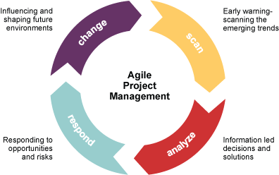
Agile Methodology
Purpose: Agile is used to help teams stay on task and accountable for goals while also creating more flexibility than older methods of project management
Our Rating: 3.5/5
Notes:
Agile has a lot of advantages, but it was really difficult for us to implement it properly because we weren’t meeting daily, and we didn’t have a scrum master to guide us through the process. We also only had a few sprints and so there wasn’t much potential for improving methodology from sprint to sprint.

Slide 7
Trello
Purpose: Trello is a board for keeping track of tasks. It allows tasks to be assigned to users with certain deadlines and other attributes. Tasks can be moved between columns that state whether the task is in the backlog, to-do in the current sprint, in progress, done, or released.
Our Rating: 4/5
Notes:
Trello is easy to use and effective for keeping track of tasks.

Slide 8
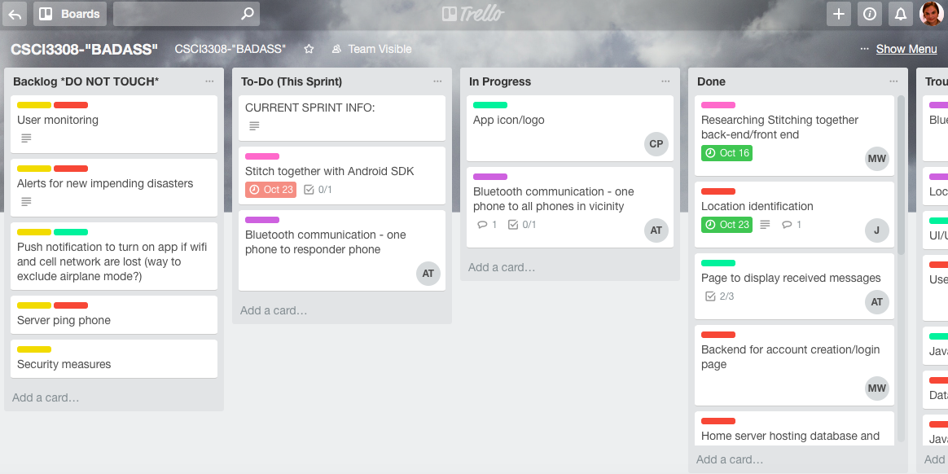

Slide 9

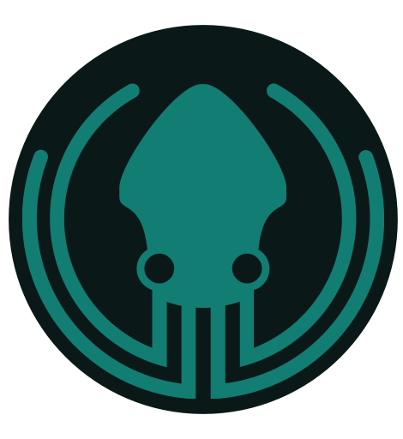
GitHub
Purpose: GitHub is a VCS repository that is widely used by developers to share code for projects. It allows multiple people to work on the same code.
Our Rating: 5/5 (especially GitKraken)
Notes:
GitHub is easy to use (especially if paired with GitKraken) and allows for effective version control.

Slide 10
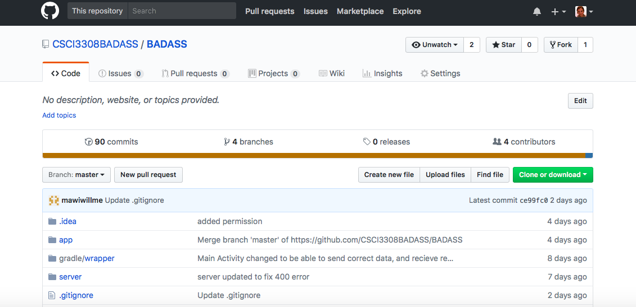

Slide 11
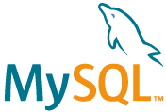
MySQL
Purpose: MySQL is an open-source relational database management system using Structured Query Language.
Our Rating: 4/5
Notes:
MySQL is easy to use but very insecure.

Slide 12

Flask
Purpose: Flask is used as a python backend server to handle restful requests, and perform server side actions.
Our Rating: 2.5/5
Notes:
Flask is easy to program and test, but deploying it to a server is extremely hard and time consuming.

Slide 13
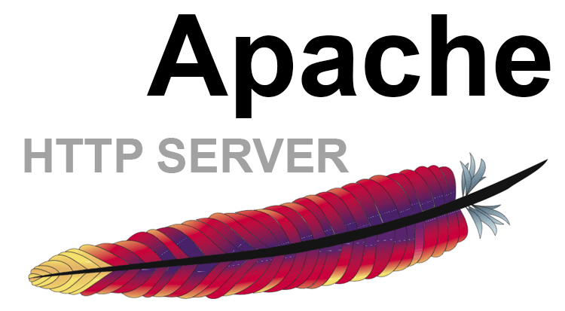
Apache
Purpose: Acts as a request handler that handles incoming requests to a server, and forwards those requests to the server application.
Our Rating: 4.5/5
Notes:
Very reliable request handler, but configuring it can be hard.

Slide 14
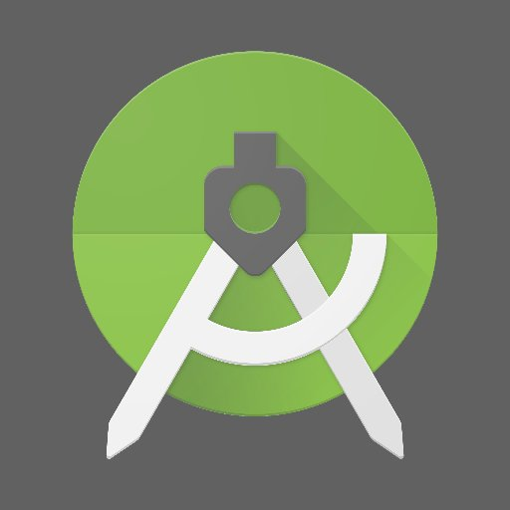
Android Studio
Purpose: Android studio SDK is used as the main IDE for creating an android application. Here we could tie the database into our application for user authentication, create the main bluetooth chat activity, and create a well designed XML layout for the different pages of the application.
Our Rating: 2.5/5
Notes:
The number of libraries, coupled with a handy XML designer makes it very useful. However, the system requirements as well as limitations in the emulator make it hard to work with in a team format.

Slide 15
Espresso (Android Studio)
Purpose: Espresso is a testing framework that comes integrated with the Android Studio IDE. It allows the user to write Unit Tests and then run them, all in the same environment.
Our Rating: 4/5
Notes:
Espresso is pretty easy to use, and having it integrated with our IDE was great. None of us had a lot of experience with testing software, so it was hard to evaluate this tool as compared to others that might be out there.

Slide 16
Challenges
Computer Problems
Time Management
Software Development
Scheduling Meetings

Slide 17
Live Demo!

