Slide 1
Jungle Break
Presentation Slides
Team C
Brian Warner, Eric Ausland, Taylor Dragoo, Demarcus Jackson & Elisha Schultz

Slide 2

Who does Jungle Break benefit?
Restaurant Businesses
Staff
Managers
Owners
& Customers

Slide 3

What does Jungle Break do?
Improve time management
Increase communication among workers
Rise in customer satisfaction
Expand inventory accuracy
Decrease in expenses
Profit growth

Slide 4
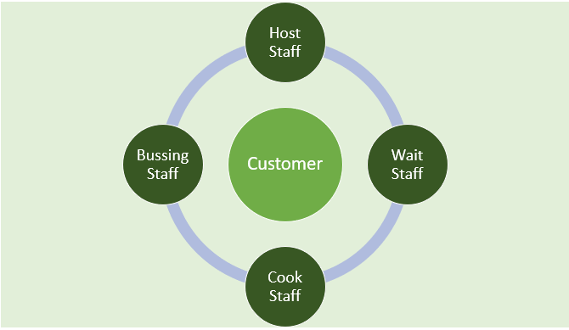
How does it work? (Example: Customer visit)
Host Staff quickly seats customer
Update table to occupied
Wait Staff alerted & takes order.
Submits to kitchen
Cook Staff makes order
Reports meal is ready
Bussing Staff looks for dirty tables to clean
Updates system for Host

Slide 5

Jungle Break Timeline
Present Demo #1
Fix major issues &complete Report #3 – Part 1
Fix minor issues &complete Report #3 – Part 2
Finalize Demo #2
1
2
3
4
10/26
---------
11/23
11/2
----------
11/30
11/9
----------
12/7
11/16
11/23
5
6
7
8
Present Demo #2
Demonstration of Finish Product

