Slide 1
Authorship Attribution for Small Documents
By Robert Smith, Miles Baer, William Cope, Nathaniel Boyer, Charles Johnson

Slide 2
Text Processing for Small Documents
Neural Networks are generally good at Classification Problems
There is a rise of text that is Limited in size
Twitter
Email
Facebook
Online Reviews
Inspiration for Project
http://cs.uh.edu/~prasha/papers/cnn-aa-short.pdf

Slide 3
Encoding Methods
Word2Vec
https://arxiv.org/pdf/1411.2738.pdf
Doc2Vec
https://cs.stanford.edu/~quocle/paragraph_vector.pdf
Our Custom Method
Reversing the Input Text
Removing Punctuation

Slide 4
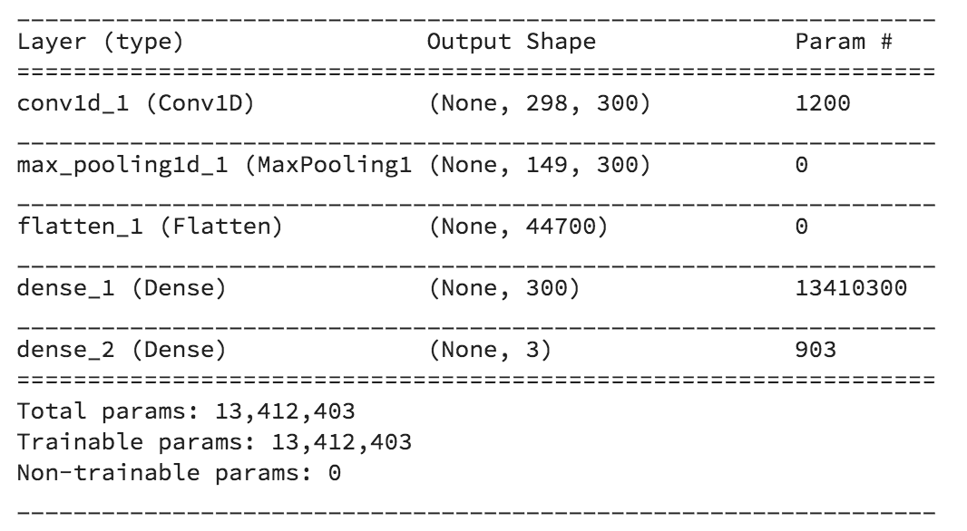
Neural Networks used in the Project
CNN
L1,L2 Regularizers
MaxPooling1D
Flatten
Dense
Flatten

Slide 5
Dataset and Sampling
53,000+ Reviews for Office Supplies
Author Training Size
3
35
500
5000
Normal Sampling vs Oversampling

Slide 6
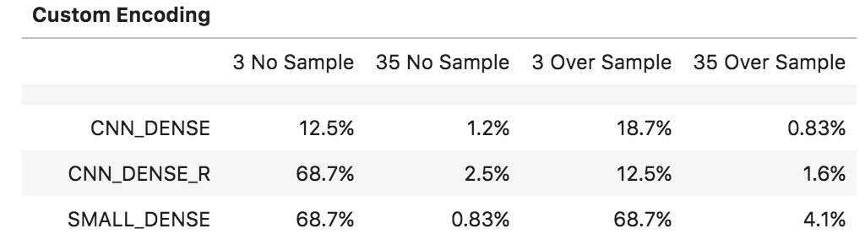
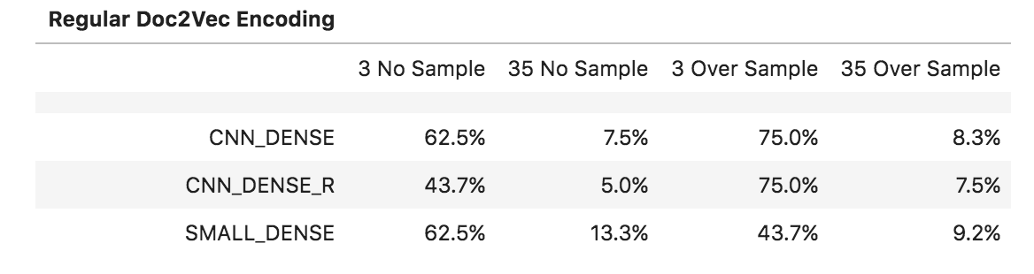
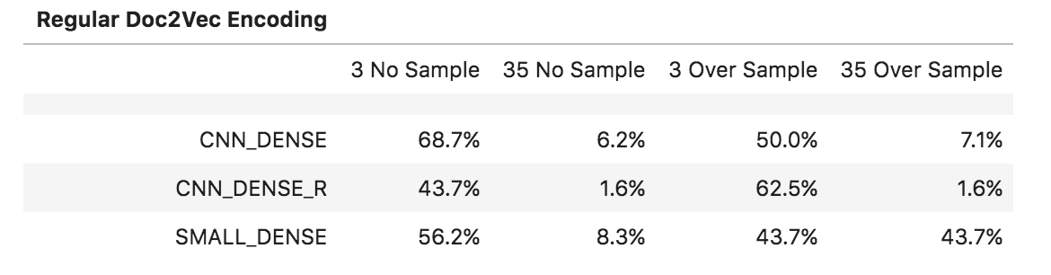
Results

Slide 7
Results Cont…

Slide 8
Conclusion
Mostly Unsuccessful
Doc2Vec
Performed the Best (3 Authors, normal encoding)
Custom Encoding
Performed the Worst
Overfitting was Prevalent
Small Number of Epochs Needed

Slide 9
Future Works
Explore the Method used in the previously Mention Paper
Embedding Layer
Concatenated CNNs (filters = [3,4,5])
Softmax Layer
Mess Around with Punctuation
More Even Data Distribution
More Reviews per Author

Slide 10
Questions?

