Slide 1
Authorship Attribution for Small Documents
By Robert Smith, Miles Baer, William Cope, Nathaniel Boyer, Charles Johnson

Slide 2
Text Processing for Small Documents
Neural Networks are generally good at Classification Problems
There is a rise of text that is Limited in size
Twitter
Email
Facebook
Online Reviews
Inspiration for Project
Convolutional Neural Networks for Authorship Attribution of Short Texts ( Shrestha et. Al)

Slide 3
Encoding Methods & Preprocessing
ENCODINGS
Preprocessing
Word2Vec
Efficient Estimation of Word Representations in Vector Space
Tomas Mikolov, Kai Chen, Greg Corrado, Jeffrey Dean
Doc2Vec
Distributed Representations of Sentences and Documents
Le, Quoc and Mikolov, T.
Our Custom Method
Simple Sum of Word2Vec representations generated with spaCy and genism
Reversed the Input Text
Non-reversed Input Text
Removing Punctuation

Slide 4
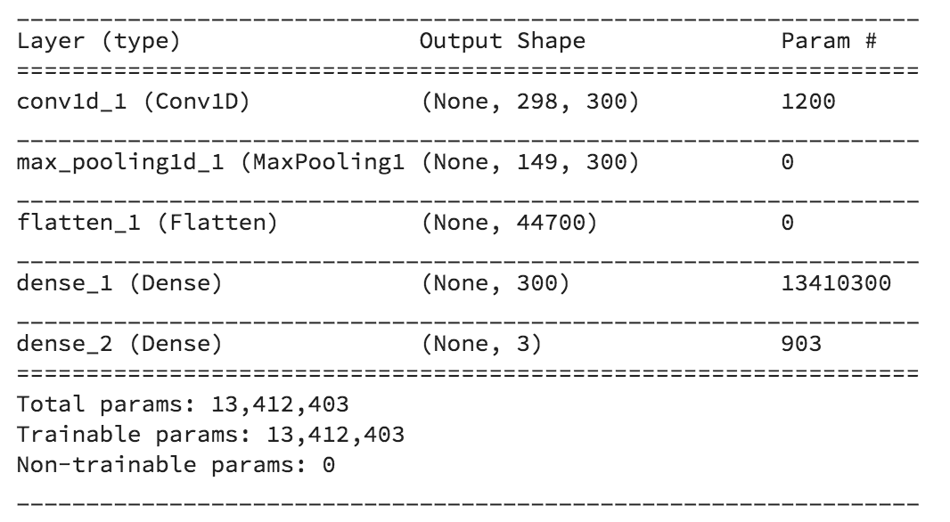
Neural Networks used in the Project
CNN
L1,L2 Regularizers
MaxPooling1D
Flatten
Dense
Flatten

Slide 5
Dataset and Sampling
53,000+ Reviews for Office Supplies
Author Training Size
3
35
500
5000
Normal Sampling vs Oversampling
Using 3 times the training data

Slide 6
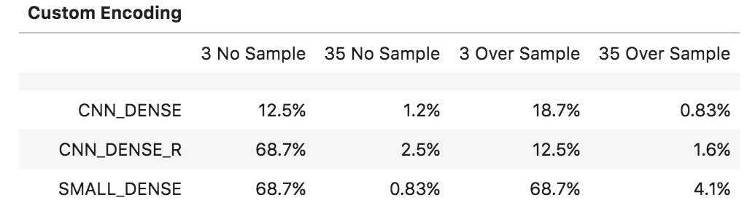
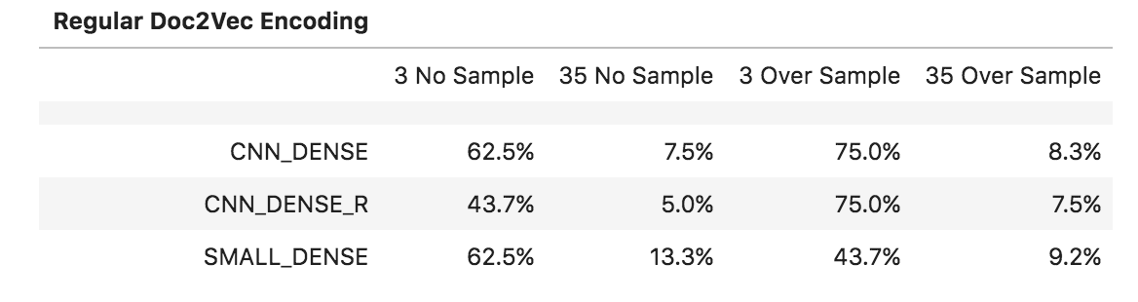
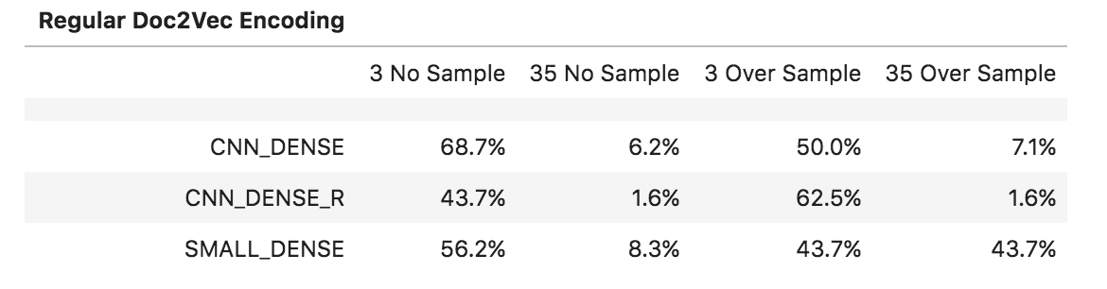
Results

Slide 7
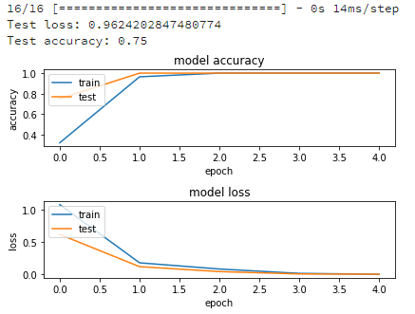
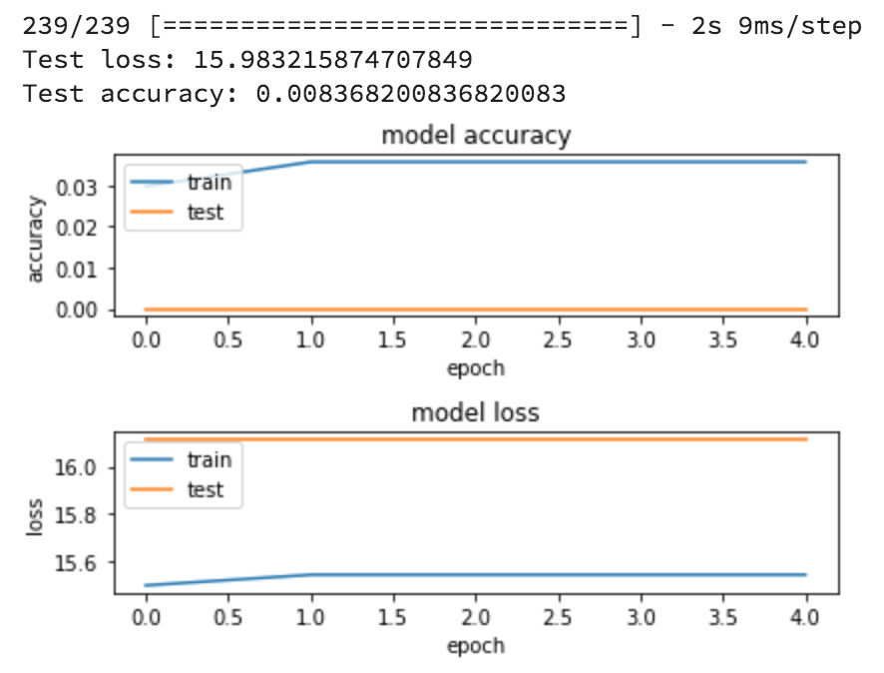
Results Cont…
Regular Doc2Vec Encoding
Using duplicate data helped network learn authors better
Reversed Doc2Vec Encoding
Each sentence was reversed before encoding
Poor performance when oversampling was used
Custom Encoding
Best results when only 3 authors and normal sample size

Slide 8
Conclusion
Mostly Unsuccessful
Doc2Vec
Performed the Best (3 Authors, normal encoding)
Custom Encoding
Performed the Worst
Overfitting was Prevalent
Small Number of Epochs Needed

Slide 9
Future Works
Explore the Method used in the previously Mention Paper
Embedding Layer
Concatenated CNNs (filters = [3,4,5])
Filters are window/kernel sizes (it will form a numerical representation over n number of words, characters, etc.)
Softmax Layer
Change Activation Methods
Change Loss Metric
Adjust Learning Rate
Mess Around with Punctuation
Use punctuation as individual “words”
More Even Data Distribution
More Reviews per Author

Slide 10
Questions?

Slide 11
References
Le, Q. and Mikolov, T., 2014, January. Distributed representations of sentences and documents. In International Conference on Machine Learning (pp. 1188-1196).
Tomas Mikolov, Kai Chen, Greg Corrado, and Jeffrey Dean. Efficient Estimation of Word Representations in Vector Space. In Proceedings of Workshop at ICLR, 2013.
Shrestha, P., Sierra, S., Gonzalez, F., Montes, M., Rosso, P. and Solorio, T., 2017. Convolutional neural networks for authorship attribution of short texts. In Proceedings of the 15th Conference of the European Chapter of the Association for Computational Linguistics: Volume 2, Short Papers (Vol. 2, pp. 669-674).

