Slide 1
Playing poker using neural networks
Delkhaz Ibrahimi
Loraina Lampley
Brandon Lowery
Jeremy Watts

Slide 2
The objective
Our goal was to train two different kinds of neural networks to classify poker hands and test which kind of neural net is superior for the task.
Feed-Forward vs Convolutional
In order to play poker, an agent must be able to recognize the hand that it has, otherwise it will be making poor choices.
We wanted to make a driver that would allow a human user to play a simple 5-card draw game against the superior neural network.
We predicted that a feed forward neural network would out-perform the convolutional neural net.

Slide 3
Data set
“Poker Hand Dataset” from UCI Machine Learning Repository
http://archive.ics.uci.edu/ml/datasets/Poker+Hand
A simple but robust data set that captures every possible permutation of a given 5 card hand (there are 480 possible Royal Flush hands as compared to 4)
Cited to be a challenging data set for classification algorithms

Slide 4
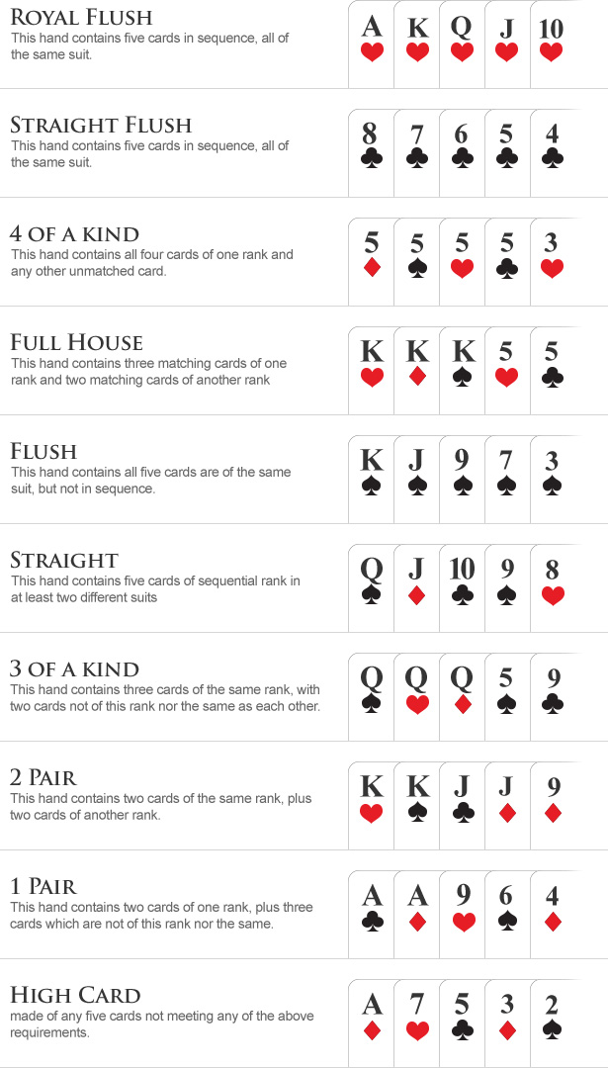
Poker hands
Source: www.wsop.com/poker-hands

Slide 5
True odds
Royal Flush: 0.000154%
Straight Flush: 0.00139%
Four of a Kind: 0.0240%
Full House: 0.1441%
Flush: 0.1965%
Straight: 0.3925%
Three of a Kind: 2.1128%
Two Pair: 4.7539%
One Pair: 42.2579%
High Card: 50.1177%
Differs from the training and data set.
Straight Flush & Royal Flush is oversampled in training (14 and 129 times more likely respectively)
Cumulative prob. above 1 pair is 7.62%

Slide 6
Project motivations
The idea of using a neural network to play a game is engaging
Poker is a straightforward game to understand and play
Poker provides a challenging task for traditional classification algorithms that seems well-suited for a neural network to solve
The reason is because the poker data set is “imbalanced” to favor lower ranked hands
Our team wanted to find out if a convolutional neural net could successfully compete in this task against a traditional feed forward net

Slide 7
Why use a neural network?
Saves time thinking of and implementing an appropriate classification algorithm to exhaust all possibilities of a hand
Given a good enough classifier, the same neural network can be used for more than one variant of poker
The same network can also be used for multiple different drivers as long as the software supports the same framework (i.e. Keras)
If the goal is to make a poker-playing agent that acts like a human, then it would be most accurate to have an agent that does not perfectly classify the hands that are presented (mis-read)

Slide 8

Lol just code it explicitly

Slide 9
No

Slide 10
Key aims
Develop and train the two distinct neural networks
Run a sample of 1000 games between the two of them
Determine which of the neural networks is superior from this data
Develop an interactive demonstration to pit a human player against the superior neural network.

Slide 11
strategy
Jeremy and Delkhaz went to work preparing the neural networks, training them and testing them
Brandon constructed a driver program on top of a Python poker library called “Treys”
This library allowed for “pretty printing” the suits of the hand and an evaluation mechanism to determine who wins
Loraina kept in contact with the team and began working on the paper to collate and publish the results

Slide 12
results
A convolutional neural network and a feedforward neural network were produced with comparable accuracy (96% vs 98%)
A finished driver was created that could test the two networks to find the “real world” difference between the two given their difference in accurately classifying a presented poker hand
Additionally, a human player can interact and play against the Neural Network
The result of this testing seemed to reinforce the original hypothesis that the feed forward neural network would be superior (FF wins 52.1% of the time)
The methodology of the experiment with the corresponding results were published in the paper.

Slide 13
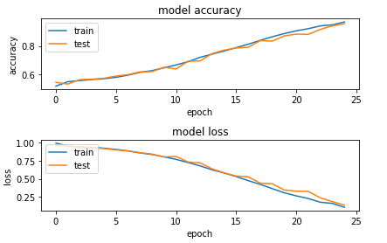
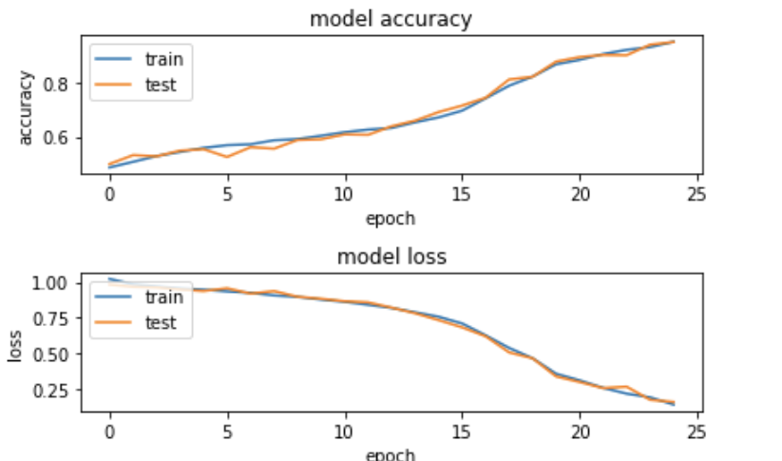

ResultS
Feed-forward
Convolutional

Slide 14
contributions

Slide 15
demo

