Slide 1
Playing poker using neural networks
Delkhaz Ibrahimi
Loraina Lampley
Brandon Lowery
Jeremy Watts

Slide 2
Data set
“Poker Hand Dataset” from UCI Machine Learning Repo
http://archive.ics.uci.edu/ml/datasets/Poker+Hand
A simple but robust data set that captures every possible permutation of a given 5 card hand (there are 480 possible Royal Flush hands as compared to 4)
Found to be a challenging data set for classification algorithms

Slide 3
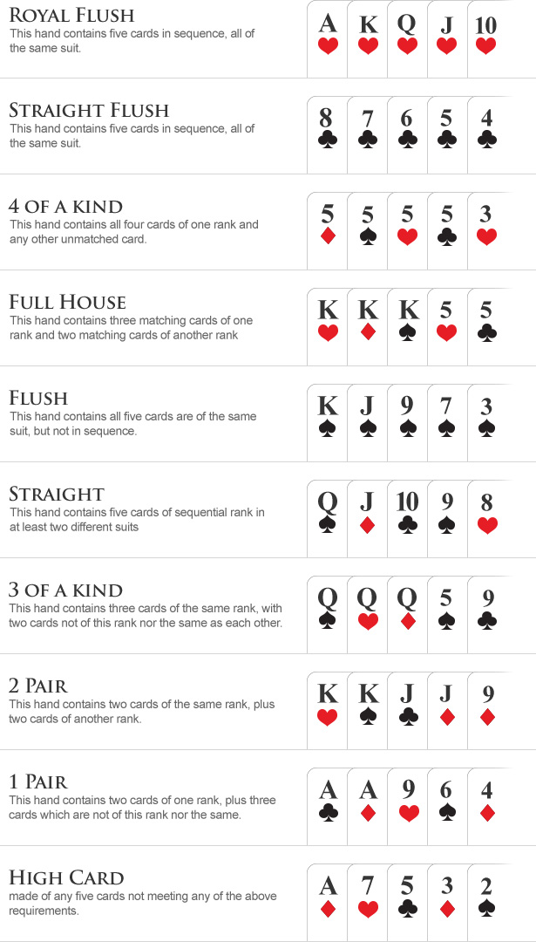
Poker hands
Source: www.wsop.com/poker-hands

Slide 4
True odds
Royal Flush: 0.000154%
Straight Flush: 0.00139%
Four of a Kind: 0.0240%
Full House: 0.1441%
Flush: 0.1965%
Straight: 0.3925%
Three of a Kind: 2.1128%
Two Pair: 4.7539%
One Pair: 42.2579%
High Card: 50.1177%
Differs from the training and data set.
Straight Flush & Royal Flush is oversampled in training (14 and 129 times more likely respectively)
Cumulative prob. above 1 pair is 7.62%

Slide 5
Project motivations
The idea of using a neural network to play a game is fun
Poker is an easy game to understand and play
Poker provides a challenging task for traditional classification algorithms that seems well-suited for a neural network to solve

Slide 6
Why use a neural network?
Saves time thinking of and implementing an appropriate classification algorithm
Given a good enough classifier, the same neural network can be used for more than one variant of poker
The same network can also be used for multiple different drivers as long as the software supports the same framework (i.e. Keras)

Slide 7
Key aims

Slide 8
strategy

Slide 9
contributions

Slide 10
demo

