Slide 1
Galaga Net
Neocognitron TeaM

Slide 2

The Neocognitron Team
Chris Gerspacher
cag7a@mtmail.mtsu.edu
https://github.com/cag7a
Cameron Justice
cj4g@mtmail.mtsu.edu
https://github.com/cameron-justice
Ian Seal
ins2c@mtmail.mtsu.edu
https://github.com/masturffect
Jonathan Gregory
https://github.com/vat880
Justin Wade
jww5f@mtmail.mtsu.edu
https://github.com/JustinWade
Nathan Byrnes
ndb3w@mtmail.mtsu.edu
https://github.com/NathanByrnes

Slide 3
Introduction

Slide 4
Motivations & Key Aims

Slide 5
General strategy
address those project aims (include technical details when needed, but remember that you should spend more time talking about what you accomplished with your software than the software itself).

Slide 6
Questions?

Slide 7

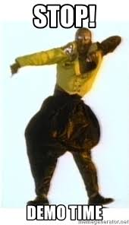
DEMO

