Slide 1

Leabra
Of human motion and excersise

Slide 2
Members & Contributions
Research Origin & Leader:
Matthew Schroder
Data Collection & Processing:
Bradley Carter
Chris Sutton
Network Training & media demo:
Justin Cao
Sean Gately
Notes:
Before explaining our project I will briefly introduce our members and what key roles and contributions each participated in.
While we all collaborated on everything as our project changed vastly over the course, we generally broke in this these roles.
As you you can see the origin of our idea came from Matthew so he served as leader.
With Chris and Brad being in charge mostly of Data collection and Processing
And Networking Management and compilation were left up to justin(Me) and Sean

Slide 3
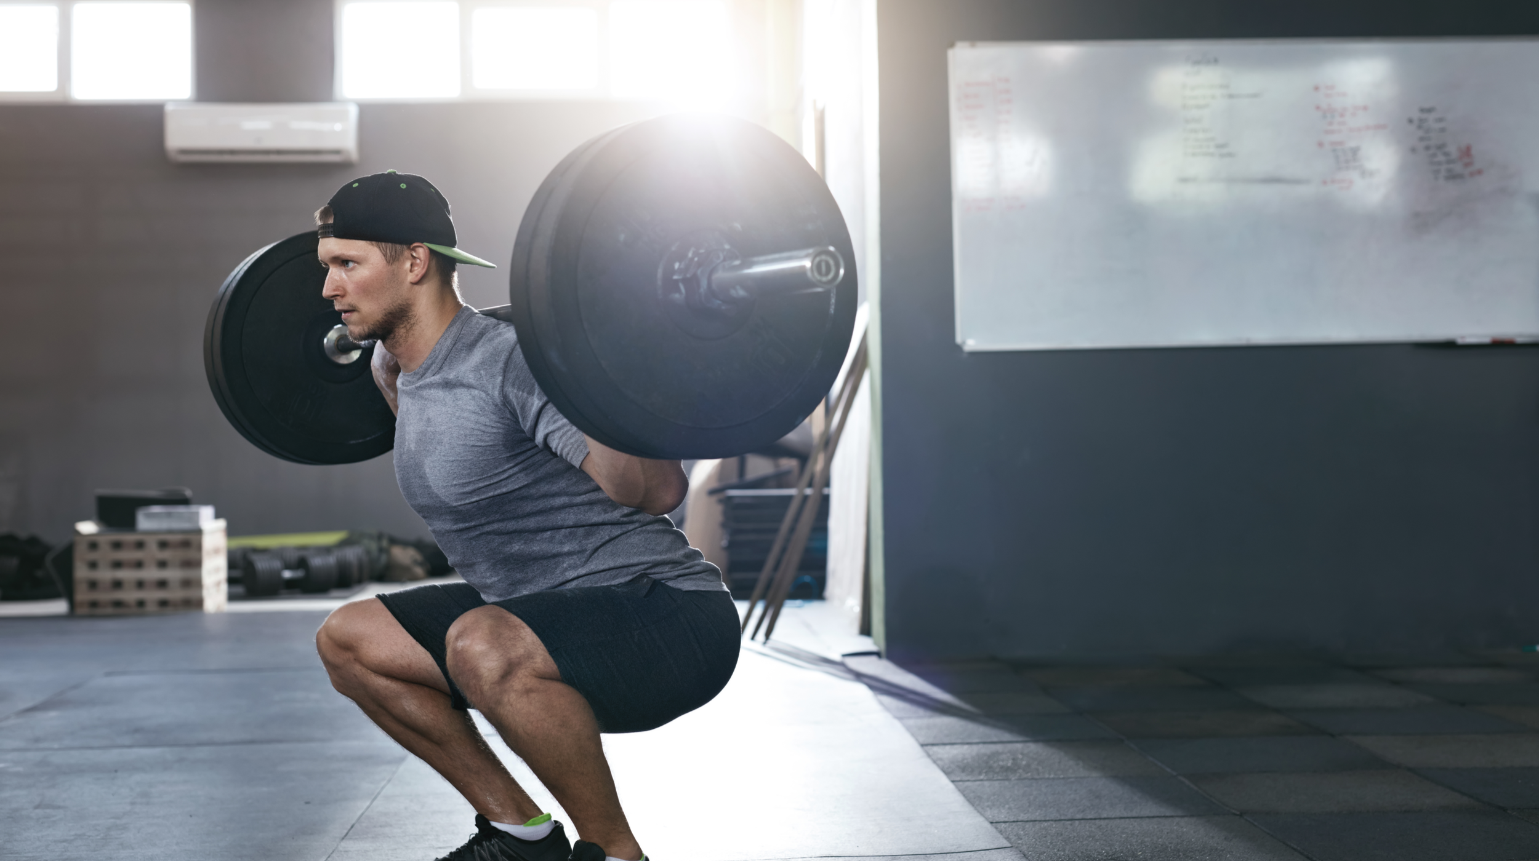
The Idea
Live or Static data input
Feed forward Network
Squat Detection
Squat Performance
Form
Technique
Notes:
As you can see by the image our research has to do with exercise.
In particularly the squat.
The idea was for us to develop a neural network that can
Accept live such as images or videos from a webcam
Or static images such as from google
And for our network to determine not only if the exercise in question was a squat
But also the performance of the said squad for example judge the form or techinque

Slide 4
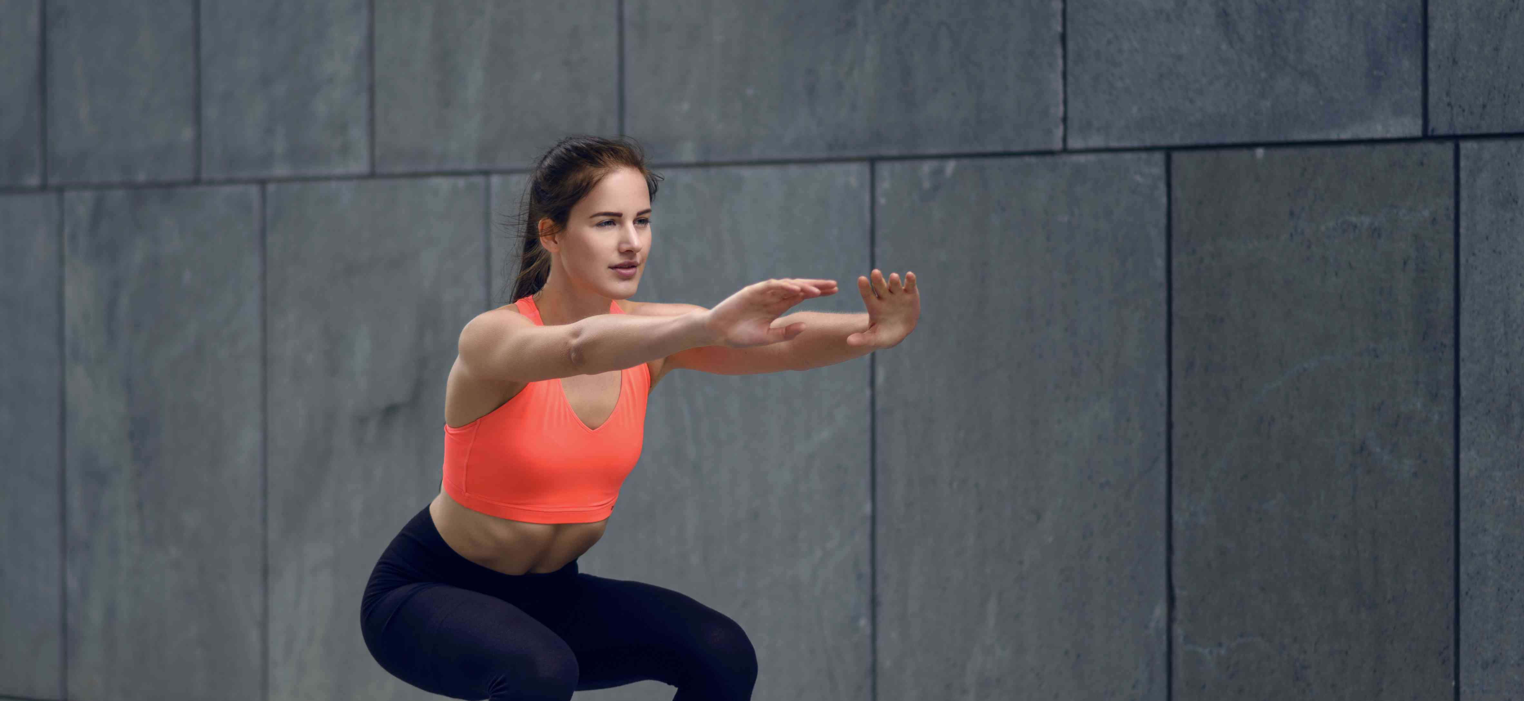
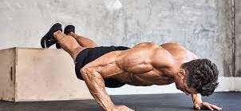
Data Collection
Image Scrapper
Google Images
Categorize Images
Reformat Images
Reshape to NumPy Arrays
Notes:
To begin our process we first needed an input.
A collection of images.
To achieve that we used a data scrapper in conjunction with google images to get our data set
Images were then split into two categories good squats and non squats
Reshape to be used in Numpy arrays for our network

Slide 5
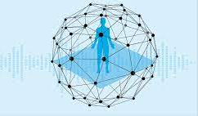
The Network
Convolutional Neural Network (CNN)
Excel for image data inputs
Reusability
Ideal for classifications and prediction problems
Notes:
Without going to much into the architecture of this network as that is all in our demo
We will be explain the pros and why we choose a convolutional neural network
CNNs excel for image data inputs
As They Preserve the spatial relationship between pixels, features and weights.
Reusability is key
They are also ideal for classifications and prediction problems
As they are designed to be invariant to object position and distortion
So dealing with our images and form in exercise was obvious.

Slide 6
Demo

