Slide 1
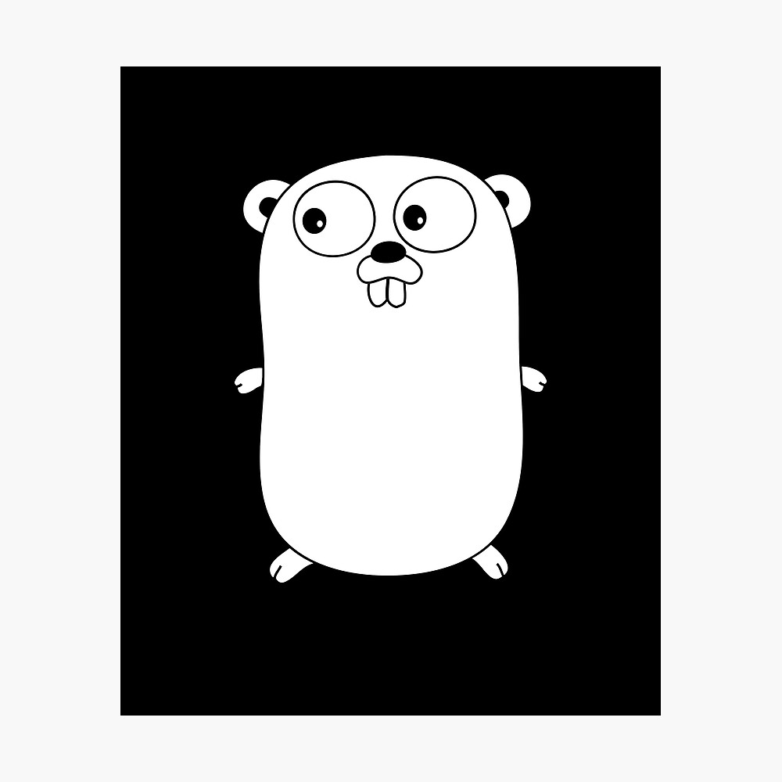
GOLANG PROJECT
ADVANCED SOFTWARE PARADIGMS
Professor : Walcelio Melo
Ajay Y |Nikith M| Sumedha M |Madhuri D | Sravani B

Slide 2
Objective of the Project
The primary goal of the project is to develop a real time Chat Application.
This Chat Application is built utilizing server-side events in which backend is written in GoLang while the frontend is written in React with TypeScript.

Slide 3
CONSTRAINTS
The Chat Application does not have any notification alerts.
Unable to deal with inappropriate content in the messages
Limit on the length of messages.
Cannot share images in the conversation

Slide 4
FEATURES
The Chat Application has no limit on the number of the joinees in a room.
Contains the real time events such as the room number and the number of people in each room
The messages have the time stamp at which the communication is made.

Slide 5
Technology used
This chat application has server-side events, with the backend developed in Go and the frontend in React using TypeScript.
The integration of Redis which is used to store data, enables horizontal scalability, as each server instance avoids storing crucial state information in memory.
To maintain control, a rudimentary session ID system is implemented using JWT, ensuring that users are restricted to sending messages only in the room they are presently engaged in.

Slide 6
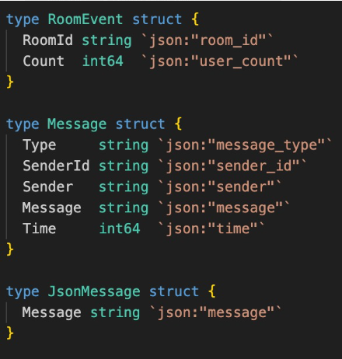
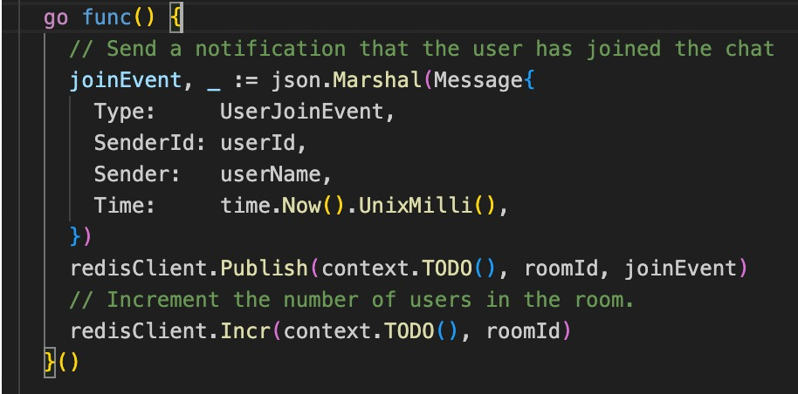
Usage of Structs and GO ROUTINES

Slide 7
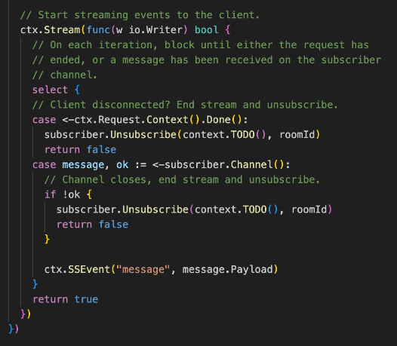
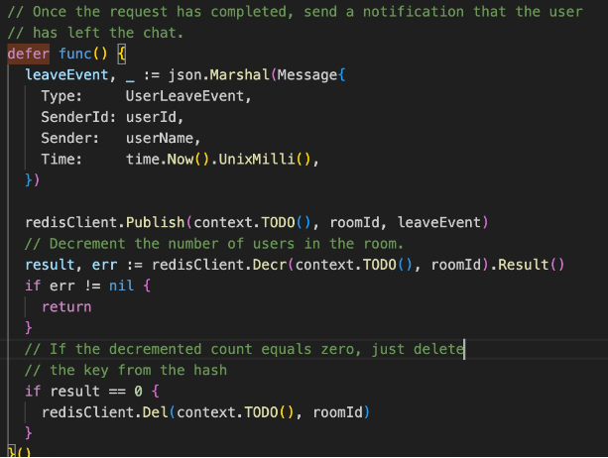
Usage of Structs and GO ROUTINES

Slide 8
PROJECT APPLICATION
Customer Support
- Chatbots are widely used in customer service to provide instant responses to frequently asked questions, troubleshoot issues, and guide users through processes.
E-commerce
- Assists users in finding products, processing orders, and answering inquiries about product details, availability, and shipping information.
Healthcare:
- In healthcare, chatbots can provide basic medical information, answer queries about symptoms, offer medication reminders, and schedule appointments.

Slide 9
THANK YOU!!

