Slide 1

GO PROGRAMMING LANGUAGE
ADVANCED SOFTWARE PARADIGMS
Professor : Walcelio Melo
Ajay Y |Nikith M| Sumedha M |Madhuri D | Sravani B

Slide 2
LETS GO!!
Go is an open source procedural programming language which makes it easy to build reliable and efficient software.
Developed by Robert Griesemer, Rob Pike, and Ken Thompson at Google, in 2007 and launched in 2009.
Go is a strong and statically typed, concurrent, and garbage-collected programming language
It is developed with the vision of high performance and fast development
Notes:
Static typing offers several advantages, such as improved code reliability, better performance, and improved tooling support.

Slide 3
Why do we even need another programming language?
How is it different?
The infrastructure where the applications were deployed changed a lot in the last few years.
Multicore processors became common and using cloud infrastructure with hundreds and thousands of servers with multiple processors to deploy applications became pretty universal.
Infrastructure became more scalable and distributed, dynamic, and had more capacity.
Existing programming languages did not fully take advantage of these infrastructure improvements
Example: Google Drive

Slide 4
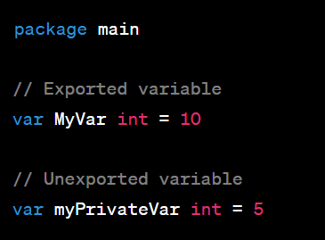
NAMES, BINDING AND SCOPE
NAMES
In Go, the convention for naming variables, functions, types, etc., is camelCase. However, there's an important distinction:
Exported Names: If the name starts with a capital letter, it's exported, meaning it can be accessed from other packages.
Unexported Names: If the name starts with a lowercase letter, it's unexported, meaning it's private to the package.

Slide 5
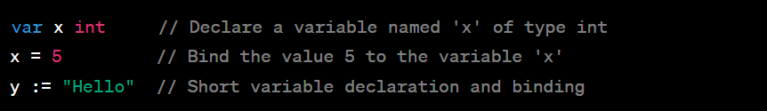
NAMES, BINDING AND SCOPE
BINDING
Binding refers to the association of a name with a value. In Go, this is done using the assignment operator ‘=’.

Slide 6
NAMES, BINDING AND SCOPE
SCOPE
The scope of a name is the region of the program where it can be used. In Go, there are several levels of scope:
Universal Scope: Names that are available everywhere, like built-in functions (len, make, etc.).
Package Scope: Names declared outside any function are accessible throughout the entire package.
Local Scope: Names declared inside a function are only accessible within that function.
Block Scope: Names declared inside curly braces {}, such as in if, for, switch, and case, have their scope limited to that block.

Slide 7
Data Types
Basic Data Types:
Integers, Boolean, Floating Point, String, Complex Numbers
Derived Data Types
Arrays
Slices
Pointers
Maps
Structs
Interfaces
Channels

Slide 8
Expressions and Assignment Statements
Expressions: An expression in Go represents a value and is composed of operands and operators. Expressions can be as simple as literals or more complex, involving function calls, arithmetic operations, and more.
Literals: These are basic expressions representing fixed values.
Arithmetic Operations: These involve standard arithmetic operations.
Relational Operations: These are used for comparison and return a boolean value.
Function Calls: A function call is also an expression that returns a value.

Slide 9
Expressions and Assignment Statements
Assignment Statements: Assignment statements in Go are used to assign values to variables.
Basic Assignment: x := 10
y = 20
Multiple Assignment : a, b := 5, 10
Tuple Assignment : a, b := swap(5, 10)
Assignment with Operators: x += 5
Notes:
expressions in Go evaluate to values and can be composed of various components like literals, operators, and function calls. Assignment statements, on the other hand, allow us to store values in variables, and Go offers a flexible way to perform these assignments. Understanding these concepts is foundational to programming in Go.

Slide 10
Support to OO programming
Go supports many principles of Object-Oriented (OO) programming, though it approaches them differently than traditional OO languages like Java or C++. Instead of classes and inheritance, Go uses structs and interfaces
Structs: In Go, you can define structs to represent data structures. Structs can be used to encapsulate data fields, similar to classes in OOP.
Methods: Go allows you to define methods associated with a struct. Methods in Go are functions that operate on a specific type, and they can be attached to a struct type, providing behavior similar to methods in OOP.

Slide 11

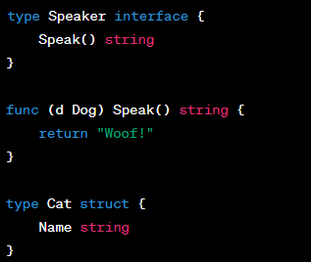
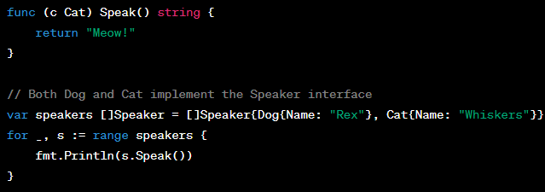
Support to OO programming
Encapsulation: Go supports encapsulation by using exported and unexported names. If a struct field starts with a capital letter, it's exported (public); otherwise, it's unexported (private).
Polymorphism with Interfaces: Go achieves polymorphism through interfaces. Any type that satisfies an interface's methods is said to implement that interface.

Slide 12
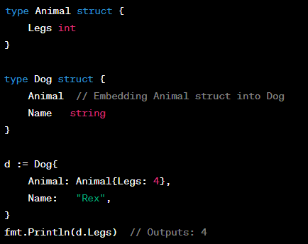
Support to oo programming
Composition Instead of Inheritance: Go prefers composition over inheritance. Instead of inheriting properties, you can embed one struct into another.

Slide 13
Concurrency
Concurrency is a core feature of Go, and the language provides easy-to-use primitives, such as goroutines and channels, to facilitate concurrent execution.
Goroutines:A goroutine is a lightweight thread managed by the Go runtime. To run a function concurrently, simply use the go keyword before a function call.
Channels: Channels provide a way for two goroutines to communicate with each other and synchronize their execution. You can send data into a channel and receive data from a channel.
Select: The select statement allows a goroutine to wait on multiple communication operations. It's like a switch statement, but for channels.

Slide 14
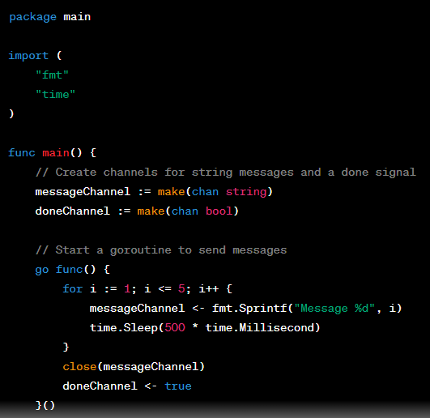
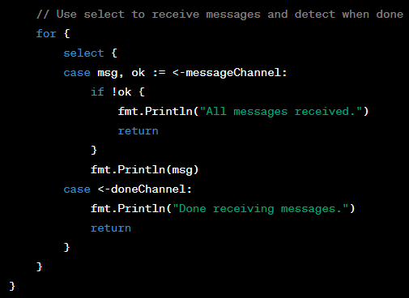

Slide 15
EXCEPTION HANDLING
Go has a unique way of handling errors compared to many traditional programming languages. Instead of exceptions, Go uses an error-returning mechanism.
Error Handling: In Go, functions that can result in an error typically return an additional value of type error. It's idiomatic to return the result and an error, and to check if the error is nil before proceeding.
Error Returning
Custom Error Types
Panic and Recover: While Go encourages the use of error values for most error-handling, there are cases where the program cannot or should not continue to run. For these cases, Go provides the panic and recover mechanisms.
Panic
Recover

Slide 16
EVENT HANDLING
Go does not have a built-in, general-purpose event-handling mechanism like some languages/frameworks geared towards UI development. However, you can build event-driven systems using channels and goroutines, or use third-party libraries and frameworks depending on your specific needs.
Notes:
In summary, Go's approach to error handling is explicit and encourages developers to handle errors as values. While it doesn't have exceptions in the traditional sense, it provides the tools necessary to handle unexpected conditions and build robust systems.
In summary, Go's approach to error handling is explicit and encourages developers to handle errors as values. While it doesn't have exceptions in the traditional sense, it provides the tools necessary to handle unexpected conditions and build robust systems.

Slide 17
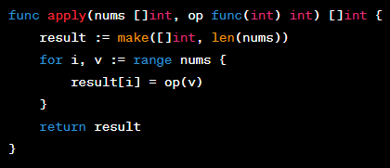
FUNCTIONAL PROGRAMMING
While Go is primarily procedural and doesn't emphasize functional programming as much as some other languages, it certainly supports many functional concepts.
We can:
Assign a function to a variable.
var fn func() = greet //greet()
Pass a function as a parameter.
Return a function from another function
Notes:
In summary, Go's approach to error handling is explicit and encourages developers to handle errors as values. While it doesn't have exceptions in the traditional sense, it provides the tools necessary to handle unexpected conditions and build robust systems.
In summary, Go's approach to error handling is explicit and encourages developers to handle errors as values. While it doesn't have exceptions in the traditional sense, it provides the tools necessary to handle unexpected conditions and build robust systems.

Slide 18
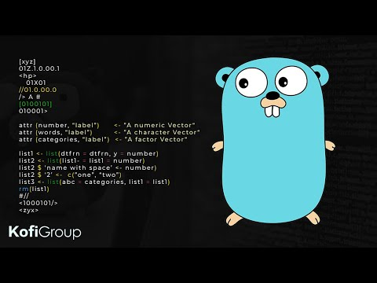
PROJECT PROPOSAL
Objective
To build a Real Time Chat Application
Constraints
Cannot alert users about new messages
Unable to deal with inappropriate content in the messages
Features
Multiple users can chat in real time in same session
Time stamps included with each messages
Technologies Used
Go
React
Web Sockets

Slide 19

YOU ARE READY TO…
Questions!?

