Slide 1
Project 4: Reinforcement Learning
Grid World

Slide 2
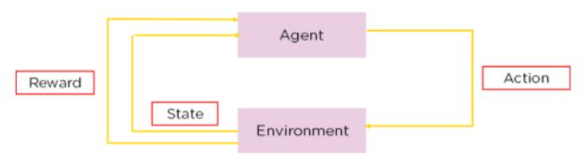

Approach
Q-learning
Notes:
Our main idea of this project is Q-Learning and Epsilon Greedy. The basic idea of the algorithm is to gradually optimize the strategy by iteratively updating the Q table, so that the agent can take the optimal action in different states, so as to obtain the maximum cumulative reward.

Slide 3
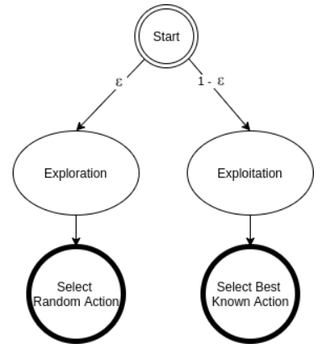
Approach
Epsilon Greedy
Notes:
However, if we only rely on Q-Learning,the algorithm will fall into a local optimum. Therefore, we introduce Epsilon Greedy strategy.
The goal is to strike a balance between exploration and exploitation. Exploration allows us some room to try new things, sometimes contradicting what we have already learned. So we started by turning up the value of epsilon so that we could get more useful information from exploration. As the number of experiments increases, We hope to rely more on the results of q-learning. At this point we then turn down the value of epsilon to make the previously obtained Q-value work.

Slide 4
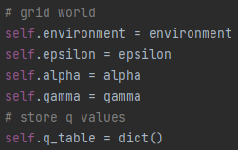
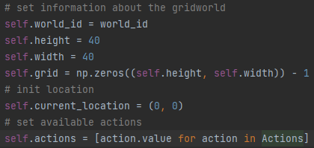
Data Structure
Grid World
Q-Agent
Notes:
Here is a snippet of our code. Q-Agent and Grid World are two of our main class. Here are the variables in each class. Actions is a enum class which defines all the action agent can move.

Slide 5
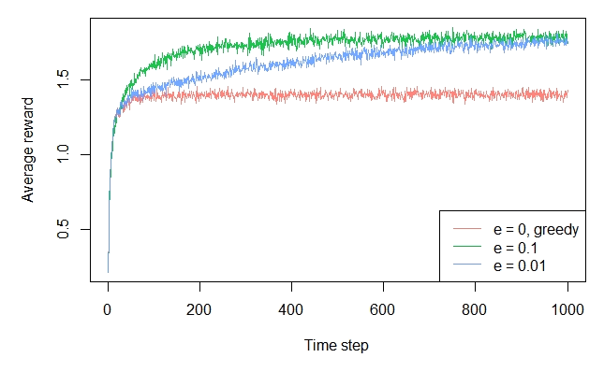
Constants & Parameters
ε – Epsilon Greedy Exploration
α – Learning Rate
γ – Discount
Notes:
Let’s move to constants and parameters. The agent will takes an exploratory action with probability Epsilon and a greedy action with probability 1 - Epsilon. The greater Epsilon, the more probability the agent will take exploratory action. We can see from the picture that proper epsilon is helpful for the agent to get more reward.
In Q- learning formula q(s,a), α is the learning rate. It decides algorithm convergence speed. The greater the learning rate α, the less effect of previous training to decisions of agent, which means algorithm will take less time to converge.
γ(Gamma) is the discount of the effect of future reward in Q-learning formula. The greater the discount γ, the more effect of future reward. Usually, we will set gamma to a constant close to 1 to ensure that the algorithm can consider the impact of each decision in the long run.

Slide 6
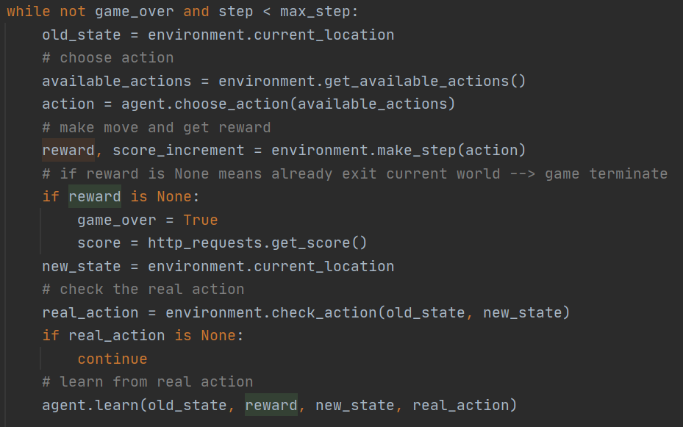
Exploration
old_state
reward
new_state
real_action
Notes:
Here is our exploration logic. We can get old_state from current_location. After we make a move, we can get a dictionary which contains reward and new_state. The action could be different from what we expected due to the noise, so we need to check if the action we supposed is the real_action by comparing the old_state and new_state. Finally, we select the real_action as our action.
Now we have old_state, reward, new_state, and action, we can calculate the q_value for state ‘s’ taking action ‘a’. Repeat above steps until we reach the max_step or game_over is True. When finished, we store the q_value table in use for the next trial.

Slide 7
Thank you!

