Slide 1

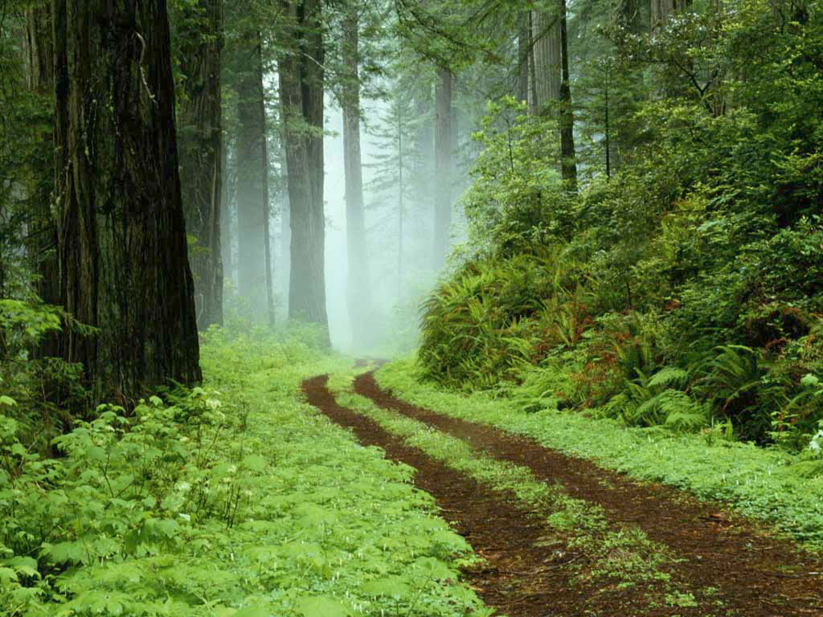
FOREST RESOURCES

Slide 2
RESOURCES

Slide 3

Resources
Meaning of resources:
The term resources was taken to mean only the natural factors or things like mountains, mineral deposit, forests, animal life, soil, water, air etc ‘Resource’ was used to refer to only natural resources.
This term was taken to mean all natural phenomenon or factors, whether they are useful to man or not.

Slide 4
Today resources is taken to mean only those natural, human and cultural factors which satisfy human wants and contribute to human welfare
The modern meaning of the term “resources” is given Prof.Zimmermann as “A means of attaining given ends, the ends being satisfaction of human wants and attainment of social objectives”.
According to B.S.Negi, “Resources are those aspects of mans environment which facilitate the satisfaction of human wants and the attainment of social objectives”

Slide 5

FOREST RESOURCE
Meaning of the forest:
The term “forest ”is derived from the latin word “foris” meaning outside. Originally ,it is uncultivated and uninhabitated village boundary consisting of natural plants, i.e., trees and grasses .
It means an association of plants , natural or cultivated, predominantly trees.
In the words of Allen and Shorpe, “Forest is a community of trees and associated organism covering a considerable area, utilizing air, water and minerals to attain maturity and to reproduce and capable of furnishing mankind with indispensable products and services”

Slide 6
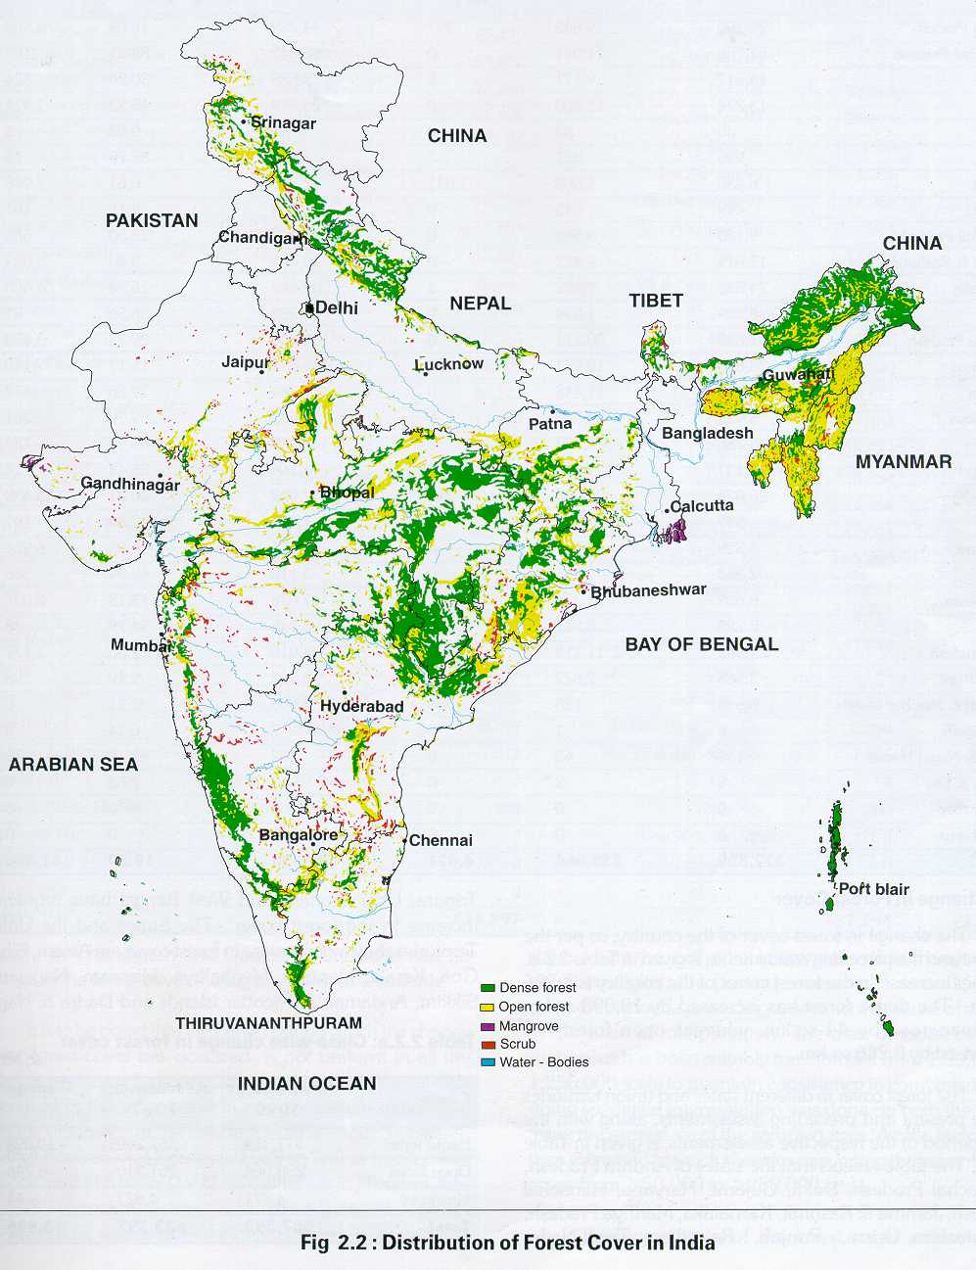

Slide 7
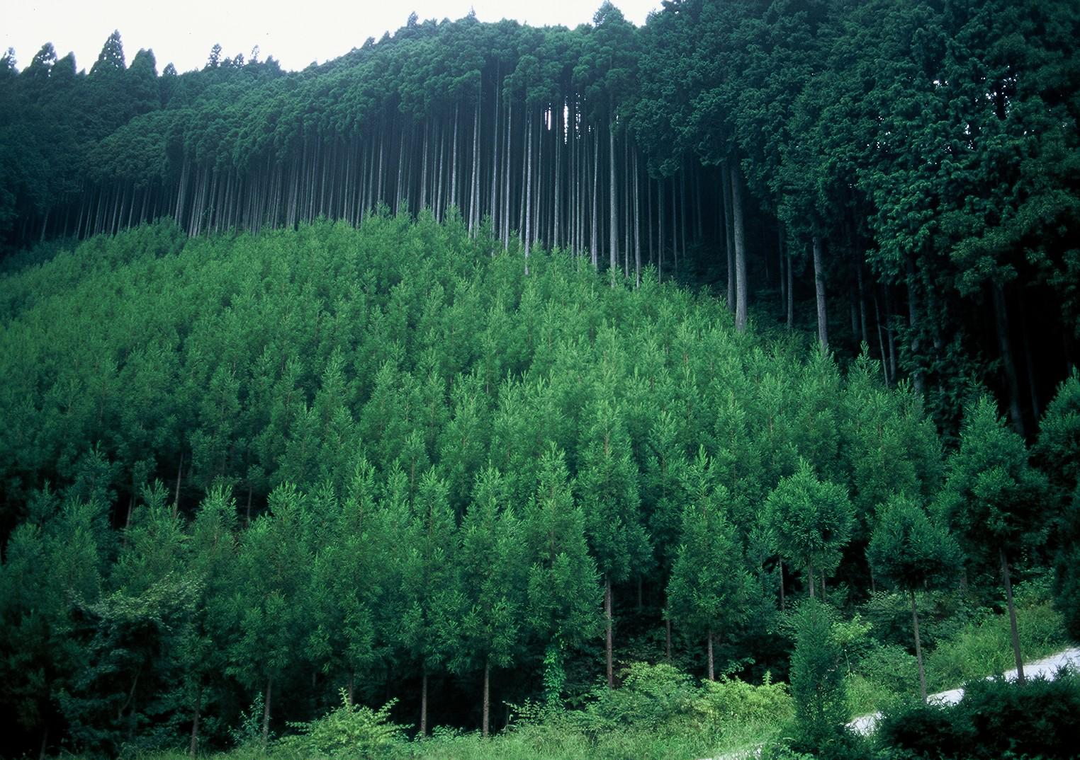

Slide 8

Uses of forest
They provide timber for house-building, ship-building, bridges, railway carriages, furniture etc.
They supply fire wood and charcoal for fuel in homes and in industries.
They provide wood pulp for the paper and rayon industries.
They provide honey for food and medicines.
They provide bee wax for candles, medicines, shoe-making etc.
They provide canes for baskets, mats, chairs, ropes, walking sticks and umbrella handles.
They provide sandal wood for carved boxes and small domestic articles .
They provide tanning materials in the form of wood, barks, leaves, roots, and fruits for tanning hides and skin.

Slide 9
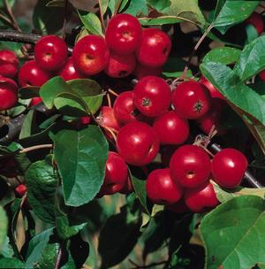

They provide corks for bottle-stoppers.
They provide camphor for medicines.
They provide rubber for rubber industries.
They provide balata for the preparation of sea cables and machine belts.
They provide edible fruits.
They provide fibres.
They provide grasses for the grazing of animals, thatching

Slide 10
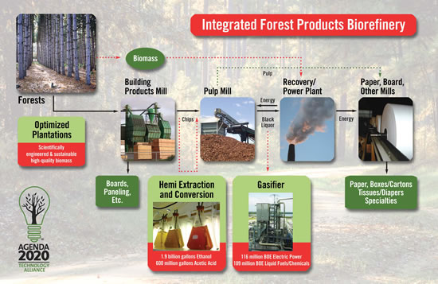

Slide 11
Indirect uses of forest.
They stop the rain-bearing winds and cause the rainfall.
They increase the moisture content in the atmosphere and thereby provide additional precipitation(i.e., rainfall) in the locality
They minimize the extreme variation in climatic condition and make the climate more equable.
They control floods during heavy rain by absorbing excess rain water.
They prevent soil erosion by checking the force of flowing of water.
The thick roots of the trees absorb large quantity of water thus, forest help in the flow of rivers and streams.

Slide 12

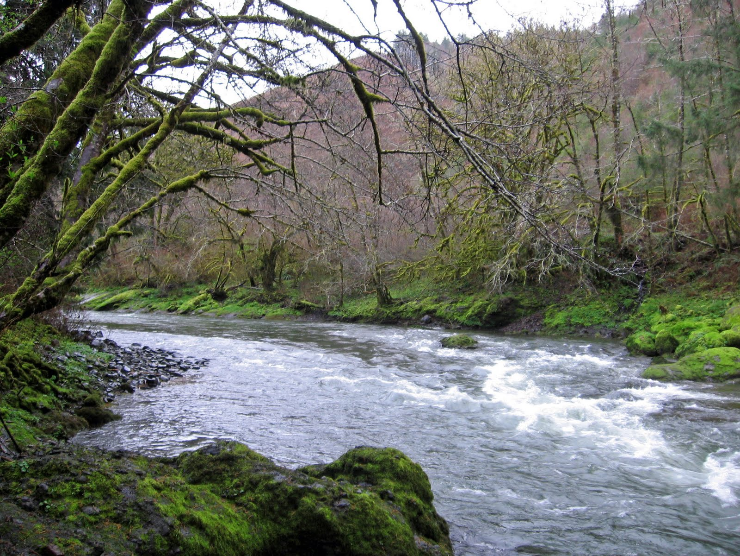
They offer hunting grounds.
They provide shelter to wild animals and birds.
They improve the sanitary condition of a place .
They are a source of revenue to the government .
They facilitate human existence by providing O₂ to human beings and absorbing CO₂ released by human beings.
They provide employment large number of people in different capacities as wood cutters, carriers etc.

Slide 13
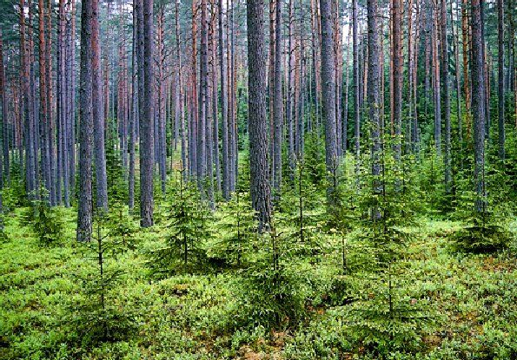

Slide 14

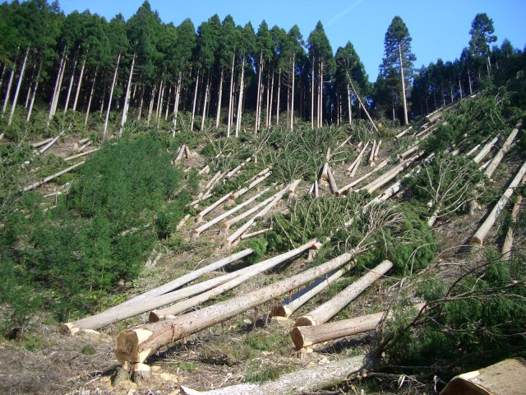
Depletion of forest resource.
The history of the exploitation of forest is as old as man himself but during older times, the exploitation was balanced through natural growth of forest because at that time , exploitation was only for personal and community uses. But in recent year , depletion of forest has been on a large scale.

Slide 15

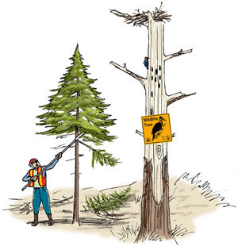
The main reasons for large scale depletion of forest.
Expansion of agriculture, more forest have been cleared for agriculture.
Large area of forest lands have been cleared for urbanization and human settlement.
Commercial exploitation of forest .
Forest fires .
Mining activities in forest areas.
Forest diseases are also partly responsible for depletion forest.

Slide 17

Adverse effects of depletion of trees
It has contributed to rise in temperature.
It has contributed to lesser precipitation.
It is responsible for increased rate of soil erosion
It is responsible for increase in the frequency and volume of floods .
it has lead to loss of soil productivity.
It is responsible for loss of biodiversity.
It has lead to extinction of several species of plants and animals.
It has caused imbalance in ecosystem.

Slide 18
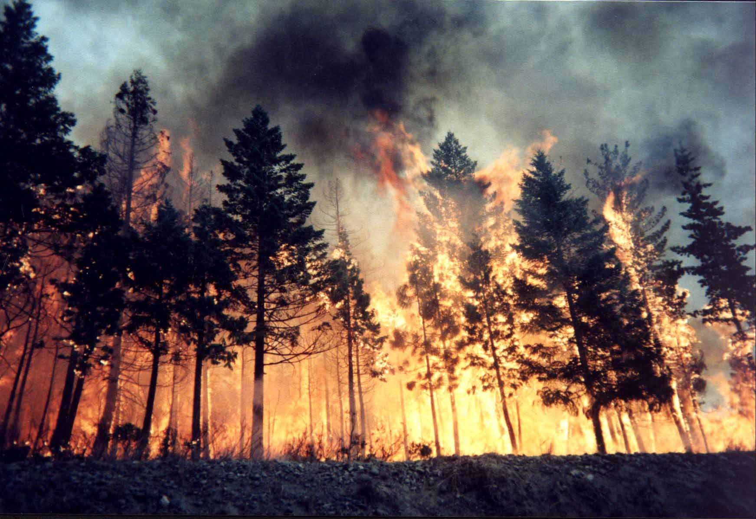

Slide 19

Conservation of Forest.
Regulated and planned cutting of trees.
Control over forest fires.
Reforestation.
Afforestation .
Check on forest clearance for agriculture and human habitation and settlement.
Development green belt around cities.
Check on mining activities in forest areas.
Protection of existing forest.
Conservation of threatened species of trees.

Slide 20


Social forestry and agro-forestry.
Development of national parks and game sanctuaries.
Development of botanical gardens
Development of seed banks.
Forest management.
Proper role of government in forest conservation

Slide 21
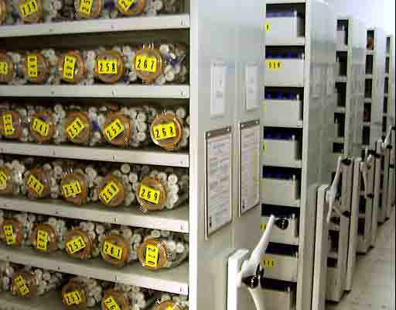
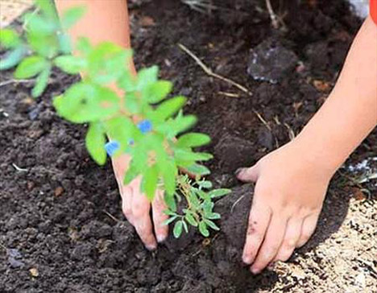
Conservation of forest.

Slide 22
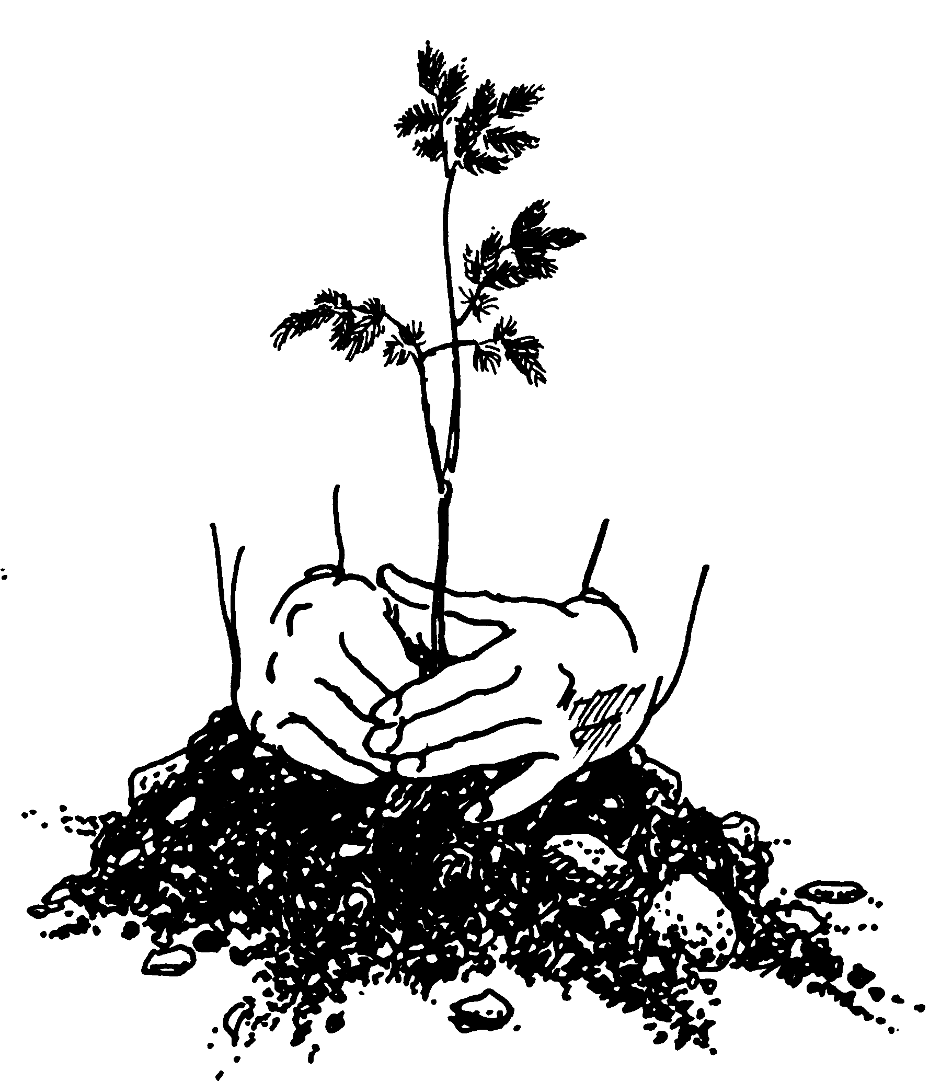

Slide 23
DEFORESTATION
It means reckless or large-scale felling or cutting of trees by man for commercial and other purposes.
The FAO(Food and Agriculture Organization) of the UN defines ”change of forest with depletion of tree crown cover more than 90%.”

Slide 24
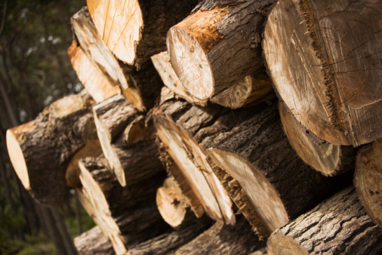
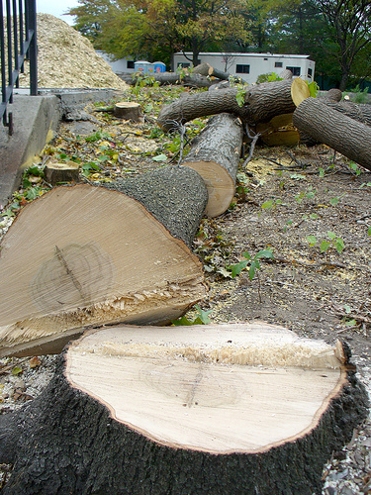
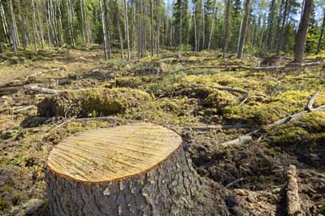

Slide 25
Causes of deforestation.
Desertification.
Soil degradation and soil erosion.
Loss of vegetation cover.
Destruction of natural habitat and loss of wildlife.
Changes in climatic condition.
Environmental pollution.
Damage to ecosystem
Reduction in soil moisture.

Slide 26
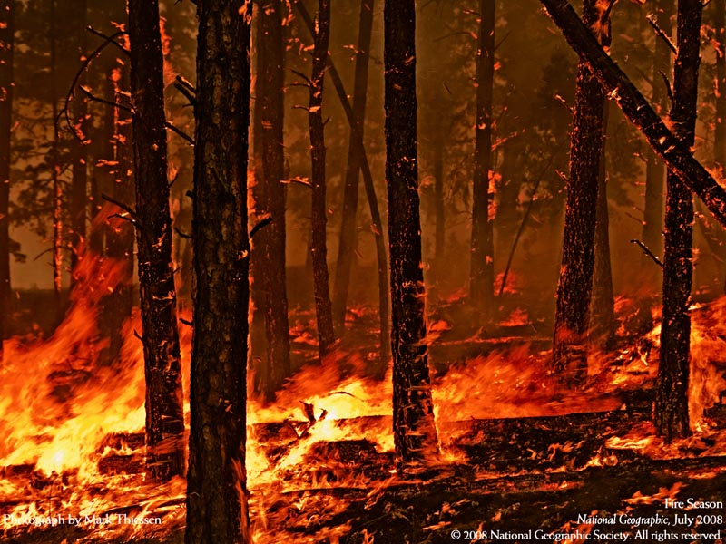

Slide 27
Control of deforestation.
Prevention of human settlement in forest areas.
Check on expansion of agriculture into forest lands.
Prohibition of setting up of agriculture into forest lands
Check on reckless cutting of trees.
Controlled mining in forest areas.
Check on construction of large dams in forest areas.
Control on over grazing in forest areas.

Slide 28
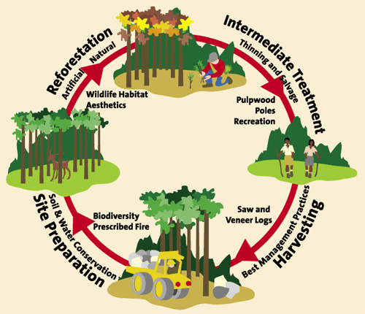

Slide 29

THANK YOU

