Slide 1

IMS Project
By Charles Cairney

Slide 2
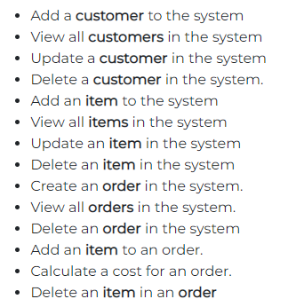
ABOUT US
The Projects task was to complete an inventory management system that end user can interact with via the Command line Interface. Below are the product feature requirements.

Slide 3
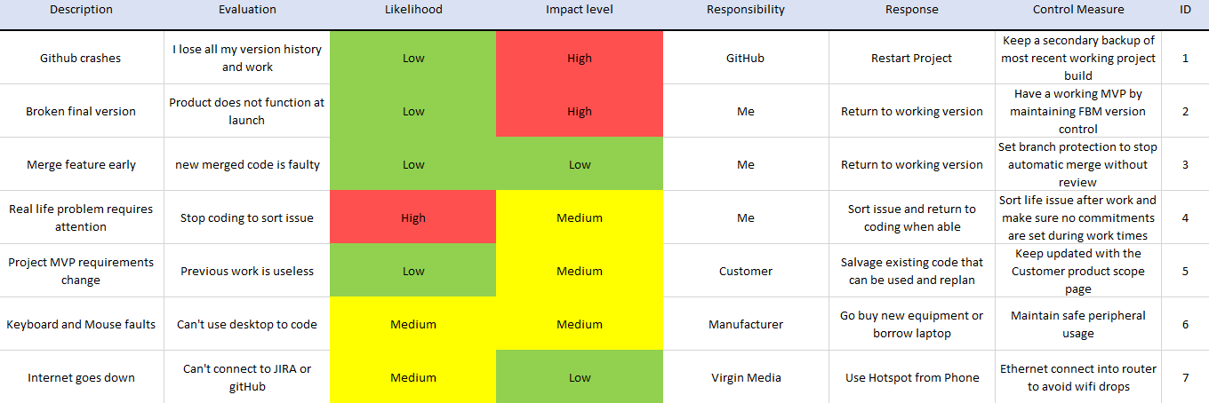
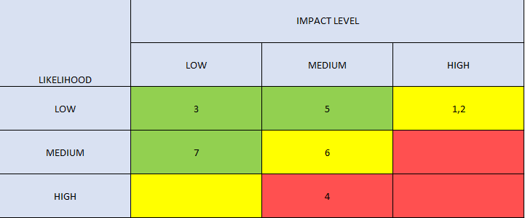
INITIAL RISK assessment
Link to Risk assessment excel spreadsheet found in the documents section of the Repo.

Slide 4
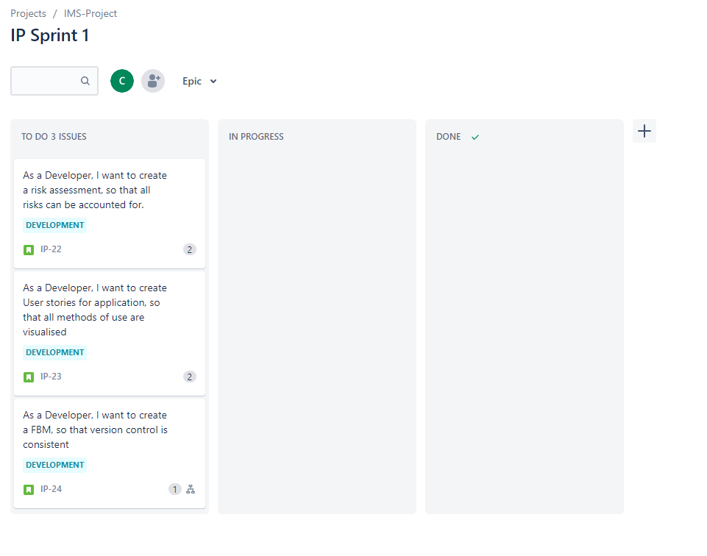
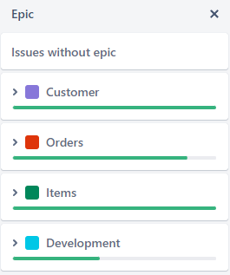
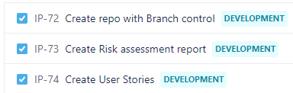
Kanban board
SPRINT 1
Initial sprint with Risk assessment, user stories created for all users and creation of repo with full FBM & branch protection.
Example of tasks:

Slide 5
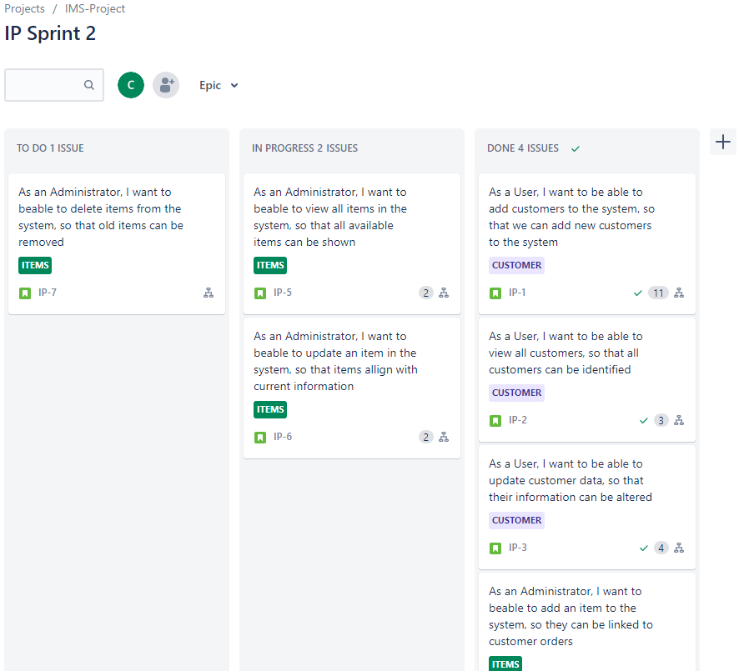
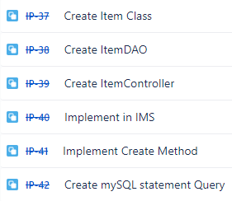
Kanban board
SPRINT 2
2nd Sprint was taking the generated stories for users and implement task that complete the product specification requirements for Customers and items.
Example of tasks:

Slide 6
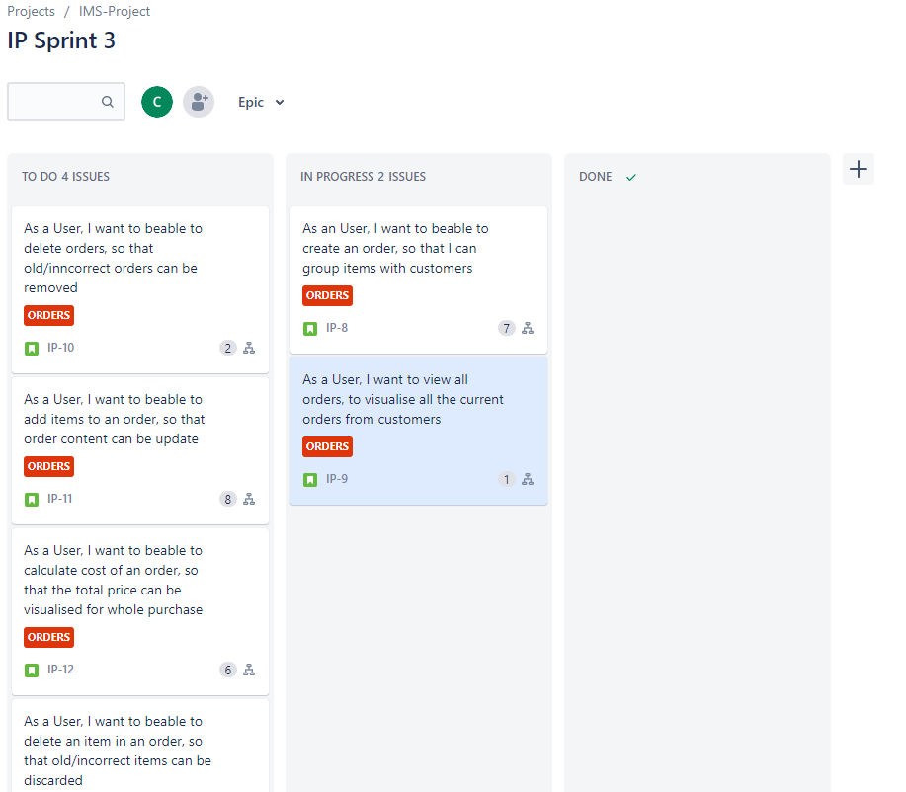
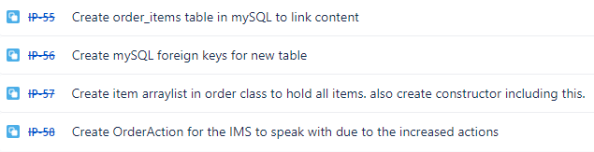
Kanban board
SPRINT 3
The 3rd sprint was to complete the Order requirements as they were more difficult. Linked order items table in MySQL to connect foreign keys to allow queries to pull all the information for actions like cost or add_item. Also, the increase actions in the order section required a new action table to be create and implemented into the existing IMS class for full functionality.
Example of task:

Slide 7
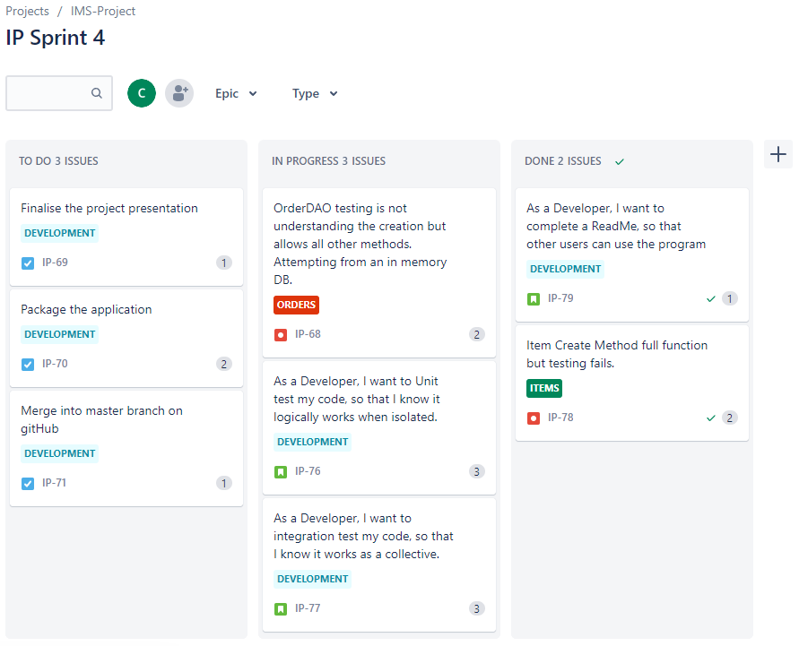
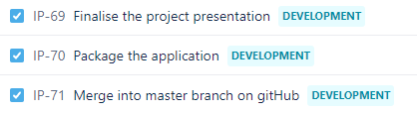
Kanban board
SPRINT 4
Sprint 4 consisted of the main unit testing and integration testing of the methods to ensure full functionality and finalising full documentation due to completion.
Example of task:

Slide 8
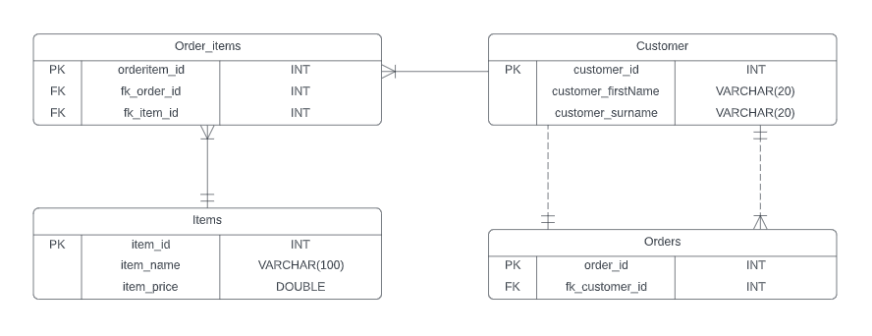
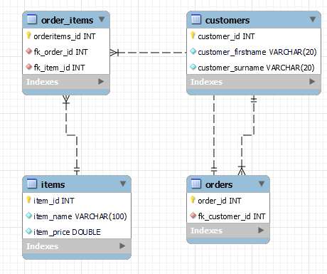
ERD and MYSQL
MYSQL Reverse engineered ERD
Concept ERD

Slide 9
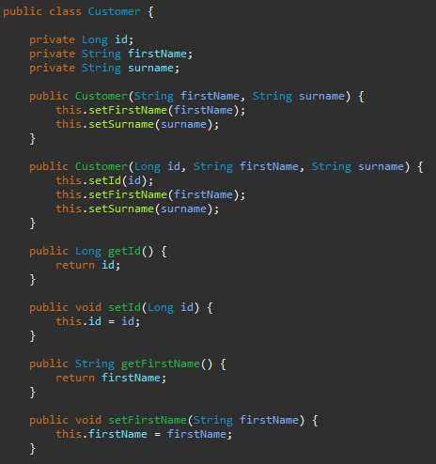
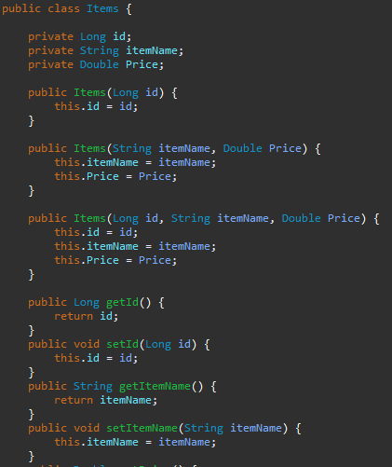
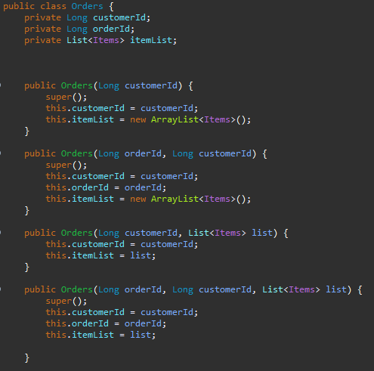
DOMAINS
Customer
ITEMS
ORDERS

Slide 10
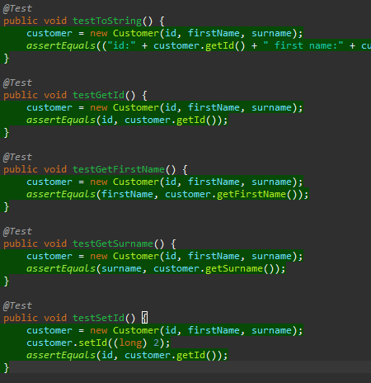
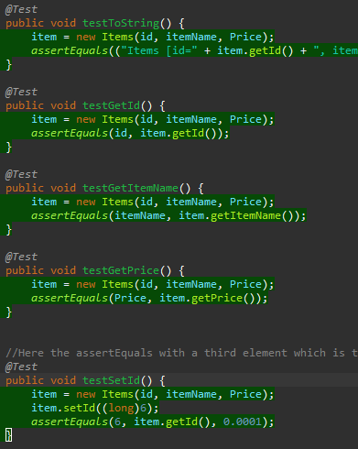
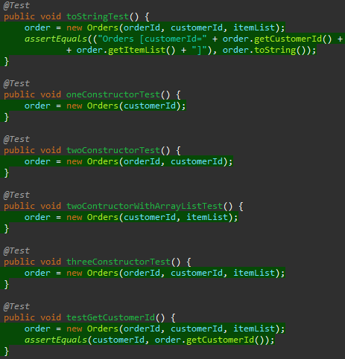
DOMAINS TESTING
Customer
ITEMS
ORDERS

Slide 11
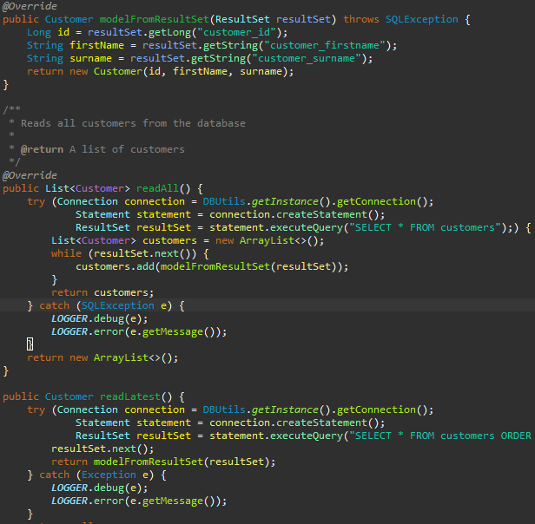
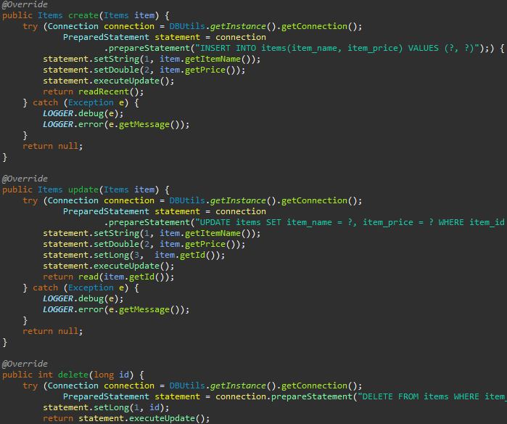
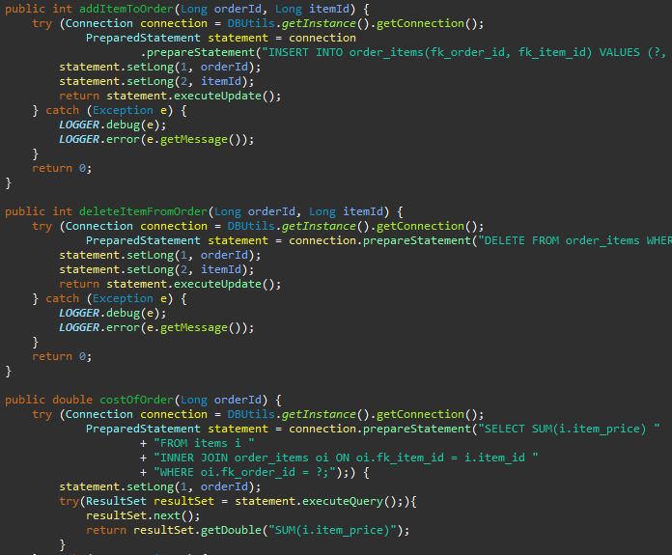
Data Access Object (DAO)
Customer
ITEMS
ORDERS

Slide 12
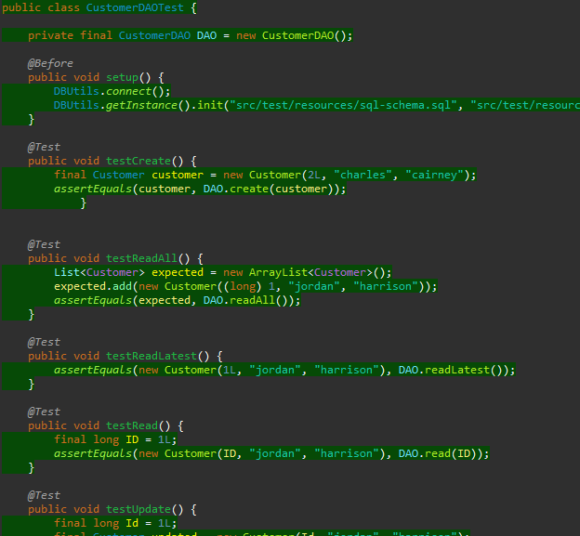
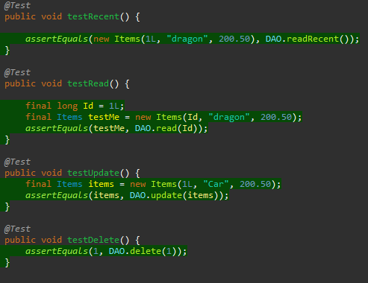
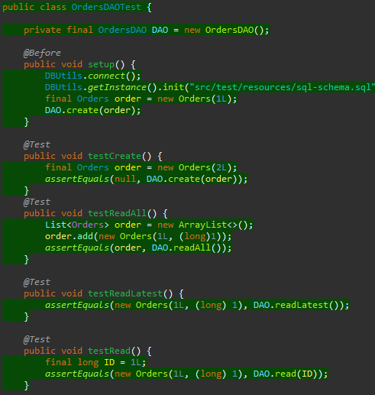
Data Access Object (DAO) TESTING
CustomerDAO
ITEMS
ORDERS

Slide 13
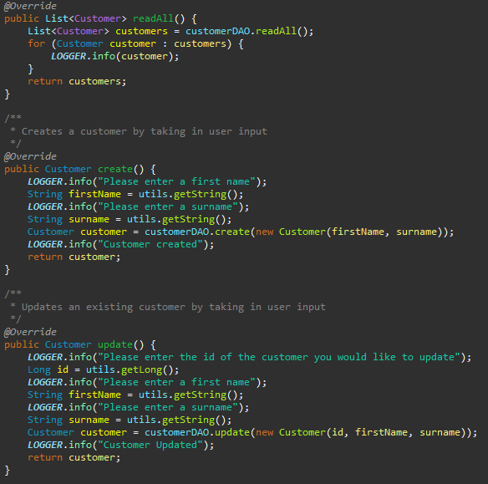
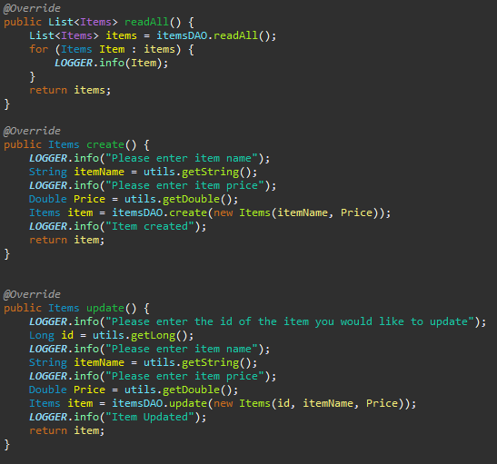
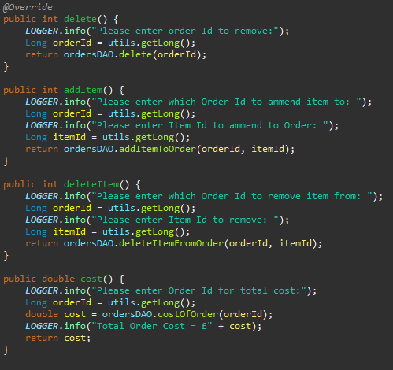
Controllers
Customer
ITEMS
ORDERS

Slide 14
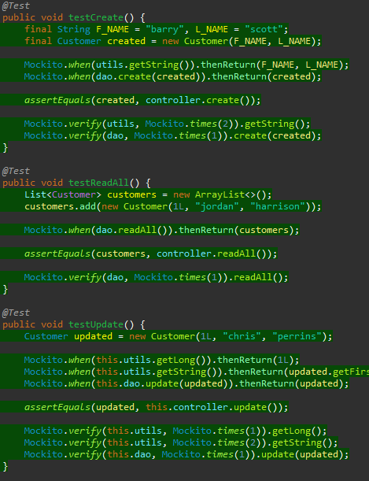
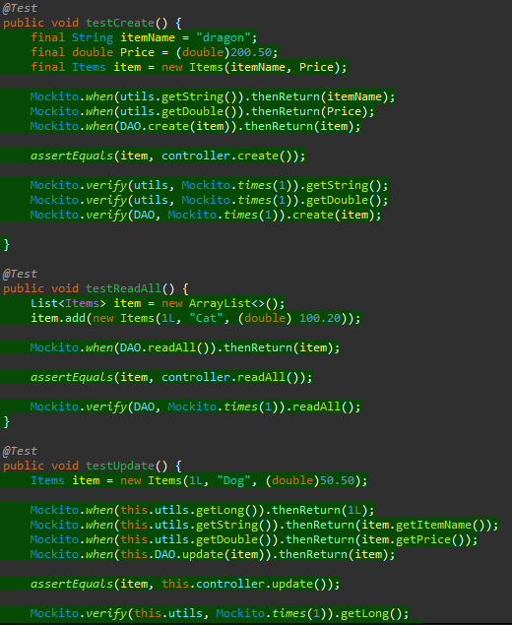
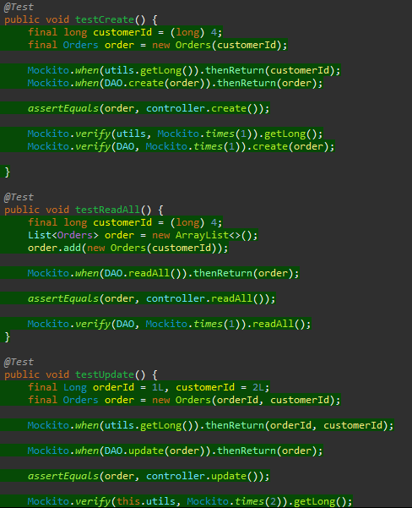
Controllers TESTING
Customer
ITEMS
ORDERS

Slide 15
THANKs for listening
Charles Cairney​
https://github.com/CSCairneywww.contoso.com

