Slide 1

IMS Project
By Charles Cairney
Notes:
Hello my name is Charles Cairney and welcome to my IMS project. Where we were tasked with building an inventory management system using Java and MySQL.

Slide 2
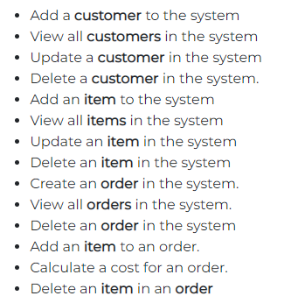
ABOUT US
The Projects task was to complete an inventory management system that end user can interact with via the Command line Interface. Below are the product feature requirements.
Notes:
Read About Us.
Read Requirements

Slide 3
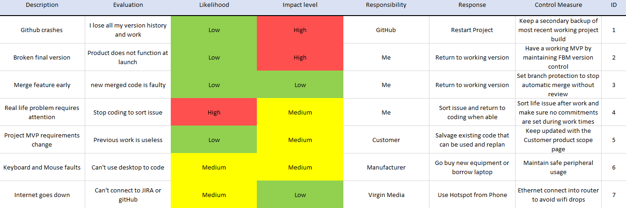
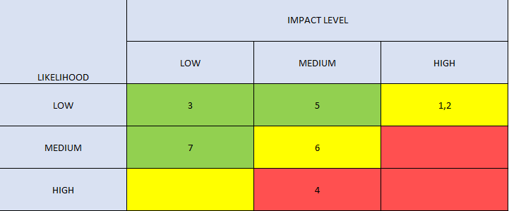
INITIAL RISK assessment
Link to Risk assessment excel spreadsheet found in the documents section of the Repo.
Notes:
First step in the product was to generate a risk assessment.
A risk assessment is created to mitigate damage they could cause.
In a risk assessment you IDENTIFY risks, ASSESS the probability and IMPACT, And PLAN counter measures to stop these every becoming true. Also helps identify all areas to monitor throughout the project.
READ ALL RISKS
4 is the worst due to post pandemic, current high temperatures and elderly family.
READ RISKS FULLY AND EXPLAIN MATRIX

Slide 4
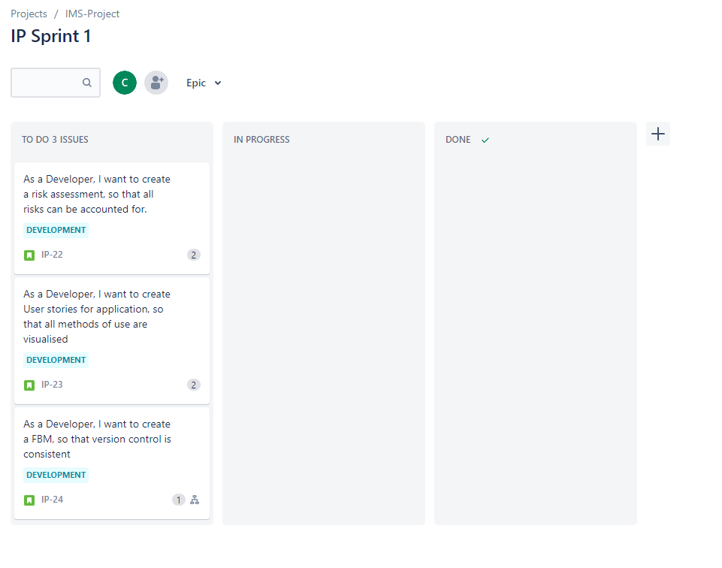
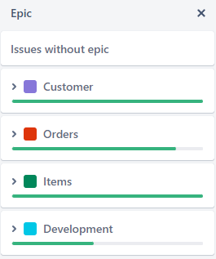
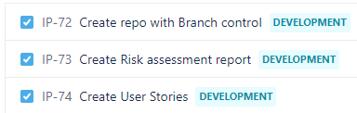
Kanban board
SPRINT 1
Initial sprint with Risk assessment, user stories created for all users and creation of repo with full FBM & branch protection.
Example of tasks:
Notes:
The site used for my agile project management was JIRA and specifically the Kanban board aspect.
To begin with I created as many User Stories as possible with the product requirements as my guide and coding experience to fill in gaps required.
Once all the user stories were created Epics through common themes in user stories were generated (items, customer, orders and system) which allowed us to tag/link stories to correct epics.

Slide 5
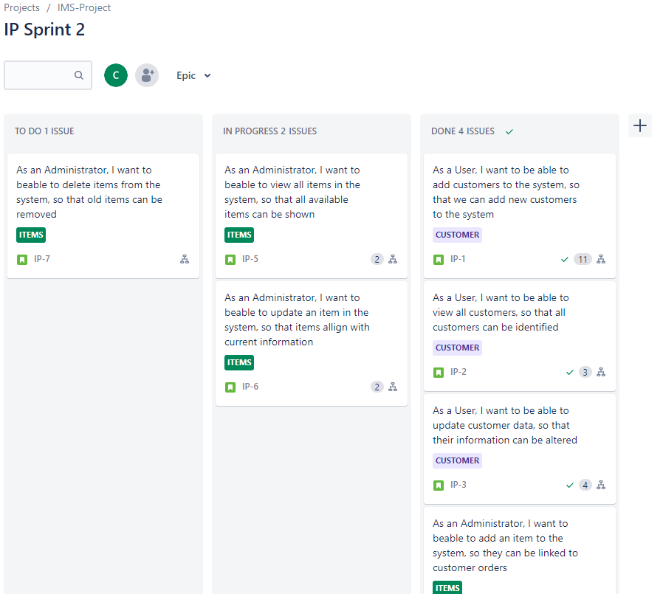
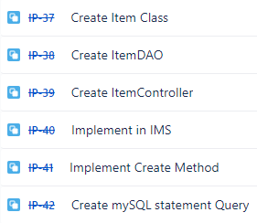
Kanban board
SPRINT 2
2nd Sprint was taking the generated stories for users and implement task that complete the product specification requirements for Customers and items.
Example of tasks:
Notes:
The second sprint was use for creating the class, DAO (data access object) and controller for customer and items and updating the IMS to access these entities to become active controllers.
This included deciding the attributes required for each entity and if any relationships required special assessment. Also creating the tables in MySQL and the statements required with the functionality to also pull long, int and double values from the database with conversion models. Here I ran into a couple of issues when I attempted to run the application before updating the IMS, therefore the item domain was not a case in the running order to become active with its controller/DAO, resulting in failure.

Slide 6
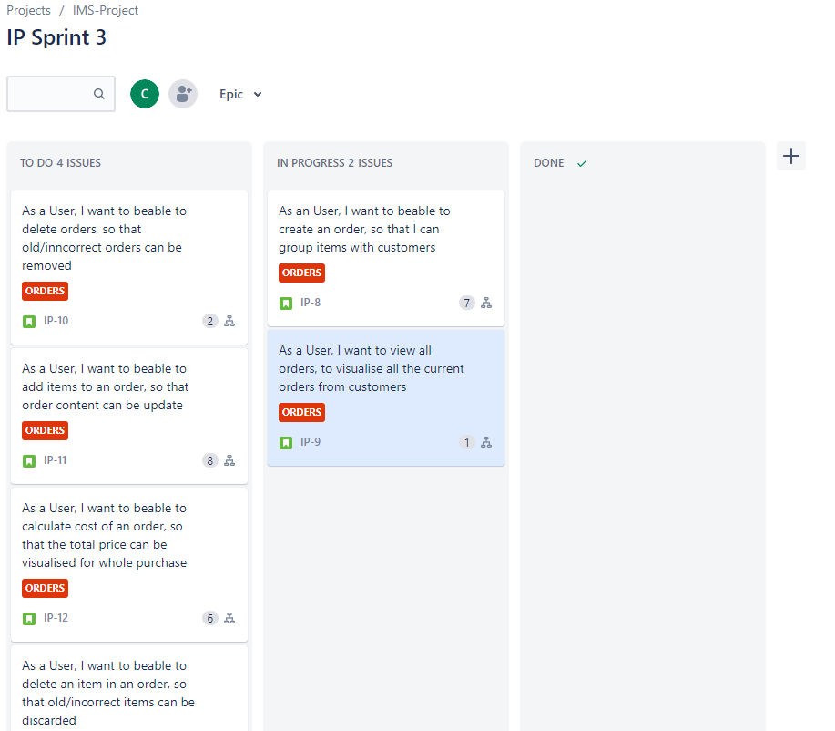
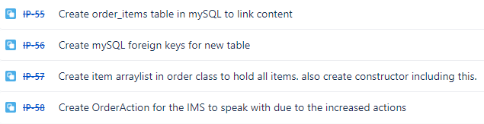
Kanban board
SPRINT 3
The 3rd sprint was to complete the Order requirements as they were more difficult. Linked order items table in MySQL to connect foreign keys to allow queries to pull all the information for actions like cost or add_item. Also, the increase actions in the order section required a new action table to be create and implemented into the existing IMS class for full functionality.
Example of task:
Notes:
The third sprint was dedicated to the production of the order class, DAO and controller. When creating the user stories and implementing story points, orders was identified as the heavier task. This was mainly due to the requirement of an OrderAction enum, the cost order method, the requirement to add items to these order and delete items from these orders.
Read the user stories

Slide 7
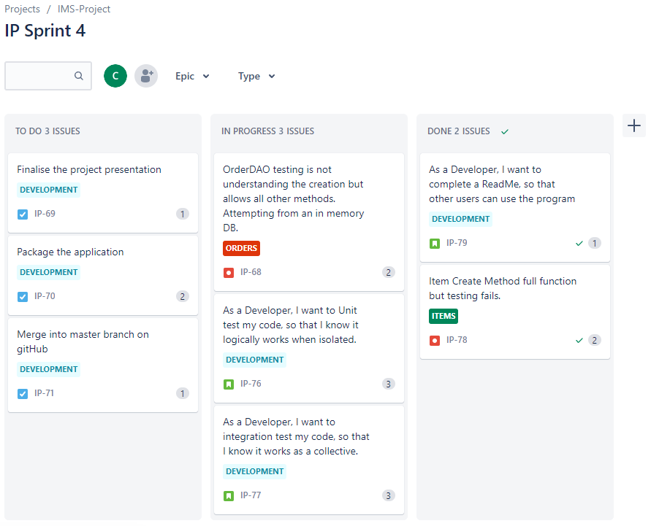
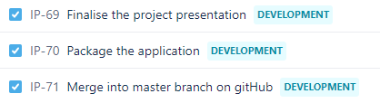
Kanban board
SPRINT 4
Sprint 4 consisted of the main unit testing and integration testing of the methods to ensure full functionality and finalising full documentation due to completion.
Example of task:
Notes:
The final sprint was about unit & integration testing and documentation finalisation with the final merge into the master branch for full Feature branch model creation.
An example of a user story
From here would be “As a developer, I want to complete a ReadMe, So that other users can use the program correctly”

Slide 8
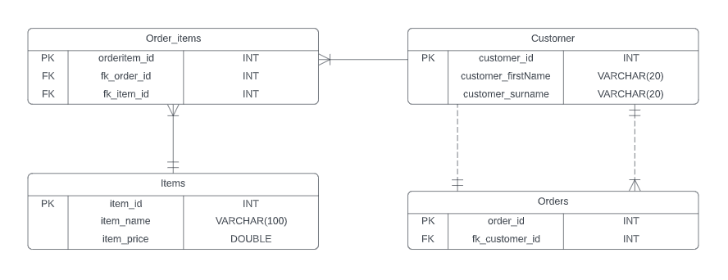
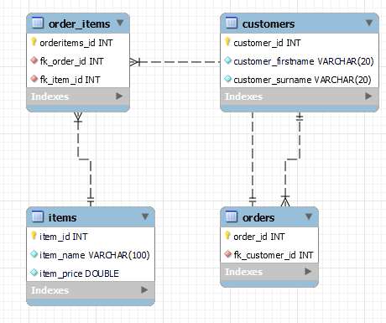
ERD and MYSQL ERD
MYSQL Reverse engineered ERD
Concept ERD
Notes:
Here my conceptualised ERD was the same as the reverse engineered ERD from MySQL.
The relationships are as follows:
(Items – order_items) is a one and only one to One or many relationship.
customers to orders is a one and only one to One or many relationship
order to customer is a one and only one relationship
Customer to order_items, is a one way, One or Many relationship

Slide 9
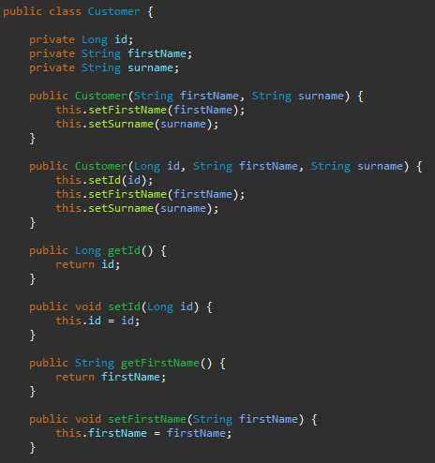
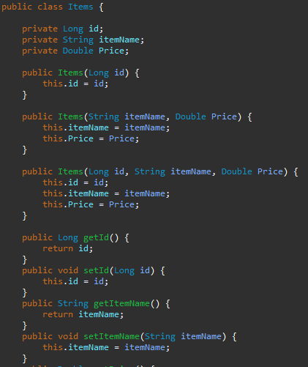
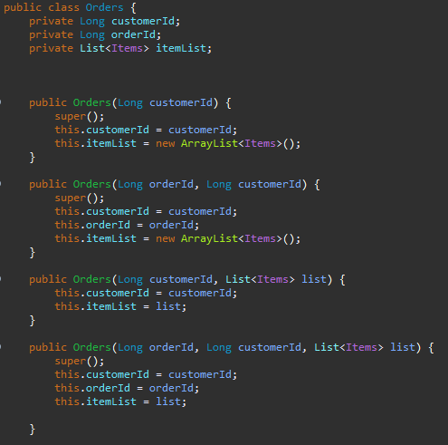
DOMAINS
Customer
ITEMS
ORDERS
Notes:
Here is an example of the initial code for the domains of each. As you can see they all contain constructors, getters/setters and just off screen which I will show later is the toString, hashcode generation and Equals method.

Slide 10
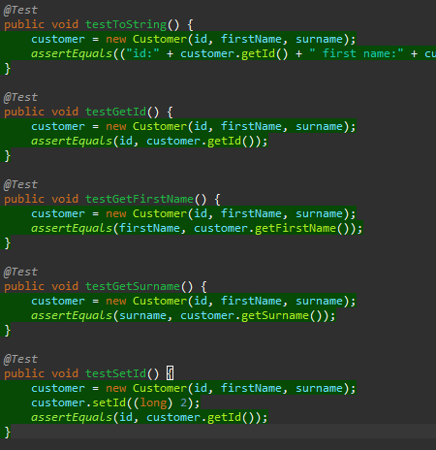
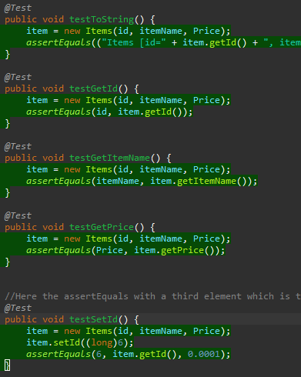
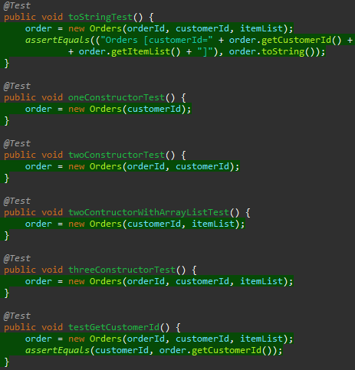
DOMAINS TESTING
Customer
ITEMS
ORDERS
Notes:
Here I used Unit testing using the dependency Junit, which a link for can be found in the ReadMe. The only issue with the unit testing, was with the setters as you had to initially use the set method and check the completion using the get method in the assertEquals. If I could have improved the testing in this segment it would be by setting up a @Before and @After to generate the base customer so it didn’t have to instantiated every test and the @After would delete the customer, saving time and memory.

Slide 11
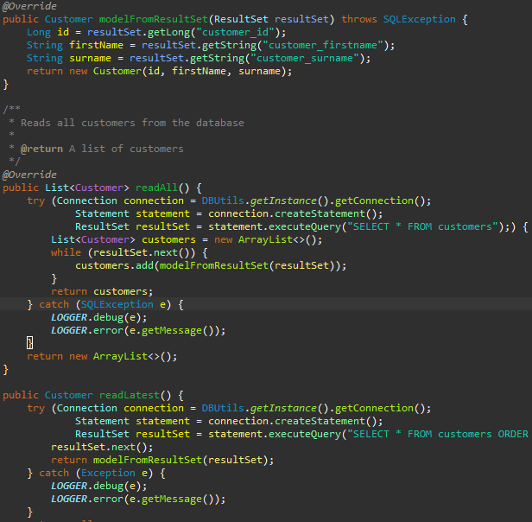
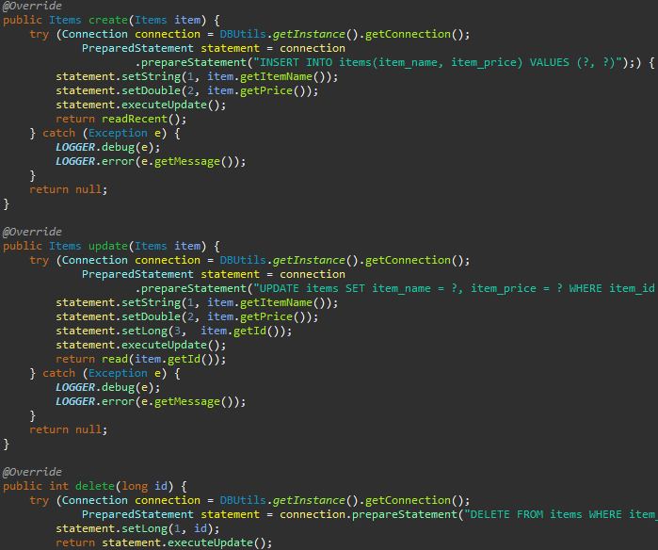
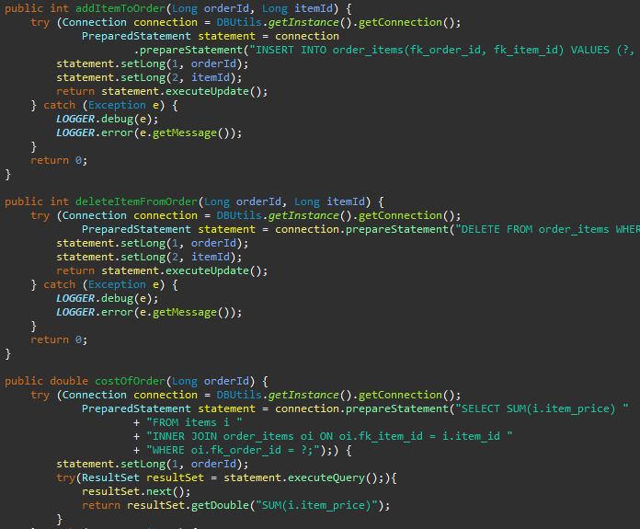
Data Access Object (DAO)
Customer
ITEMS
ORDERS
Notes:
Here we have screenshots of the Data access objects for customer, items and orders. Here the CRUD functionality was easy to implement for customer/items as all you have to do was firstly gain connection to the database in use, through the implementation of your access username/password found in the Dbproperties tab where the SQL-schema is also found, the SQL-schema is used for DB & table generation which ensures correct formation for new users.
Assuming connection was a success for each CRUD functionality a JDBC prepare statement object is used. The statement is a string formatted in a MySQL query order. With ? For the areas in which you want to input Java code specific information like orderId or itemName so the final end user can send information to the Database from the command Line. For example, the statement.setString(1, “kevin”) would replace the first instance of ? With Kevin and so on. If the statement is a success it returns the result process through the ModelFromResultSet which converts the MySQL query result back into it respective java code kind of going in reverse of the first preparedstatement to ensure a two way conversation with each other.

Slide 12
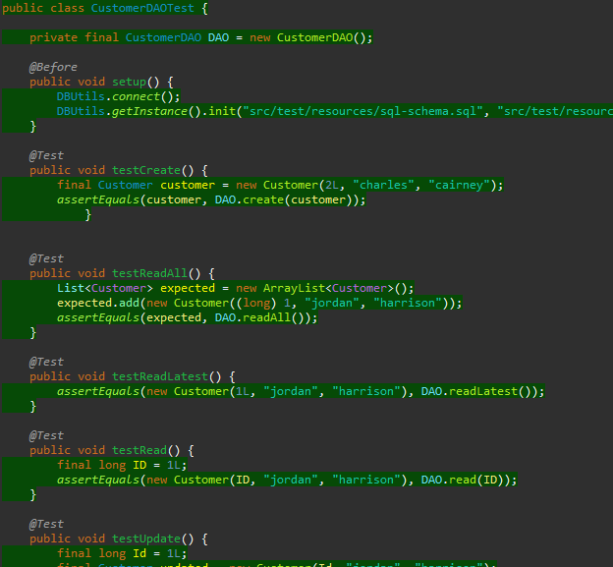
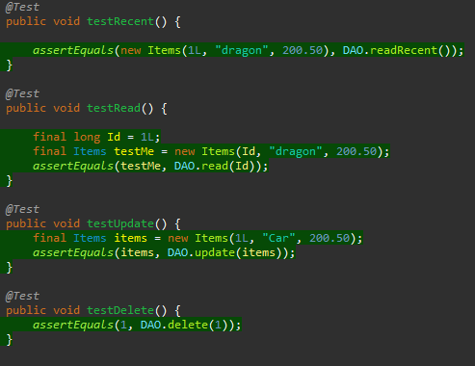
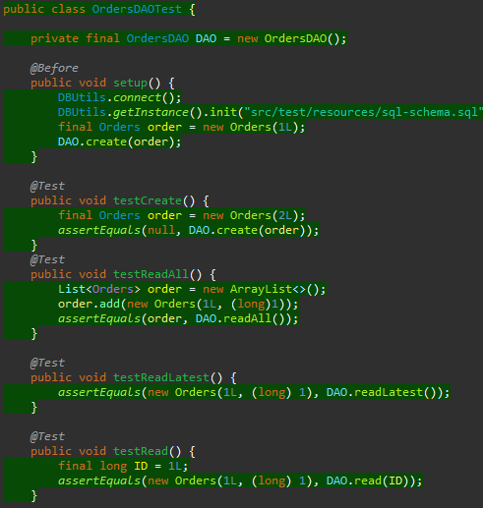
Data Access Object (DAO) TESTING
CustomerDAO
ITEMS
ORDERS
Notes:
For my testing here I created a local testIMS database to contain test data that could be controled for the test environment. A new test schema with tIMS database creation was also added in the test resources. This was effective, but also during the DAO testing, I experienced the most of my difficulties. The first issue was after running the tests here the second attempt would always fail. This problem was fixed after awhile by creating @Before and @After test requirements that would add customers, items and orders to the DB and then remove when finished therefore allow repeatability in testing.

Slide 13
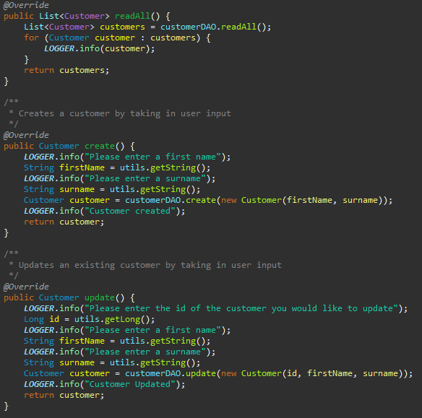
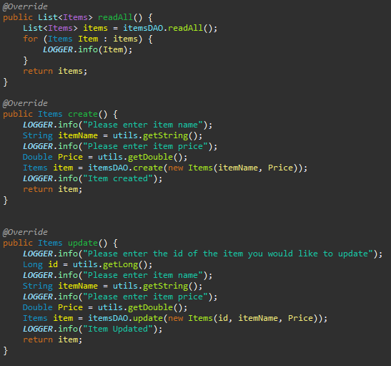
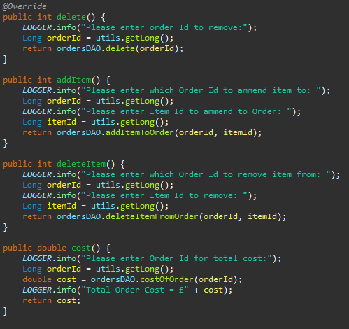
Controllers
Customer
ITEMS
ORDERS
Notes:
Finally I created a controller for each customer, items and orders. The Item controller was created directly with the customer controller as they both contained the same options for the user to pick from Create, Read, update and delete with variations of read like (readLatest/readRecent and readAll) which were implemented to serve as a function for the other options where required, for example my create method required the use of displaying only the customer it just created therefore it used readlatest which used my sql queries special parameter of LIMIT 1 DESC.
Order functionality was a little more advanced as it required Add_item, Delete_item and Cost.
This created an issue of the original Action enum not being acceptable so a new OrderAction enum was generated in the same way but with the added functions. Also the IMS was altered with an IF statement when the ORDER domain was selected to instead activate the new OrderAction instead of original Action enum.

Slide 14
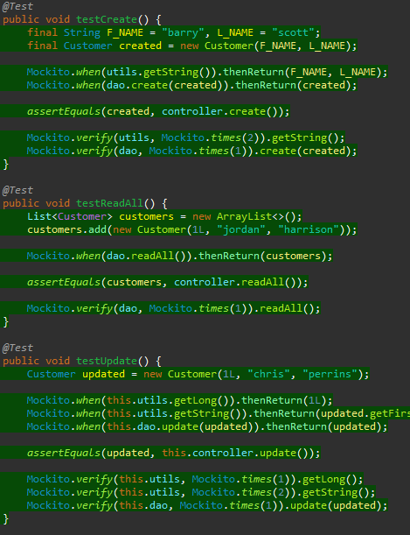
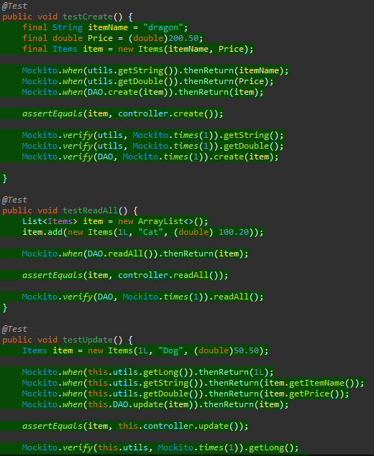
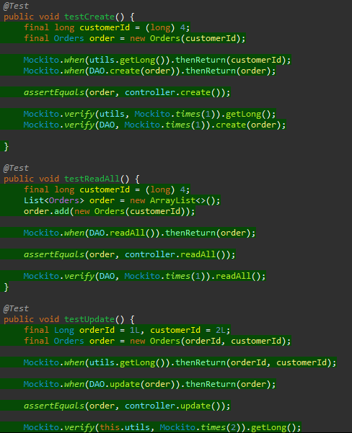
Controllers TESTING
Customer
ITEMS
ORDERS
Notes:
For the controllers I used Integration testing with the use of Mockito which a link for can be found in the ReadMe, integration testing was used as these controller implemented many modules of the program and could not be logically isolated therefore Mockito was able to call and simulate the DAO return function which works hand in hand with the assertEquals from Junit.

Slide 15
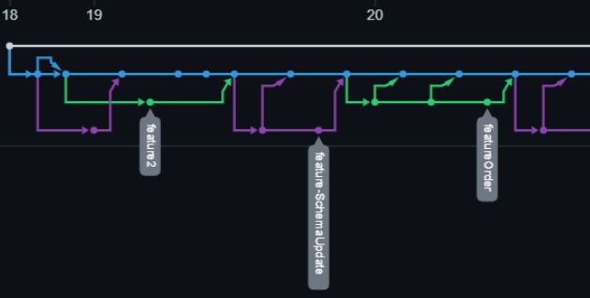
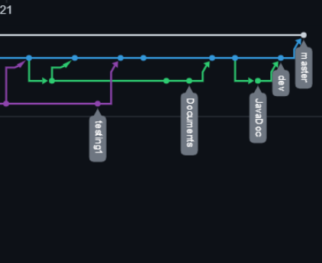
Feature branch Model
Notes:
Here is the full feature branch model after merge into master due to the complete build meeting the project requirements creating a MVP with a testing coverage of 74%.

Slide 16
THANKs for listening
Charles Cairney​
https://github.com/CSCairney

