Slide 1
Computer Science Camp December 2015
Welcome!
Art Simon
Lowell High School
San Francisco, CA
simart@gmail.com
(510) 289-2945

Slide 2
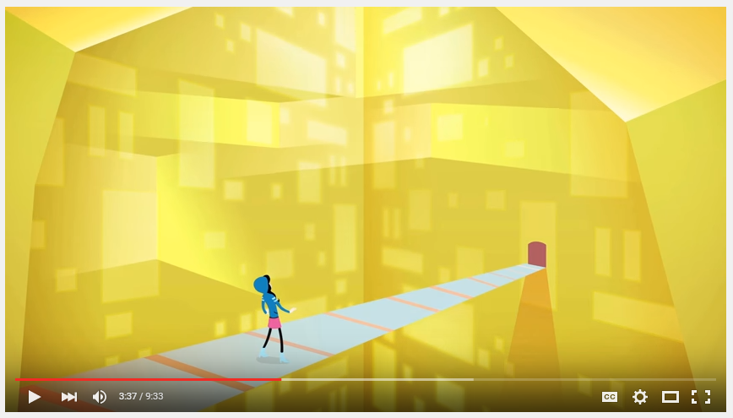
What is Computer Science?
https://www.youtube.com/watch?v=dU1xS07N-FA

Slide 3
What you’ll learn
How to make computer programs using Java, the language used in Advanced Placement Computer Science
How to put your program on a webpage and share it using GitHub
How to format your webpage using a little bit of html and css
How to program Arduinos, the microcontroller used in robotics
How to make wearable electronics using Arduinos

Slide 4
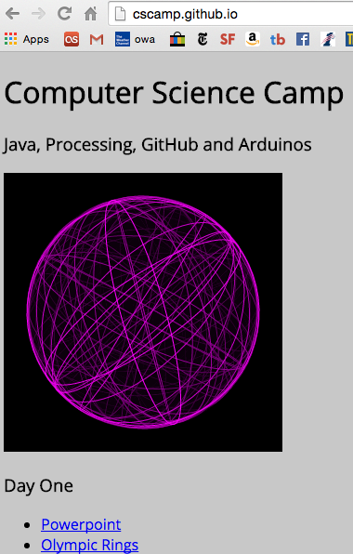
CSCamp.github.io
All the information for the camp is available on our GtiHub site

Slide 5


We’ll be using free software called Processing available at processing.org
We’ll also need a free account at GitHub.com, which is sort of google docs for computer programmers
Then we will work on four different programs and put them up on GitHub:
Olympic Rings
Penguin
Functions and Animation
User Input

Slide 6
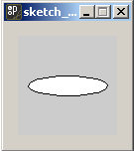
How to make your own computer software
Start Processing
Type ellipse(50,50,80,20);
Press "Run"
You should see this:

Slide 7
How to make your own computer software
ellipse(50,50,80,20);
An example of a function
functions "do something" this one "draws an ellipse with this size and position"
The numbers are called arguments or parameters

Slide 8
Coordinates in Computer Graphics
In computer graphics, the coordinate system is only positive.
The origin is the top left corner of the window
(0,0)
+ X
+ Y

Slide 9
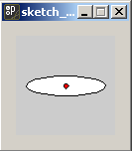
ellipse(50,50,80,20);
The first two arguments (in Red) are the x and y coordinates of the center of the ellipse
50
50

Slide 10
ellipse(50,50,80,20);
The third argument (in Yellow) is the width of the ellipse
The fourth argument (in Green) is the height
If the width and height are the same, the result is a circle
80
20

Slide 11
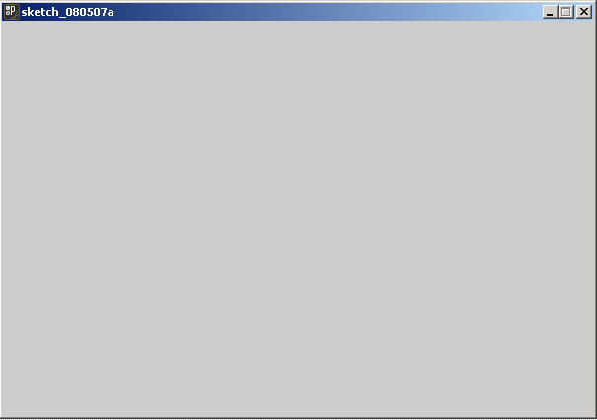
size(300,200);
Another function, should always be called first
This one increases (or decreases) the screen area
The two arguments are width and height
Keep your applets small, no bigger than 800x600, and usually smaller

Slide 12
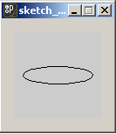
How to make your own computer software
noFill();
ellipse(50,50,80,20);
A program can use any number of functions
The noFill() function changes how ellipses are drawn
Notice that noFill() has no arguments, it's parenthesis are empty

Slide 13
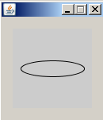
How to make your own computer software
noFill();
smooth();
ellipse(50,50,80,20);
smooth() also has no arguments
It smoothes out the curves of the ellipse

Slide 14
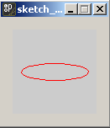
How to make your own computer software
noFill();
stroke(255,0,0);
ellipse(50,50,80,20);
The stroke() function changes the color of the outline
It's 3 arguments are the amount of Red, Green and Blue in the range 0 - 255

Slide 15
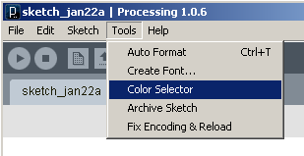
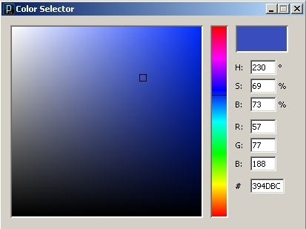
The Color Selector: click on the color you want and read the RGB values

Slide 16
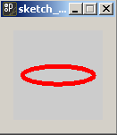
How to make your own computer software
noFill();
stroke(255,0,0);
strokeWeight(5);
ellipse(50,50,80,20);
The strokeWeight() function changes the thickness of the outline

Slide 17
Order is important
ellipse(50,50,80,20);
noFill();
stroke(255,0,0);
strokeWeight(5);
Here changing the stroke and fill has no effect, because it's done after the ellipse had already been drawn

Slide 18
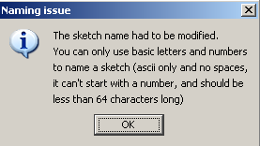
Java is very picky about names
You may get this error message:

Slide 19
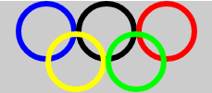
Program #1: Olympic Rings
Write a program that produces a design similar to the Olympic Rings with 5 differently colored circles
Your program will use the following functions (some more than once):
strokeWeight();
stroke()
ellipse()
size()
noFill()

Slide 20
Common Mistakes
Put each statement on a separate line.
Once you call noFill(), from then on, all ellipses will be unfilled. Don't call it more than once.
Same with smooth() and strokeWeight(). Don't call them more than once.

Slide 21
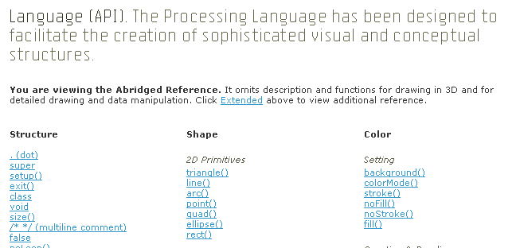
The Processing "Dictionary"
http://processing.org/reference/index.html
The API* is the dictionary of a computer language
* API stands for Application Programming Interface, but you don't really care and it won't be on the test

Slide 22
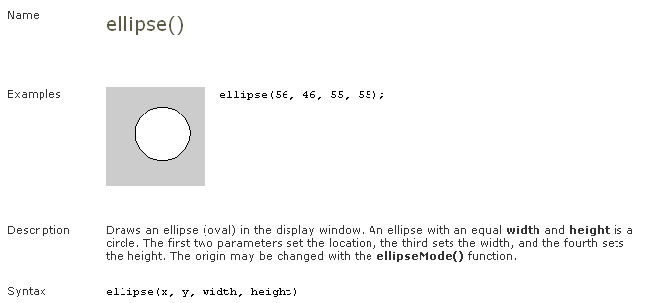
The "definition" of ellipse()

Slide 23
Drawing Functions
triangle()
rect() (also squares)
quad()
ellipse() (also circles)
point()
line()
bezier()and arc() (for curves)
beginShape()and endShape() (for polygons)

Slide 24
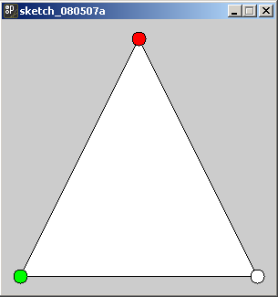
triangle(150,20,20,280,280,280);

Slide 25
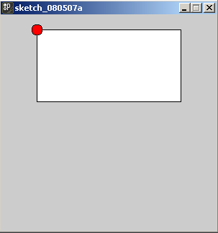
rect(50,20,200,100);

Slide 26
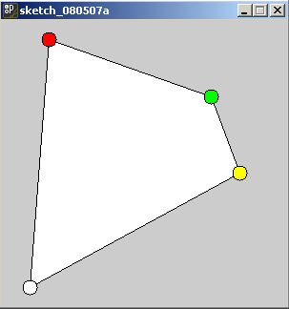
quad(50,20,220,80,250,160,30,280);

Slide 27
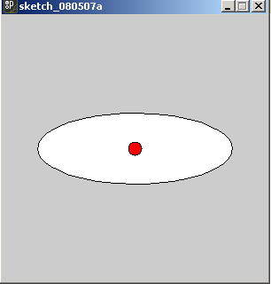
ellipse(150,150,220,80);

Slide 28
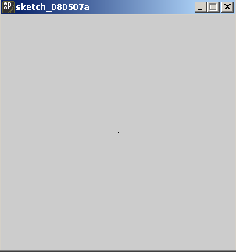
point(150,150);

Slide 29
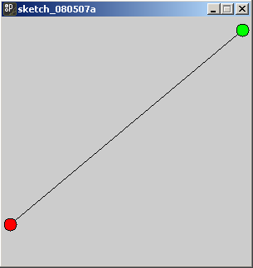
line(10,250,290,15);

Slide 30
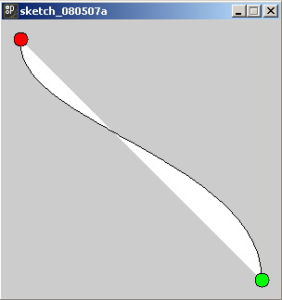
The endpoints
bezier(20,20,10,110,280,150,280,280);

Slide 31
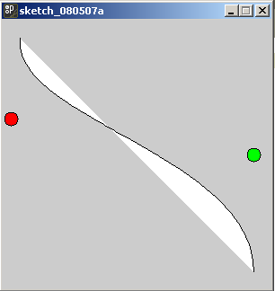
These two invisible points "pull" the curve
bezier(20,20,10,110,280,150,280,280);

Slide 32
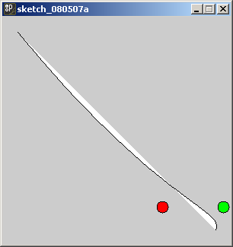
The effect at the ends is weaker
bezier(20,20,210,250,290,250,280,280);

Slide 33
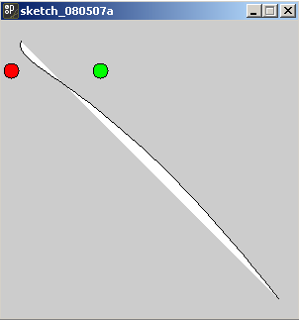
The effect at the ends is weaker
bezier(20,20,10,50,100,50,280,280);

Slide 34
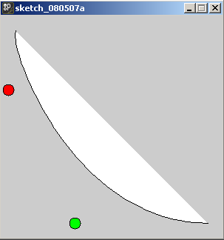
Both points on the same side
bezier(20,20,10,50,100,280,280,280);

Slide 35
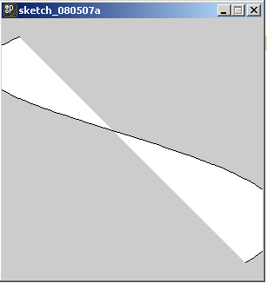
The points can be off the screen!
bezier(20,20,-200,110,500,150,280,280);

Slide 36
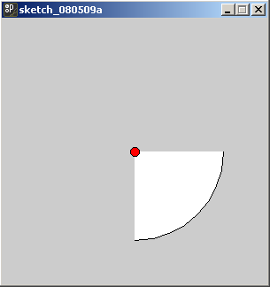
arc() draws part of an ellipse()
arc(150, 150, 200, 200, 0, PI/2);

Slide 37
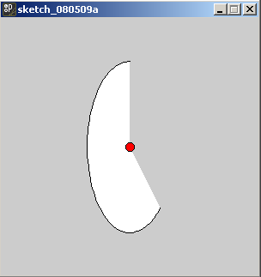
arc() draws part of an ellipse()
arc(150, 150, 100, 200, PI/4, 3*PI/2);

Slide 38
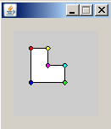
Polygons
beginShape();
vertex(20, 20);
vertex(40, 20);
vertex(40, 40);
vertex(60, 40);
vertex(60, 60);
vertex(20, 60);
endShape(CLOSE);

Slide 39
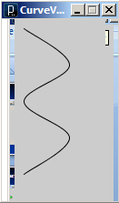
curveVertex
size(100,200);
noFill();
beginShape();
curveVertex(10,10);
curveVertex(10,10);
curveVertex(60,50);
curveVertex(10,90);
curveVertex(60,130);
curveVertex(10,170);
curveVertex(10,170);
endShape();

Slide 40
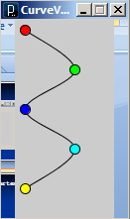
curveVertex
size(100,200);
noFill();
beginShape();
curveVertex(10,10);
curveVertex(10,10);
curveVertex(60,50);
curveVertex(10,90);
curveVertex(60,130);
curveVertex(10,170);
curveVertex(10,170);
endShape();

Slide 41
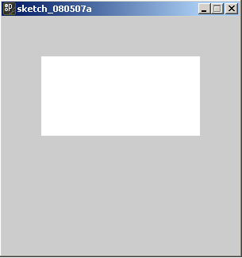
noStroke(); rect(50,50,200,100);

Slide 42
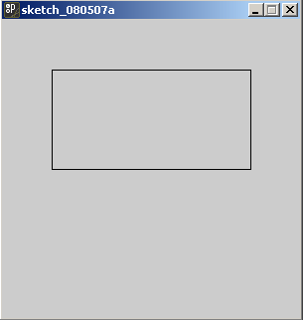
noFill(); rect(50,50,200,100);

Slide 43
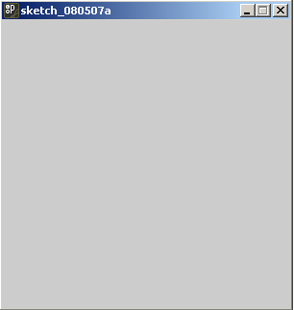
noFill(); noStroke(); rect(50,50,200,100);
Empty!

Slide 44
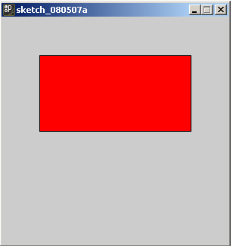
fill(255,0,0); rect(50,50,200,100);

Slide 45
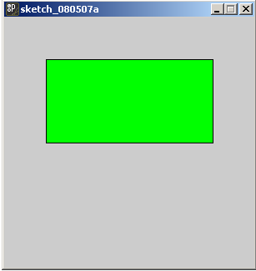
fill(0,255,0); rect(50,50,200,100);

Slide 46
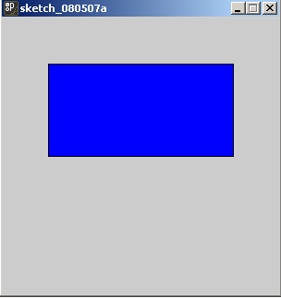
fill(0,0,255); rect(50,50,200,100);

Slide 47
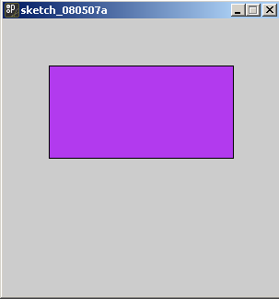
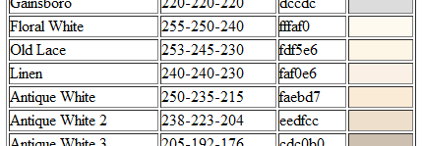
fill(178,58,238); rect(50,50,200,100); RGB Color Codes: http://www.tayloredmktg.com/rgb/

Slide 48
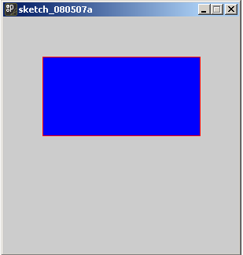
fill(0,0,255); stroke(255,0,0); rect(50,50,200,100);

Slide 49
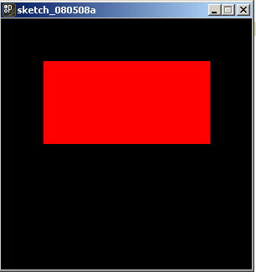
background(0,0,0); fill(255,0,0); rect(50,50,200,100);

Slide 50
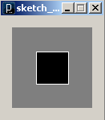
Grayscale
There are one argument versions of fill() and stroke() that give grayscale colors.
background(127); fill(0);
stroke(255); rect(30,30,40,40);
The default background is 204

Slide 51
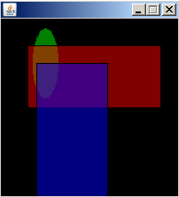
opacity
You can make shapes transparent by using the four argument version of fill()
the fourth argument is opacity
size(200,200);
background(0);
fill(0,255,0,127);
ellipse(50,50,30,80);
fill(255,0,0,127);
rect(30,30,150,70);
fill(0,0,255,127);
rect(40,50,80,170);

Slide 52
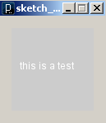
text("this is a test",10,50);

Slide 53
stroke(0); //no effect! text("this is a test",10,50);

Slide 54
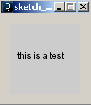
fill(0); text("this is a test",10,50);

Slide 55
textAlign(CENTER); text("this is a test",50,50);

Slide 56
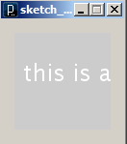
textSize(24); text("this is a test",10,50);

Slide 57
Don't use spaces in Java names
Java won't allow you to put spaces in the name of functions or programs
It's also a bad idea to use spaces in file names

Slide 58
Instead use CamelCase
CamelCase is a style of writing without spaces
It's "good style" to use CamelCase for names in Java
Each separate word in the name is capitalized within the compound—as in beginShape(), endShape(), MacGyver, or iPod.
It's named after the "humps" of the capitals

Slide 59
Comments
Two forms: Single and Multi-line
// Single Line
/* Multi-Line */
Tells the computer "ignore this", this is for people
Good Style: Always put your name, assignment , class and url in comments at the top of your program

Slide 60
Arithmetic
Calculations use the following arithmetic operators: + - * / %
The operators can be combined with numbers to make expressions.
The expression 5 + 3 evaluates to 8
Parenthesis can be used to create more complicated expressions
(5 * (2 – 3)) evaluates to -5

Slide 61
Expressions can be arguments
What will be the height and width of the following ellipse?
ellipse(150,150,2*(22+78),40*(8-2));

Slide 62
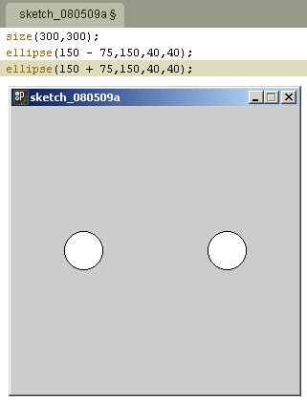
Symmetry
Expressions can be used to make placing symmetrical arrangements easier

Slide 63
Symmetry
size(300,300);
ellipse(150-75,150,40,40);
ellipse(150+75,150,40,40);

Slide 64
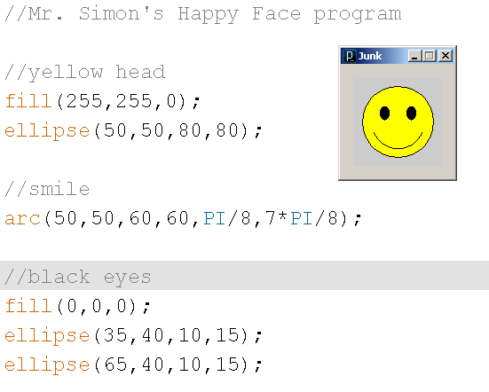
Comments can be used to organize the parts of your program

Slide 65
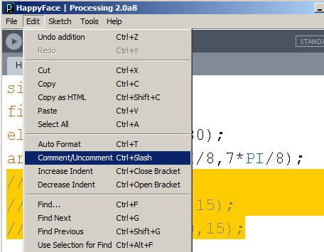
Commenting out code
It’s easy to forget what some code is doing
It’s best to focus on one thing at a time
You can temporarily remove code with Edit | Comment/Uncomment or Ctrl+/

Slide 66
Variables and Declarations
Sometimes you want a place to store a number in computer memory.
You can think of this as a "mailbox"
There different sizes of "mailboxes" for different kinds of numbers.
Integers: int
Decimals: float
Characters (Letters, Punctuation & Digits): char
boolean holds only true or false

Slide 67
Variables and Declarations
Vari-ables allow values to change

Slide 68
Variable Declarations & Initializations
To create a mailbox, you declare it.
int num;
num is the "name" of the variable
names can't have spaces or unusual characters
Once its declared you can store a number in it
num = 5;
This is called initializing
You can also do both at once
int value = 17;

Slide 69
Using variables in expression
Once a variable has been declared and initialized, you can use it in an expression
What will be the x and y coordinates of the center of the ellipse?
int value1 = 17;
int value2 = 13;
ellipse(50+value1,50-value2,12,44);

Slide 70
The assignment operator
= is called the assignment operator
It takes the value on the right, and puts it in the variable on the left
num = 5;
You can't do it the other way around!
5 = num;

Slide 71
The assignment operator
You can't do an assignment as an argument
ellipse(int x = 45,55,10,10);
You have to do in two separate lines
int x = 45;
ellipse(x,55,10,10);

Slide 72


The type of variable must match
You can't put a decimal in an int
Otherwise you'll get an error message

Slide 73
The assignment operator
This looks weird if you are use to algebra, but it's very common in programming
int x = 3;
x = x + 1;
What value is in the x variable after those two lines of code are executed?

Slide 74

Variables can be reused as many times as you like

Slide 75

Now With just one change. . .

Slide 76

"Moving" a circle
size(200,100);
int x = 50;
int y = 50;
ellipse(x,y,60,60);

Slide 77
"Moving" a circle
size(200,100);
int x = 50;
int y = 50;
ellipse(x,y,60,60);
x = x + 50;

Slide 78

"Moving" a circle
size(200,100);
int x = 50;
int y = 50;
ellipse(x,y,60,60);
x = x + 50;
ellipse(x,y,60,60);

Slide 79
"Moving" a circle
size(200,100);
int x = 50;
int y = 50;
ellipse(x,y,60,60);
x = x + 50;
ellipse(x,y,60,60);
x = x + 50;

Slide 80

"Moving" a circle
size(200,100);
int x = 50;
int y = 50;
ellipse(x,y,60,60);
x = x + 50;
ellipse(x,y,60,60);
x = x + 50;
ellipse(x,y,60,60);

Slide 81

Notice the difference?
size(200,100);
int x = 50;
int y = 50;
ellipse(x,y,60,60);
x = x + 50;
ellipse(x,y,60,60);
x = x + 50;
ellipse(x,y,60,60);

Slide 82
The top picture drew the left circle first, while the bottom drew the left circle last
size(200,100);
int x = 50;
int y = 50;
ellipse(x,y,60,60);
x = x + 50;
ellipse(x,y,60,60);
x = x + 50;
ellipse(x,y,60,60);

Slide 83
The bottom picture doesn't match the output of this program
size(200,100);
int x = 50;
int y = 50;
ellipse(x,y,60,60);
x = x + 50;
ellipse(x,y,60,60);
x = x + 50;
ellipse(x,y,60,60);

Slide 84






Find the matching output
size(100,100);
int x = 50;
int y = 50;
ellipse(x,y,60,60);
x = x + 30;
ellipse(x,y,60,60);
y = y - 30;
ellipse(x,y,60,60);
B
A
C
D
E
F

Slide 85
You wouldn't write a paper that was just one long paragraph
You'd have many paragraphs, each of which would focus on one topic
It's the same in programs—we divide our program into chunks called functions
Each function focuses on one job or task

Slide 86
Creating your own functions
Processing allows you to separate your program into different functions.
This is one of the key elements of good style, and makes programs easier to understand, modify and reuse.
A well designed function should do one thing; that is you should be able to describe what it does without using the word and or or.

Slide 87
setup() and draw()
Processing programs that use functions must contain two special functions called setup() and draw()
Put things that happen only once at the beginning in setup()
Put code that draws in draw()
You may create as many additional functions as you want

Slide 88

Happy Face Example
Let's say I had a program that drew a happy face

Slide 89

Happy Face Example
Here's what it would look like separated into setup() and draw() functions
void setup()
{
size(200,100);
}
void draw()
{
fill(255,255,0);
ellipse(100,50,80,80);
arc(100,50,60,60,PI/8,7*PI/8);
fill(0,0,0);
ellipse(85,40,10,15);
ellipse(115,40,10,15);
}

Slide 90
The syntax of functions
void setup()
{
size(200,100);
}
For now, every function starts with void which marks the beginning of the head
Then a name followed by parenthesis
Curly braces mark the beginning and ending of the body of the function
The head and body together are called the function definition

Slide 91

Happy Face Example
Here I've added my own face() and head() functions
void setup()
{
size(200,100);
}
void draw()
{
head();
face();
}
void head()
{
fill(255,255,0);
ellipse(100,50,80,80);
}
void face()
{
arc(100,50,60,60,PI/8,7*PI/8);
fill(0,0,0);
ellipse(85,40,10,15);
ellipse(115,40,10,15);
}

Slide 92

Oops! What happened?
void setup()
{
size(200,100);
}
void draw()
{
face();
head();
}
void head()
{
fill(255,255,0);
ellipse(100,50,80,80);
}
void face()
{
arc(100,50,60,60,PI/8,7*PI/8);
fill(0,0,0);
ellipse(85,40,10,15);
ellipse(115,40,10,15);
}

Slide 93


Auto Format
before
after
Ctrl T is the keyboard shortcut for Auto Format

Slide 94
Simple Animation
We can take advantage of the way setup() and draw() work to create simple animations
(demo)

Slide 95

loops make things repeat
Looping means repeating over and over
If you wanted to display 10 circles to the screen, you could copy and paste code like this:
noFill();
ellipse(5,50,50,50);
ellipse(15,50,50,50);
ellipse(25,50,50,50);
ellipse(35,50,50,50);
ellipse(45,50,50,50);
ellipse(55,50,50,50);
ellipse(65,50,50,50);
ellipse(75,50,50,50);
ellipse(85,50,50,50);
ellipse(95,50,50,50);

Slide 96
Loops
On the other hand, if you wanted to display100 or 1000 or even more circles to the screen, using copy and paste would be tedious
A much better way is to use a loop

Slide 97
while Loops
The simplest loop in java is the while loop
It uses a variable to keep track of how many repetitions to make
The variable has a starting point, an ending point, and some way of progressing from start to end

Slide 98
what is changing?
Each of the circles are identical except for one small change – each circle has a different x coordinate
noFill();
ellipse(5,50,50,50);
ellipse(15,50,50,50);
ellipse(25,50,50,50);
ellipse(35,50,50,50);
ellipse(45,50,50,50);
ellipse(55,50,50,50);
ellipse(65,50,50,50);
ellipse(75,50,50,50);
ellipse(85,50,50,50);
ellipse(95,50,50,50);

Slide 99
To store a changing value use a variable
We could make a variable for the changing x coordinate
noFill();
int x = 5;
ellipse(x,50,50,50);
x = x + 10;
ellipse(x,50,50,50);
x = x + 10;
ellipse(x,50,50,50);
//and so on. . .

Slide 100
Here it is with a while loop
This is the entire program!
noFill();
int x = 5;
while(x < 96)
{
ellipse(x,50,50,50);
x = x + 10;
}

Slide 101
Starting, stopping and progressing
This is the entire program!
noFill();
int x = 5;
while(x < 96)
{
ellipse(x,50,50,50);
x = x + 10;
}

Slide 102
How many ellipses will this program make?
int y = 25;
while(y < 76)
{
ellipse(50,y,25,25);
y = y + 25;
}

Slide 103

How many ellipses will this program make?
int y = 25;
while(y < 76)
{
ellipse(50,y,25,25);
y = y + 25;
}

Slide 104

Here’s a pattern of ellipses of different widths
size(300,300);
background(0);
smooth();
noFill();
stroke(240,20,229,175);
int w = 0;
while(w < 300)
{
ellipse(150,150,w,100);
w = w + 10;
}

Slide 105
How many lines will this program make?
int x = 10;
while(x < 91)
{
line(x,0,x,100);
x = x + 10;
}

Slide 106

How many lines will this program make?
int x = 10;
while(x < 91)
{
line(x,0,x,100);
x = x + 10;
}

Slide 107
What’s this program going to do?
int x = 0;
while(x < 100)
{
line(x,0,x,100);
x = x + 1;
}

Slide 108

What’s this program going to do?
int x = 0;
while(x < 100)
{
line(x,0,x,100);
x = x + 1;
}

Slide 109
We can extend this idea of filling the screen with different lines to make a gradient
(demo)

Slide 110

A program that uses a loop to make a gradient in the background
size(256,256);
int redAmount = 0;
int blueAmount = 255;
int x = 0;
while(x < 256)
{
stroke(redAmount,0,blueAmount);
line(x,0,x,255);
x = x + 1;
redAmount = redAmount + 1;
blueAmount = blueAmount - 1;
}

Slide 111
We can have additional variables to x change as well
size(256,256);
int redAmount = 0;
int blueAmount = 255;
int x = 0;
while(x < 256)
{
stroke(redAmount,0,blueAmount);
line(x,0,x,255);
x = x + 1;
redAmount = redAmount + 1;
blueAmount = blueAmount - 1;
}

Slide 112
Watch out for this mistake!
int x = 0;
while(x < 100);
{
line(x,0,x,100);
x = x + 1;
}

Slide 113
Not a complete sentence
int x = 0;
while(x < 100);
{
line(x,0,x,100);
x = x + 1;
}

Slide 114





Practice quiz question Find the output
int numCircles = 1;
while(numCircles < 5)
{
ellipse(50,numCircles * 20,30,40);
numCircles = numCircles + 1;
}
A
B
C
D
E

Slide 115




Practice quiz question Find the output
A
noFill();
int mystery = 10;
while( mystery < 100)
{
ellipse(50,50,mystery,mystery);
mystery = mystery + 10;
}
B
C
D

Slide 116

Symmetry in a loop
noFill();
int h = 10;
int offset = 0;
while(offset < 100)
{
ellipse(50 - offset,50,10,h);
ellipse(50 + offset,50,10,h);
h = h + 3;
offset = offset + 5;
}

Slide 117
Notice that offset is "in charge" of the loop and h is "along for the ride"
noFill();
int h = 10;
int offset = 0;
while(offset < 100)
{
ellipse(50 - offset,50,10,h);
ellipse(50 + offset,50,10,h);
h = h + 3;
offset = offset + 5;
}

Slide 118

Reversing a loop
This loop positions the x coordinates at 10, 20, 30, 40, 50, 60, 70, 80 and 90
int x = 10;
while(x < 91)
{
ellipse(x,50,20,20);
x = x + 10;
}

Slide 119

Reversing a loop
How would I make this pattern with the x coordinates at 90, 80, 70, 60, 50, 40, 30, 20 and 10?
int x = ??;
while(x ??)
{
ellipse(x,50,20,20);
x = x ??;
}

Slide 120
Reversing a loop
How would I make this pattern with the x coordinates at 90, 80, 70, 60, 50, 40, 30, 20 and 10?
int x = 90;
while(x ??)
{
ellipse(x,50,20,20);
x = x ??;
}

Slide 121
Reversing a loop
How would I make this pattern with the x coordinates at 90, 80, 70, 60, 50, 40, 30, 20 and 10?
int x = 90;
while(x > 9)
{
ellipse(x,50,20,20);
x = x ??;
}

Slide 122
Reversing a loop
How would I make this pattern with the x coordinates at 90, 80, 70, 60, 50, 40, 30, 20 and 10?
int x = 90;
while(x > 9)
{
ellipse(x,50,20,20);
x = x - 10;
}

Slide 123
A loop within a loop
How many ellipses will this program make?
int y = 20;
while (y < 81)
{
ellipse(50,y,20,20);
y = y + 30;
}

Slide 124

A loop within a loop
How many ellipses will this program make?
int y = 20;
while (y < 81)
{
ellipse(50,y,20,20);
y = y + 30;
}

Slide 125
A loop within a loop
int x = 20;
while(x < 81)
{
int y = 20;
while (y < 81)
{
ellipse(x,y,20,20);
y = y + 30;
}
x = x + 30;
}
Now, what if we put that loop inside another loop ? How many ellipses would we get?

Slide 126

A loop within a loop
int x = 20;
while(x < 81)
{
int y = 20;
while (y < 81)
{
ellipse(x,y,20,20);
y = y + 30;
}
x = x + 30;
}

Slide 127

A loop within a loop
int x = 20;
while(x < 81)
{
int y = 20;
while (y < 81)
{
line(x,y,50,50);
y = y + 30;
}
x = x + 30;
}
I’ve changed it to make 9 lines

Slide 128

A loop within a loop
int x = 20;
while(x < 81)
{
int y = 20;
while (y < 81)
{
line(x,y,50,50);
y = y + 6;
}
x = x + 6;
}
Now how many lines?

Slide 129
A loop within a loop
int x = 20;
while(x < 81)
{
int y = 20;
while (y < 81)
{
line(x,y,50,50);
y = y + 6;
}
x = x + 6;
}
121!

Slide 130
Rotatations
You can use rotate() and translate() to rotate shapes, but it's very confusing
You will NOT be tested on rotate() and translate()

Slide 131

Rotatations
ellipse(50,50,80,20);

Slide 132

Rotatations
rotate(PI/4);
ellipse(50,50,80,20);

Slide 133

Rotatations
translate(50,50);
rotate(PI/4);
ellipse(50,50,80,20);

Slide 134

Rotatations
translate(50,50);
rotate(PI/4);
ellipse(0,0,80,20);

Slide 135

Rotatations
translate(50,50);
rotate(PI/4);
ellipse(0,0,80,20);
ellipse(50,50,80,20);

Slide 136

Rotatations
translate(50,50);
rotate(PI/4);
ellipse(0,0,80,20);
rotate(-PI/4);
translate(-50,-50);
ellipse(50,50,80,20);

Slide 137

Oops! Colors must stay between 0 & 255
size(300, 300);
int white = 0;
int x = 0;
while (x < 300)
{
stroke(white);
line(x, 0, x, 300);
white = white + 1;
x = x + 1;
}

Slide 138

A "scaled" gradient
size(300, 300);
float white = 0;
int x = 0;
while (x < 300)
{
stroke(white);
line(x, 0, x, 300);
white = white + 255.0/300.0;
x = x + 1;
}

Slide 139

Fade from Sea Green 46-164-87 to Sandy Brown 244-139-96
size(300,200);
float r = 46;
float g = 164;
float b = 87;
int x = 0;
while(x < 300)
{
stroke(r,g,b);
line(x,0,x,200);
x = x + 1;
r = r + (244-46)/300.0;
g = g + (139-164)/300.0;
b = b + (96-87)/300.0;
}

Slide 140
Modern programs are very big—they are organized into Functions
Year | Operating System | Lines of Code
1993 | Windows NT 3.1 | 6,000,000
1996 | Windows NT 4.0 | 16,000,000
2000 | Windows 2000 | 29,000,000
2001 | Windows XP | 40,000,000
2005 | Windows Vista Beta 2 | 50,000,000
2005 | Mac OS X 10.4 | 86,000,000
2005 | Red Hat Linux 7.1 | 30,000,000
2005 | Debian GNU/Linux | 213,000,000
Programs can be difficult to understand Windows Vista has over 50,000,000 lines of computer code!
One way to make programs easier to understand is to break them down into smaller "chunks" or modules
One name for these modules is functions

Slide 141
You wouldn't write a paper that was just one long paragraph
You'd have many paragraphs, each of which would focus on one topic
It's the same in programs—we divide our program into chunks called functions
Each function focuses on one job or task

Slide 142
Creating your own functions
Processing allows you to separate your program into different functions.
This is one of the key elements of good style, and makes programs easier to understand, modify and reuse.
A well designed function should do one thing; that is you should be able to describe what it does without using the word and or or.

Slide 143
setup() and draw()
Processing programs that use functions must contain two special functions called setup() and draw()
Put things that happen only once at the beginning in setup()
Put code that draws in draw()
You may create as many additional functions as you want

Slide 144
Happy Face Example
Let's say I had a program that drew a happy face

Slide 145
Happy Face Example
Here's what it would look like separated into setup() and draw() functions
void setup()
{
size(200,100);
}
void draw()
{
fill(255,255,0);
ellipse(100,50,80,80);
arc(100,50,60,60,PI/8,7*PI/8);
fill(0,0,0);
ellipse(85,40,10,15);
ellipse(115,40,10,15);
}

Slide 146
The syntax of functions
void setup()
{
size(200,100);
}
For now, every function starts with void which marks the beginning of the head
Then a name followed by parenthesis
Curly braces mark the beginning and ending of the body of the function
The head and body together are called the function definition

Slide 147
Happy Face Example
Here I've added my own face() and head() functions
void setup()
{
size(200,100);
}
void draw()
{
head();
face();
}
void head()
{
fill(255,255,0);
ellipse(100,50,80,80);
}
void face()
{
arc(100,50,60,60,PI/8,7*PI/8);
fill(0,0,0);
ellipse(85,40,10,15);
ellipse(115,40,10,15);
}

Slide 148
Oops! What happened?
void setup()
{
size(200,100);
}
void draw()
{
face();
head();
}
void head()
{
fill(255,255,0);
ellipse(100,50,80,80);
}
void face()
{
arc(100,50,60,60,PI/8,7*PI/8);
fill(0,0,0);
ellipse(85,40,10,15);
ellipse(115,40,10,15);
}

Slide 149
Auto Format
before
after
Ctrl T is the keyboard shortcut for Auto Format

Slide 150
Simple Animation
We can take advantage of the way setup() and draw() work to create simple animations
(demo)

Slide 151
while loops and draw()
One of the most confusing things in processing is the “invisible” loop that repeatedly cause the draw() function to run
while loops will run instantaneously
The draw() function loops over time

Slide 152

while loops and draw()
This program draws all the circles immediately
void setup()
{
size(300,300);
noFill();
}
void draw()
{
int diam = 40;
while(diam < 300)
{
ellipse(150,150,diam,diam);
diam = diam + 10;
}
}

Slide 153



while loops and draw()
This program draws the circles one at a time
int diam = 40;
void setup()
{
size(300, 300);
noFill();
}
void draw()
{
ellipse(150, 150, diam, diam);
diam = diam + 10;
}

Slide 154
while loops and draw()
The general rule of thumb is:
If you want the loop to run immediately, use a while loop
If you want an animation that changes over time, use the “invisible” draw() loop

Slide 155

Download Latest Processing 2.0.3
Download and “Extract All” to your downloads folder
If you are not sure how to do it, don’t worry, I can talk you through it
No rush, in the next week or two

Slide 156

Animating with rotate()
You can make a animation that rotates objects by changing the amount of rotation (called rot in this program) over time

Slide 157
Checking the value in a variable
One of the confusing things in programming is keeping track of the values as they change
You can print the values to the black box at the bottom of Processing with
print() //on same line
println() //print first
//then next line

Slide 158


Checking the value in a variable
Apparently (15%2) + 27 is 28

Slide 159
Printing Text
Text can be words, sentences, paragraphs, numbers and more
It's any collection of characters, punctuation, numbers and spaces
To print text use double quotes
print("Testing, 1, 2, 3");
"Testing, 1, 2, 3" is an example of a literal

Slide 160
Functions and variable declarations
If you declare a variable in a function, you can only use it in that function
void setup()
{
int num = 5;
println(num);
}
void draw()
{
println(num);
}

Slide 161
Functions and variable declarations
If you declare a variable in a function, you can only use it in that function
void setup()
{
int num = 5;
println(num); //OK!
}
void draw()
{
println(num);
}

Slide 162
Functions and variable declarations
If you declare a variable in a function, you can only use it in that function
void setup()
{
int num = 5;
println(num);
}
void draw()
{
println(num); //Error!
}

Slide 163

Functions and variable declarations
void setup()
{
int num = 5;
println(num);
}
void draw()
{
println(num); //Error!
}

Slide 164
The basic scope rule*
Scope is like a neighborhood, it's where the variable is known
The basic scope rule* is the scope of variable begins with it's declaration and ends with the closing curly brace of the block of code where it was declared
*there are exceptions to this rule, but we don't really care and we certainly aren't going to worry about it now

Slide 165
The scope of diameter is in yellow
void draw()
{
ellipse(30,30,50,80);
noFill();
strokeWeight(5);
int diameter = 100;
stroke(255,0,0);
ellipse(60,60,diameter,diameter);
println(diameter);
}

Slide 166
If you declare the variable at the top of the program outside of any function, it's scope is the entire program
int diameter = 10;
void setup()
{
println(diameter); //OK
}
void draw()
{
ellipse(30,30,50,80);
noFill();
strokeWeight(5);
diameter = diameter + 10; //OK
stroke(255,0,0);
ellipse(60,60,diameter,diameter); //OK
println(diameter); //OK
}

Slide 167
Local vs. Global
A global variable can be used anywhere in the program
You create a global variable by declaring it at the top of the program
A local variable is declared in a function

Slide 168

The circle gets bigger
int diameter = 10;
void setup()
{
size(300,300);
noFill();
}
void draw()
{
ellipse(150,150,diameter,diameter);
diameter = diameter + 10;
}

Slide 169

The circle DOESN'T get bigger
void setup()
{
size(300,300);
noFill();
}
void draw()
{
int diameter = 10;
ellipse(150,150,diameter,diameter);
diameter = diameter + 10;
}

Slide 170

the background drawn once (leaves a trail of circles)
int x = 0;
void setup()
{
background(0,0,0);
stroke(255,255,255);
noFill();
}
void draw()
{
ellipse(x,50,20,20);
x = x + 5;
}

Slide 171

the background is drawn every time the screen is drawn (no trail)
int x = 0;
void setup()
{
stroke(255,255,255);
noFill();
}
void draw()
{
background(0,0,0);
ellipse(x,50,20,20);
x = x + 5;
}

Slide 172

A black rectangle drawn every time with opacity (faint trail)
int x = 0;
void setup()
{
stroke(255,255,255);
noFill();
background(0,0,0);
}
void draw()
{
fill(0,0,0,10);
rect(0,0,100,100);
ellipse(x,50,20,20);
x = x + 5;
}
* thanks Arthur!

Slide 173




Practice Quiz Question
Which picture matches the output of this program?
void setup()
{
background(0,0,0);
}
void draw()
{
anotherMystery();
mysteryFunction();
fill(255,0,0);
ellipse(50,50,40,40);
}
void mysteryFunction()
{
fill(0,255,0);
ellipse(60,50,40,40);
}
void anotherMystery()
{
fill(0,0,255);
ellipse(70,50,40,40);
}
A
B
C
D

Slide 174
The if statement
if(num > 150)
{
println("num is pretty big");
}
a "test" within parentheses ( )
a block of statements within curly braces { }.
The test is any expression that evaluates to true or false.
The if-statement evaluates the test and then runs the body code only if the test is true. If the test is false, the body is skipped.

Slide 175


if statement
int num = 5;
if(num > 2)
{
println("It worked!");
}

Slide 176


if statement
int num = 5;
if(num > 7)
{
println("It worked!");
}
Empty!

Slide 177
Using an if to "start over if it gets too big"
int diameter = 10;
void setup()
{
size(300,300);
background(0,0,0);
noFill();
stroke(255,255,255);
}
void draw()
{
ellipse(150,150,diameter,diameter);
diameter = diameter + 20;
if(diameter > 300)
{
background(0,0,0);
diameter = 10;
}
}

Slide 178
Watch our for this mistake!
if(diameter > 300);
{
background(0,0,0);
diameter = 10;
}

Slide 179
Don't put a semi-colon here
if(diameter > 300);
{
background(0,0,0);
diameter = 10;
}
If diameter is greater than 300 is not a complete sentence

Slide 180
Now it's correct
if(diameter > 300)
{
background(0,0,0);
diameter = 10;
}
If diameter is greater than 300, then draw a black background and set diameter to 30 is a complete sentence

Slide 181




Find the Output
void setup()
{
size(300,300);
}
void draw()
{
mystery3();
mystery1();
}
void mystery1()
{
ellipse(150,100,150,150);
}
void mystery2()
{
ellipse(150,150,150,150);
}
void mystery3()
{
ellipse(150,200,150,150);
}
A
B
C
D

Slide 182
A Circle that moves left to right
int x = 0;
void setup()
{
size(300,300);
}
void draw()
{
background(0);
ellipse(x,150,30,30);
x = x + 1;
}

Slide 183
A Circle that moves back & forth
int x = 0;
int change = 1;
void setup()
{
size(300,300);
}
void draw()
{
background(0);
ellipse(x,150,30,30);
x = x + change;
if(x > 300)
{
change = -1;
}
if(x < 0)
{
change = 1;
}
}

Slide 184

Changing the amount of change
The rate of change in the x and y direction is the slope. If the rate of change stays the same, the result is a straight line. Changing the amount of change produces a curve
int x = 0;
int y = 0;
int xChange = 1;
void setup()
{
size(300,300);
}
void draw()
{
ellipse(x,y,10,10);
x = x + xChange;
y = y + 1;
if(x < 150)
{
xChange = xChange + 1;
}
if(x >= 150)
{
xChange = xChange - 1;
}
}

Slide 185

Changing the amount of change
Here the ball bounces off the botton of the screen when we change changeY to be equal to it’s opposite.
float x = 0;
float y = 0;
float changeX = 1;
float changeY = 0;
void setup()
{
size(300,300);
background(0);
}
void draw()
{
fill(0,0,0,8);
rect(0,0,300,300);
fill(255);
ellipse(x,y,30,30);
x = x + changeX;
y = y + changeY;
changeY = changeY + .02;
if(x > 300)
{
changeX = -1;
}
if( x < 0)
{
changeX = 1;
}
if(y > 300)
{
changeY = -changeY;
}
}

Slide 186




Practice quiz question
A
Find the output that best matches the following code
int mystery = 0;
void setup()
{
noFill();
}
void draw()
{
ellipse(50,mystery,20,20);
mystery = mystery + 15;
}
B
C
D

Slide 187
Expressions vs. Literals
These two function calls produce different output
println("2 + 3");
println( 2 + 3);

Slide 188
Expressions vs. Literals
These two function calls produce different output
println("2 + 3");
//displays 2 + 3
println(2 + 3);
//displays 5

Slide 189
print() vs. println()
println() means "go to the next line AFTER you print."
print() doesn't
print("x");
print(2);
//displays: x2
println("x");
println(2);
//displays: x
// 2

Slide 190
Whitespace
You can make the output more readable by including blank whitespace
print(2);
print("and");
print(2);
print("makes");
print(4);
//displays 2and2makes4
print(2);
print(" and ");
print(2);
print(" makes ");
print(4);
//displays 2 and 2 makes 4
Processing generally ignores whitespace unless you place it in a literal surrounded by double quotes

Slide 191

Printing two variables
You might use both print() and println() to keep track of two variables

Slide 192
Practice with print()
What's the output?
int x = 2;
print("x");
print(x);

Slide 193
Practice with print()
Now, what's the output?
int x = 2;
println("x");
println(x);

Slide 194
Practice with print()
Here's another one
int x = 2;
int y = 3;
println("x");
println(x);
println("y");
println(y);

Slide 195
Practice with print()
Notice some are print and some are println
int x = 2;
int y = 3;
print ("x");
println(x);
print ("y");
println(y);

Slide 196
Practice with print()
Here the order of print and println are reversed
int x = 2;
int y = 3;
println ("x");
print(x);
println ("y");
print(y);

Slide 197
Practice Quiz Question
What is the output of the following program?
int x = 13 / 5;
int y = 13 % 5;
print("x");
print(x);
println("y");
print(y);

Slide 198
Input
Most programs we see get input from people
The most common ways people provide input are:
Typing on the keyboard
Moving and/or clicking the mouse

Slide 199
Input
Processing makes input from the mouse and keyboard about as easy as it gets
There are several predefined "system variables"
mouseX
mouseY
key
“Predefined system variables” are variables that Processing has already declared and initialized

Slide 200
Moving a circle with the mouse
void setup()
{
size(300,300);
}
void draw()
{
ellipse(mouseX,mouseY,30,30);
}
The ellipse will track the mouse

Slide 201
Functions that respond to events
keyTyped()
keyPressed()
keyReleased()
mouseMoved()
mousePressed()
mouseReleased()
mouseClicked()
mouseDragged()

Slide 202
Painting only if mouse is dragged
void setup()
{
size(300,300);
}
void draw()
{
}
void mouseDragged()
{
ellipse(mouseX,mouseY,10,10);
}

Slide 203
More on if: Relational Operators
< <= == >= > !=
if statements are created by comparing two things
if(5 < 3)
if(num == 5)
if(num >= 5)
if(num != 5)
if the the comparison in the parenthesis is true, the code in the curly braces after the if executes. Otherwise it is skipped.

Slide 204
More on if: Relational Operators
if (num1 < num2 < num3)
Comparisons must be done two at a time

Slide 205
More on if: Relational Operators
< <= == >= > !=
The operators that are used for comparisons are called relational operators

Slide 206
= vs. ==
A single equals (called the assignment operator) MAKES two things equal
num = 3;
Don't put this in an if—it will always be true!
The double equals asks a question: Are these two things equal?
num==3
Use the double equals anywhere you would use a condition: if, etc.
if(num==3)
{
println("num is three");
}

Slide 207
Moving the ellipse with the keyboard
int x, y;
void setup()
{
size(300,300);
x = 150;
y = 150;
}
void draw()
{
ellipse(x,y,30,30);
}
void keyPressed()
{
if(key == 'w')
{
y = y - 5;
}
}

Slide 208
More system variables: pmouseX and pmouseY
mouseX and mouseY hold the current position of the mouse
pmouseX and pmouseY hold the previous position of the mouse

Slide 209

A drawing program
void setup()
{
size(300,300);
}
void draw()
{
stroke(0);
fill(0,0,0,10);
rect(0,0,300,300);
}
void mouseDragged()
{
stroke(255);
line(mouseX,mouseY,pmouseX,pmouseY);
}

Slide 210

The complete list of input functions and variables is in the API

Slide 211
Painting only if the right mouse button is clicked
void setup()
{
size(300,300);
}
void draw()
{
}
void mousePressed()
{
if(mouseButton==RIGHT)
{
ellipse(mouseX,mouseY,10,10);
}
}

Slide 212
boolean variables
booleans are the smallest, simplest kind of "mailbox"
They can hold only one of two possible values: true or false
Examples:
boolean zoom = true;
boolean cond = 3 >= 3;
boolean isBig = num > 7;

Slide 213
Painting only if the mouse is pressed and a key is pressed
void setup()
{
size(300,300);
}
void draw()
{
}
void keyPressed()
{
if(mousePressed==true)
{
ellipse(mouseX,mouseY,10,10);
}
}

Slide 214
Painting only if the mouse is pressed and a key is pressed a different way
void setup()
{
size(300,300);
}
void draw()
{
}
void mousePressed()
{
if(keyPressed==true)
{
ellipse(mouseX,mouseY,10,10);
}
}

Slide 215

Logical Operators
&& //AND
|| //OR
! //NOT
Used to combine multiple conditions ("tests")
Truth tables shown at right above
Examples
( 0 < nCount ) && ( nCount <= 100 )
( 0 < nCount ) || ( nCount <= 100 )
(‘A’ <= cGrade) && (cGrade <= ‘F’)
! (19 >= nAge && nAge >= 13)
19 < nAge || nAge < 13

Slide 216
Painting only if the mouse is dragged and the 'w' key is pressed
void setup()
{
size(300,300);
}
void draw()
{
}
void mouseDragged()
{
if(keyPressed == true && key == 'w')
{
ellipse(mouseX,mouseY,10,10);
}
}

Slide 217
Practice Quiz Question: What is the output?
int num = 4;
float dNum = 7.2;
if((num > 5) && (dNum < 8))
{
println("first");
}
if((num > 5) || (dNum < 8))
{
println("second");
}
if(!(num > 5))
{
println("third");
}
if(!(dNum < 8))
{
println("fourth");
}

Slide 218
Watch out for this error
int num = 5;
if(num > 7);
{
println("num is big");
}

Slide 219
There shouldn't be a semi-colon here
int num = 5;
if(num > 7);
{
println("num is big");
}

Slide 220
There shouldn't be a semi-colon here
int num = 5;
if(num > 7);
{
println("num is big");
}
Is "If num is greater than 7." a complete sentence?

Slide 221
Now it's fixed
int num = 5;
if(num > 7)
{
println("num is big");
}
No, the complete sentence is "If num is greater than 7 then num is big."

Slide 222
Symmetrical reflections (mirrors)
(50,30)
200
300

Slide 223
Symmetrical reflections (mirrors)
(50,30)
50
200
300

Slide 224
Symmetrical reflections (mirrors)
(50,30)
50
50
200
300

Slide 225
Symmetrical reflections (mirrors)
(50,30)
(300-50,30)
50
50
200
300

Slide 226

Symmetrical reflections (mirrors)
void setup()
{
size(300,300);
}
void draw()
{
ellipse(mouseX,mouseY,10,10);
ellipse(300-mouseX,mouseY,10,10);
}

Slide 227

Android Mode
You can put a processing program on your Android phone or tablet fairly easily
The process is called side loading
First, you need to go to the settings on your Android device to allow installation of non-Market apps from Unknown Sources

Slide 228
Android Mode
For Android mode to work, we need to install two additional pieces of software:
The Android SDK (Software Developers Kit)
The USB drivers for your phone
You can find the details at http://wiki.processing.org/w/Android
The Android SDK and drivers for HTC & Samsung phones and Google Nexus tablets have already been installed on the computers here in room 334

Slide 229
Android Mode
You should probably make a couple changes to your program
You can’t use size(). Since your phone’s screen is fixed in size you will need to use the system variables width and height instead.
Also, you can’t use mouseButton
Other than that your program should work just fine

Slide 230


Android Mode
Save your program
Switch to Android mode
Connect your phone to the computer with a usb cable
Choose Run on device
Your program will be installed on your Android device and started

Slide 231
Random numbers
The random() function has two versions:
random(5) returns a decimal value between 0 and up to but not including 5.0
random(-5, 10.2) returns a decimal value between -5.0 and up to but not including 10.2.
To drop the decimal part of a random number, use the int() function.
int randNum = int(random(6));
randNum now holds an integer from 0 up to but not including 6: {0,1,2,3,4,5}

Slide 232
dice example
Let's say I wanted to make an applet that simulated rolling a single six sided die
What numbers would be possible?

Slide 233
dice example
Let's say I wanted to make an applet that simulated rolling a single six sided die
What numbers would be possible?
{1,2,3,4,5,6}

Slide 234
dice example
Let's say I wanted to make an applet that simulated rolling a single six sided die
What numbers would be possible?
{1,2,3,4,5,6}
int roll = ??

Slide 235
dice example
Let's say I wanted to make an applet that simulated rolling a single six sided die
What numbers would be possible?
{1,2,3,4,5,6}
int roll = int(random(?,?));

Slide 236
dice example
Let's say I wanted to make an applet that simulated rolling a single six sided die
What numbers would be possible?
{1,2,3,4,5,6}
int roll = int(random(?,?));
+1

Slide 237
dice example
Let's say I wanted to make an applet that simulated rolling a single six sided die
What numbers would be possible?
{1,2,3,4,5,6}
int roll = int(random(1,7));
+1

Slide 238
A bug with negative arguments
What arguments would you use to get this range?
{-3,-2,-1,0,1,2,3}
int roll = int(random(?,?));

Slide 239
A bug with negative arguments
For some reason the low limit is one less.
{-3,-2,-1,0,1,2,3}
int roll =int(random(-4,4));
+1
-1

Slide 240
Random Walk
The position or state of an object changes unpredictably (by a random amount) over time
Software uses random walks to model many "real life" things including:
Weather
Stock Prices
Load on a web server
Chemistry (gas particles)
Biology (food foraging)

Slide 241
More Random Walk examples
http://www.mit.edu/~kardar/teaching/projects/chemotaxis(AndreaSchmidt)/random.htm

Slide 243
A Random Walk isn't a Random Jump
I'd call this a random jump
x = int(random(0,400));

Slide 244
A Random Walk isn't a Random Jump
I'd call this a random jump
x = int(random(0,400));
I'd call this a random walk
x = x + int(random(-2,2));

Slide 245

A one-dimensional random walk
The one dimension is the x axis, y doesn't change
int x = 150;
void setup()
{
size(300,100);
}
void draw()
{
background(0);
ellipse(x,50,40,40);
x = x + int(random(-2,2));
}

Slide 246
Practice Quiz Questions
Fill in the blanks to create the indicated random numbers
A random integer from 0 to 10: (including 10)
int(random(________))
A random integer from 1 to 100: (including 100)
int(random(________))
A random integer from -5 to 5: (including -5 & 5)
int(random(________))

Slide 247
if and if/else
int num = 5;
if(num > 150)
{
num = 5;
}
An if controls some code that either runs or doesn't
if(num > 150)
{
num = 5;
}
else
{
num = num + 10;
}
An if/else always runs the code in the if or the else, but never both

Slide 248
"Chained" if/else
if(temp > 80)
{
println("Go swimming");
}
else if(temp > 50)
{
println("Go Fishing");
}
else if(temp > 32)
{
println("Go hot tubbing");
}
else
{
println("Go sledding");
}

Slide 249
if vs. if/else
void draw()
{
background(204);
if(int(random(4)) == 0)
{
ellipse(50,50,100,100);
}
if(int(random(4)) == 1)
{
ellipse(150,50,100,100);
}
if(int(random(4)) == 2)
{
ellipse(250,50,100,100);
}
if(int(random(4)) == 3)
{
ellipse(350,50,100,100);
}
}
Here is a program that uses four separate ifs
void setup()
{
size(400,100);
frameRate(2);
}

Slide 250


if vs. if/else
void draw()
{
background(204);
if(int(random(4)) == 0)
{
ellipse(50,50,100,100);
}
if(int(random(4)) == 1)
{
ellipse(150,50,100,100);
}
if(int(random(4)) == 2)
{
ellipse(250,50,100,100);
}
if(int(random(4)) == 3)
{
ellipse(350,50,100,100);
}
}
Every time the screen is drawn I could see any number of ellipses from 0 to 4

Slide 251
if vs. if/else
void draw()
{
background(204);
int num = int(random(4));
if(num == 0)
{
ellipse(50,50,100,100);
}
else if(num == 1)
{
ellipse(150,50,100,100);
}
else if(num == 2)
{
ellipse(250,50,100,100);
}
else
{
ellipse(350,50,100,100);
}
}
Here is a program that uses a chained if/else
void setup()
{
size(400,100);
frameRate(2);
}

Slide 252


if vs. if/else
void draw()
{
background(204);
int num = int(random(4));
if(num == 0)
{
ellipse(50,50,100,100);
}
else if(num == 1)
{
ellipse(150,50,100,100);
}
else if(num == 2)
{
ellipse(250,50,100,100);
}
else
{
ellipse(350,50,100,100);
}
}
Every time the screen is drawn I will see exactly 1 ellipse

Slide 253
Practice Quiz Question: What is the output of this program?
int num1= 2;
int num2 = 7;
float decimal = 9;
if(num1 == 2)
{
println("First");
}
else if (num2 == 3)
{
println("Second");
}
else if (decimal == 9)
{
println("Third");
}
else
{
println("Fourth");
}
if(num2/num1 != 1)
{
println("Fifth");
}
if(num2/num1 != 3)
{
println("Sixth");
}
else
{
println("Seventh");
}

Slide 254

Using Pictures and Images
Processing can display .gif, .jpg, .tga, and .png image
First, choose Sketch | Add File to select the the image you want

Slide 255
Images
Now, write code like this, where hallway.jpg is the name of the picture
PImage b;
void setup()
{
size(415,350);
b = loadImage("hallway.jpg");
}
void draw()
{
image(b, 0, 0,415,350);
}

Slide 256

Using a URL for an image
Another way to load an image into your program is with a URL
Right click on an image that’s on the internet and select Copy image URL

Slide 257

Using a url for an image

Slide 258
Images
b is the name of the variable that holds the image
0,0 is the x and y of the top left hand corner
415,350 is the width and height
PImage b;
void setup()
{
size(415,350);
b = loadImage("hallway.jpg");
}
void draw()
{
image(b, 0, 0 ,415,350);
}

Slide 259
Using an image for the background()
Make sure the size() of the applet is the same as the size of the image.
PImage bill;
void setup()
{
size(450,315);
bill = loadImage("bill-gates-mugshot.jpg");
}
void draw()
{
background(bill);
}

Slide 260

tint()
You can change the color and opacity of an image with the tint function
PImage checkers;
void setup()
{
size(400,400);
checkers =
loadImage("OpArt.JPG");
}
void draw()
{
background(0);
image(checkers,50,
50,152,138);
}

Slide 261

tint()
tint(255,0,0); will give a red tint
PImage checkers;
void setup()
{
size(400,400);
checkers =
loadImage("OpArt.JPG");
}
void draw()
{
background(0);
tint(255,0,0);
image(checkers,50,
50,152,138);
}

Slide 262

tint(255,255,255,130); will give no tint (it's white) but will change the opacity
PImage checkers;
void setup()
{
size(400,400);
checkers =
loadImage("OpArt.JPG");
}
void draw()
{
background(0);
tint(255,255,255,130);
image(checkers,50,
50,152,138);
image(checkers,75,
75,152,138);
}

Slide 263

Adding Sound
To create a program that uses sound, we need to import a library called minim
A library is extra code that other programmers have made available for us to use
import is like “invisibly” cutting and pasting someone else’s code into our program

Slide 264

Adding Sound
Then, we need to add the file that has the sound
It can be a WAV, AIFF, AU, SND, or MP3 file
Choose Sketch | Add File and browse to the file

Slide 265
If the file I just added was mysong.mp3, the following code would play it when the program starts
Minim minim;
AudioPlayer song;
void setup()
{
minim = new Minim(this);
// this loads mysong.mp3 from the data folder
song = minim.loadFile("mysong.mp3");
song.play();
}
void draw(){} //empty for now
void stop()
{
song.close();
minim.stop();
super.stop();
}

Slide 266
Other useful functions
song.play(1000)starts the song from 1000 milliseconds (1 second)
song.rewind()
song.loop() plays the song continuously
song.loop(3) plays the song 3 times
song.setLoopPoints(1000,2000) will set the loop points to 1 second and 2 second
song.pause()

Slide 267

Which dot is moving in a random walk?

Slide 268

Which dot is moving in a random walk?

Slide 269

Which dot is moving in a random walk?

Slide 270

Which dot is moving in a random walk?

Slide 271

Which dot is moving in a random walk?

Slide 272

Which dot is moving in a random walk?

Slide 273

Which dot is moving in a random walk?

Slide 274
Random Walks
In a random walk, you always take one step at a time
You don't take different size random jumps to an entirely new random location
In a random walk, if we leave a trail, there will not be any gaps

Slide 275

A Pacman style random walk
Keeps the objeect moving
Limits movement to up, down, left and right (not diagonal)
Takes a step of a discrete size (always the same number, never zero)

Slide 276
4 possible values {0,1,2,3}
int direction = int(random(0,4));
if(direction == 0)
{
x = x + 20; //right
}
else if(direction == 1)
{
x = x - 20; //left
}
else if(direction == 2)
{
y = y + 20; //down
}
else // direction must be 3
{
y = y - 20; //up
}

Slide 277

The complete program

Slide 278
mousePressed function vs. variable
Processing has both a mousePressed() function and a mousePressed system variable
The thing to remember is that the mousePressed() function will run once every time the mouse is pressed.

Slide 279

If I use the function, I get one ellipse with every press
void setup()
{
size(300,300);
}
void draw()
{
//empty
}
void mousePressed()
{
ellipse(random(300),random(300),30,30);
}

Slide 280

If I use the variable in draw(), I get more ellipses the longer I press
void setup()
{
size(300,300);
}
void draw()
{
if(mousePressed == true)
{
ellipse(random(300),random(300),30,30);
}
}

Slide 281
3 Practice Quiz Questions
Fill in the blanks so that the x coordinate is changed in a random walk pattern by -1,0, or 1
x = _____ + int(random(__,__));
True / False (3!=4) && (2<=2)
Three "system variables" that are used for user input are ________, ________ and _______ .

Slide 282
Problems with user input on webs.com?
Add the following comment to the top of your program and see what happens
/* @pjs globalKeyEvents="true"; */
Don’t ask me to explain how it works!

Slide 283

Anyone who does not have the latest version of processing?
For ticklish penguin, I want you to submit it with the url and your name in comments
You will need the latest version to follow my directions for loading your program to your website

Slide 284
Practice Quiz Questions (continues on next page)
true/false 5 % 2 == 1
true/false (4 > 3) && (3 != 3)
true/false (4 > 3) || (3 != 3)
true/false int(random(-2,2)) will correctly generate a random integer in the range {-2,-1,0,1,2}.
true/false mouseMoved() is an example of a predefined system variable

Slide 285
Practice Quiz Questions (continued)
6. Complete the following program so that the ellipse moves in a one dimensional random walk pattern when 'w' is pressed
int x = 150;
void setup()
{
size(300,300);
}
void draw()
{
background(0);
if(_________________ == true && ___________________)
{
x = ______________________________;
}
ellipse(x,150,30,30);
}

