Slide 1
Pouta Cloud Course
17.10.2017
Jukka Nousiainen, Senior Systems Specialist
Shubham Kapoor, Systems Specialist

Slide 2
Syllabus
9:00 - 10:30 Course introduction
  Cloud computing in general
  Cloud service landscape
  Creating virtual resources in cPouta
  Training account login tests
10:30 - 10:45 Coffee break
10:45 - 12:00 Exercises
  Creating virtual resources via the Web User Interface
12:00 - 13:00 Lunch
13:00 - 14:30 Theory
  cPouta vs. ePouta
  Using Security Groups to secure your resources
  Using Persistent Volumes for safely storing your data
  Obtaining cPouta computing resources
14:30 - 14:45 Coffee break
14:45 - 16:00 Exercises
  Security Group configurations
  Volume configurations and best practices

Slide 3

Course Introduction
“This course will give a practical introduction to using CSC's cloud service cPouta”
Infrastructure as a Service (IaaS) Cloud
Allows running Virtual Machines (VMs) on CSC's Data Center infrastructure
Grants users full control of applications and operating system
  On the flipside, users must manage and secure their VMs
Provides VMs direct connection to the Internet, allowing for new collaboration and integration opportunities compared to timeshare based computing environments

Slide 4
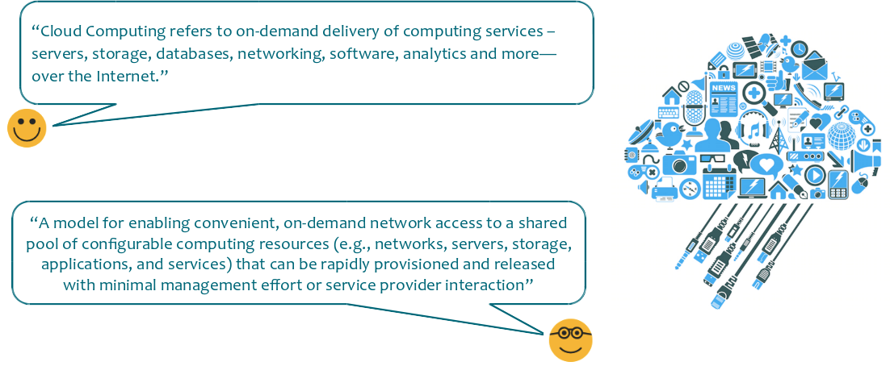
Cloud Computing

Slide 5
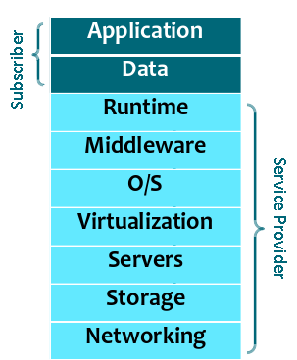
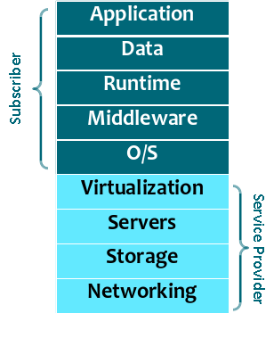
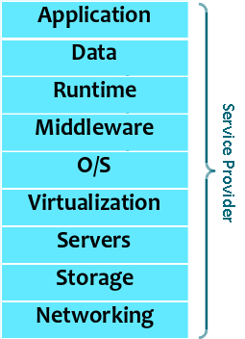
Myriads-as-a-Service
Infrastructure as a Service (IaaS)
Platform as a Service (PaaS)
Software as a Service (SaaS)
For example:
pouta.csc.fi, Amazon EC2, Microsoft Azure, Google Compute Engine
For example:
notebooks.csc.fi, Google AppEngine, Heroku, Amazon Elastic Beanstalk
For example:
notebooks.csc.fi, chipster.csc.fi, Google Web Apps, Microsoft Web Apps, Dropbox, Spotify

Slide 6
Cloud Service Landscape
Software as a Service (SaaS)
“Cloud” is a very overloaded term
  And for good reason - almost any kind of workload can be crammed in there!
  Most often cloud is confused to be SaaS and nothing more
Chances are that on a daily basis you encounter tens of services which are using a cloud backend for storing both content and state
  Anything from your employer’s electronic access control system to a public transport information service to a music service you pick up the latest grooves from
For example:
notebooks.csc.fi, chipster.csc.fi, Google Web Apps, Microsoft Web Apps, Dropbox, Spotify

Slide 7
Cloud Service Landscape
Infrastructure as a Service (IaaS)
This course is strictly about IaaS cloud
However, as in the universe at large, also in the ICT field things are in constant fluxx and nothing is permanent
Yesterday’s services in a Virtual Machine are today’s containerized microservices; today’s containerized microservices are tomorrow’s serverless architectures
IaaS probably has some evolutionary cycles left, too
Let’s proceed to look at how IaaS is used!
For example:
pouta.csc.fi, Amazon EC2, Microsoft Azure, Google Compute Engine

Slide 8
Cloud Service Landscape
Infrastructure as a Service (IaaS)
This course is strictly about IaaS cloud
However, as in the universe at large, also in the ICT field things are in constant fluxx and nothing is permanent
Yesterday’s services in a Virtual Machine are today’s containerized microservices; today’s containerized microservices are tomorrow’s serverless architectures
IaaS probably has some evolutionary cycles left, too
Let’s proceed to look at how IaaS is used!
For example:
pouta.csc.fi, Amazon EC2, Microsoft Azure, Google Compute Engine

Slide 9



Creating virtual resources in cPouta - User Interfaces
Web User Interface - https://pouta.csc.fi
  Suitable for administering individual VMs, keys, images, volumes…
  The only UI to support Haka federated login
Today’s MO
CLI tools
  Suitable for more elaborate resource provisioning and possibly some lightweight (scripted) software integrations
  More info at https://research.csc.fi/pouta-install-client
Programming APIs
  Suitable for building very large systems and stacks
  Support from individual services (compute, storage) to full-fledged orchestration
  List of APIs available at https://pouta.csc.fi/dashboard/project/access_and_security/

Slide 10
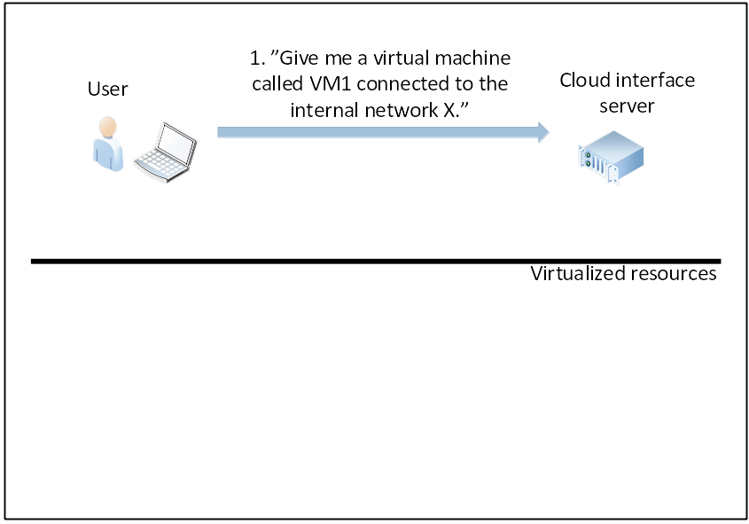
Workflow For Creating Resources

Slide 11
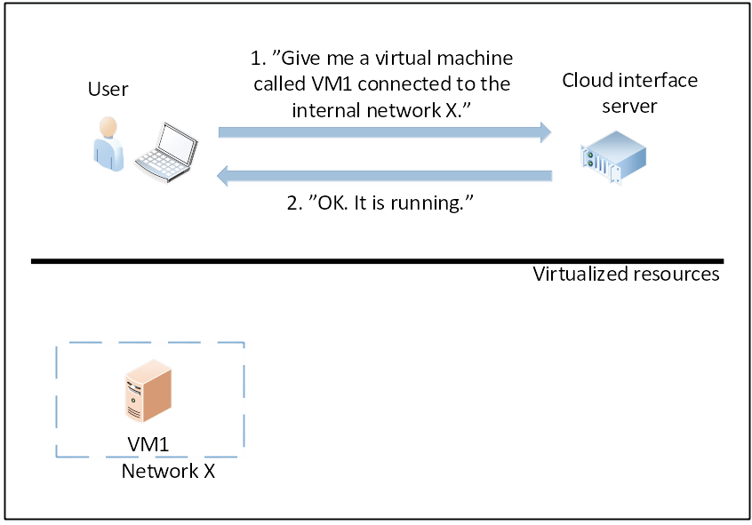
Workflow For Creating Resources

Slide 12
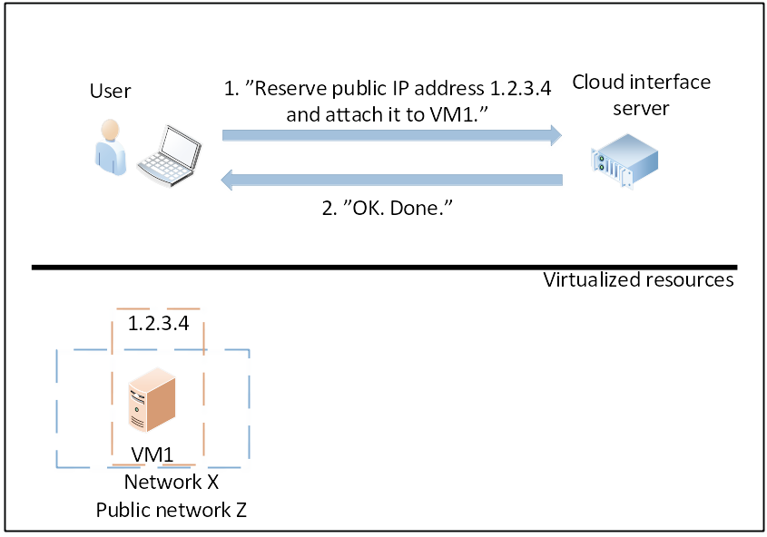
Workflow For Creating Resources

Slide 13
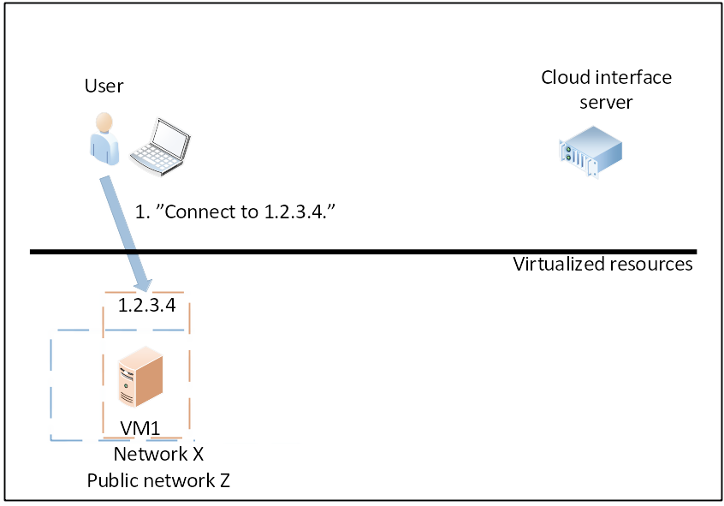
Workflow For Creating Resources

Slide 14
Things needed to create and access a VM
Access to cPouta Web UI
One IPv4 address - a public “Floating IP”
Security Group permitting access from User’s computer
Identity
  Password (not recommended, but acceptable for one-time test)
  Key-Based Authentication (recommended)
SSH client software
Internet access

Slide 15
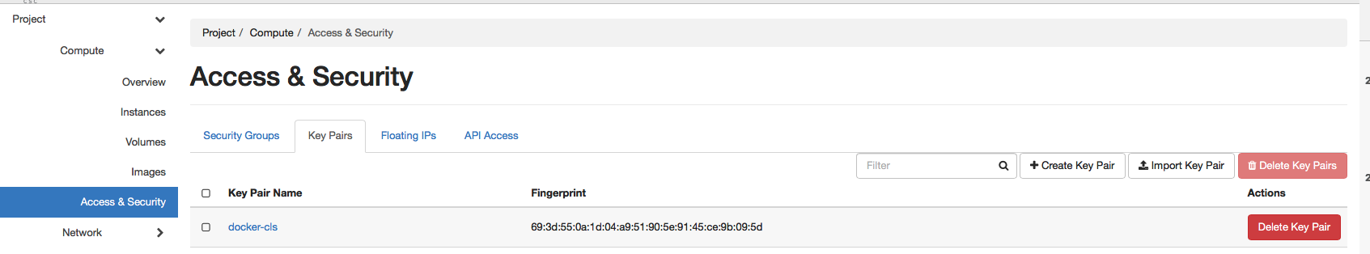
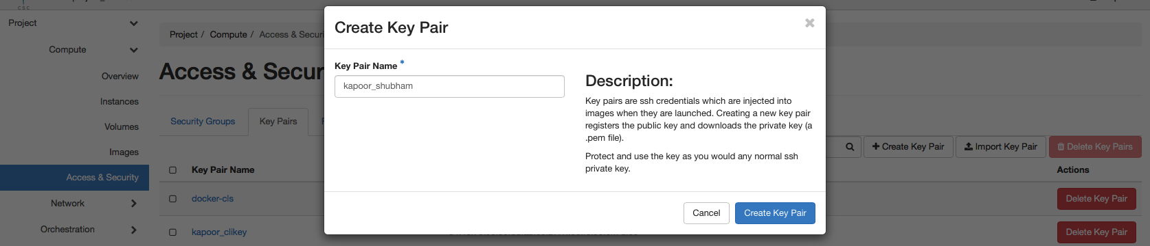
Creating a Key pair
Navigate to Compute>Access and Security>Key Pairs
Click on create Key Pair, name key as lastname_firstname

Slide 16


Storing a Key pair
Windows
Download Putty and Puttygen tools if you don’t have them
  https://www.chiark.greenend.org.uk/~sgtatham/putty/latest.html
  CertUtil -hashfile putty-0.70-installer.msi SHA256
  822da752a69f399377614561125f51a9220a7aa0f4e8afcf1b0e5cd341c0b676
Load your private key (yourkey.pem) into puttygen and change it to .ppk format
Open Putty, load .ppk file under Connection | SSH | Auth | Private key file for authentication
  Provide user name cloud-user
  Provide password which you added to Puttygen (Optional)
Linux and Mac OS X
Create .ssh directory in ~ if its not there already
mkdir -p .ssh
chmod 700 .ssh
Move key pair to .ssh directory
cd .ssh
mv ../Downloads/yourkey.pem .
Make key unreadable by others
chmod 600 yourkey.pem
Protect key with passphrase (Optional)
ssh-keygen -p -f yourkey.pem

Slide 17
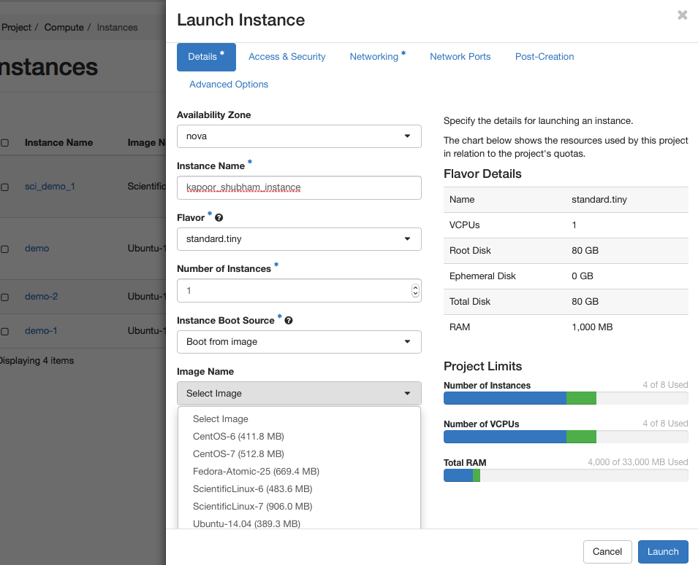
Creating an Instance
Navigate to Compute>Instances and Launch Instance
Give Instance name as lastname_firstname_instance
Select a Flavor of your choice (standard.tiny is a good first choice)
Select Instance Boot Source as Boot from image
Pick an image - any image
Navigate to Access & Security in same popup. Make sure that the “SSH - World” Security Group is selected.
Populate the Post-Creation script as per https://gist.github.com/junousi/b9f7369be06b5a4698d74f4a5e921e37

Slide 18
Creating an Instance - Redux!
Add SSH key pair to Web UI
Create instance as before
In Access & Security, make sure that the SSH key pair is selected
When connecting to the instance, designate the private key into the session or pre-populate it into an SSH agent prior to making a connection

Slide 19
Let’s check that everybody can log in to the Web UI
Load https://pouta.csc.fi/ into your browser
Log in using provided training “trngXX” username and password
  All set? Great!
  Issues logging in? Please let Jukka or Shubham know and we’ll help
Everybody should be able to log in to the cPouta Web UI before we head out for a break

Slide 20
Coffee break

Slide 21
Exercise Set 1: Creating Virtual Resources
Exercise 1 - Creating a temporary Virtual Machine for testing login
  Log in to Cloud Dashboard at https://pouta.csc.fi/
  Create your own Virtual Machine Instance (with disposable password as per https://gist.github.com/junousi/ )
  Associate Floating IP to Virtual Machine Instance
  Log in to your VM using SSH or Putty
  Exit and delete the VM
Exercise 2 - Creating an SSH key pair for secure login to an Instance
  Create an SSH key pair, storing the private key in a safe place
  Create new VM Instance using this key pair
  Associate Floating IP address to VM
  Log in
  Declare victory! Now you can get your bearings inside the newly created VM.
Exercise 3 - Install a webserver (nginx or apache2) and see if you can load a page

Slide 22
Lunch

Slide 23

For dessert, an overview of both Pouta services

Slide 24
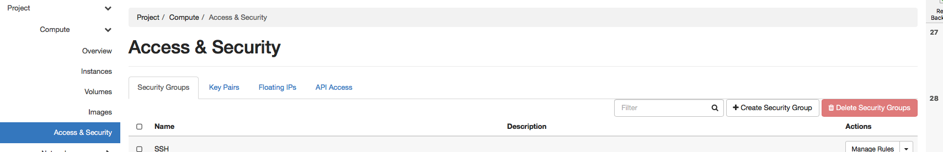
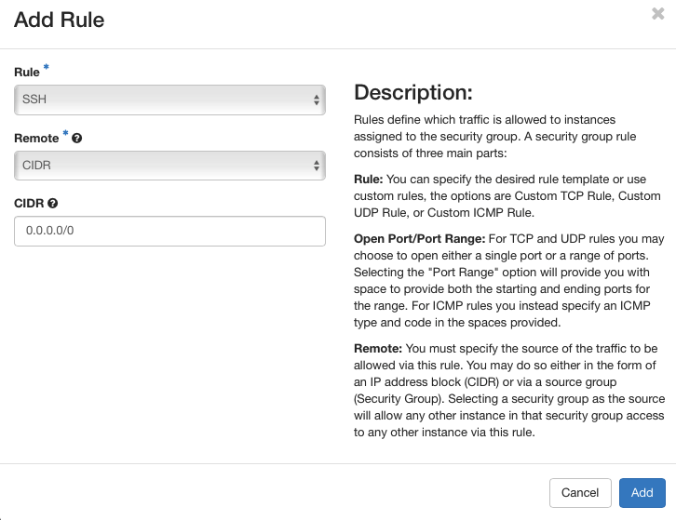
Security Groups
A Security Group defines a set of firewall rules for filtering traffic, typically inbound
Created by navigating to Compute>Access and Security>Create Security Group
  Several predefined rule sets are available, such as for SSH
  At bare minimum you need to select the Source IP for the traffic
  Modify the CIDR field to allow SSH connections only from specific IPs

Slide 25
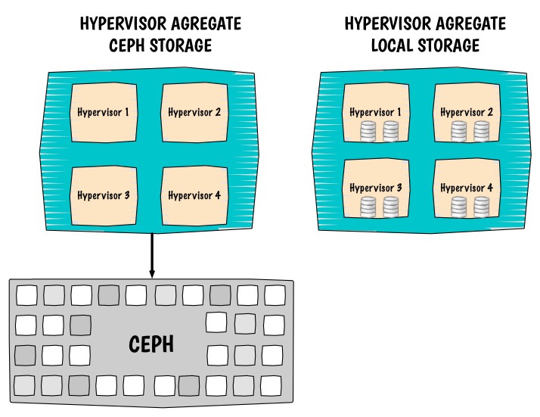
Persistent Volumes
cPouta:
hpc-gen1.*
hpc-gen2.*
io.*
gpu.1.*
ePouta:
io.*
tb.*
cPouta:
standard.*
ePouta:
hpc.*
Root volume can be reconfigured to reside on Persistent Storage! Even if by default flavor uses local disk.

Slide 26
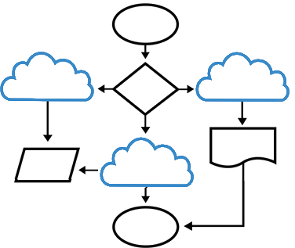
Cloud native service paradigm
In “traditional” enterprise hosting, many workloads and applications are running on a single host designed for HA/redundancy and failover
In an IaaS cloud, many workloads function best if workers and state are in separate failure domains and the loss of an individual node has no impact on the overall system
  This typically means distributing to multiple availability zones and/or clustering

Slide 27
Cloud native service paradigm
Just because most things can be crammed into cloud, doesn’t mean they need to be!
Try to identify where your workload keeps state and if there are clustered or redundant options available for storing that state
  If not, use standard.* flavors for storing state
  If not, enterprise hosting may be a better fit-for-purpose
IaaS Cloud is best suited for workloads which can be partitioned into failure domains, which in turn reflect the Cloud’s own failure domains.

Slide 28
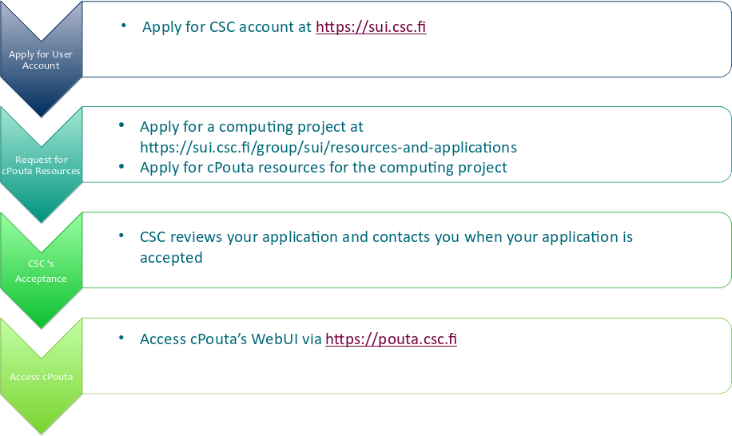
Getting Started with cPouta Services - MinEdu funded track

Slide 29
Getting Started with cPouta Services - Other tracks
Contact servicedesk@csc.fi

Slide 30
Coffee break

Slide 31
Exercises: Security and data controls
Exercise 3 - Create your own Security Group
  Log in to Cloud Dashboard
  Create your own Security Group
  Add rule(s) to the Security Group
  Launch cloud machine with your own Security Group
  Associate Floating (Public) IP
  Log in to your cloud machine
Exercise 4 - Create Snapshot
  Create Snapshot of your machine
  Delete your machine
  Launch new machine from snapshot

Slide 32
Exercises: Security and data controls (cont’d)
Exercise 5 - Manage your own volumes
  Create your own volume
  Attach it to your cloud machine
  Install file system on volume.
  Create some files in volume
  Detach/Reattach volume to your instance.
Optional: Exercise 6 - Orchestration with Heat

