Slide 1
Simulating Migration Behavior Observed in Individual-level Spatial Temporal Data Lee Fiorio SOC 533 March 7, 2014

Slide 2
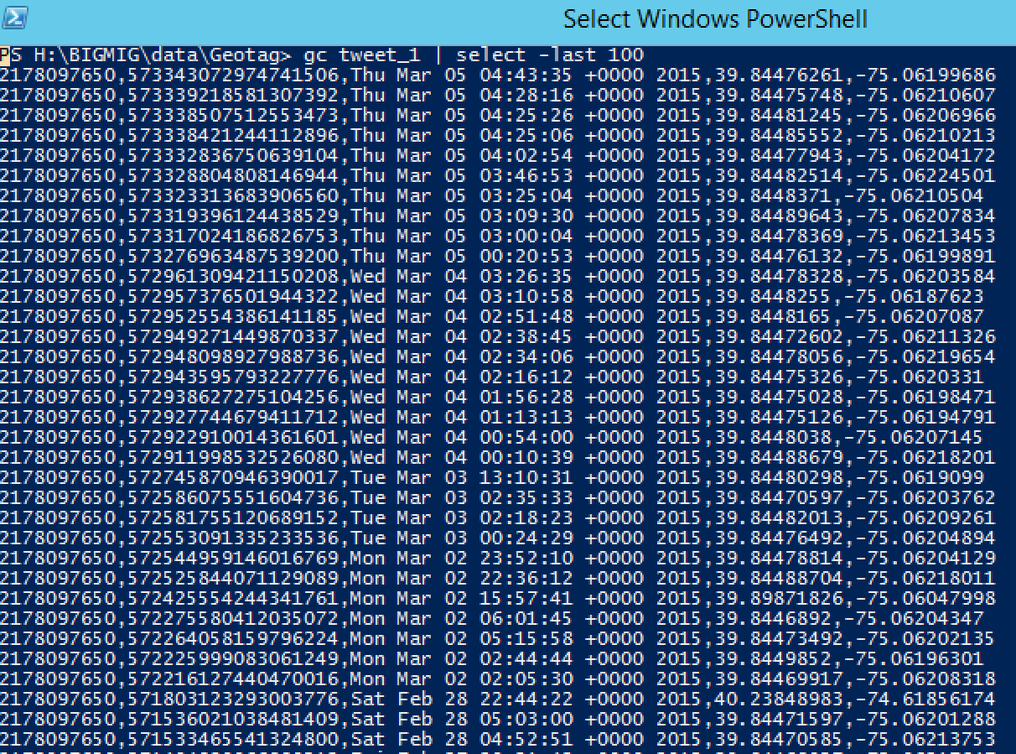
1,000,000s of Geo-referenced Tweets
Mobility Flows Between Regions
?

Slide 3
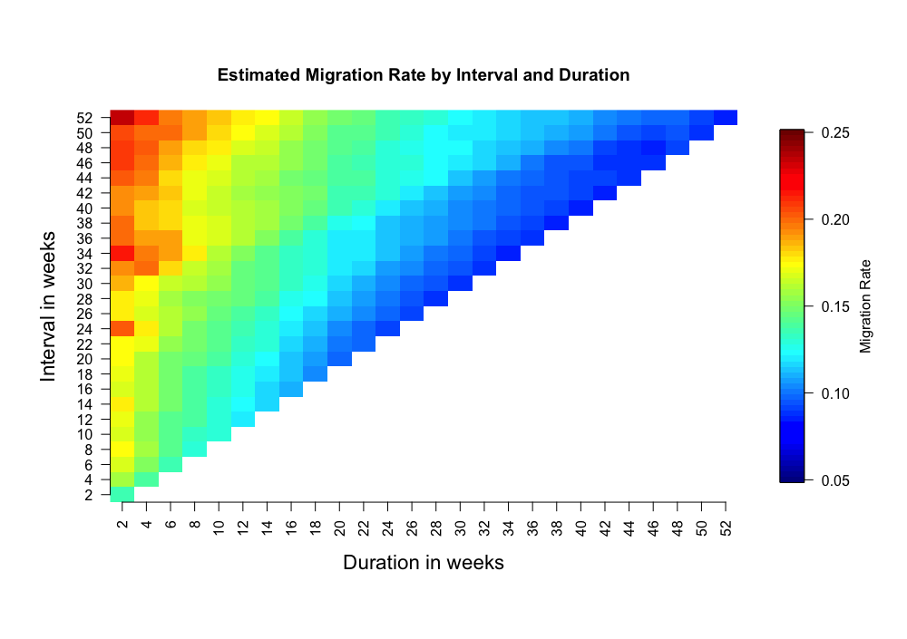
Migration Contours by Interval and Duration

Slide 4
A Simple Model with Three Parameters
City 1
City 0

Slide 5
1) Probability of tweeting from ‘home’ at time t given tweet from ‘home’ at time t-1
City 1
City 0
1 - P(Y_{t} = 1 | Y_{t-1} = 1)
P(Y_{t} = 1 | Y_{t-1} = 1)

Slide 6
2) Probability of tweeting from ‘away’ at time t given tweet from ‘away’ at time t-1
1 - P(Y_{t} = 0 | Y_{t-1} = 0)
City 1
City 0
1 - P(Y_{t} = 1 | Y_{t-1} = 1)
P(Y_{t} = 0 | Y_{t-1} = 0)
P(Y_{t} = 1 | Y_{t-1} = 1)

Slide 7
3) Threshold (count of consecutive ‘aways’) at which ‘away’ takes on home probabilities and vice versa
1 - P(Y_{t} = 0 | Y_{t-1} = 0)
City 1
City 0
1 - P(Y_{t} = 1 | Y_{t-1} = 1)
P(Y_{t} = 0 | Y_{t-1} = 0)
P(Y_{t} = 1 | Y_{t-1} = 1)

Slide 8
3) Threshold (count of consecutive ‘aways’) at which ‘away’ takes on home probabilities and vice versa
1 - P(Y_{t} = 1 | Y_{t-1} = 1)
City 0
City 1
1 - P(Y_{t} = 0 | Y_{t-1} = 0)
P(Y_{t} = 1 | Y_{t-1} = 1)
P(Y_{t} = 0 | Y_{t-1} = 0)

Slide 9
So imagine simulating the mobility behavior for a hypothetical person using this method
0.4
City 1
City 0
0.15
0.85
0.6
Threshold = 6

Slide 10
So imagine simulating the mobility behavior for a hypothetical person using this method
1
0.4
City 1
City 0
0.15
0.85
0.6
Threshold = 6

Slide 11
So imagine simulating the mobility behavior for a hypothetical person using this method
11
0.4
City 1
City 0
0.15
0.85
0.6
Threshold = 6

Slide 12
So imagine simulating the mobility behavior for a hypothetical person using this method
111
0.4
City 1
City 0
0.15
0.85
0.6
Threshold = 6

Slide 13
So imagine simulating the mobility behavior for a hypothetical person using this method
1111
0.4
City 1
City 0
0.15
0.85
0.6
Threshold = 6

Slide 14
So imagine simulating the mobility behavior for a hypothetical person using this method
11110
0.4
City 1
City 0
0.15
0.85
0.6
Threshold = 6

Slide 15
So imagine simulating the mobility behavior for a hypothetical person using this method
111101
0.4
City 1
City 0
0.15
0.85
0.6
Threshold = 6

Slide 16
So imagine simulating the mobility behavior for a hypothetical person using this method
1111011
0.4
City 1
City 0
0.15
0.85
0.6
Threshold = 6

Slide 17
So imagine simulating the mobility behavior for a hypothetical person using this method
11110110
0.4
City 1
City 0
0.15
0.85
0.6
Threshold = 6

Slide 18
So imagine simulating the mobility behavior for a hypothetical person using this method
111101101
0.4
City 1
City 0
0.15
0.85
0.6
Threshold = 6

Slide 19
So imagine simulating the mobility behavior for a hypothetical person using this method
1111011011
0.4
City 1
City 0
0.15
0.85
0.6
Threshold = 6

Slide 20
So imagine simulating the mobility behavior for a hypothetical person using this method
1111011011…
0.4
City 1
City 0
0.15
0.85
0.6
Threshold = 6

Slide 21
So imagine simulating the mobility behavior for a hypothetical person using this method
111101101111111111100101011111110100111111111111111111111111 111111111011111101111111011101000010000111111100011000111111001101111110100011111111110000 0001000000000010000000001111000000000011100001111010000000…
0.4
City 1
City 0
0.15
0.85
0.6
Threshold = 6

Slide 22
And repeating this simulation for many hundreds of hypothetical persons… and then calculating migration estimates from this simulated dataset

Slide 23
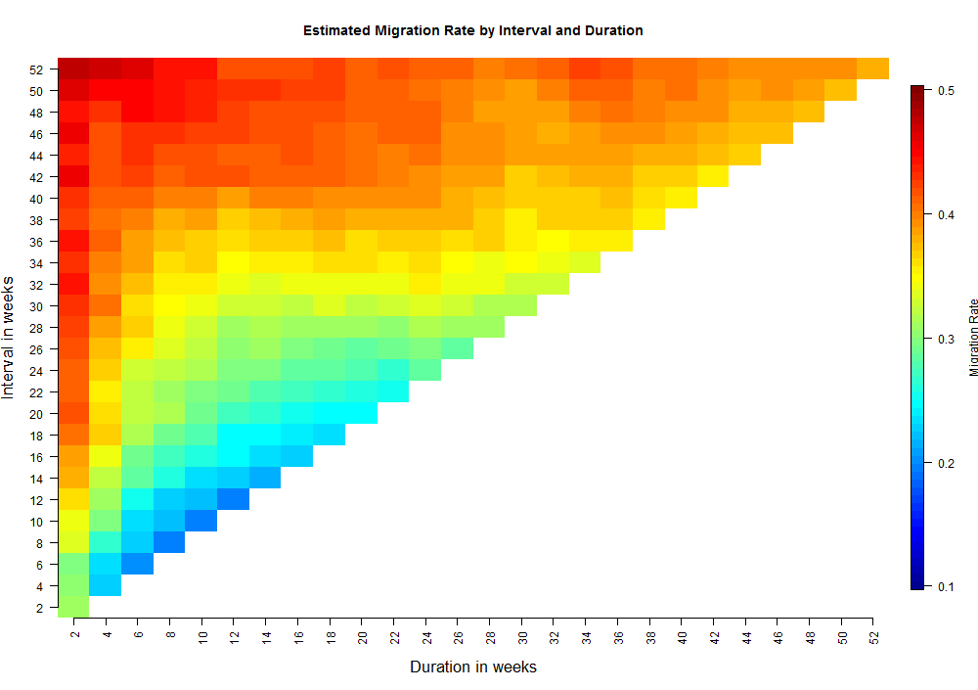

Slide 24
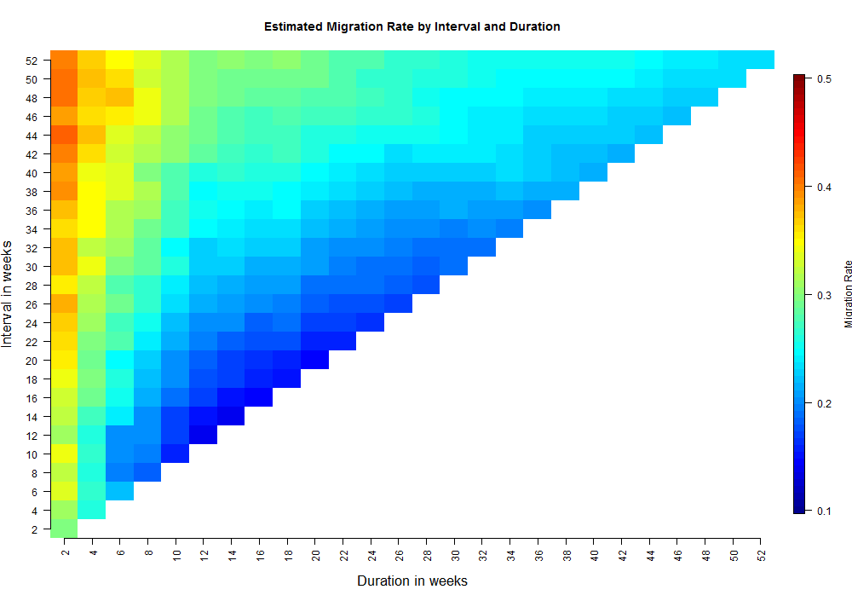

Slide 25
