Slide 1
Research Methods in Demography Presentation
Rachel Kulikoff

Slide 2
Project Introduction and Premise
Data quality is poor in years of natural disaster or war
In addition to directly modeling mortality through IHME’s model life table system, for those years with “mortality shocks,” deaths are manually added from databases and news sources at the end of the modeling process
Used Haiti as a case study because it would be obvious if something went wrong…

Slide 3
Project Steps
Inputs: a shock-free life table, death numbers, and deaths due to shocks
Could just calculate a with-shock mx using with-shock death numbers over population
Problems: want to do this without population
Death numbers and populations are only specific to the 95 + age group while the life table goes to 110+
Instead, create a scalar that is shocks+deaths/deaths. Multiplying this by with non-shock mx will give you the with shock mx
This way, I can apply the scalar for the 95+ age group to the mx values for 95-99, 100-104, 105-109 and 110+

Slide 4
Future Directions
Currently, ax is not changing when shocks are being added. This is incorrect but using ax graduation methodology also gives unreasonable values
Want to look in to how to incorporate changing/modeling ax into the model

Slide 5
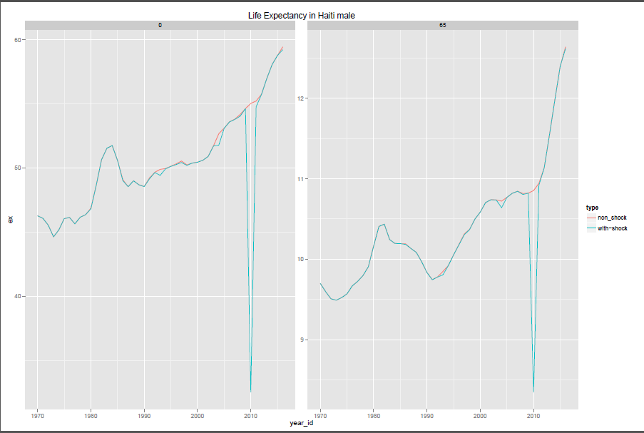
Some results

Slide 6
