Slide 1
Dependency ratio of China
Xiaxia Yang

Slide 2
Total dependency ratio from 1950 to 2015
Source: UN population division https://esa.un.org/unpd/wpp/Download/Standard/Fertility/

Slide 3
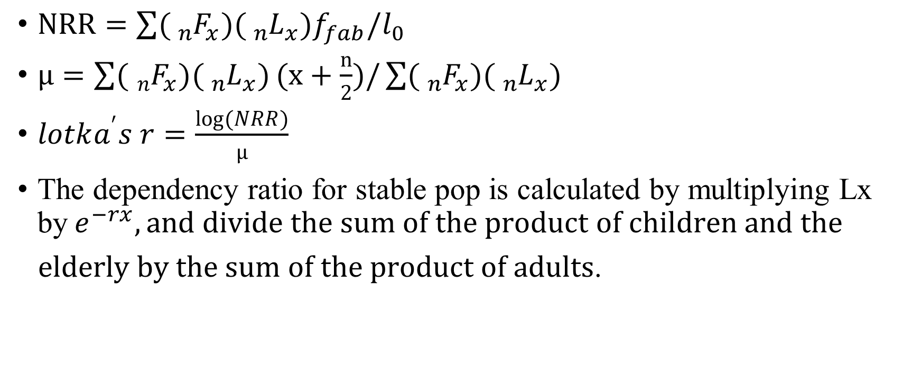
Calculate dependency ratios for stable population
$NRR=\sum{({}_{n}^{}{F_{x})(}{}_{n}^{}{L_{x})f_{fab}/l_{0}}}$
$μ=\sum{({}_{n}^{}{F_{x})({}_{n}^{}{L_{x})}}}(x+\frac{n}{2})/\sum{({}_{n}^{}{F_{x})({}_{n}^{}{L_{x})}}}$
$lotka^{′}s r=\frac{log(NRR)}{μ}$
The dependency ratio for stable pop is calculated by multiplying Lx by${ e}^{−rx}, and divide the sum of the product of children and the$
$elderly by the sum of the product of adults$.
Source: World health organization http://apps.who.int/gho/data/?theme=main&vid=60340
Notes:
Net reproduction rate; mean age at child bearing; lotka’s intrinsic rate of natural increase r. Compared with observed ratios, the ratios calculated in the context of stable population get rid of the effect of migration and prior history. It is sort of the intrinsic character of the pop.

Slide 4
Dependency ratio of China from 2000 to 2015 with stable age pyramids

