Slide 1
A slice of microdemography: contraceptive usage & fertility
SOC 533 Presentation
Tiffany Pan & Madison Leia

Slide 2
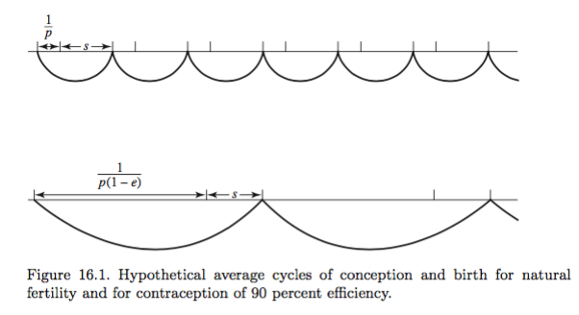


Keyfitz & Caswell approach BOOK “Trends in applied mathematical demography”
$$w=\frac{1}{p}+s$$
The average length of the cycle is:
$$w∗ = \frac{1}{p\left(1−e\right)}+s$$
The effect of contraception on the average length of the cycle is:

Slide 3






the Bongaarts approach BOOK “Demography: measuring and modeling population processes”
$$TFR= \frac{TFR}{TMFR}×\frac{TMFR}{TNFR}×\frac{TNFR}{MTFR}× MTFR$$
$${TFR= C}_{m }× \left(C_{c}×C_{a}\right)×C_{i}×15.3$$
$$C_{m}=\frac{TFR}{TMFR}$$
$$C_{a}= \frac{TFR}{TFR+0.4\left(1+u\right)TA}$$
$$C_{i}= \frac{20}{18.5+i}$$
$$C_{c}=1−1.08 × u × e$$
Notes:
This approach takes into account different fertility determinants, one of which is contraceptive usage and induced abortion.
TNFR = total natural fertility rate
MTFR = maximum potential fertility rate, which is estimated at 15.3
(in a population without contraception, without induced abortion, with a minimum non-susceptible period of 1.5 months, in which all women marry at 15 and remain married until age 50, the total fertility rate is 15.3) – although no known population has reached such a rate
The coefficient 1.08 9s added to account for the fact that sterile couples may not use contraception knowing they are not at risk of conception
TA is the total abortion rate (the sum of age-specific abortion rates)

Slide 4

Our calculation of contraceptive efficacy
$$e= \sum{c_{x}×e_{x}}$$
Where c_{x} is proportion of women using
each type of contraceptive in the US*
And e_{x} is the efficacy of that contraceptive**
* “Trends in Contraceptive Use Worldwide”, United Nations, 2015
** CDC Effectiveness of Family Planning Methods, 2011
Notes:
National Survey of Family Growth has age specific contraceptive usage

