Slide 1
In order to access Twitter data, you need to have a valid Twitter account and you need to obtain your “API keys” and “Access Tokens.”
First, open an account at twitter.com and validate it with your phone. If you already have an account, but it is not validated with a phone, you need to validate it (see https://support.twitter.com/articles/110250 )
The following slides include screenshots of the process. If you could obtain your API keys and access tokens before the workshop day, it would be ideal. If not, we will help you out during the workshop.

Slide 2
Twitter Application Authentication Steps
Start with Slide 3 to create a Twitter account if you do not have one (https://twitter.com)
Start with Slide 9 to create your application if you already have a Twitter account (https://dev.twitter.com)

Slide 3
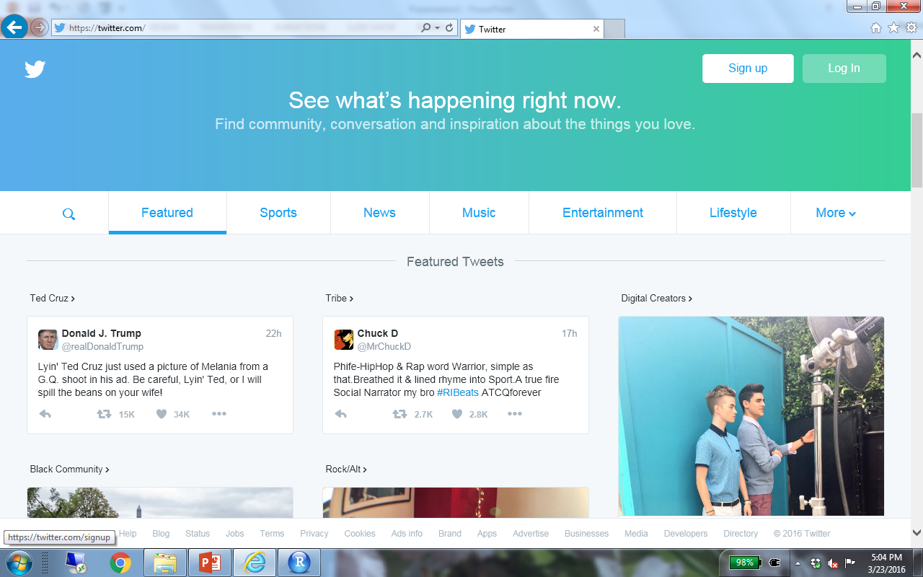
https://twitter.com

Slide 4
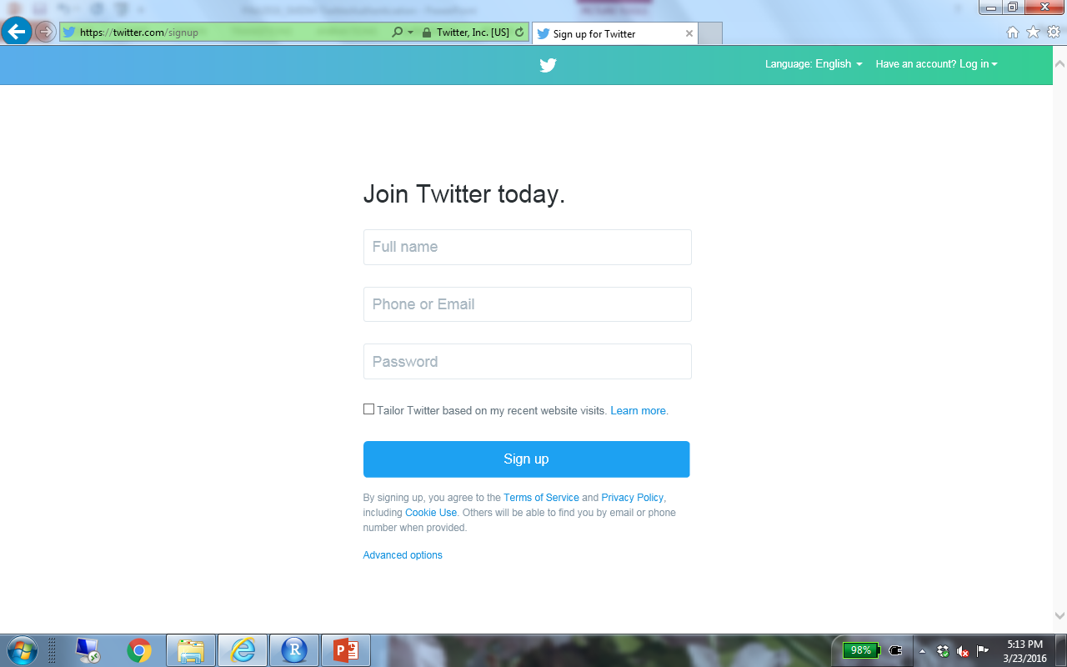

Slide 5
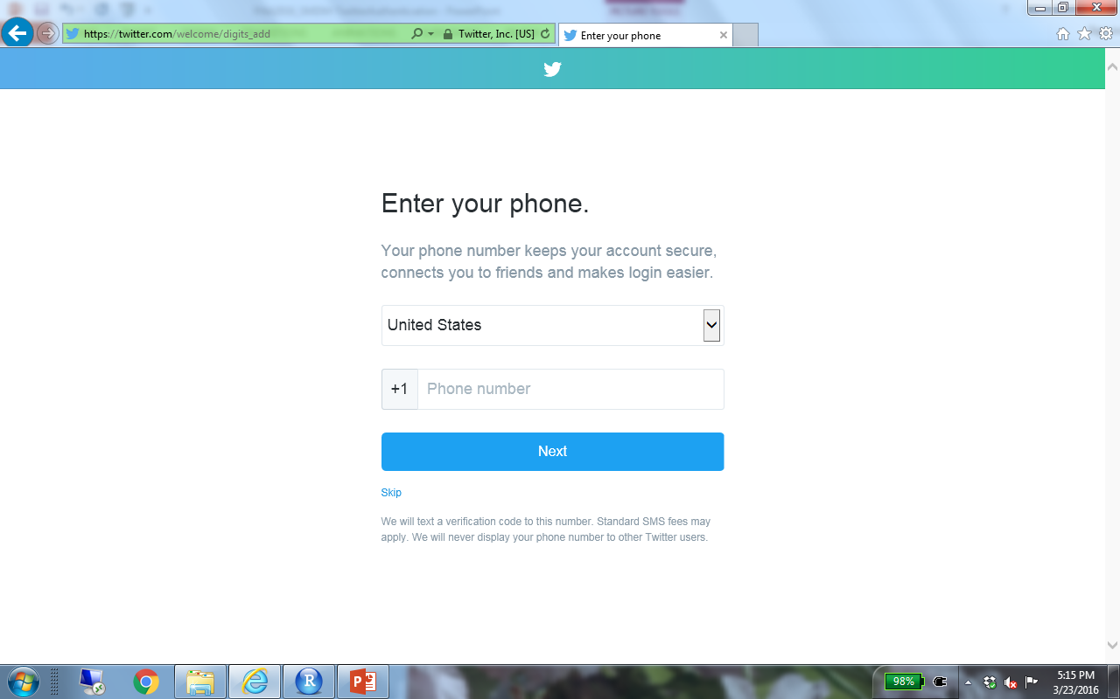

Slide 6
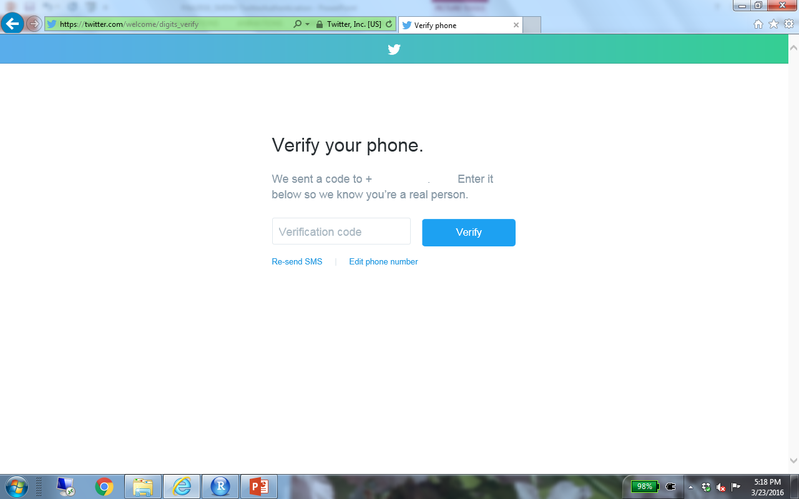

Slide 7
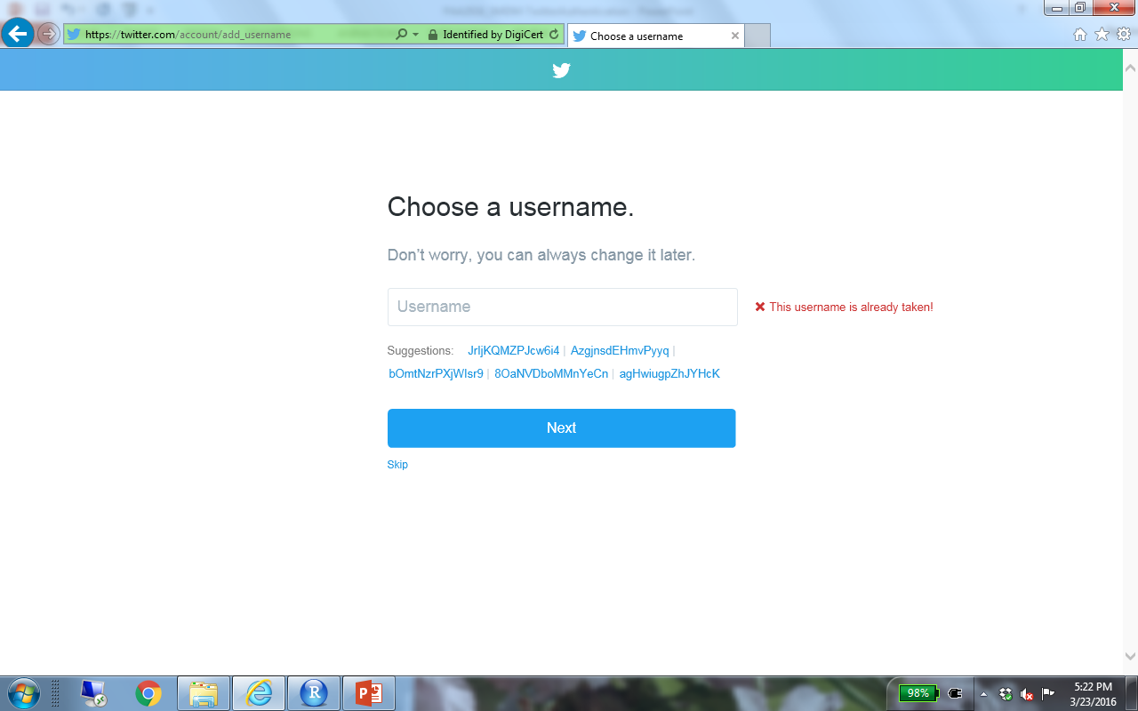

Slide 8
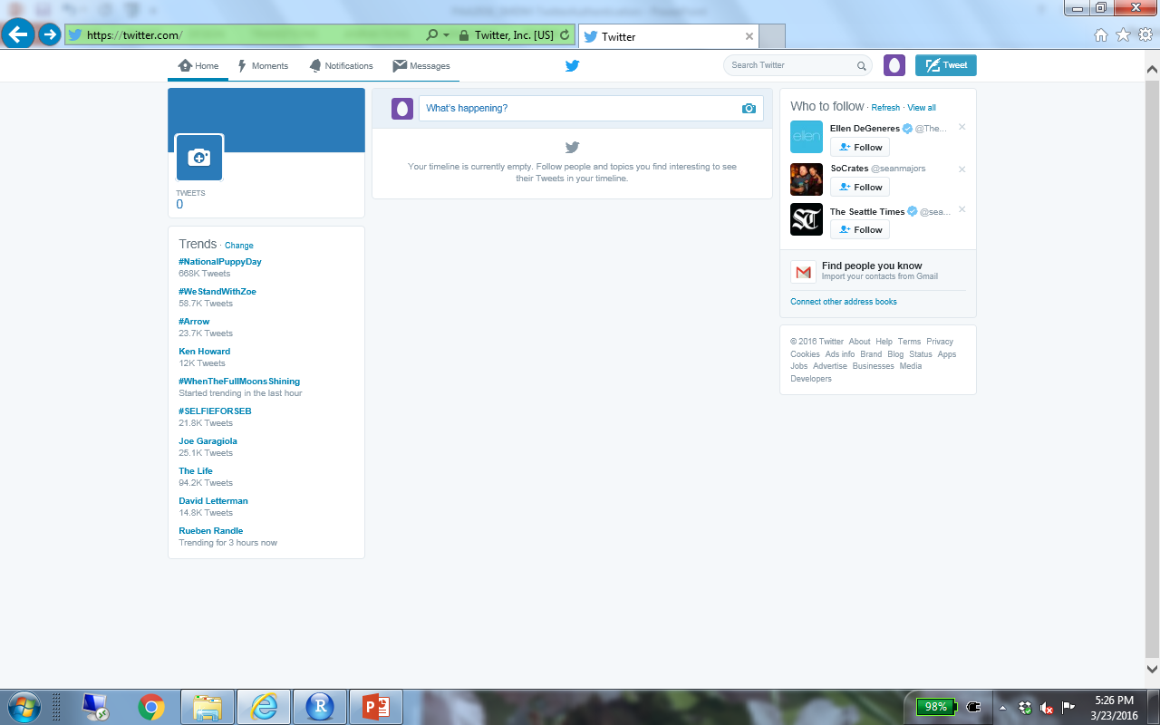

Slide 9
The following slides show screenshots for the following steps:
-Go to the twitter developers’ page (dev.twitter.com) to create an app
-Go to “Manage my apps”
-Create a new app (it can have any name and you can use any website,
as long as you include the full Web address (staring with http://).
Leave the “callback URL” empty.

Slide 10
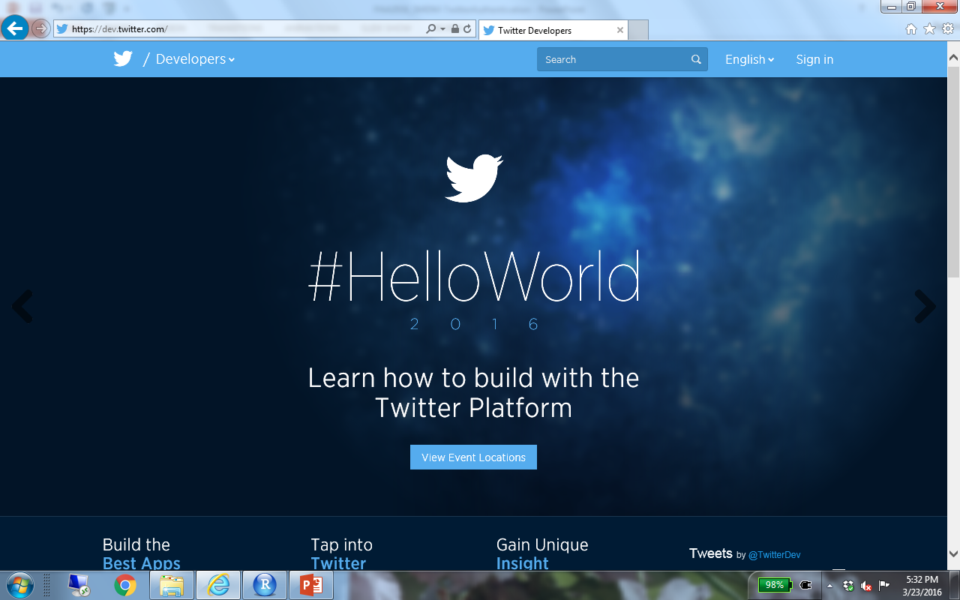
https://dev.twitter.com
https://

Slide 11
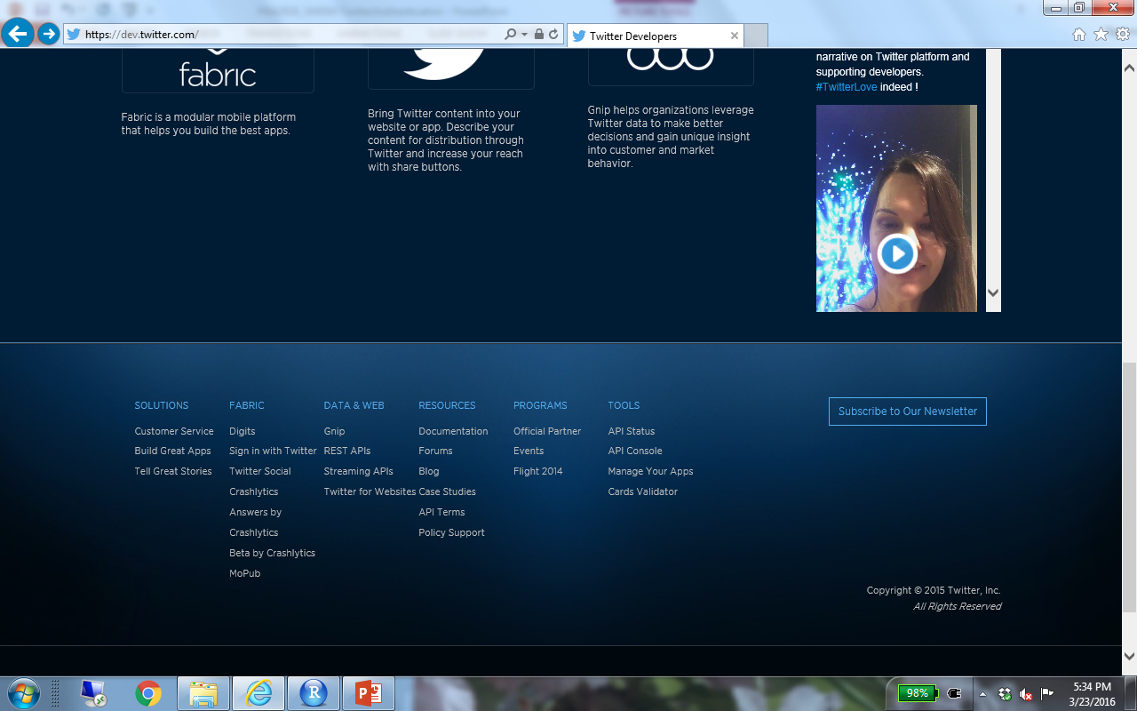

Slide 12
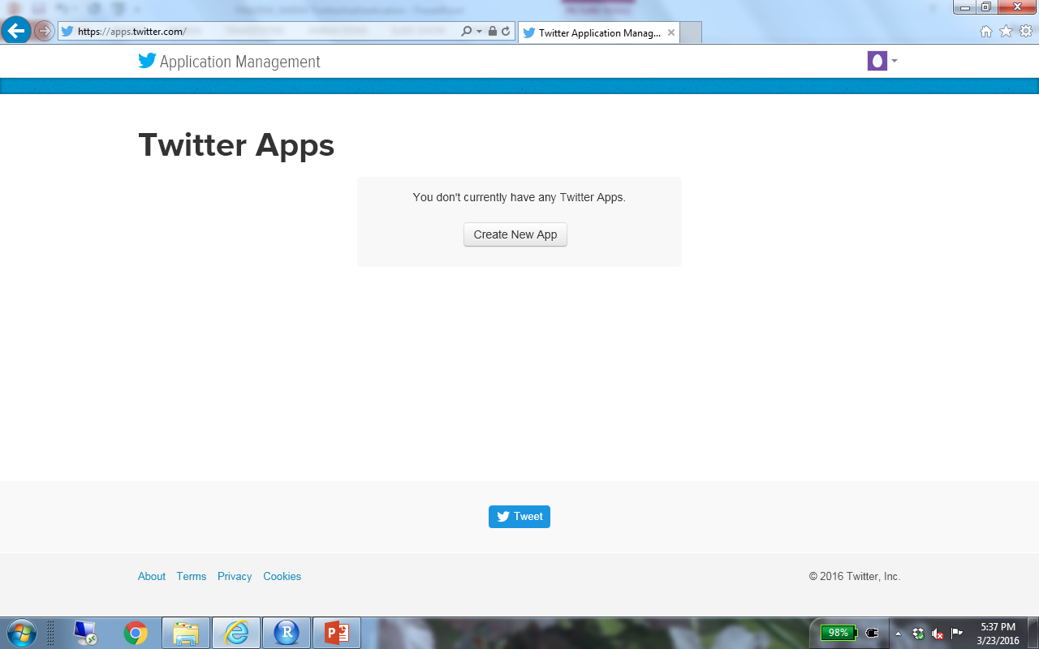

Slide 13
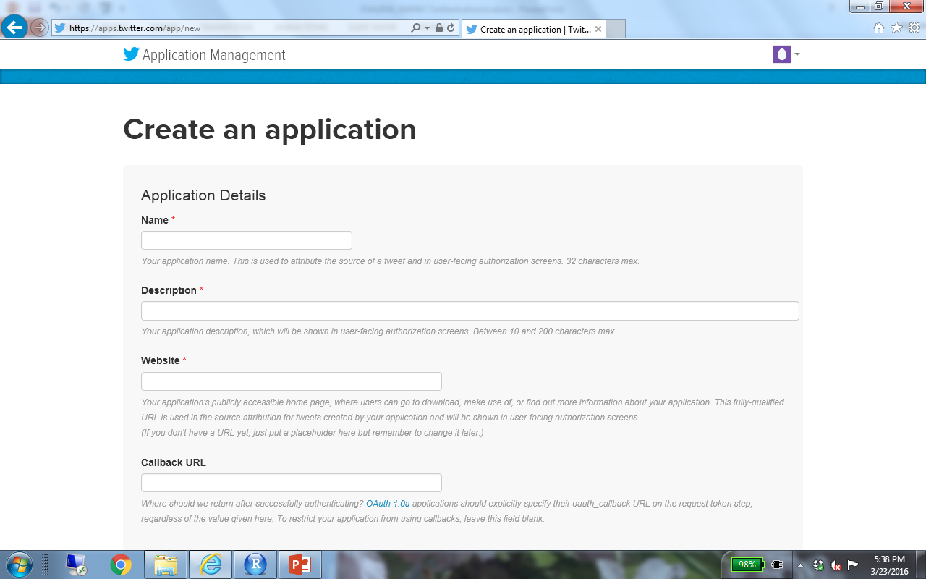
EPC2016-Mainz-My_Initials
Test Application for EPC 2016
http://www.example.com

Slide 14
Use the appropriate tab to find the “consumer key” and “the consumer secret” > copy and paste those strings somewhere as we will need them
Then create the your access tokens and copy and paste the “Access Token” and “Access Token Secret” somewhere, as we will need them.
The following slides show the screenshots for the steps

Slide 15
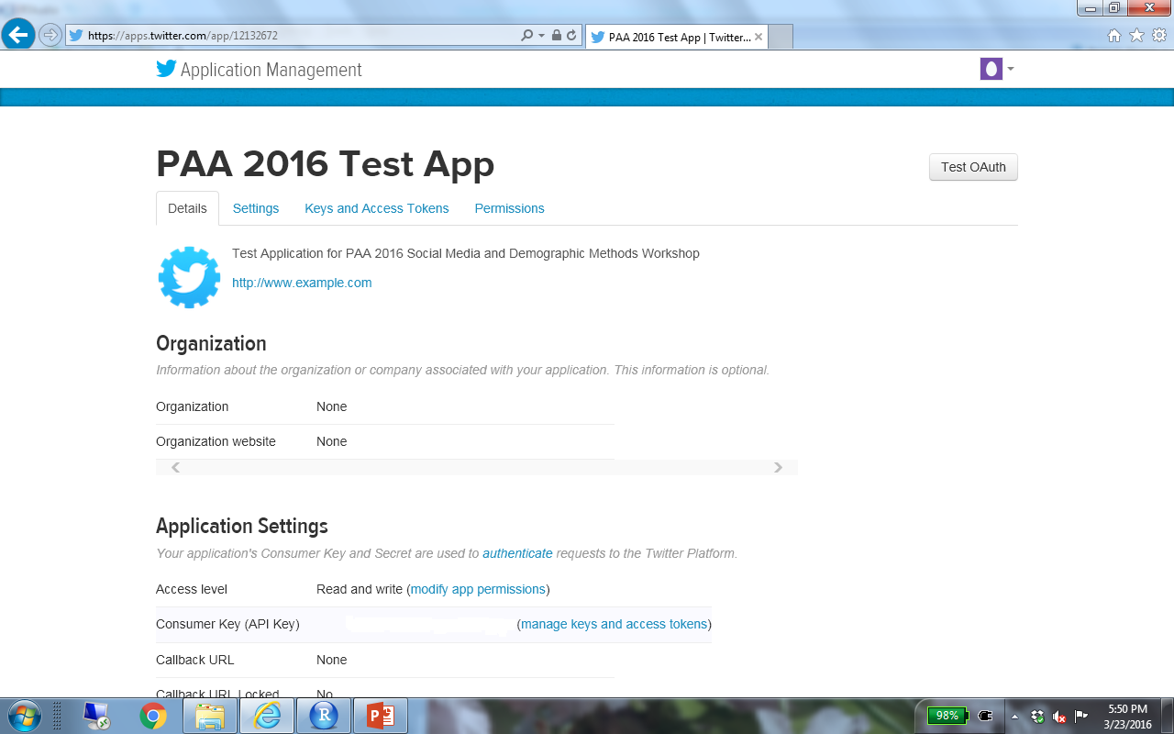


Slide 16
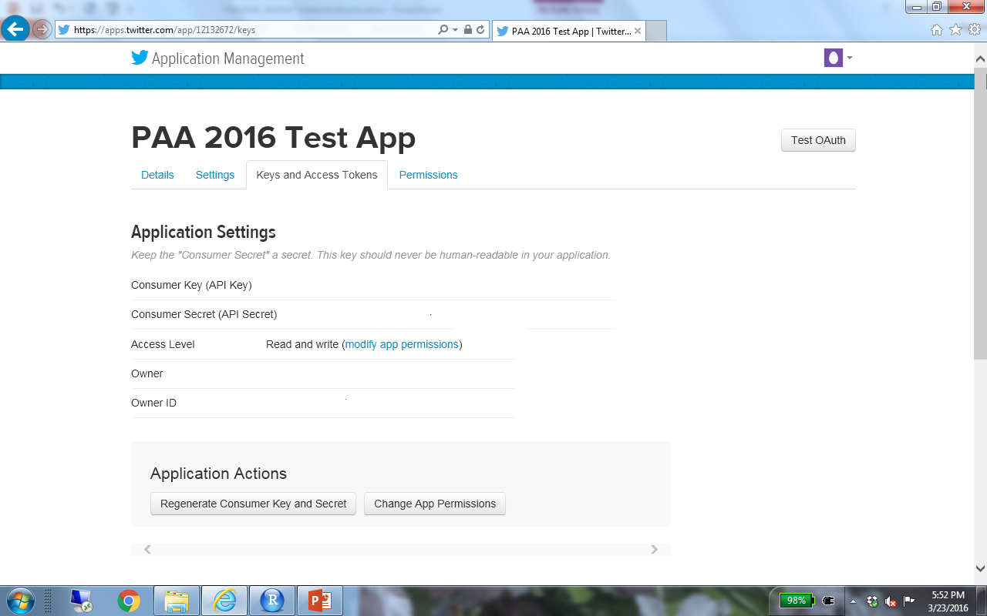
Copy Consumer Key and Consumer Secret
Scroll down to generate tokens

Slide 17
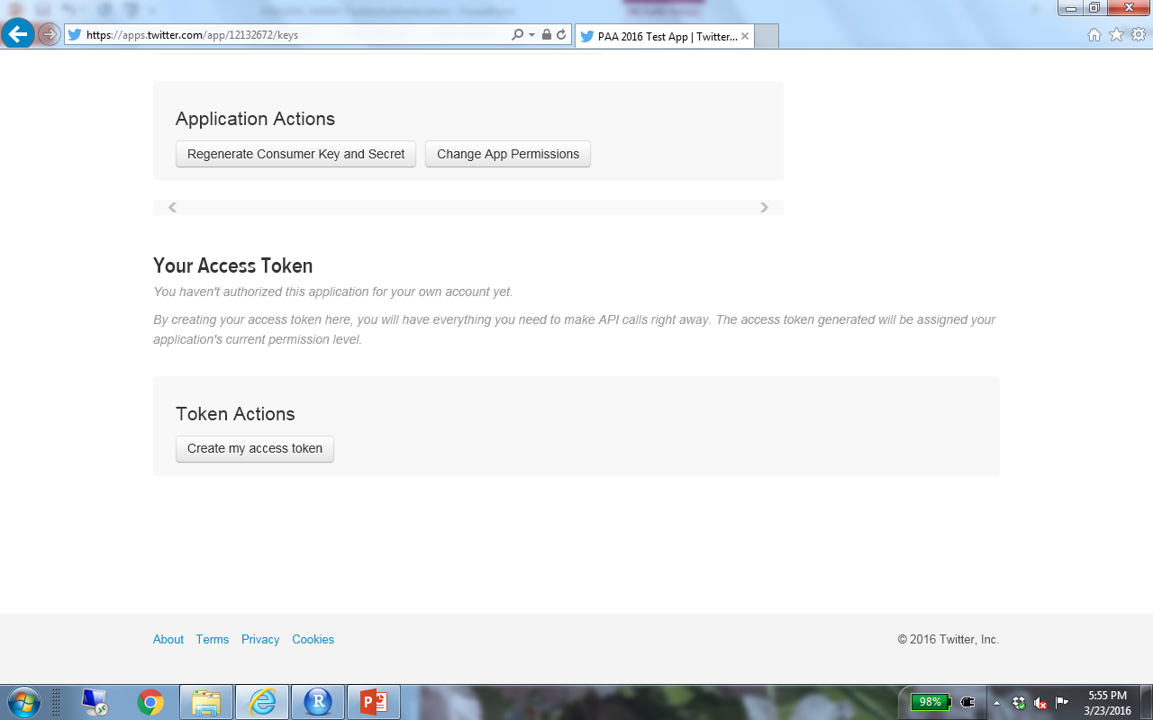

Slide 18
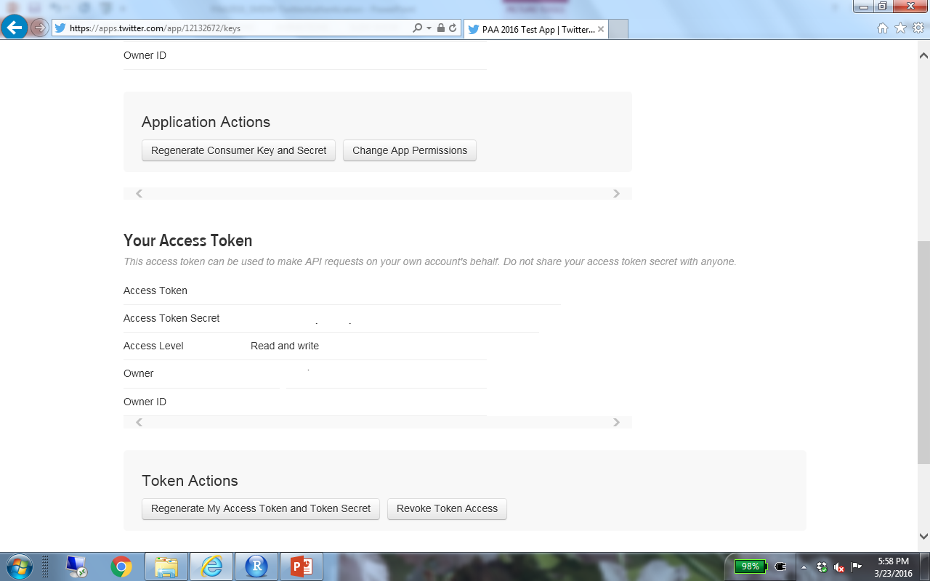
Copy Access Token and Access Token Secret

