Slide 1
Introduction to Visualization with Shiny

Slide 2
What is Shiny?
Web application framework for R
Can build interactive web applications without knowledge of CSS, HTML, JavaScript…
Easy to take visualizations made in R, make them interactive and deploy to the web

Slide 3
Examples
http://shiny.rstudio.com/gallery/faithful.html
http://shiny.demog.berkeley.edu/monicah/stable/
http://shiny.demog.berkeley.edu/monicah/French/

Slide 4
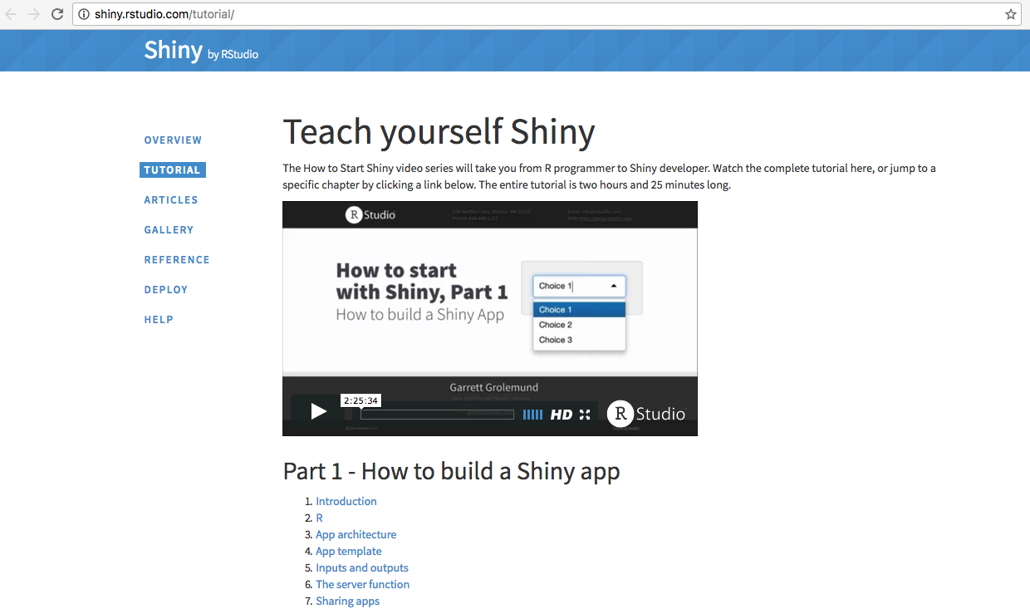
A lot of help online!

Slide 5
The basic layout of a Shiny App
Two pieces:
server.R
The code needed to build the visualizations
ui.R
User interface: the code needed to determine the layout of the app

Slide 6
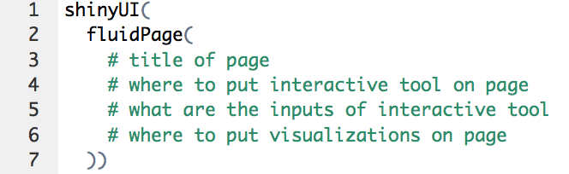
The basic layout of a Shiny App
User interface

Slide 7
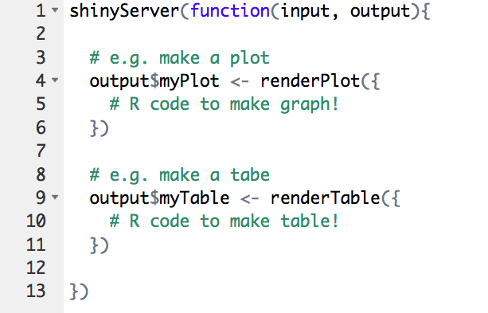
The basic layout of a Shiny App
server.R

Slide 8
How to deploy
Put server.R, ui.R and dataset(s) in one folder
Host through RStudio cloud:
Get account at shinyapps.io (http://www.shinyapps.io/)
Run app through RStudio
Press publish

