Slide 1
Twitter Application Authentication Steps
Start with Slide 1 to create a Twitter account if you do not have one (https://twitter.com)
Start with Slide 7 to create your application if you already have a Twitter account (https://dev.twitter.com)

Slide 2
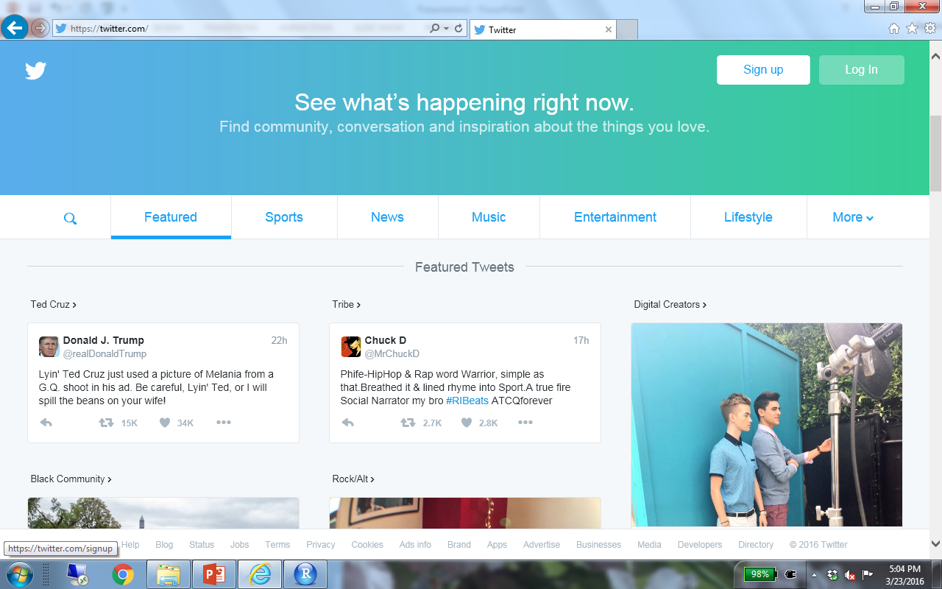
https://twitter.com

Slide 3
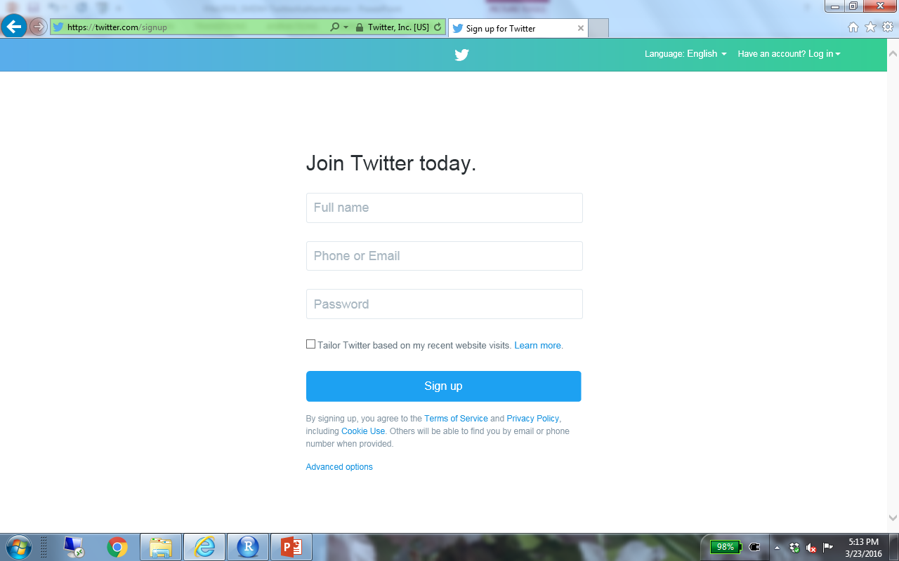

Slide 4
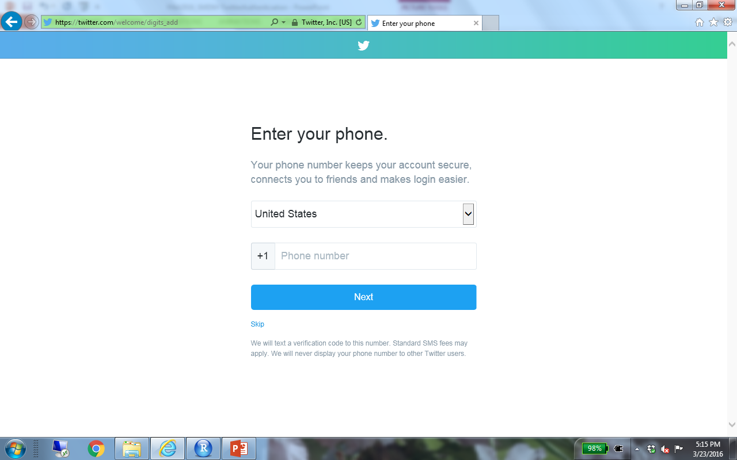

Slide 5
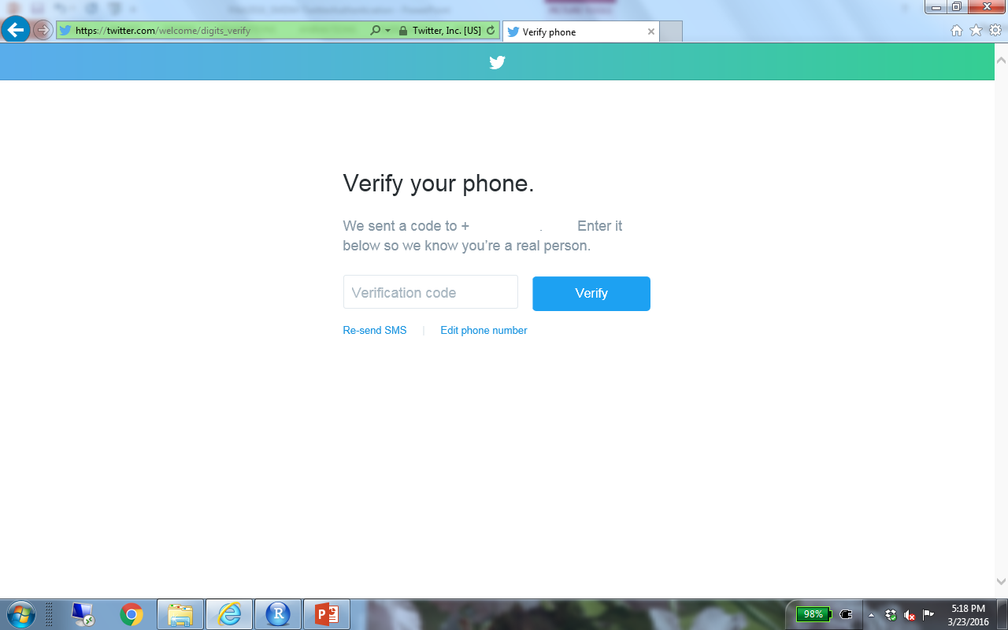

Slide 6
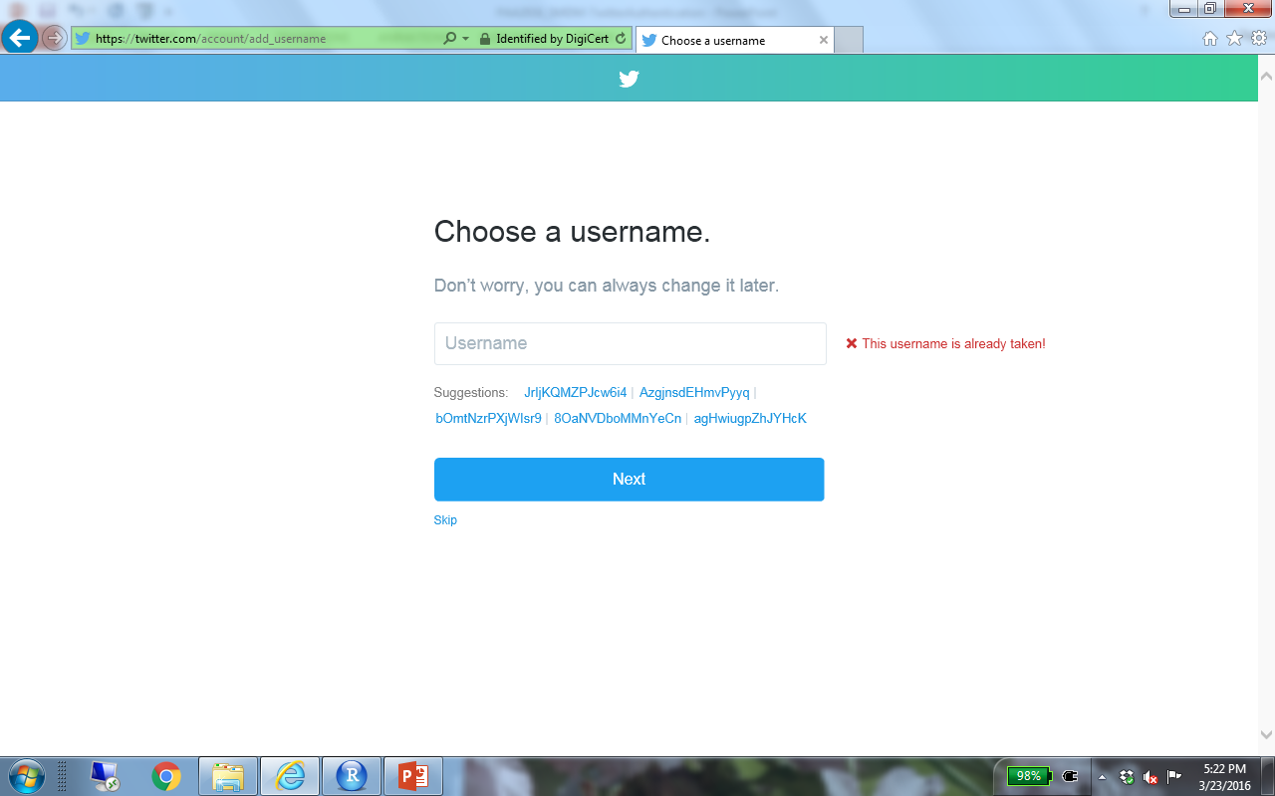

Slide 7
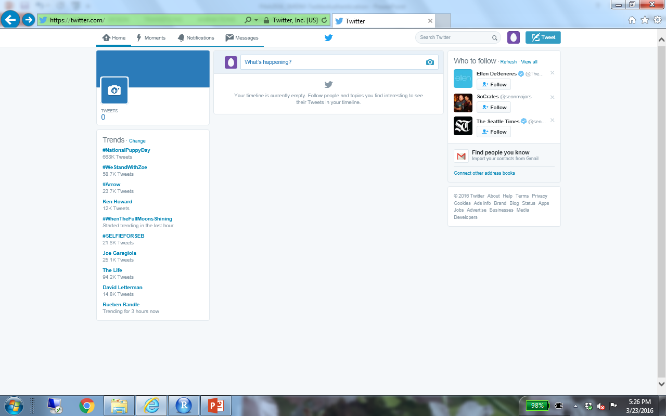

Slide 8
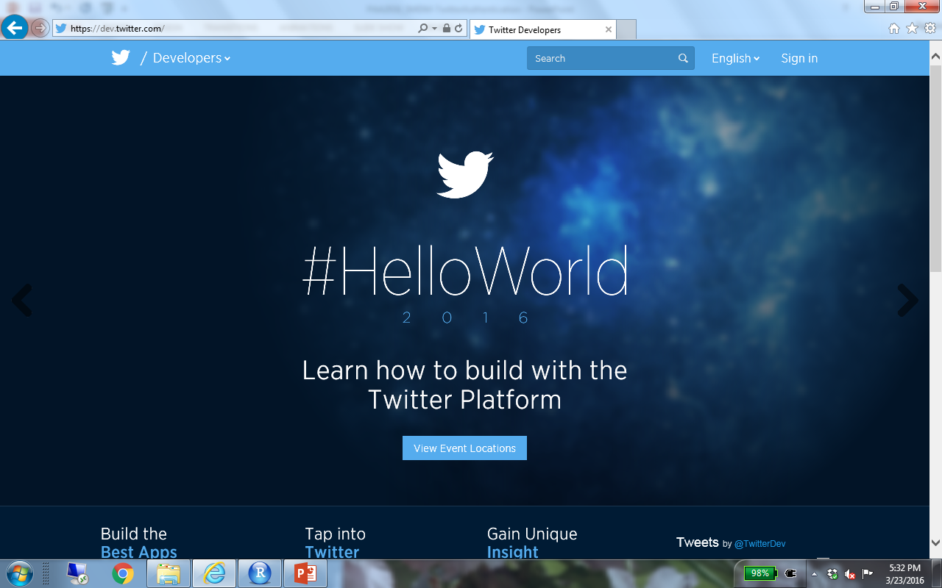
https://dev.twitter.com
https://

Slide 9
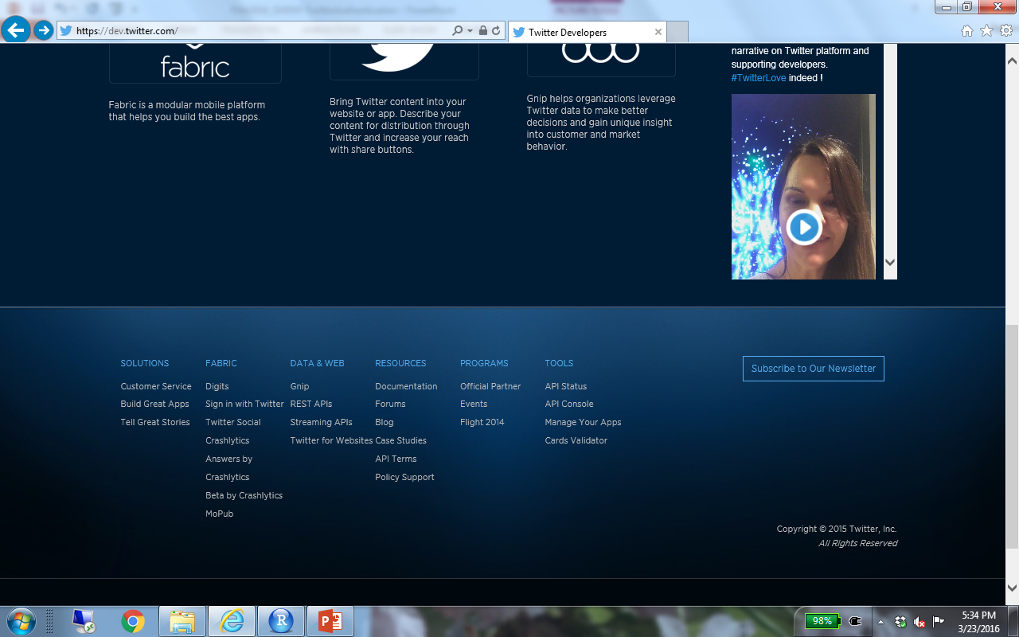

Slide 10
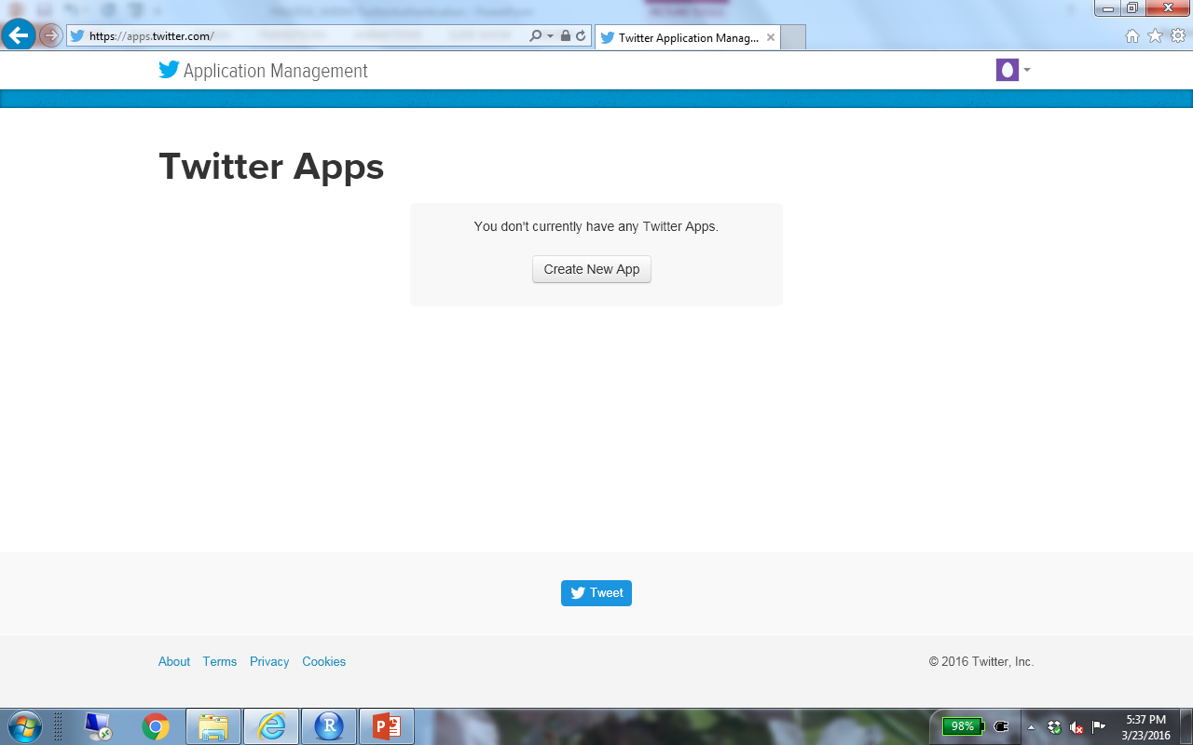

Slide 11
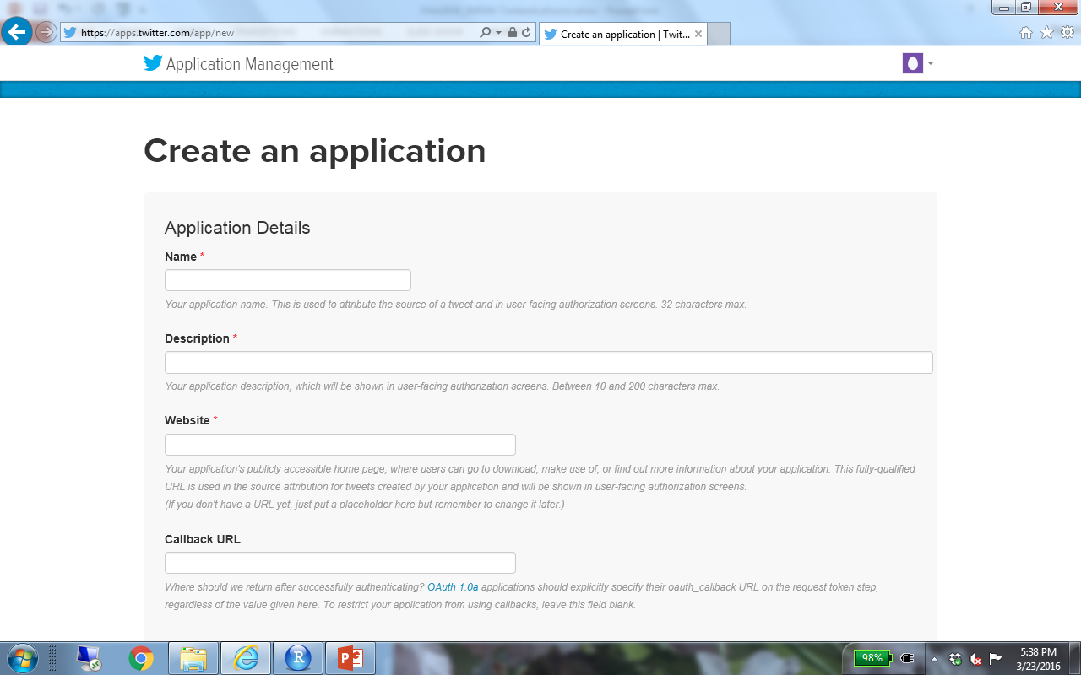
EPC2016-Mainz-My_Initials
Test Application for EPC 2016
http://www.example.com

Slide 12
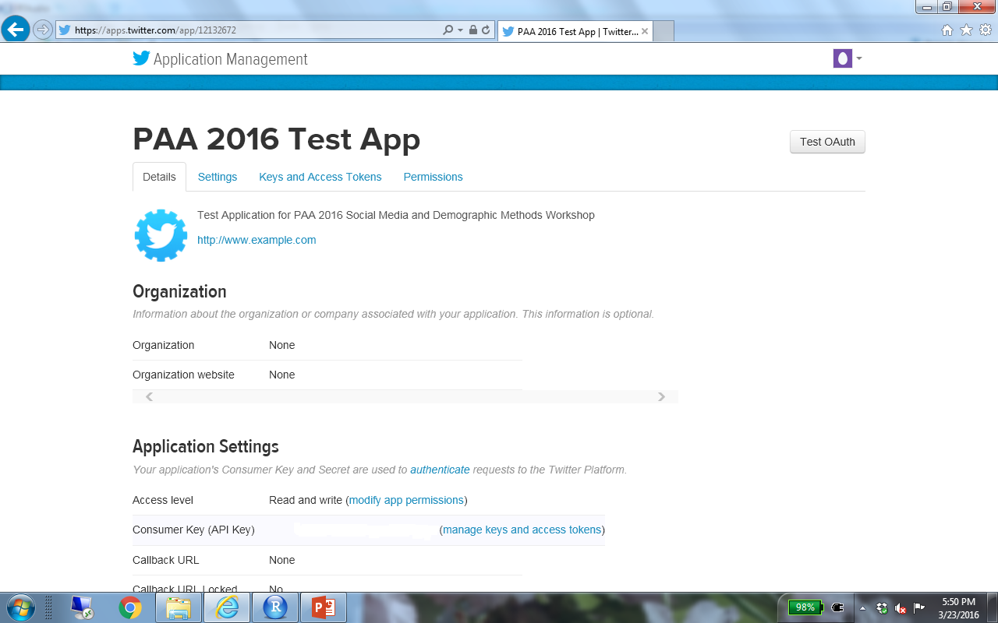


Slide 13
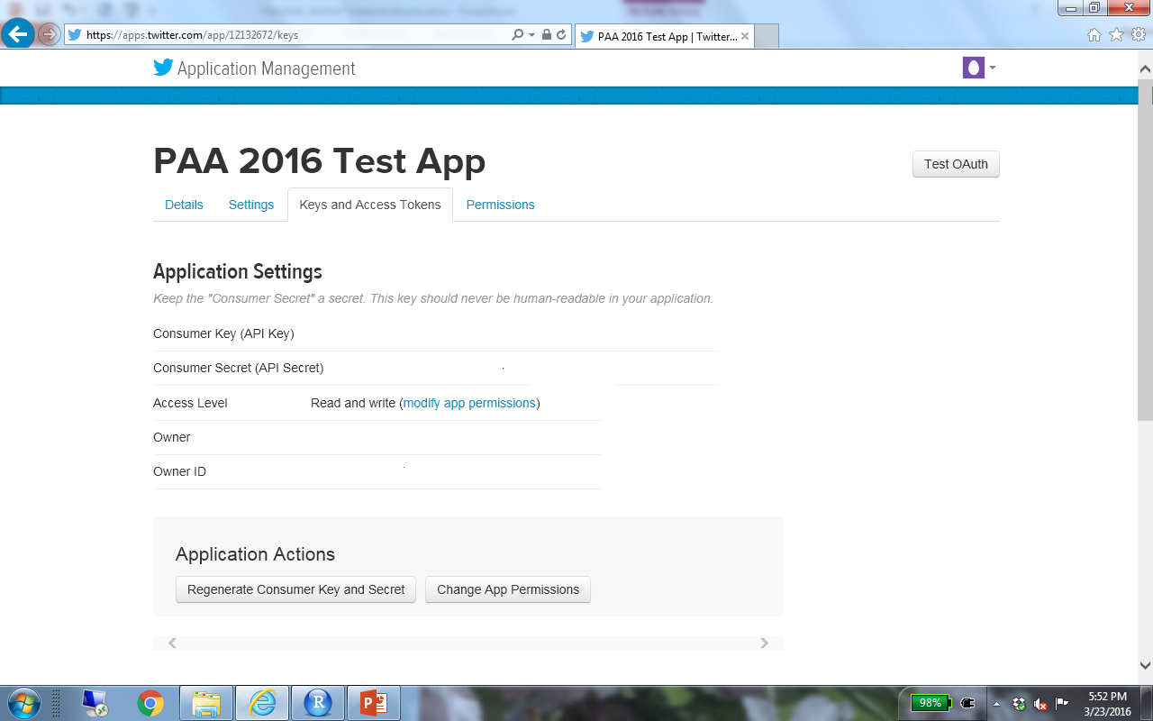
Copy Consumer Key and Consumer Secret
Scroll down to generate tokens

Slide 14
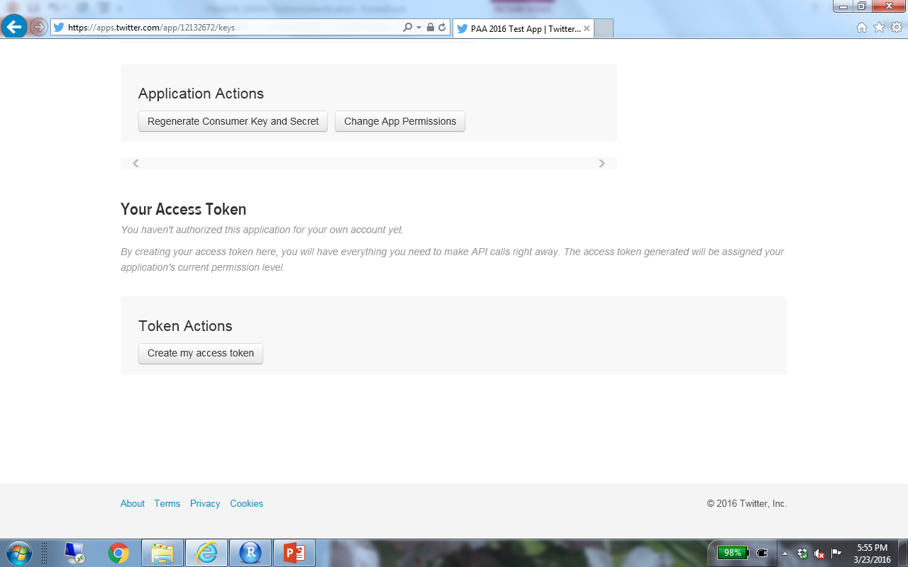

Slide 15
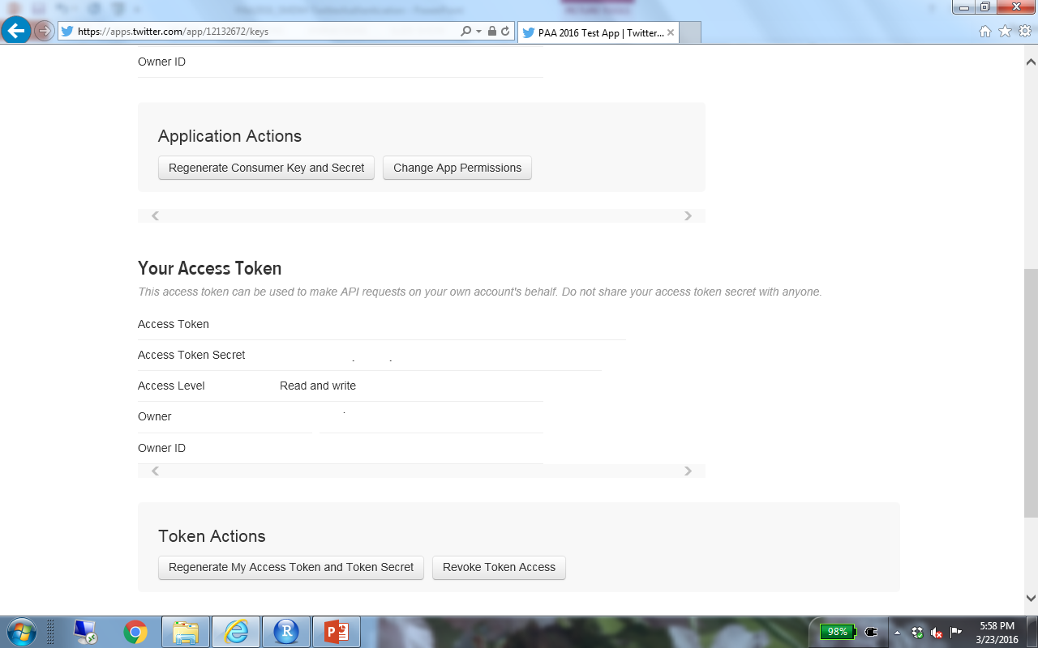
Copy Access Token and Access Token Secret

Slide 16
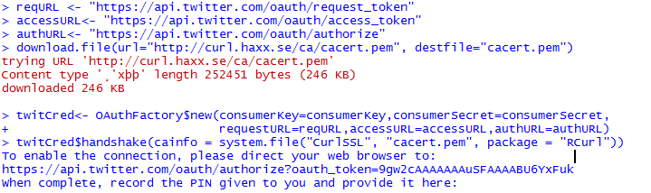

Slide 17
