Slide 1
Section 3
Ch3. Introduction to SQL
Slide contents follow
Database System Concepts, 7th edition.
Prepared by:
AbdElrahman Rabea, Eng.

Slide 2
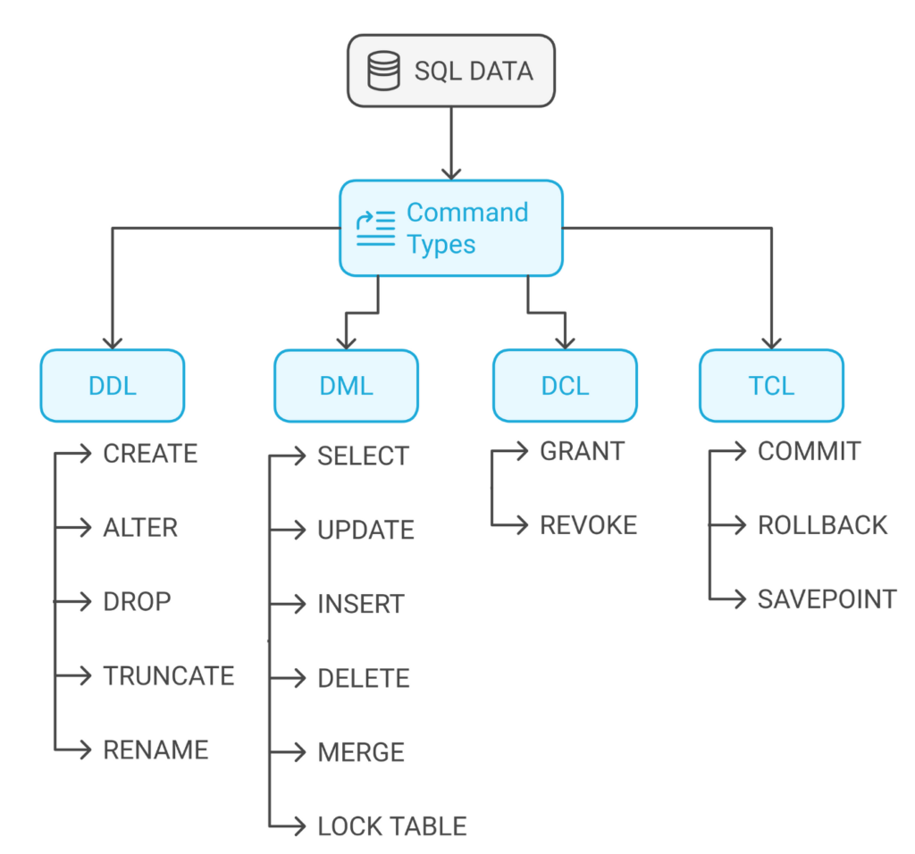
SQL
SQL refers to Structured Query Language.
SQL serves as the interface between users or applications and the database management system (DBMS).
It is referred as query language but it can do much more than query database
SQL enables users to perform essential database operations, including:
Data Definition: Creating, altering, and deleting database structures such as tables.
Data Manipulation: Inserting, updating, retrieving, and deleting data.
Data Control: Managing database access permissions and security.
Transaction Control: Ensuring database integrity during operations.
You can use it interactive (GUI), prompt or embedded in programs
Declarative and based on relational algebra

Slide 3
SQL History Timeline
Early 1970s: IBM developed the original version of SQL, initially called Sequel, as part of the System R project.
Late 1970s: The language evolved, and its name changed to SQL (Structured Query Language).
1986: The American National Standards Institute (ANSI) and International Organization for Standardization (ISO) published the first SQL standard, SQL-86.
1989: ANSI released an extended standard, SQL-89.
1992: The SQL-92 standard introduced significant improvements.
1999: SQL:1999 introduced features like triggers, recursive queries, and procedural extensions (e.g., procedural SQL).
2003: SQL:2003 added XML-related features and window functions.
2006: SQL:2006 improved XML integration.
2008: SQL:2008 introduced new data types, MERGE statements, and better error handling.
2011: SQL:2011 focused on temporal databases, adding support for tracking historical data.
2016: SQL:2016 introduced JSON support, enhanced analytics, and new security features.
2023: The most recent standard, SQL:2023
Most commercial RDBMS (Relational Database Management Systems) fully implement SQL-92, along with features from later SQL standards. However, each DBMS adds its own proprietary features beyond the standard.
All SQL statements covered in this course are compatible with Microsoft SQL Server.

Slide 4
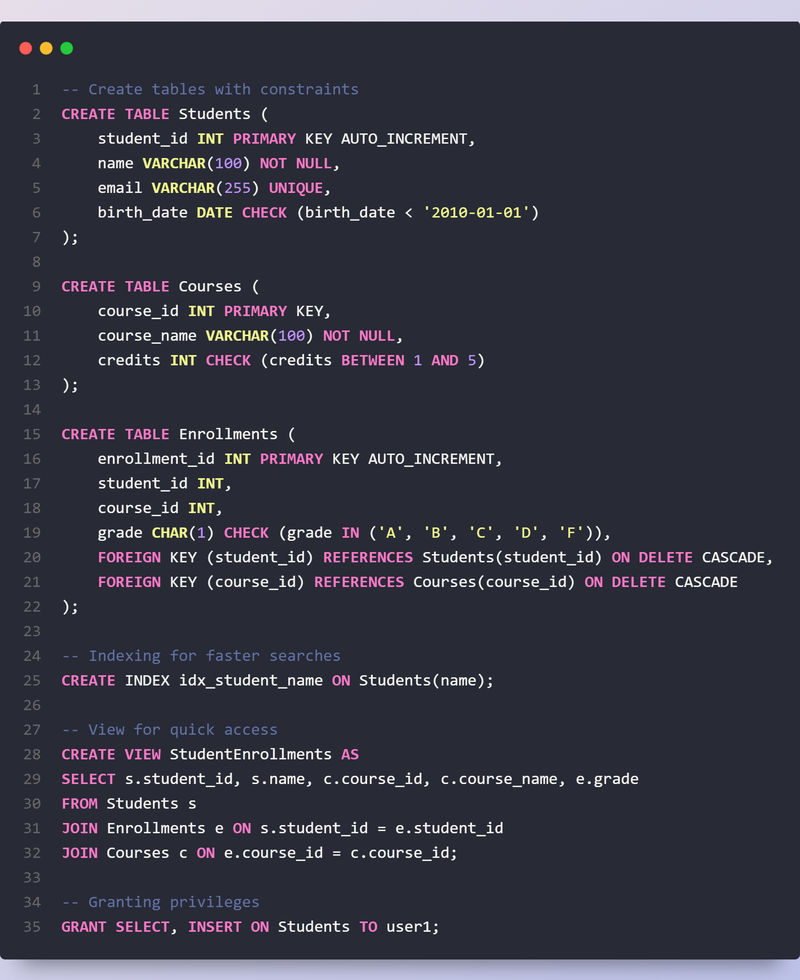
Data Definition Language (DDL)
What DDL can do?
Defines the schema for each relation.
Specifies the types of values for each attribute.
Enforces integrity constraints (PRIMARY KEY, FOREIGN KEY, UNIQUE, NOT NULL, CHECK).
Defines indexes to improve query performance.
Manages security and authorization (GRANT, REVOKE).
Specifies the physical storage structure of relations on disk.
Allows view creation (CREATE VIEW).
Supports triggers for automated actions.
Defines sequences and auto-increment for unique identifiers.

Slide 5
Recall Relational model structure
A relational database consists of set of named relations (tables)
Each relation has a set of named attributes (columns)
Each tuple (row) has a value for each attribute
Each attribute has a domain
Domain is the set of allowed values for each attribute. Ex. dept-name
The special value null is a member of every domain. Indicated that the value is “unknown”.
The null value causes complications in the definition of many operations.
Attributes (columns)
instructor relation
ID | name | dept name | salary
22222 | Einstein | Physics | 95000
12121 | Wu | Finance | 90000
32343 | El Said | History | 60000
45565 | Katz | Comp. Sci. | 75000
98345 | Kim | Elec. Eng. | 80000
76766 | Crick | Biology | 72000
10101 | Srinivasan | Comp. Sci. | 65000
58583 | Califieri | History | 62000
83821 | Brandt | Comp. Sci. | 92000
15151 | Mozart | Music | 40000
33456 | Gold | Physics | 87000
76543 | Singh | Finance | 80000
Tuples (rows)

Slide 6
Recall Keys
Key: attribute whose value is unique in each tuple Or set of attributes whose combined values are unique
Primary key: key that is unique and can’t be null
Foreign-key constrainst:
Foreign-key constraints enforce consistency between relations in a database.
The dept_name attribute in the instructor relation must correspond to an existing department in the department relation, that is No tuple in instructor should have a dept_name value that does not exist in department.
Given a tuple ta from instructor, there must be a corresponding tuple tb in department with the same dept_name value.
A foreign-key constraint from attribute(s) A in relation r₁ to the primary key B in relation r₂ ensures:
The value of A in each tuple of r₁ must match a value of B in some tuple of r₂.
The foreign key (A) belongs to r₁ and references r₂.
r₁ is called the referencing relation, while r₂ is the referenced relation.
Classroom (building, room number, capacity)
department(dept_name, building, budget)
course(course_id, title, dept name, credits)
Instructor(ID, name, dept name, salary)
section(course id, sec id, semester, year, building, room number, time slot id)
teaches(ID, course id, sec id, semester, year)
student(ID, name, dept name, tot cred)
takes(ID, course id, sec id, semester, year, grade)
advisor(s ID, i_ID)
time slot(time slot id, day, start time, end time)
prereq(course id, prereq id)
Schema of the university database.

Slide 7
Basic Data types
Category | Data Type | Description | Example
Character Types | CHAR(n) | Fixed-length character string with length n. Full form: CHARACTER. | 'Hello'
 | VARCHAR(n) | Variable-length character string with max length n. Full form: CHARACTER VARYING. the n defines the string length in byte-pairs | 'SQL Server'
 | NCHAR(5) | Fixed-length Unicode character string. | N'مرحبا'
 | NVARCHAR(10) | Variable-length Unicode character string. | N'こんにちは'
Integer Types | INT | Standard integer (machine-dependent range). Full form: INTEGER. | 100000
 | SMALLINT | Small integer (machine-dependent range). | 32000
Decimal & Numeric | NUMERIC(p, d) | Fixed-point number with p total digits, d of which are decimal places. Example: NUMERIC(3,1) stores 44.5, but not 444.5. | 123.45
 | DECIMAL(p, d) | Same as NUMERIC. | 99.9
Floating-Point | REAL | Floating-point number with machine-dependent precision. (4bytes) | 3.14
 | FLOAT(n) | n is the number of bits that are used to store the mantissa of the float number in scientific notation and, therefore, dictates the precision and storage size.
 |  |  | 2.7182818284
Date & Time | DATE | Stores only date (YYYY-MM-DD). | '2025-03-03'
 | TIME | Stores only time (hh:mm:ss). | '14:30:00'
 | DATETIME | Stores both date and time (YYYY-MM-DD hh:mm:ss). | '2025-03-03 14:30:00'

Slide 8
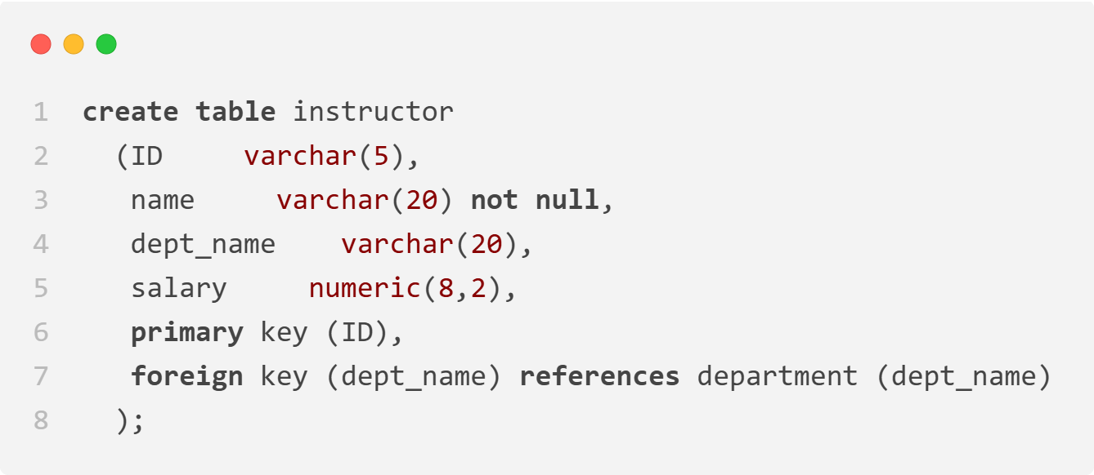
Lets create our first table
An SQL relation is defined using the create table command:
create table r
(A₁ D₁, A₂ D₂, ..., A_{n} D_{n}, (integrity-constraint₁), ..., (integrity-constraint_{k}))
r is the name of the relation
each A_{i} is an attribute name in the schema of relation r
D_{i} is the data type of values in the domain of attribute A_{i}
Example:

Slide 9
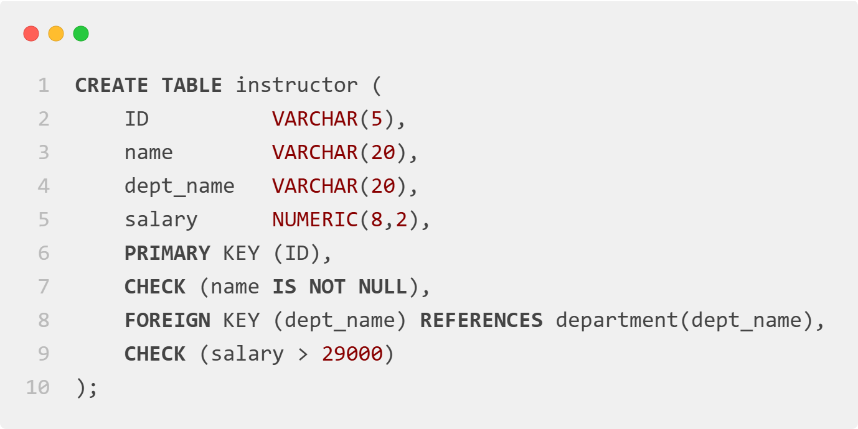
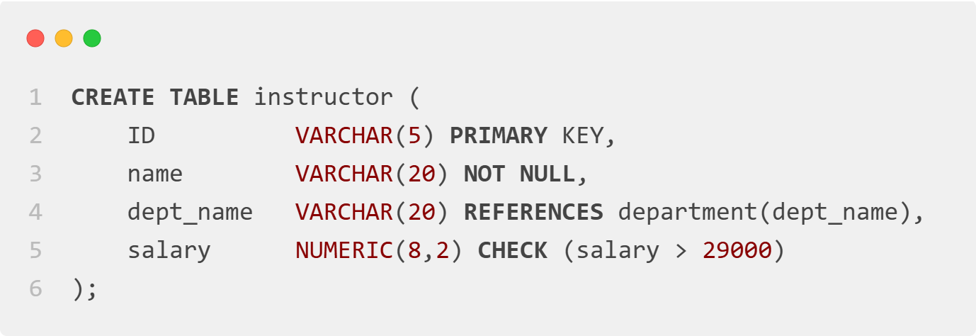
Integrity constrains
Primary key
Foreign key
Unique
Check
Not null
For simple constraints you can do this:

Slide 10

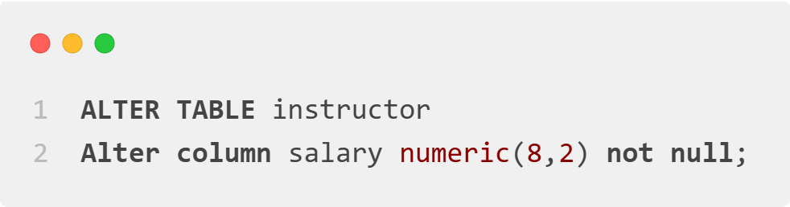


Alter table
Add a New Column
Modify an Existing Column (Increase name Size)
Drop an Existing Column (hire_date)
Add a New NOT NULL Constraint (salary)
And much more …..
Mainly you are modifying the structure ( rename, datatypes, domains, …. )

Slide 11
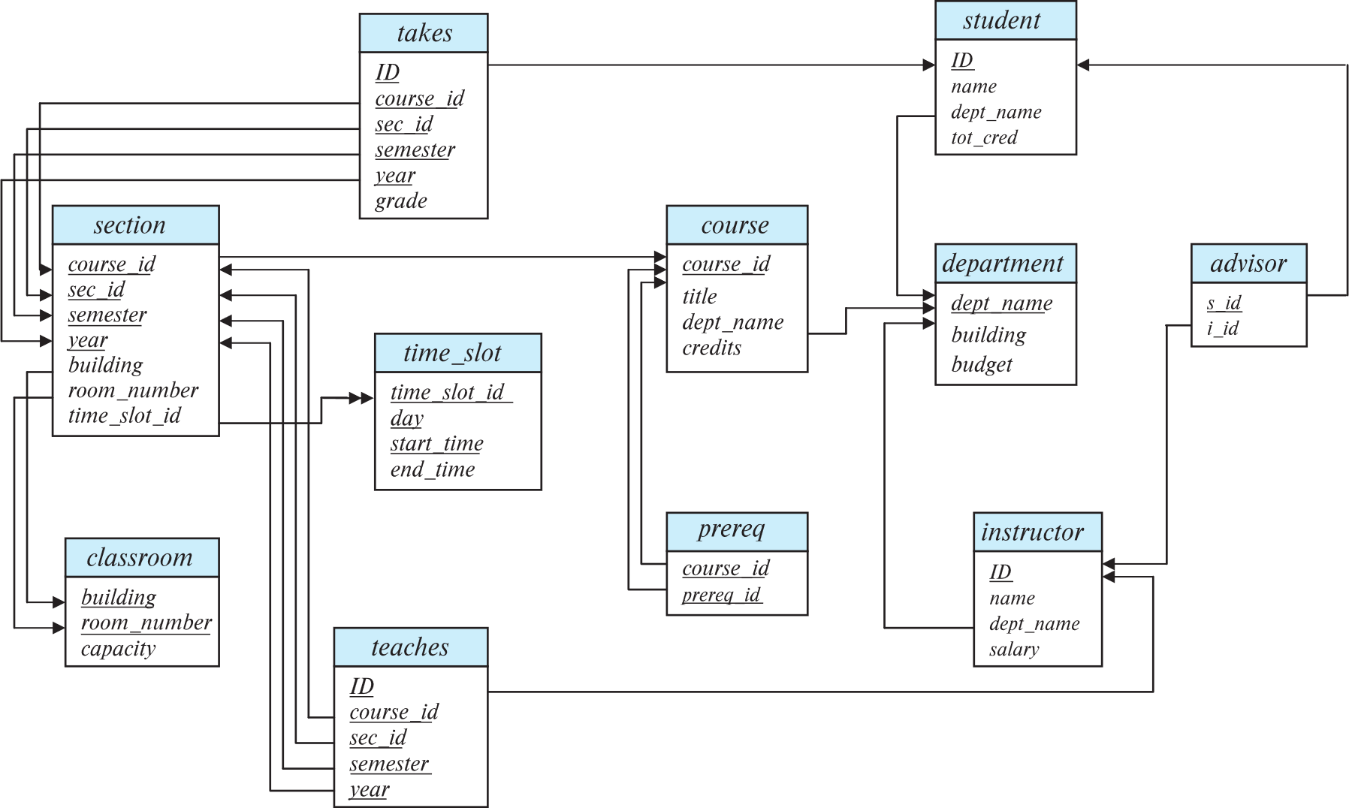
University Schema diagram ( practice DDL )

