Slide 1
Section 1
Ch1. Introduction to Database
Slide contents follow
Database System Concepts, 7th edition.
Prepared by:
AbdElrahman Rabea, Eng.

Slide 2

Motivation
Why should we study database?
Because information are very important
many application is all about data that is, The central aspect of the application is not a program performing some calculation, but rather the data themselves. (suppose a bank system without its data)
Databases power a wide range of applications, from banking and healthcare to e-commerce and social media.
Some application:
Social Media Networks.
Banking Systems.
E-Commerce Platforms

Slide 3
Purpose of database
In the early days, database applications were built directly on top of file systems, which leads to:
Data redundancy and inconsistency: data is stored in multiple file formats resulting induplication of information in different files
Difficulty in accessing data
Need to write a new program to carry out each new task ( suppose updating some constraint )
Data isolation
Different developer - Multiple files and formats
Integrity problems
Integrity constraints become “buried” in program code rather than being stated explicitly
Hard to add new constraints or change existing ones
Atomicity of updates
Failures may leave database in an inconsistent state with partial updates carried out
Example: Transfer of funds from one account to another should either complete or not happen at all

Slide 4
Purpose of database
In the early days, database applications were built directly on top of file systems, which leads to:
Concurrent access by multiple users
Concurrent access needed for performance
Uncontrolled concurrent accesses can lead to inconsistencies
Ex: Two people reading a balance (say 100) and updating it by withdrawing money (say 50 each) at the same time
Security problems
Ex: Hard to provide user access to some, but not all, data

Slide 5
Exploring the solution
There exist a solution that solves all of the previous problems.
Database system: is a collection of interrelated data and a set of programs that allow users to access and modify these data.
Database: is a collection of interrelated data
database-management system (DBMS):
the software that manages the database.
It’s primary goal is to provide a way to store and retrieve database information that is both convenient and efficient.
Ex. Microsoft SQL Server, MySql

Slide 6
Some benefits of DBMS
DBMS Facilitates all of these
Data Storage: Stores data in a structured format (e.g., tables in a relational database).
Data Retrieval: Allows users to query and retrieve data (e.g., using SQL)
Data Manipulation: Enables users to insert, update, and delete data.
Data Security: Controls access to the data (e.g., user authentication and authorization).
Data Integrity: Enforces rules to ensure data accuracy and consistency (e.g., constraints like primary keys).
Concurrency Control: Manages simultaneous access by multiple users.
Backup and Recovery: Ensures data is not lost in case of failures.
provide users with an abstract view of the data.
And much more …

Slide 7
View of Data and data models
A major purpose of a database system is to provide users with an abstract view of the data.
Data abstraction
Hide the complexity of data structures to represent data in the database from users through several levels of data abstraction.
Why? For the system to be usable, it must retrieve data efficiently. The need for efficiency has led database system developers to use complex data structures to represent data in the database. Since many database-system users are not computer trained, developers hide the complexity from users through several levels of data abstraction, to simplify users’ interactions with the system. Many benefits will be discussed later.

Slide 8
View of Data and data models
The lowest level of abstraction describes how the data are actually stored. The physical level describes complex low-level data structures in detail.
Database systems use complex data structures to store and retrieve data efficiently.
These structures help manage large datasets, reduce disk I/O, and improve performance.
B-Tree Index (For Fast Searching)
Hash Indexing (For Fast Exact Match Lookups).
These complex data structures:
✅ Improve query performance (fast lookups, efficient scans). ✅ Optimize disk space (efficient storage management). ✅ Reduce I/O operations (faster access, less disk reads).
Physical level

Slide 9
View of Data
The next-higher level of abstraction describes what data are stored in the database, and what relationships exist among those data.
The logical level thus describes the entire database in terms of a small number of relatively simple structures.
Although implementation of the simple structures at the logical level may involve complex physical-level structures, the user of the logical level does not need to be aware of this complexity (physical data independency).
Example using relational model.
Logical level
ID | Name | Dept Name | Salary
76766 | Crick | Biology | 72000

Slide 10
Data model
A collection of conceptual tools for describing
data
data relationships,
data semantics,
and consistency constraints.
Data models types:
Relational model ( next section in great detail )
Entity-Relationship data model (mainly for database design)
Object-based data models (Object-oriented and Object-relational)
Semi-structured data model (XML)

Slide 11
Section scope
In this course, our focus will not be on the database management system (DBMS) itself, but rather on designing efficient and well-structured databases as will as writing queries to retrieve and manipulate data effectively. We will explore how to model data, create relational schemas, and use SQL to interact with databases, rather than delving into the internal workings of a DBMS.
Database design
System analysis
Database design
Database mapping
Database implementation.
More on this later in the course!

Slide 12
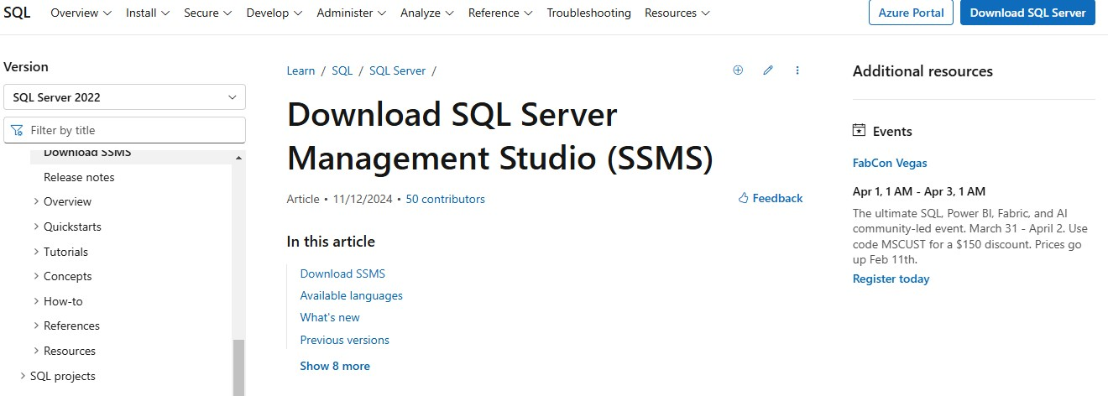
Setup Microsoft sql server
Screenshots credit: Mostafa Abdelnaby

Slide 13
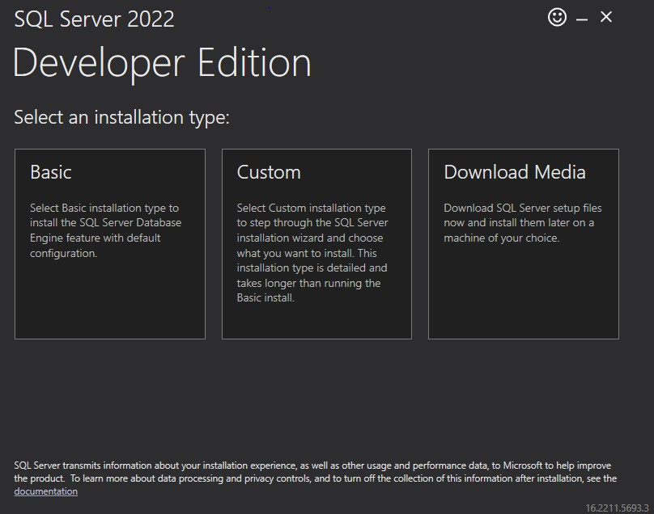
Setup Microsoft sql server

Slide 14
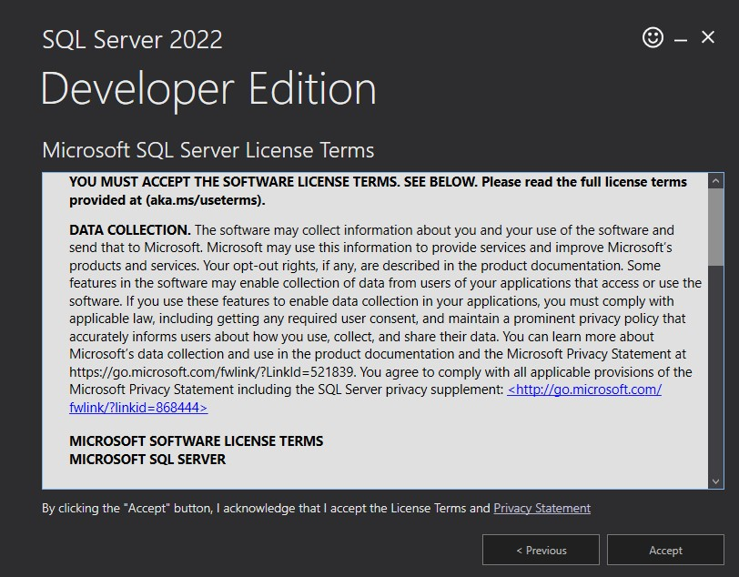
Setup Microsoft sql server

Slide 15
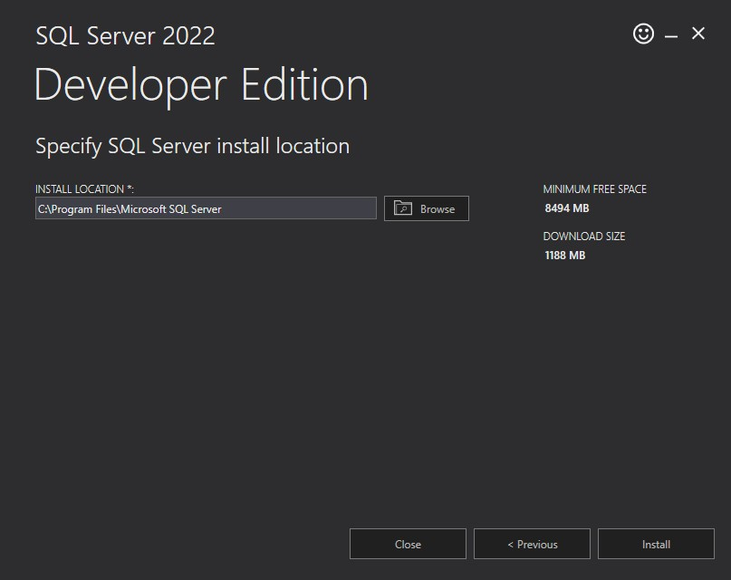
Setup Microsoft sql server

Slide 16
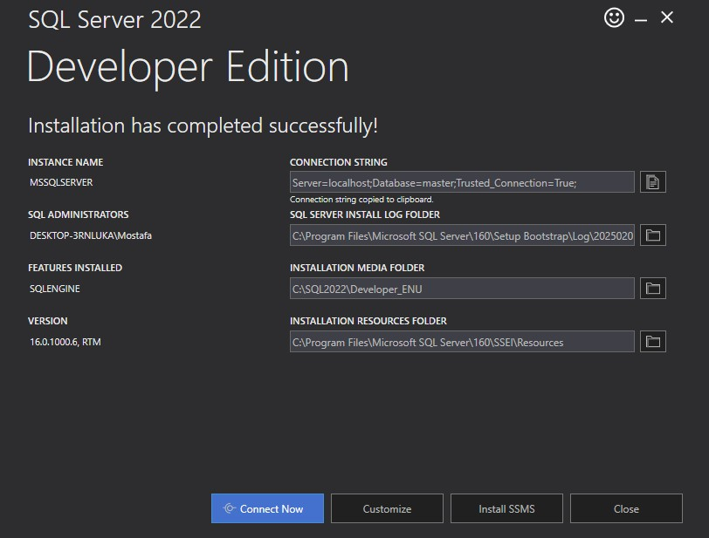
Setup Microsoft sql server

Slide 17
Install SQL server management studio(SSMS)

Slide 18
Install SQL server management studio(SSMS)

Slide 19
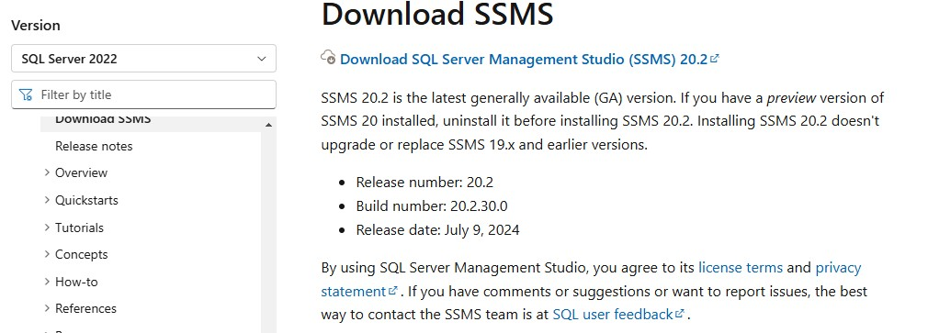
Install SQL server management studio(SSMS)

Slide 20
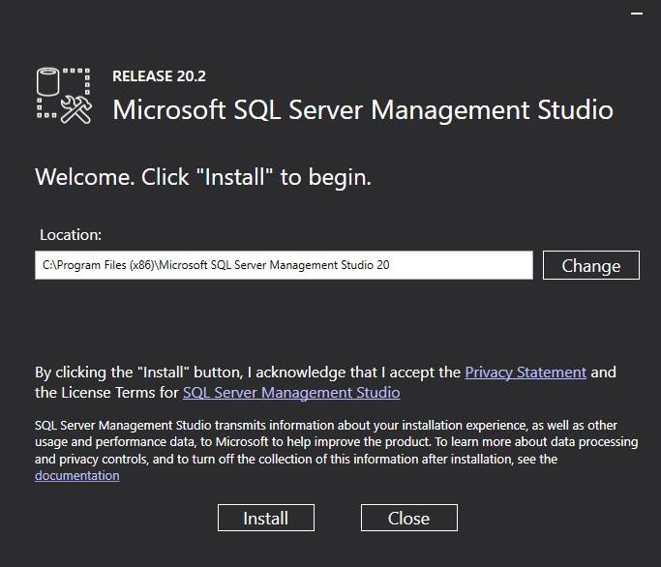
Install SQL server management studio(SSMS)

Slide 21
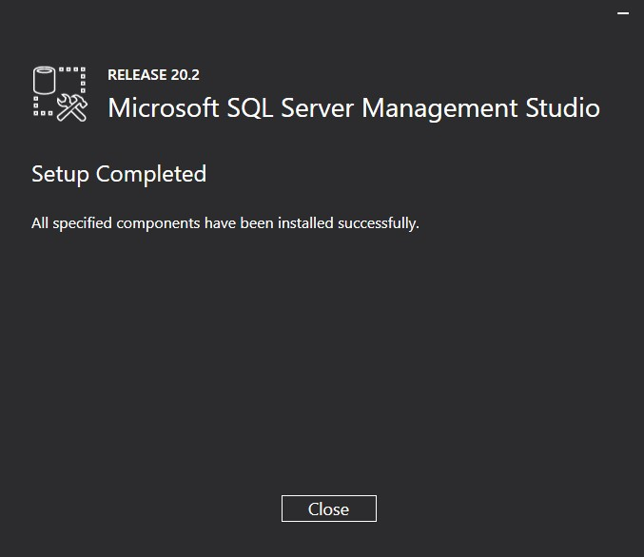
Install SQL server management studio(SSMS)

Slide 22
Install SQL server management studio(SSMS)

Slide 23
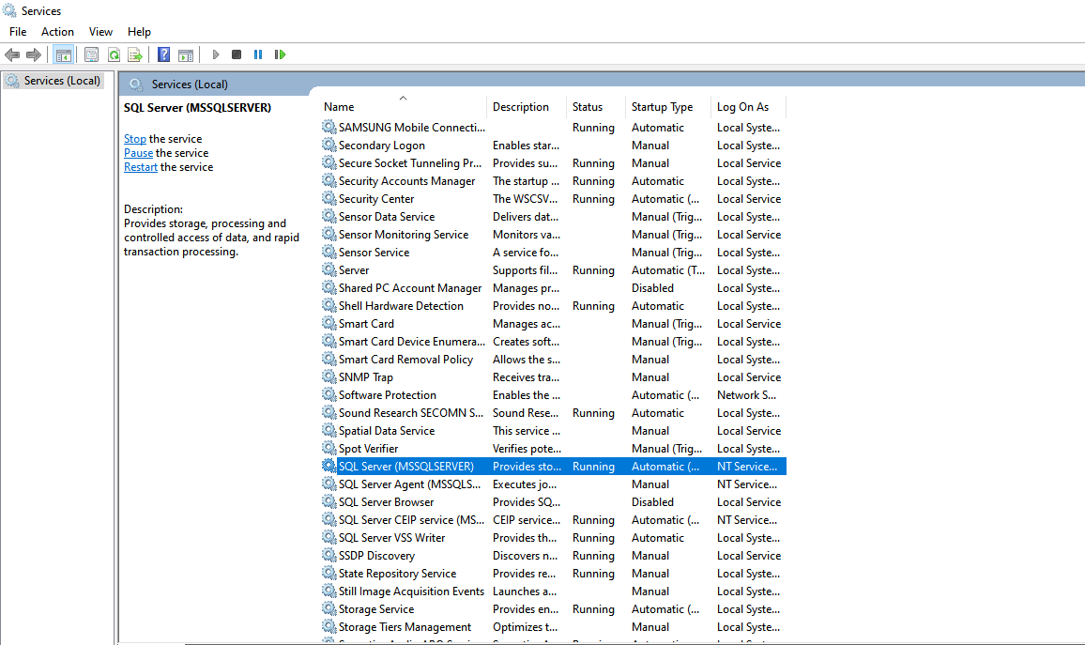
Install SQL server management studio(SSMS)

