Slide 1
Section 2
Ch2. Introduction to the relational model
Slide contents follow
Database System Concepts, 7th edition.
Prepared by:
AbdElrahman Rabea, Eng.

Slide 2
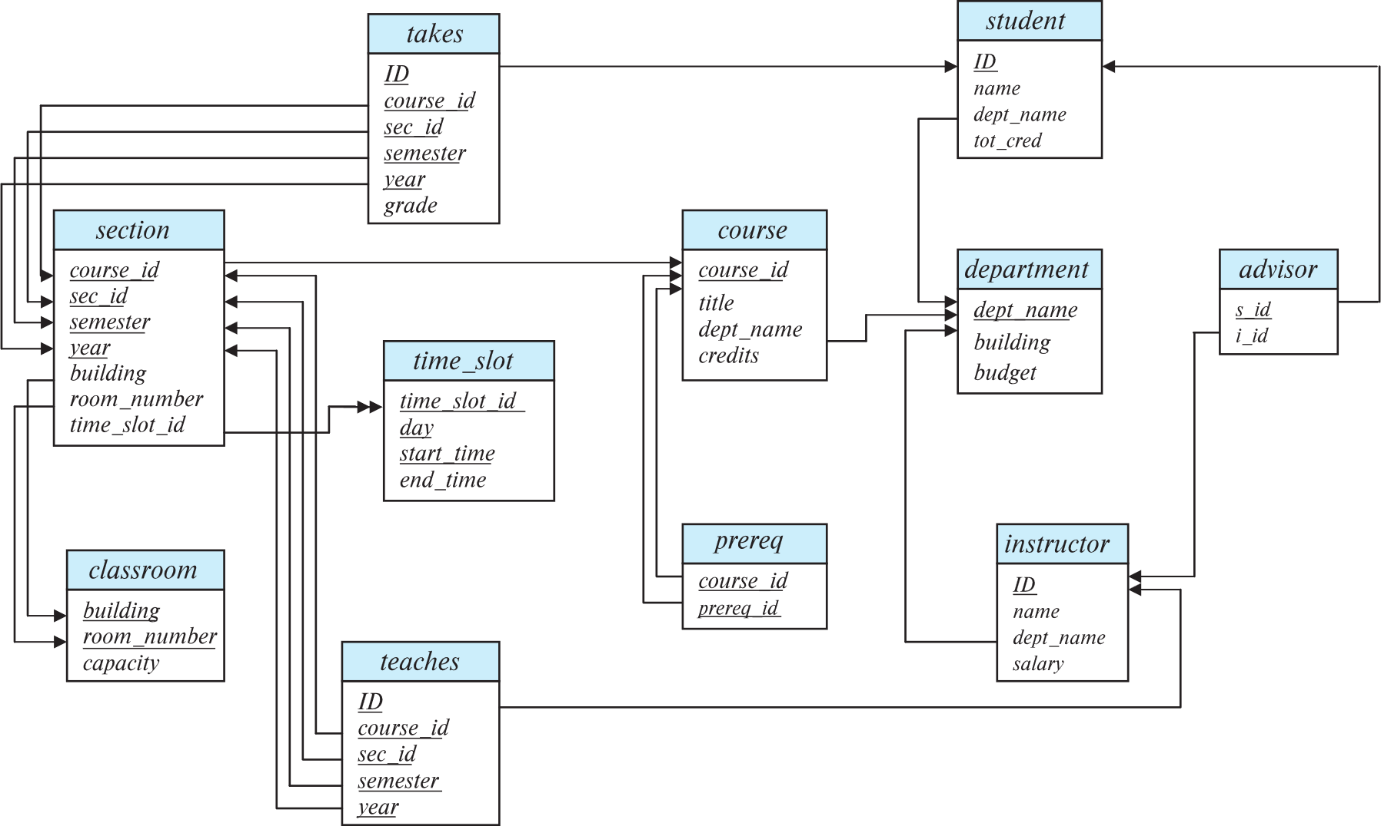
Relational model
The relational data model is the foundation of Relational Database Management Systems (RDBMS).
Key benefits:
✅ Widely Used & Standardized: relational model remains the primary data model for commercial data-processing applications.
✅ Simple & Structured – Data is described in clear table-based formats, making it easy to understand and manage.
✅ Data Integrity & Accuracy – Ensures consistency with constraints (Primary Key, Foreign Key, Unique) and eliminates redundancy.
✅ Efficient & Scalable – Optimized implementations support indexing, large datasets, and concurrent access.
✅ Flexible & Independent – Logical and physical storage are separate, allowing schema evolution without affecting applications.

Slide 3
Relational model structure
A relational database consists of set of named relations (tables)
Each relation has a set of named attributes (columns)
Each tuple (row) has a value for each attribute
Each attribute has a domain
Domain is the set of allowed values for each attribute. Ex. dept-name
The special value null is a member of every domain. Indicated that the value is “unknown”.
The null value causes complications in the definition of many operations.
Attributes (columns)
instructor relation
ID | name | dept name | salary
22222 | Einstein | Physics | 95000
12121 | Wu | Finance | 90000
32343 | El Said | History | 60000
45565 | Katz | Comp. Sci. | 75000
98345 | Kim | Elec. Eng. | 80000
76766 | Crick | Biology | 72000
10101 | Srinivasan | Comp. Sci. | 65000
58583 | Califieri | History | 62000
83821 | Brandt | Comp. Sci. | 92000
15151 | Mozart | Music | 40000
33456 | Gold | Physics | 87000
76543 | Singh | Finance | 80000
Tuples (rows)

Slide 4
Database Schema vs instances
Database schema -- is the logical structure of the database.
Database instance -- is a snapshot of the data in the database at a given instant in time.
Example:
schema: instructor (ID, name, dept_name, salary)
instance
ID | name | dept name | salary
22222 | Einstein | Physics | 95000
12121 | Wu | Finance | 90000
32343 | El Said | History | 60000
45565 | Katz | Comp. Sci. | 75000
98345 | Kim | Elec. Eng. | 80000
76766 | Crick | Biology | 72000
10101 | Srinivasan | Comp. Sci. | 65000
58583 | Califieri | History | 62000
83821 | Brandt | Comp. Sci. | 92000
15151 | Mozart | Music | 40000
33456 | Gold | Physics | 87000
76543 | Singh | Finance | 80000

Slide 5
Database Schema vs instances
Key: attribute whose value is unique in each tuple Or set of attributes whose combined values are unique
Primary key: key that is unique and can’t be null
Foreign-key constrainst:
Foreign-key constraints enforce consistency between relations in a database.
The dept_name attribute in the instructor relation must correspond to an existing department in the department relation, that is No tuple in instructor should have a dept_name value that does not exist in department.
Given a tuple ta from instructor, there must be a corresponding tuple tb in department with the same dept_name value.
A foreign-key constraint from attribute(s) A in relation r₁ to the primary key B in relation r₂ ensures:
The value of A in each tuple of r₁ must match a value of B in some tuple of r₂.
The foreign key (A) belongs to r₁ and references r₂.
r₁ is called the referencing relation, while r₂ is the referenced relation.
Classroom (building, room number, capacity)
department(dept_name, building, budget)
course(course_id, title, dept name, credits)
Instructor(ID, name, dept name, salary)
section(course id, sec id, semester, year, building, room number, time slot id)
teaches(ID, course id, sec id, semester, year)
student(ID, name, dept name, tot cred)
takes(ID, course id, sec id, semester, year, grade)
advisor(s ID, i_ID)
time slot(time slot id, day, start time, end time)
prereq(course id, prereq id)
Schema of the university database.
Formal definition of keys as will as other types of keys will be discussed later
Notes:
Benefits of key:
1. to identify certain tuple to make query of it
2. database system build special index structure for this key (for efficiency)
3. if one relation wants to refer a tuple in another (there is no pointer here)

Slide 6
University Schema diagram

Slide 7
Query Languages
Relational Algebra
The relational algebra consists of a set of operations that take one or two relations as input and produce a new relation as their result.
However the relational algebra operations form the basis for the widely used SQL query language, database systems do not allow users to write queries in relational algebra.
Select, project, rename, join
SQL (next sections)
course(course_id, title, dept name, credits)
Instructor(ID, name, dept name, salary)
teaches(ID, course id, sec id, semester, year)
Simple schema to practice relational algabra

Slide 8
Relational Algebra (SIMPLE SCHEMA)
Instructor(ID, name, dept_name, salary)
teaches(ID, course id, sec_id, semester, year)
course(course_id, title, dept_name, credits)
instructor
teaches
course
ID | name | dept name | salary
10101 | Srinivasan | Comp. Sci. | 65000
12121 | Wu | Finance | 90000
15151 | Mozart | Music | 40000
22222 | Einstein | Physics | 95000
32343 | El Said | History | 60000
33456 | Gold | Physics | 87000
45565 | Katz | Comp. Sci. | 75000
58583 | Califieri | History | 62000
76543 | Singh | Finance | 80000
76766 | Crick | Biology | 72000
83821 | Brandt | Comp. Sci. | 92000
98345 | Kim | Elec. Eng. | 80000
ID | course id | sec id | semester | year
10101 | CS-101 | 1 | Fall | 2017
10101 | CS-315 | 1 | Spring | 2018
10101 | CS-347 | 1 | Fall | 2017
12121 | FIN-201 | 1 | Spring | 2018
15151 | MU-199 | 1 | Spring | 2018
22222 | PHY-101 | 1 | Fall | 2017
32343 | HIS-351 | 1 | Spring | 2018
45565 | CS-101 | 1 | Spring | 2018
45565 | CS-319 | 1 | Spring | 2018
76766 | BIO-101 | 1 | Summer | 2017
76766 | BIO-301 | 1 | Summer | 2018
83821 | CS-190 | 1 | Spring | 2017
83821 | CS-190 | 2 | Spring | 2017
83821 | CS-319 | 2 | Spring | 2018
98345 | EE-181 | 1 | Spring | 2017
course id | title | dept name | credits
BIO-101 | Intro. to Biology | Biology | 4
BIO-301 | Genetics | Biology | 4
BIO-399 | Computational Biology | Biology | 3
CS-101 | Intro. to Computer Science | Comp. Sci. | 4
CS-190 | Game Design | Comp. Sci. | 4
CS-315 | Robotics | Comp. Sci. | 3
CS-319 | Image Processing | Comp. Sci. | 3
CS-347 | Database System Concepts | Comp. Sci. | 3
EE-181 | Intro. to Digital Systems | Elec. Eng. | 3
FIN-201 | Investment Banking | Finance | 3
HIS-351 | World History | History | 3
MU-199 | Music Video Production | Music | 3
PHY-101 | Physical Principles | Physics | 4

Slide 9
Relational Algebra
Simples query: relation name
Example: instructor
will return instructor instances
instructor
teaches
course
ID | name | dept name | salary
10101 | Srinivasan | Comp. Sci. | 65000
12121 | Wu | Finance | 90000
15151 | Mozart | Music | 40000
22222 | Einstein | Physics | 95000
32343 | El Said | History | 60000
33456 | Gold | Physics | 87000
45565 | Katz | Comp. Sci. | 75000
58583 | Califieri | History | 62000
76543 | Singh | Finance | 80000
76766 | Crick | Biology | 72000
83821 | Brandt | Comp. Sci. | 92000
98345 | Kim | Elec. Eng. | 80000
ID | course id | sec id | semester | year
10101 | CS-101 | 1 | Fall | 2017
10101 | CS-315 | 1 | Spring | 2018
10101 | CS-347 | 1 | Fall | 2017
12121 | FIN-201 | 1 | Spring | 2018
15151 | MU-199 | 1 | Spring | 2018
22222 | PHY-101 | 1 | Fall | 2017
32343 | HIS-351 | 1 | Spring | 2018
45565 | CS-101 | 1 | Spring | 2018
45565 | CS-319 | 1 | Spring | 2018
76766 | BIO-101 | 1 | Summer | 2017
76766 | BIO-301 | 1 | Summer | 2018
83821 | CS-190 | 1 | Spring | 2017
83821 | CS-190 | 2 | Spring | 2017
83821 | CS-319 | 2 | Spring | 2018
98345 | EE-181 | 1 | Spring | 2017
course id | title | dept name | credits
BIO-101 | Intro. to Biology | Biology | 4
BIO-301 | Genetics | Biology | 4
BIO-399 | Computational Biology | Biology | 3
CS-101 | Intro. to Computer Science | Comp. Sci. | 4
CS-190 | Game Design | Comp. Sci. | 4
CS-315 | Robotics | Comp. Sci. | 3
CS-319 | Image Processing | Comp. Sci. | 3
CS-347 | Database System Concepts | Comp. Sci. | 3
EE-181 | Intro. to Digital Systems | Elec. Eng. | 3
FIN-201 | Investment Banking | Finance | 3
HIS-351 | World History | History | 3
MU-199 | Music Video Production | Music | 3
PHY-101 | Physical Principles | Physics | 4

Slide 10
Relational Algebra (select)
Select operation: selects tuples that satisfy a given predicate. σ
select tuples of the instructor relation where the instructor is in the “Physics” department.
σ_{dept name = “Physics”}(instructor)
select tuples of the instructor relation where the instructor is in the “Physics” and salary > 9000
σdept name = “Physics” ∧ salary>90000 (instructor)
Select all departments whose name is the same as their building name
σ_{dept name = building}(department)
=, ≠, <, ≤, >, ≥ and (∧), or(∨) , not(¬)
instructor
teaches
course
ID | name | dept name | salary
10101 | Srinivasan | Comp. Sci. | 65000
12121 | Wu | Finance | 90000
15151 | Mozart | Music | 40000
22222 | Einstein | Physics | 95000
32343 | El Said | History | 60000
33456 | Gold | Physics | 87000
45565 | Katz | Comp. Sci. | 75000
58583 | Califieri | History | 62000
76543 | Singh | Finance | 80000
76766 | Crick | Biology | 72000
83821 | Brandt | Comp. Sci. | 92000
98345 | Kim | Elec. Eng. | 80000
ID | course id | sec id | semester | year
10101 | CS-101 | 1 | Fall | 2017
10101 | CS-315 | 1 | Spring | 2018
10101 | CS-347 | 1 | Fall | 2017
12121 | FIN-201 | 1 | Spring | 2018
15151 | MU-199 | 1 | Spring | 2018
22222 | PHY-101 | 1 | Fall | 2017
32343 | HIS-351 | 1 | Spring | 2018
45565 | CS-101 | 1 | Spring | 2018
45565 | CS-319 | 1 | Spring | 2018
76766 | BIO-101 | 1 | Summer | 2017
76766 | BIO-301 | 1 | Summer | 2018
83821 | CS-190 | 1 | Spring | 2017
83821 | CS-190 | 2 | Spring | 2017
83821 | CS-319 | 2 | Spring | 2018
98345 | EE-181 | 1 | Spring | 2017
course id | title | dept name | credits
BIO-101 | Intro. to Biology | Biology | 4
BIO-301 | Genetics | Biology | 4
BIO-399 | Computational Biology | Biology | 3
CS-101 | Intro. to Computer Science | Comp. Sci. | 4
CS-190 | Game Design | Comp. Sci. | 4
CS-315 | Robotics | Comp. Sci. | 3
CS-319 | Image Processing | Comp. Sci. | 3
CS-347 | Database System Concepts | Comp. Sci. | 3
EE-181 | Intro. to Digital Systems | Elec. Eng. | 3
FIN-201 | Investment Banking | Finance | 3
HIS-351 | World History | History | 3
MU-199 | Music Video Production | Music | 3
PHY-101 | Physical Principles | Physics | 4

Slide 11
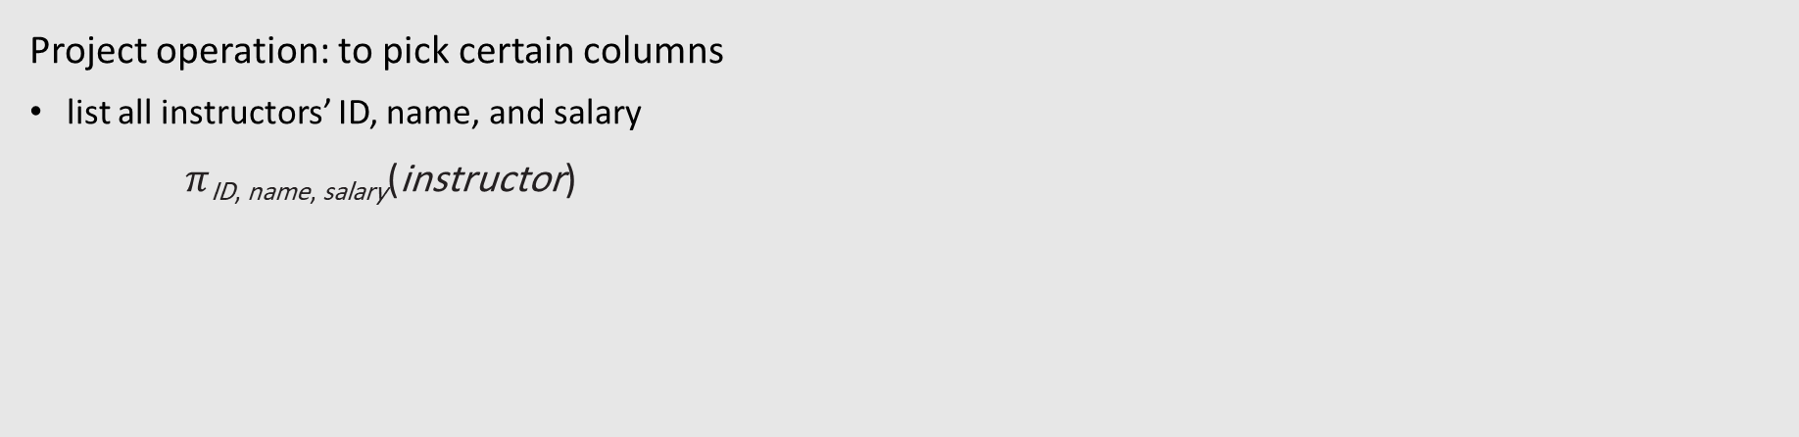
Relational Algebra (project)
Project operation: to pick certain columns
list all instructors’ ID, name, and salary
$π$_{ID, name, salary}(instructor)
instructor
teaches
course
ID | name | dept name | salary
10101 | Srinivasan | Comp. Sci. | 65000
12121 | Wu | Finance | 90000
15151 | Mozart | Music | 40000
22222 | Einstein | Physics | 95000
32343 | El Said | History | 60000
33456 | Gold | Physics | 87000
45565 | Katz | Comp. Sci. | 75000
58583 | Califieri | History | 62000
76543 | Singh | Finance | 80000
76766 | Crick | Biology | 72000
83821 | Brandt | Comp. Sci. | 92000
98345 | Kim | Elec. Eng. | 80000
ID | course id | sec id | semester | year
10101 | CS-101 | 1 | Fall | 2017
10101 | CS-315 | 1 | Spring | 2018
10101 | CS-347 | 1 | Fall | 2017
12121 | FIN-201 | 1 | Spring | 2018
15151 | MU-199 | 1 | Spring | 2018
22222 | PHY-101 | 1 | Fall | 2017
32343 | HIS-351 | 1 | Spring | 2018
45565 | CS-101 | 1 | Spring | 2018
45565 | CS-319 | 1 | Spring | 2018
76766 | BIO-101 | 1 | Summer | 2017
76766 | BIO-301 | 1 | Summer | 2018
83821 | CS-190 | 1 | Spring | 2017
83821 | CS-190 | 2 | Spring | 2017
83821 | CS-319 | 2 | Spring | 2018
98345 | EE-181 | 1 | Spring | 2017
course id | title | dept name | credits
BIO-101 | Intro. to Biology | Biology | 4
BIO-301 | Genetics | Biology | 4
BIO-399 | Computational Biology | Biology | 3
CS-101 | Intro. to Computer Science | Comp. Sci. | 4
CS-190 | Game Design | Comp. Sci. | 4
CS-315 | Robotics | Comp. Sci. | 3
CS-319 | Image Processing | Comp. Sci. | 3
CS-347 | Database System Concepts | Comp. Sci. | 3
EE-181 | Intro. to Digital Systems | Elec. Eng. | 3
FIN-201 | Investment Banking | Finance | 3
HIS-351 | World History | History | 3
MU-199 | Music Video Production | Music | 3
PHY-101 | Physical Principles | Physics | 4

Slide 12
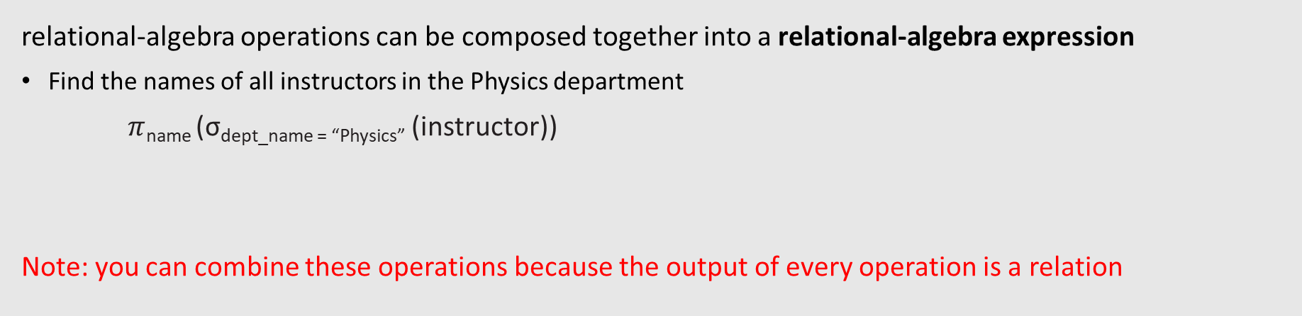
Relational Algebra (Composition)
relational-algebra operations can be composed together into a relational-algebra expression
Find the names of all instructors in the Physics department
$π$_{name} (σ_{dept_name = “Physics”} (instructor))
Note: you can combine these operations because the output of every operation is a relation
instructor
teaches
course
ID | name | dept name | salary
10101 | Srinivasan | Comp. Sci. | 65000
12121 | Wu | Finance | 90000
15151 | Mozart | Music | 40000
22222 | Einstein | Physics | 95000
32343 | El Said | History | 60000
33456 | Gold | Physics | 87000
45565 | Katz | Comp. Sci. | 75000
58583 | Califieri | History | 62000
76543 | Singh | Finance | 80000
76766 | Crick | Biology | 72000
83821 | Brandt | Comp. Sci. | 92000
98345 | Kim | Elec. Eng. | 80000
ID | course id | sec id | semester | year
10101 | CS-101 | 1 | Fall | 2017
10101 | CS-315 | 1 | Spring | 2018
10101 | CS-347 | 1 | Fall | 2017
12121 | FIN-201 | 1 | Spring | 2018
15151 | MU-199 | 1 | Spring | 2018
22222 | PHY-101 | 1 | Fall | 2017
32343 | HIS-351 | 1 | Spring | 2018
45565 | CS-101 | 1 | Spring | 2018
45565 | CS-319 | 1 | Spring | 2018
76766 | BIO-101 | 1 | Summer | 2017
76766 | BIO-301 | 1 | Summer | 2018
83821 | CS-190 | 1 | Spring | 2017
83821 | CS-190 | 2 | Spring | 2017
83821 | CS-319 | 2 | Spring | 2018
98345 | EE-181 | 1 | Spring | 2017
course id | title | dept name | credits
BIO-101 | Intro. to Biology | Biology | 4
BIO-301 | Genetics | Biology | 4
BIO-399 | Computational Biology | Biology | 3
CS-101 | Intro. to Computer Science | Comp. Sci. | 4
CS-190 | Game Design | Comp. Sci. | 4
CS-315 | Robotics | Comp. Sci. | 3
CS-319 | Image Processing | Comp. Sci. | 3
CS-347 | Database System Concepts | Comp. Sci. | 3
EE-181 | Intro. to Digital Systems | Elec. Eng. | 3
FIN-201 | Investment Banking | Finance | 3
HIS-351 | World History | History | 3
MU-199 | Music Video Production | Music | 3
PHY-101 | Physical Principles | Physics | 4

Slide 13
Relational Algebra (Cartesian-product)
Cartesian-product: combine two relations
instructor × teaches
Output schema = (instructor.ID, name, dept name, salary, teaches.ID, course id, sec id, semester, year)
For n1 tuples in r1, n2 tuples in r2 => n1 * n2 tuples
instructor
teaches
course
ID | name | dept name | salary
10101 | Srinivasan | Comp. Sci. | 65000
12121 | Wu | Finance | 90000
15151 | Mozart | Music | 40000
22222 | Einstein | Physics | 95000
32343 | El Said | History | 60000
33456 | Gold | Physics | 87000
45565 | Katz | Comp. Sci. | 75000
58583 | Califieri | History | 62000
76543 | Singh | Finance | 80000
76766 | Crick | Biology | 72000
83821 | Brandt | Comp. Sci. | 92000
98345 | Kim | Elec. Eng. | 80000
ID | course id | sec id | semester | year
10101 | CS-101 | 1 | Fall | 2017
10101 | CS-315 | 1 | Spring | 2018
10101 | CS-347 | 1 | Fall | 2017
12121 | FIN-201 | 1 | Spring | 2018
15151 | MU-199 | 1 | Spring | 2018
22222 | PHY-101 | 1 | Fall | 2017
32343 | HIS-351 | 1 | Spring | 2018
45565 | CS-101 | 1 | Spring | 2018
45565 | CS-319 | 1 | Spring | 2018
76766 | BIO-101 | 1 | Summer | 2017
76766 | BIO-301 | 1 | Summer | 2018
83821 | CS-190 | 1 | Spring | 2017
83821 | CS-190 | 2 | Spring | 2017
83821 | CS-319 | 2 | Spring | 2018
98345 | EE-181 | 1 | Spring | 2017
course id | title | dept name | credits
BIO-101 | Intro. to Biology | Biology | 4
BIO-301 | Genetics | Biology | 4
BIO-399 | Computational Biology | Biology | 3
CS-101 | Intro. to Computer Science | Comp. Sci. | 4
CS-190 | Game Design | Comp. Sci. | 4
CS-315 | Robotics | Comp. Sci. | 3
CS-319 | Image Processing | Comp. Sci. | 3
CS-347 | Database System Concepts | Comp. Sci. | 3
EE-181 | Intro. to Digital Systems | Elec. Eng. | 3
FIN-201 | Investment Banking | Finance | 3
HIS-351 | World History | History | 3
MU-199 | Music Video Production | Music | 3
PHY-101 | Physical Principles | Physics | 4

Slide 14
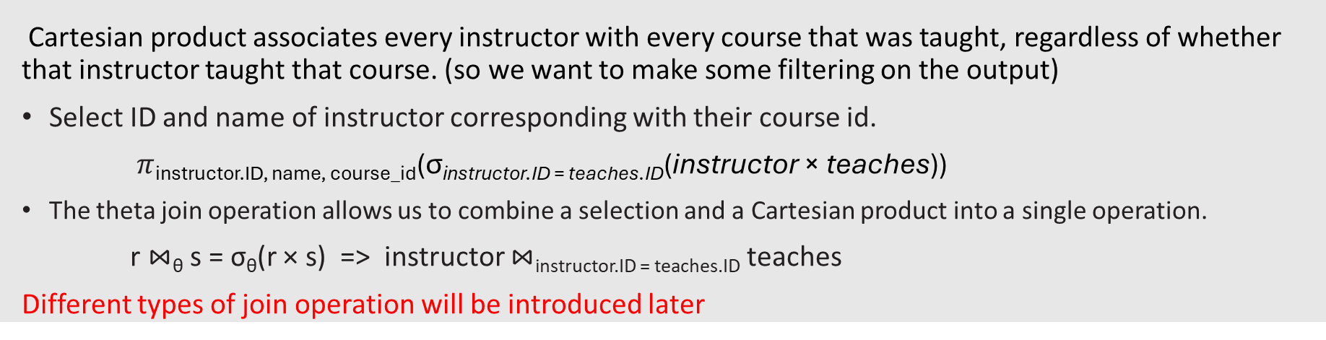
Relational Algebra (Join)
Cartesian product associates every instructor with every course that was taught, regardless of whether that instructor taught that course. (so we want to make some filtering on the output)
Select ID and name of instructor corresponding with their course id.
$π$_{instructor.ID, name, course_id}(σ_{instructor.ID = teaches.ID}(instructor × teaches))
The theta join operation allows us to combine a selection and a Cartesian product into a single operation.
r ⋈_{θ} s = σ_{θ}(r × s) => instructor ⋈_{instructor.ID = teaches.ID} teaches
Different types of join operation will be introduced later
instructor
teaches
course
ID | name | dept name | salary
10101 | Srinivasan | Comp. Sci. | 65000
12121 | Wu | Finance | 90000
15151 | Mozart | Music | 40000
22222 | Einstein | Physics | 95000
32343 | El Said | History | 60000
33456 | Gold | Physics | 87000
45565 | Katz | Comp. Sci. | 75000
58583 | Califieri | History | 62000
76543 | Singh | Finance | 80000
76766 | Crick | Biology | 72000
83821 | Brandt | Comp. Sci. | 92000
98345 | Kim | Elec. Eng. | 80000
ID | course id | sec id | semester | year
10101 | CS-101 | 1 | Fall | 2017
10101 | CS-315 | 1 | Spring | 2018
10101 | CS-347 | 1 | Fall | 2017
12121 | FIN-201 | 1 | Spring | 2018
15151 | MU-199 | 1 | Spring | 2018
22222 | PHY-101 | 1 | Fall | 2017
32343 | HIS-351 | 1 | Spring | 2018
45565 | CS-101 | 1 | Spring | 2018
45565 | CS-319 | 1 | Spring | 2018
76766 | BIO-101 | 1 | Summer | 2017
76766 | BIO-301 | 1 | Summer | 2018
83821 | CS-190 | 1 | Spring | 2017
83821 | CS-190 | 2 | Spring | 2017
83821 | CS-319 | 2 | Spring | 2018
98345 | EE-181 | 1 | Spring | 2017
course id | title | dept name | credits
BIO-101 | Intro. to Biology | Biology | 4
BIO-301 | Genetics | Biology | 4
BIO-399 | Computational Biology | Biology | 3
CS-101 | Intro. to Computer Science | Comp. Sci. | 4
CS-190 | Game Design | Comp. Sci. | 4
CS-315 | Robotics | Comp. Sci. | 3
CS-319 | Image Processing | Comp. Sci. | 3
CS-347 | Database System Concepts | Comp. Sci. | 3
EE-181 | Intro. to Digital Systems | Elec. Eng. | 3
FIN-201 | Investment Banking | Finance | 3
HIS-351 | World History | History | 3
MU-199 | Music Video Production | Music | 3
PHY-101 | Physical Principles | Physics | 4

Slide 15
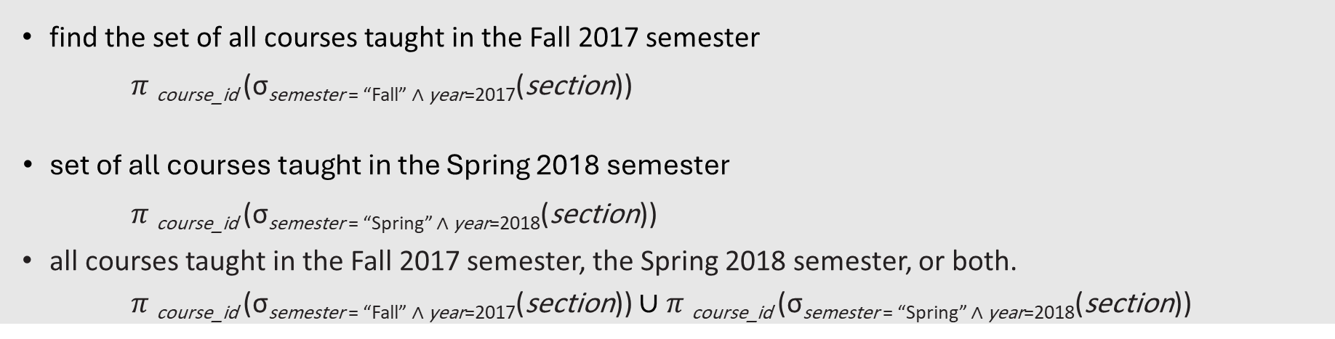
Relational Algebra (Union operation)
find the set of all courses taught in the Fall 2017 semester
$π$_{course_id} (σ_{semester = “Fall” ∧ year=2017}(section))
set of all courses taught in the Spring 2018 semester
$π$_{course_id} (σsemester = “Spring” ∧ year=2018(section))
all courses taught in the Fall 2017 semester, the Spring 2018 semester, or both.
$π$_{course_id} (σ_{semester = “Fall” ∧ year=2017}(section)) ∪$π$_{course_id} (σsemester = “Spring” ∧ year=2018(section))
section(course id, sec id, semester, year, building,
room number, time slot id)
instructor
teaches
course
ID | name | dept name | salary
10101 | Srinivasan | Comp. Sci. | 65000
12121 | Wu | Finance | 90000
15151 | Mozart | Music | 40000
22222 | Einstein | Physics | 95000
32343 | El Said | History | 60000
33456 | Gold | Physics | 87000
45565 | Katz | Comp. Sci. | 75000
58583 | Califieri | History | 62000
76543 | Singh | Finance | 80000
76766 | Crick | Biology | 72000
83821 | Brandt | Comp. Sci. | 92000
98345 | Kim | Elec. Eng. | 80000
ID | course id | sec id | semester | year
10101 | CS-101 | 1 | Fall | 2017
10101 | CS-315 | 1 | Spring | 2018
10101 | CS-347 | 1 | Fall | 2017
12121 | FIN-201 | 1 | Spring | 2018
15151 | MU-199 | 1 | Spring | 2018
22222 | PHY-101 | 1 | Fall | 2017
32343 | HIS-351 | 1 | Spring | 2018
45565 | CS-101 | 1 | Spring | 2018
45565 | CS-319 | 1 | Spring | 2018
76766 | BIO-101 | 1 | Summer | 2017
76766 | BIO-301 | 1 | Summer | 2018
83821 | CS-190 | 1 | Spring | 2017
83821 | CS-190 | 2 | Spring | 2017
83821 | CS-319 | 2 | Spring | 2018
98345 | EE-181 | 1 | Spring | 2017
course id | title | dept name | credits
BIO-101 | Intro. to Biology | Biology | 4
BIO-301 | Genetics | Biology | 4
BIO-399 | Computational Biology | Biology | 3
CS-101 | Intro. to Computer Science | Comp. Sci. | 4
CS-190 | Game Design | Comp. Sci. | 4
CS-315 | Robotics | Comp. Sci. | 3
CS-319 | Image Processing | Comp. Sci. | 3
CS-347 | Database System Concepts | Comp. Sci. | 3
EE-181 | Intro. to Digital Systems | Elec. Eng. | 3
FIN-201 | Investment Banking | Finance | 3
HIS-351 | World History | History | 3
MU-199 | Music Video Production | Music | 3
PHY-101 | Physical Principles | Physics | 4

Slide 16
Relational Algebra (Set operation)
we took the union of two sets, both of which consisted of course id values. In general, for a union operation to make sense:
We must ensure that the input relations to the union operation have the same number of attributes.
When the attributes have associated types, the types of the ith attributes of both input relations must be the same, for each i.
( compatible relations )
instructor
teaches
course
ID | name | dept name | salary
10101 | Srinivasan | Comp. Sci. | 65000
12121 | Wu | Finance | 90000
15151 | Mozart | Music | 40000
22222 | Einstein | Physics | 95000
32343 | El Said | History | 60000
33456 | Gold | Physics | 87000
45565 | Katz | Comp. Sci. | 75000
58583 | Califieri | History | 62000
76543 | Singh | Finance | 80000
76766 | Crick | Biology | 72000
83821 | Brandt | Comp. Sci. | 92000
98345 | Kim | Elec. Eng. | 80000
ID | course id | sec id | semester | year
10101 | CS-101 | 1 | Fall | 2017
10101 | CS-315 | 1 | Spring | 2018
10101 | CS-347 | 1 | Fall | 2017
12121 | FIN-201 | 1 | Spring | 2018
15151 | MU-199 | 1 | Spring | 2018
22222 | PHY-101 | 1 | Fall | 2017
32343 | HIS-351 | 1 | Spring | 2018
45565 | CS-101 | 1 | Spring | 2018
45565 | CS-319 | 1 | Spring | 2018
76766 | BIO-101 | 1 | Summer | 2017
76766 | BIO-301 | 1 | Summer | 2018
83821 | CS-190 | 1 | Spring | 2017
83821 | CS-190 | 2 | Spring | 2017
83821 | CS-319 | 2 | Spring | 2018
98345 | EE-181 | 1 | Spring | 2017
course id | title | dept name | credits
BIO-101 | Intro. to Biology | Biology | 4
BIO-301 | Genetics | Biology | 4
BIO-399 | Computational Biology | Biology | 3
CS-101 | Intro. to Computer Science | Comp. Sci. | 4
CS-190 | Game Design | Comp. Sci. | 4
CS-315 | Robotics | Comp. Sci. | 3
CS-319 | Image Processing | Comp. Sci. | 3
CS-347 | Database System Concepts | Comp. Sci. | 3
EE-181 | Intro. to Digital Systems | Elec. Eng. | 3
FIN-201 | Investment Banking | Finance | 3
HIS-351 | World History | History | 3
MU-199 | Music Video Production | Music | 3
PHY-101 | Physical Principles | Physics | 4

Slide 17
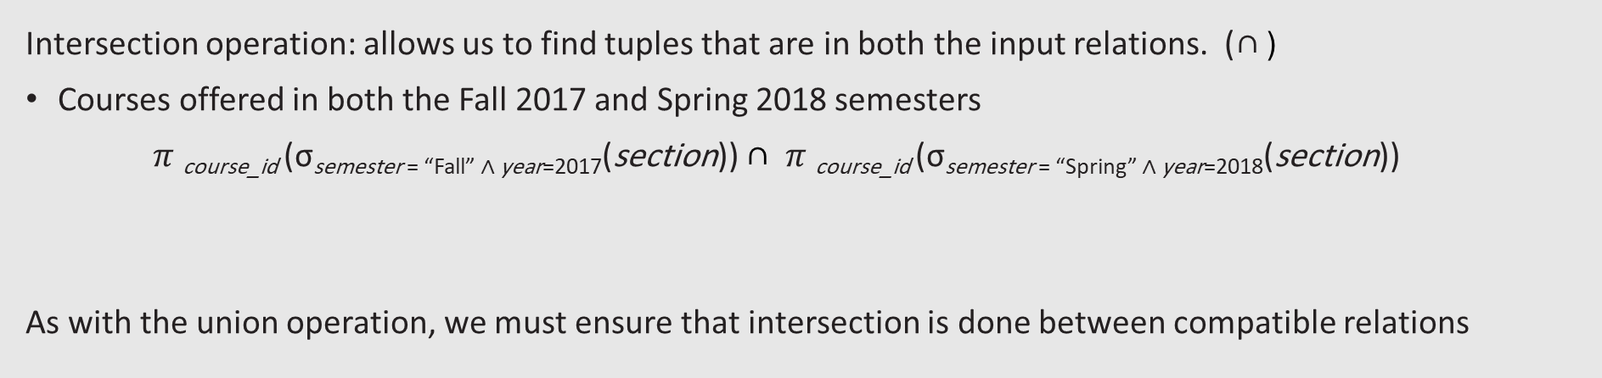
Relational Algebra (intersection operation)
Intersection operation: allows us to find tuples that are in both the input relations. (∩ )
Courses offered in both the Fall 2017 and Spring 2018 semesters
$π$_{course_id} (σ_{semester = “Fall” ∧ year=2017}(section)) ∩$π$_{course_id} (σsemester = “Spring” ∧ year=2018(section))
As with the union operation, we must ensure that intersection is done between compatible relations
instructor
teaches
course
ID | name | dept name | salary
10101 | Srinivasan | Comp. Sci. | 65000
12121 | Wu | Finance | 90000
15151 | Mozart | Music | 40000
22222 | Einstein | Physics | 95000
32343 | El Said | History | 60000
33456 | Gold | Physics | 87000
45565 | Katz | Comp. Sci. | 75000
58583 | Califieri | History | 62000
76543 | Singh | Finance | 80000
76766 | Crick | Biology | 72000
83821 | Brandt | Comp. Sci. | 92000
98345 | Kim | Elec. Eng. | 80000
ID | course id | sec id | semester | year
10101 | CS-101 | 1 | Fall | 2017
10101 | CS-315 | 1 | Spring | 2018
10101 | CS-347 | 1 | Fall | 2017
12121 | FIN-201 | 1 | Spring | 2018
15151 | MU-199 | 1 | Spring | 2018
22222 | PHY-101 | 1 | Fall | 2017
32343 | HIS-351 | 1 | Spring | 2018
45565 | CS-101 | 1 | Spring | 2018
45565 | CS-319 | 1 | Spring | 2018
76766 | BIO-101 | 1 | Summer | 2017
76766 | BIO-301 | 1 | Summer | 2018
83821 | CS-190 | 1 | Spring | 2017
83821 | CS-190 | 2 | Spring | 2017
83821 | CS-319 | 2 | Spring | 2018
98345 | EE-181 | 1 | Spring | 2017
course id | title | dept name | credits
BIO-101 | Intro. to Biology | Biology | 4
BIO-301 | Genetics | Biology | 4
BIO-399 | Computational Biology | Biology | 3
CS-101 | Intro. to Computer Science | Comp. Sci. | 4
CS-190 | Game Design | Comp. Sci. | 4
CS-315 | Robotics | Comp. Sci. | 3
CS-319 | Image Processing | Comp. Sci. | 3
CS-347 | Database System Concepts | Comp. Sci. | 3
EE-181 | Intro. to Digital Systems | Elec. Eng. | 3
FIN-201 | Investment Banking | Finance | 3
HIS-351 | World History | History | 3
MU-199 | Music Video Production | Music | 3
PHY-101 | Physical Principles | Physics | 4

Slide 18
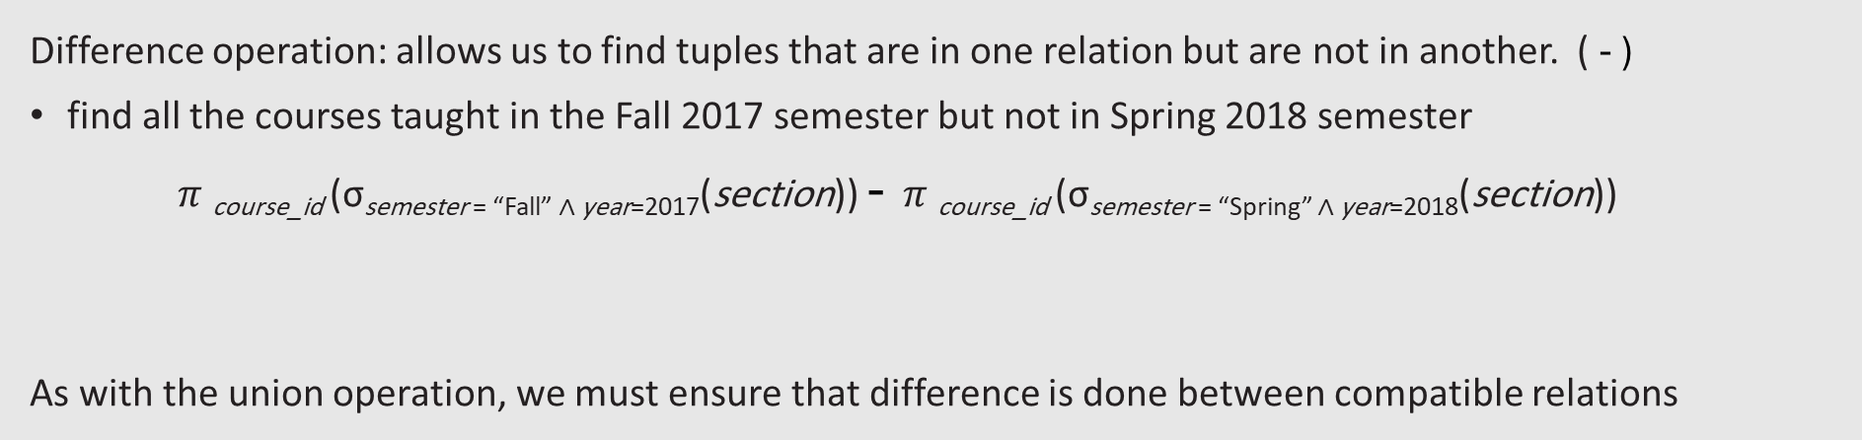
Relational Algebra (Difference)
Difference operation: allows us to find tuples that are in one relation but are not in another. ( - )
find all the courses taught in the Fall 2017 semester but not in Spring 2018 semester
$π$_{course_id} (σ_{semester = “Fall” ∧ year=2017}(section)) - $π$_{course_id} (σsemester = “Spring” ∧ year=2018(section))
As with the union operation, we must ensure that difference is done between compatible relations
instructor
teaches
course
ID | name | dept name | salary
10101 | Srinivasan | Comp. Sci. | 65000
12121 | Wu | Finance | 90000
15151 | Mozart | Music | 40000
22222 | Einstein | Physics | 95000
32343 | El Said | History | 60000
33456 | Gold | Physics | 87000
45565 | Katz | Comp. Sci. | 75000
58583 | Califieri | History | 62000
76543 | Singh | Finance | 80000
76766 | Crick | Biology | 72000
83821 | Brandt | Comp. Sci. | 92000
98345 | Kim | Elec. Eng. | 80000
ID | course id | sec id | semester | year
10101 | CS-101 | 1 | Fall | 2017
10101 | CS-315 | 1 | Spring | 2018
10101 | CS-347 | 1 | Fall | 2017
12121 | FIN-201 | 1 | Spring | 2018
15151 | MU-199 | 1 | Spring | 2018
22222 | PHY-101 | 1 | Fall | 2017
32343 | HIS-351 | 1 | Spring | 2018
45565 | CS-101 | 1 | Spring | 2018
45565 | CS-319 | 1 | Spring | 2018
76766 | BIO-101 | 1 | Summer | 2017
76766 | BIO-301 | 1 | Summer | 2018
83821 | CS-190 | 1 | Spring | 2017
83821 | CS-190 | 2 | Spring | 2017
83821 | CS-319 | 2 | Spring | 2018
98345 | EE-181 | 1 | Spring | 2017
course id | title | dept name | credits
BIO-101 | Intro. to Biology | Biology | 4
BIO-301 | Genetics | Biology | 4
BIO-399 | Computational Biology | Biology | 3
CS-101 | Intro. to Computer Science | Comp. Sci. | 4
CS-190 | Game Design | Comp. Sci. | 4
CS-315 | Robotics | Comp. Sci. | 3
CS-319 | Image Processing | Comp. Sci. | 3
CS-347 | Database System Concepts | Comp. Sci. | 3
EE-181 | Intro. to Digital Systems | Elec. Eng. | 3
FIN-201 | Investment Banking | Finance | 3
HIS-351 | World History | History | 3
MU-199 | Music Video Production | Music | 3
PHY-101 | Physical Principles | Physics | 4

Slide 19
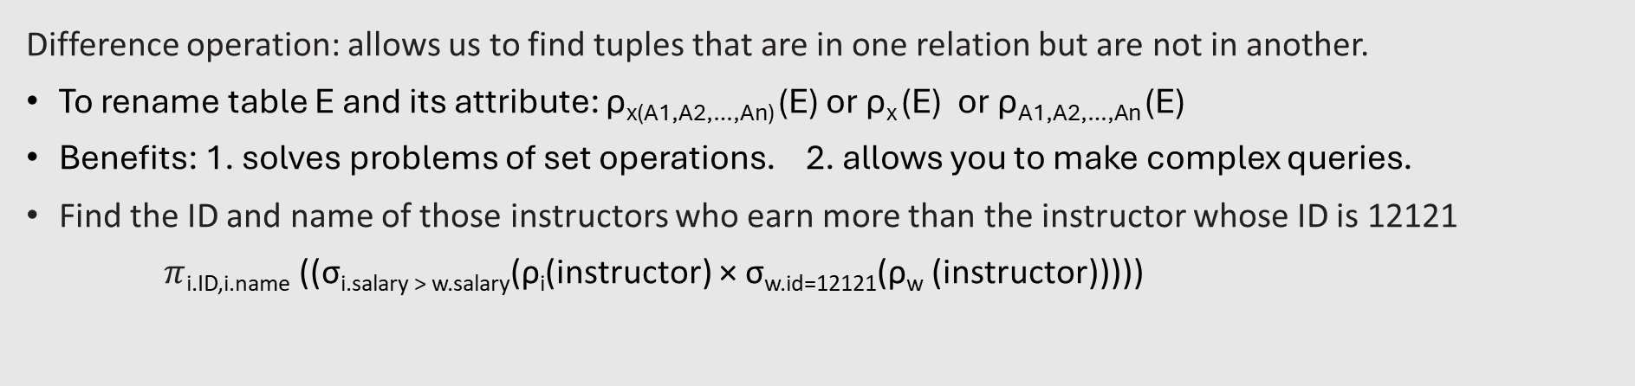
Rename operation
Difference operation: allows us to find tuples that are in one relation but are not in another.
To rename table E and its attribute: ρ_{x(A1,A2,…,An)} (E) or ρ_{x} (E) or ρ_{A1,A2,…,An} (E)
Benefits: 1. solves problems of set operations. 2. allows you to make complex queries.
Find the ID and name of those instructors who earn more than the instructor whose ID is 12121
$π$_{i.ID,i.name} ((σ_{i.salary > w.salary}(ρ_{i}(instructor) × σ_{w.id=12121}(ρ_{w} (instructor)))))
instructor
teaches
course
ID | name | dept name | salary
10101 | Srinivasan | Comp. Sci. | 65000
12121 | Wu | Finance | 90000
15151 | Mozart | Music | 40000
22222 | Einstein | Physics | 95000
32343 | El Said | History | 60000
33456 | Gold | Physics | 87000
45565 | Katz | Comp. Sci. | 75000
58583 | Califieri | History | 62000
76543 | Singh | Finance | 80000
76766 | Crick | Biology | 72000
83821 | Brandt | Comp. Sci. | 92000
98345 | Kim | Elec. Eng. | 80000
ID | course id | sec id | semester | year
10101 | CS-101 | 1 | Fall | 2017
10101 | CS-315 | 1 | Spring | 2018
10101 | CS-347 | 1 | Fall | 2017
12121 | FIN-201 | 1 | Spring | 2018
15151 | MU-199 | 1 | Spring | 2018
22222 | PHY-101 | 1 | Fall | 2017
32343 | HIS-351 | 1 | Spring | 2018
45565 | CS-101 | 1 | Spring | 2018
45565 | CS-319 | 1 | Spring | 2018
76766 | BIO-101 | 1 | Summer | 2017
76766 | BIO-301 | 1 | Summer | 2018
83821 | CS-190 | 1 | Spring | 2017
83821 | CS-190 | 2 | Spring | 2017
83821 | CS-319 | 2 | Spring | 2018
98345 | EE-181 | 1 | Spring | 2017
course id | title | dept name | credits
BIO-101 | Intro. to Biology | Biology | 4
BIO-301 | Genetics | Biology | 4
BIO-399 | Computational Biology | Biology | 3
CS-101 | Intro. to Computer Science | Comp. Sci. | 4
CS-190 | Game Design | Comp. Sci. | 4
CS-315 | Robotics | Comp. Sci. | 3
CS-319 | Image Processing | Comp. Sci. | 3
CS-347 | Database System Concepts | Comp. Sci. | 3
EE-181 | Intro. to Digital Systems | Elec. Eng. | 3
FIN-201 | Investment Banking | Finance | 3
HIS-351 | World History | History | 3
MU-199 | Music Video Production | Music | 3
PHY-101 | Physical Principles | Physics | 4

