Slide 1

Picture Courtesy of: Prof. Sarah Ford, M.A. (a.k.a. Mrs. Matthew Hertz)
How I Learned to Stop Worrying & Love the Bug

Slide 2
Overview
Course focused on software engineering concepts
“Make cool stuff” nice, but already know capable of this
Trying to develop experience & skills on important topics
Rubric (& scores) reflect emphasis; efforts should follow
Even for 1st sprint, project grows around user stories
Write many more stories than sprint will complete
Improve grade by checking stories written correctly
Create & use tasks to complete work for each sprint
Use acceptance tests for working product

Slide 3
Questions For Testing
What is correct?
Who gets to decide?
How do they know?
How To Document It Works?
Notes:
Apologize if this gets a bit philosophical

Slide 4
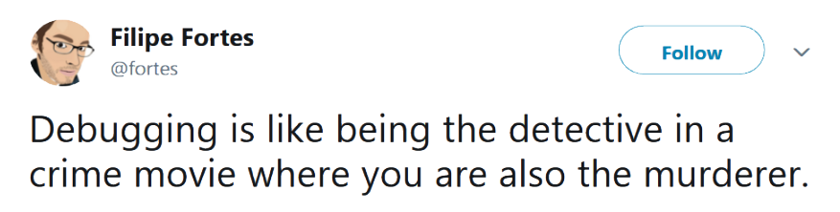
Write Code For Testing
Quality of product decided by testing
Testing properties targeted when writing code

Slide 5
Test-Driven Development (TDD)
Very popular technique developing software
Greatly increases programmer productivity
Happier programmers also found when using TDD
Requires very different approach to coding
Write tests BEFORE begin implementation process
Write stubs (but no code) for class & methods
Knowing correct outputs, write tests to check
Implement methods to pass your tests (& check often)

Slide 6
TDD Objections
Feels weird to start with tests when you first try…
.. but objections reflect poor habits checking code
Know method’s outcomes when starting to write…
… but you may not know how it will be done

Slide 7
Thought Experiment
Have new engine uses 10x less gas
New power generation method provides this boost
Of the following which test do you want:
Belts and axels moved identically with new engine
New engine still uses same carburetor & pistons

Slide 8
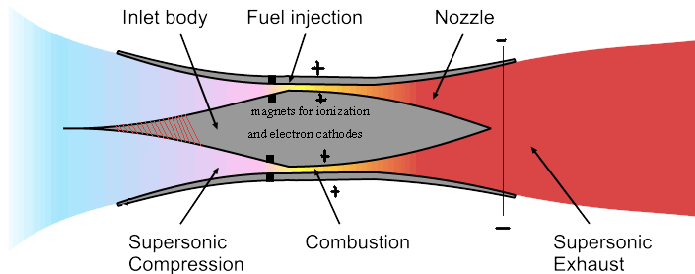
Thought Experiment
Have new engine uses 10x less gas
New power generation method provides this boost
Of the following which test do you want:
Belts and axels moved identically with new engine
New engine still uses same carburetor & pistons

Slide 9
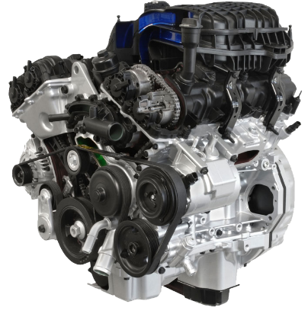
Thought Experiment
Have new engine uses 10x less gas
New power generation method provides this boost
Of the following which test do you want:
Belts and axels moved identically with new engine
New engine still uses same carburetor & pistons

Slide 10
TDD Key Concept
Check method’s results NOT method’s processes

Slide 11
Unit Testing Library
Most languages have xUnit library for unit testing
Tests written in language so can run anywhere
Strong support that make writing tests very easy
Supported by most IDEs (e.g., Eclipse, IntelliJ, BlueJ)
Started with Java – JUnit still gold standard for testing
Automation important to allow frequent testing
Testing easy – just select “Run As…” “JUnit test”
Green means good – checking results also very easy
Easy to see problems – see red when tests fail

Slide 12
Statements Performing Checks
assertEquals(X expected, X actual)
assertEquals(float exp, float act, float tol)
assertEquals(double exp, double act,double tol)
assertTrue(boolean test)
assertFalse(boolean test)
assertNull(Object objTest)
assertNotNull(Object objTest)
fail()

Slide 13
Statements Performing Checks
assertEquals(X expected, X actual)
assertEquals(float exp, float act, float tol)
assertEquals(double exp, double act,double tol)
assertTrue(boolean test)
assertFalse(boolean test)
assertNull(Object objTest)
assertNotNull(Object objTest)
fail()
@Test method should result in calling 1 or more assert* statement.
Assertion must not hold for method to fail.

Slide 14
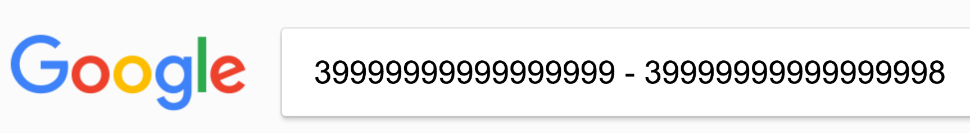
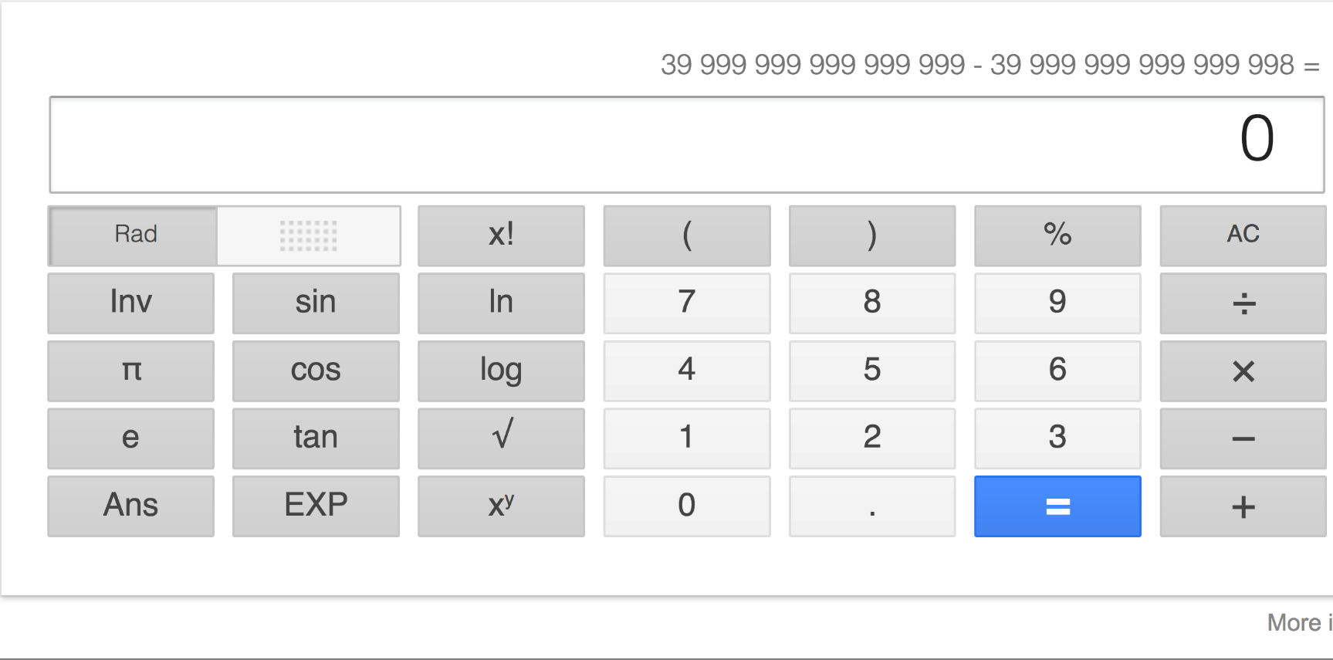
assertEquals With Decimals
Computers actually very bad at math:

Slide 15
assertEquals With Decimals
Computers actually very bad at math:

Slide 16
Math Checks With Decimals
Computers actually very bad at math
Decimal numbers hard & imprecision always created
Not limited to computers: can you write ²/₃ as decimal?

Slide 17
Math Checks With Decimals
Computers actually very bad at math
Decimal numbers hard & imprecision always created
Not limited to computers: can you write ²/₃ as decimal?
Must specify tolerance for decimal comparisons
float or double equal if difference below tolerance
assertEquals(float expect, float act, float tolerance) assertEquals(double expect, double act, double tolerance)

Slide 18
Tests Key Concept #1
Include tolerance (allowed rounding error) for floating point arithmetic checks

Slide 19
Assumptions Deadly
Often make assumptions when writing code
True writing code and still true writing test cases
Passing ≠ correct; could be no tests were run
May not check what you think; care needed writing tests
Tests should be written & run before coding
Tests must fail, since code has not yet been written!
Before wasting time, always check assumptions

Slide 20

How To Write Tests
Cannot prove there are no bugs
Testing shows the presence, not the absence of bugs
Notes:
Picture is of Edsgar Dijkstra of Dijkstra’s algorithm (and just about everything else not done by Knuth) fame.

Slide 21
Tests Key Concept #4
Assume the worst: Focus testing on unlikely
(but not impossible) situations

Slide 22
Evaluating Test Efforts
Develop tests with detailed look at the algorithm
Test coverage discussed often by people, but…
… coverage can be measured many ways
Statement coverage Run each statement at least once
Branch coverage Run each branch at least once
Path coverage Run each possible branch combination at least once
Detail Increases

Slide 23
Coverage Measures
2
4
1
3
5
All Statements: | 1, 2, 3, 4, 5
All Branches: | 1, 2, 3, 4, 5 1, 3, 5
All Paths: | 1, 2, 3, 4, 5 1, 2, 3, 5 1, 3, 4, 5 1, 3, 5
Notes:
Point out that all paths is just not really possible…
State that we can check for all statements testing (e.g., the minimum acceptable level) in Eclipse directly!

Slide 24
Loop Testing Important
Small bugs in loops can create huge errors
Lots of time executing increases odds of hitting rare case
Often error only appears when results used, not in loop
Debugging often tricky, since many scenarios to test out
Run often + hard-to-debug == critical to test well
Finding bugs important, since quality depends on this
Knowing bugs exists useless; must also simplify fixes
So narrowing bug's cause just as needed as finding bug

Slide 25

Simple Loop
For all simple loops, try inputs that:
Skip loop entirely
Make 1 pass through the loop
Make 2 passes through the loop
Make m passes through the loop, where (m > 2)
If loop executed at most n times, try inputs that:
Make n-1 & n passes through the loop

Slide 26

Nested Loops
First test set runs all outer loops exactly once
Inner loop runs (min+1), average, (max-1) & max times
Then run all but two innermost loops exactly once
Inner loops run (min+1), average, (max-1) & max times
Tests should continue growing loop-by-loop

Slide 27
Back-End Testing
Unit tests good for some tasks working on back-end
But what about tasks implementing front-end code?
User wants results and only knows what they can see
Correct results impossible if back-end fails unit tests
Back-end code very important so cannot skip tests
But invisible to user and client does not care about code

Slide 28

Front-End Testing
Need to test front-end tasks that display information
GUI classes can be checked against user stories
JUnit test cases less useful performing these tests
Automation lacks human touch; cannot check aesthetics

Slide 29
Front-End "Testing"
Worst approach: Clicking around & see what breaks
Simple & fast, but may not discover actual cause of bugs
Unrepeatable & slow when checking entire system
Done by developers, tends to follow expected uses

Slide 30
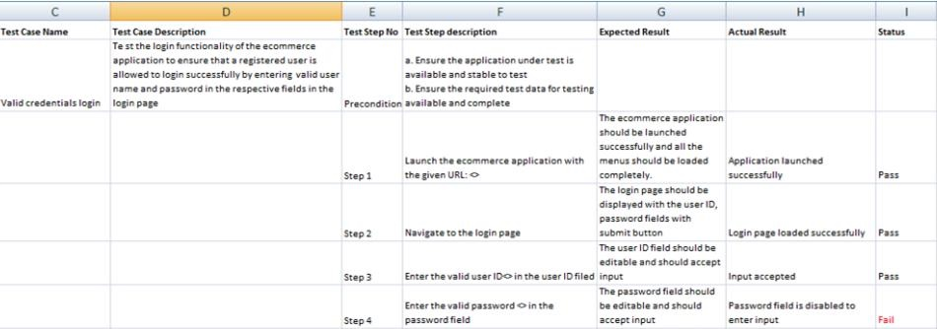
Front-End Testing
Better approach: Step-by-step script tests for errors
Low overhead & simple, but also easy to forget to run
Discover unexpected bugs by having testers run scripts
Good rules-of-thumb exist to find many common errors
List in task in ZenHub; many want files to hold scripts

Slide 31



Validation Testing
Best approach: Automate testing with UI tool/code
Creates setup costs, but guarantees predictable results
Can compensate for load times & other real issues
Often include both programming & scripting setups

Slide 32
Selenium
Allows automated testing of web-based applications
Test suite reports results of running 1 or more tests
Often create many test cases; each exposes 1 bug
Add tests in Java/C#/Python with WebDriver module
Many languages have Selenium libraries to drive tests
Loads page & defines API used to evaluate its contents
If using IDE, able to create & runs in browser
IDE easier to use: can record actions in browser as test
Will also allow updating or rewriting Selenese script

Slide 33
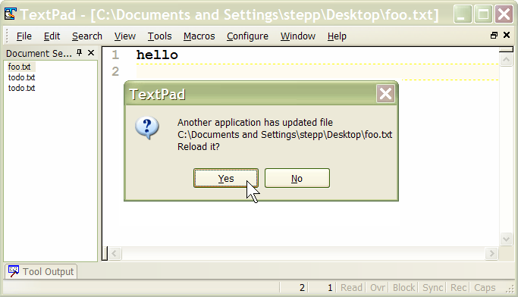
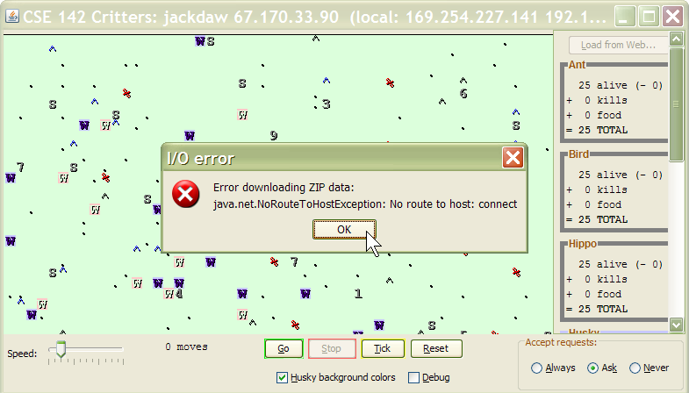
Common Front-End Errors
Violate Assumptions: Assume users jerks (or dumb)
They will make worst choice. How does system react?
What if needed files deleted, network lost, or similar?
Script explain how to start & what error should be shown

Slide 34
Common Front-End Errors
Duplication Issues: Repeatedly enter same input
If When they add/remove multiple times, what is error?
Does app handle (or provide clues) for impatient users?

Slide 35
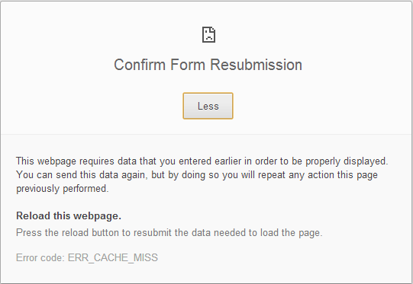
Common Front-End Errors
Duplication Issues: Repeatedly enter same input
If When they add/remove multiple times, what is error?
Does app handle (or provide clues) for impatient users?
“Back” button tempting, what does it do to web app?

Slide 36
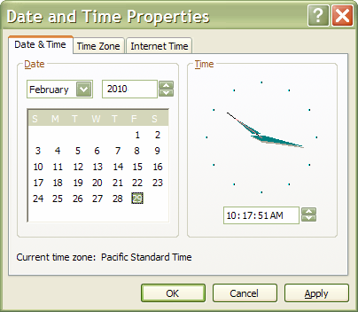
Common Front-End Errors
Invalid Data: Intentionally force invalid results
Script actions creating illegal state in widget at the end
Feb 29 remain in non-leap years? Move start after end?
Give in to the dark side & trick system into bad states

Slide 37
Sprint Grading Rubric
Last chance for questions
After this point I assume you all know how you’ll be graded for the three sprints

Slide 38
Now let’s have fun
Monday Discussion
Social Media and our data

