Slide 1
Lecture 4: Version Control
CSE 442 – Software Engineering

Slide 2

What does git do for you?
Version control AND source control
Codebase and documents tracked and changes logged
Can “revert” changes – go back to a working version
Invisibly create branch in which riskier changes done
Cannot overwrite changes by warning of merge conflicts
Why git?
Very popular; among most common systems used
Likely to use this when working in industry
Cannot be the price – open-source project is free

Slide 3
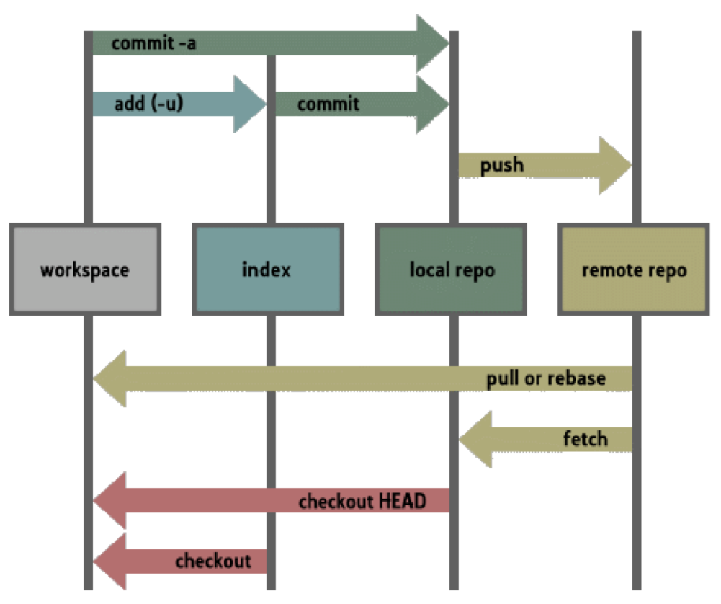
git Command Structure

Slide 4
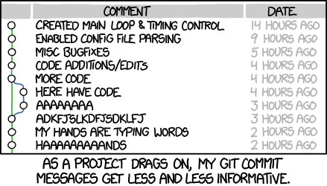
Commit messages
Many different conventions
All (but yours) sucks; choose who gets to complain
Make messages meaningful and descriptive
You will be thanked by your future self & contributors
Critical for bigger projects since vital history of work

Slide 5
Good Commit Messages
Summarizes changes so outsiders can understand
Recreate project history knowing why change needed
What was changed included, so they follow thinking
Also explain outcomes: any side-effects should be noted
List of changes important for others to know, too
Because some commits very big, this can get long
Detailed information rarely needed by casual reviewer

Slide 6
Branching
Sharing code difficult when adding or debugging
Want all benefits of version control as you develop code
Once changes complete, need to push changes back
Want any updates & limit conflicts for later push
Your half-completed code should not pollute colleagues
Version control includes branches to handle this

Slide 7
Benefits of Branching
Allows developers to work independently
Changes and updates saved in version control
Total independence not needed; others can join branch
Always able to prune branch and rejoin rest of team
Not everything is success, simplify if/when backing out
Merge branch into develop when work is complete
Should not interfere with others; you got it working!

Slide 8
master and develop
Two standard branches commonly used in git
Default branch & one initially used is master
Often create develop branch for experimental code
Only store code for stable releases in master
Every version tagged so can always find where you were
In worst case, always have solid, stable code available
Never used directly; merges added after thorough testing
Team keeps completed features in develop
Code ready for inclusion in next release/end of sprint
Gauge completion by testing develop for stability

Slide 9
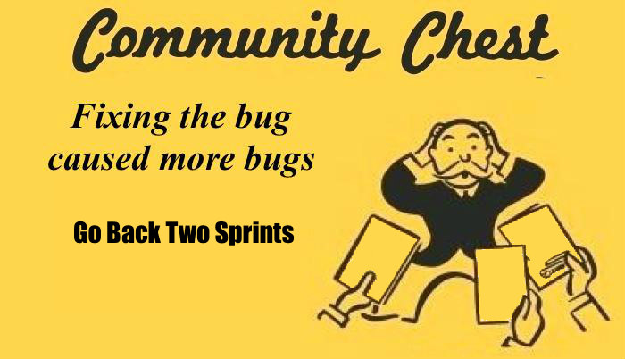
Why master and develop?
Notes:
Thanks, reddit!

Slide 10

master and develop
When time to release new version draws near….
Commits stored in develop merged into master
master subjected to last tests to verify no latent bugs
Once finalized, tag commit with version of release
…& repeat: continue work in develop for next pass

Slide 11
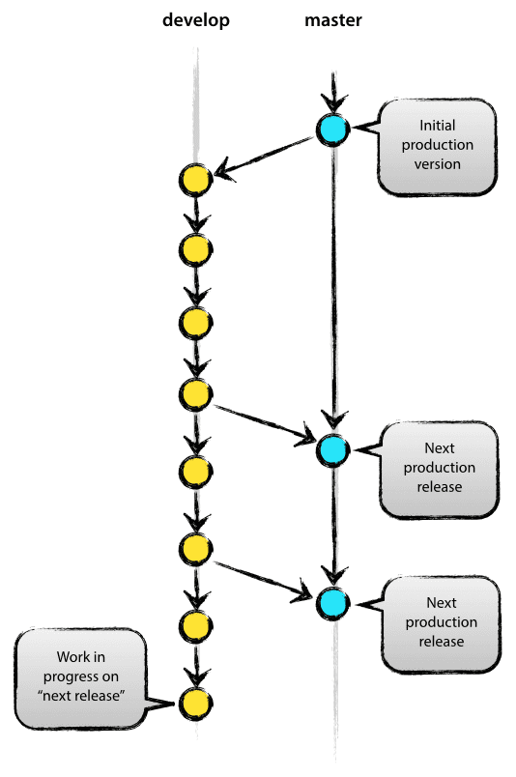
Standard Model for git

Slide 12
Developing Each Feature
Between releases branch off develop not master
Defines unit of code added back to project
Selectively merging part of branch impossible
Fine having many branches developed in parallel
With branching cheap, often create one for each feature

Slide 13

Developing Each Feature
Some, but not all, features work as expected
Avoid confusion: delete branches where ideas failed
After feature passes all tests, merge into develop
Before merging branch, can also perform code review
master always safe, even if bugs get through

Slide 14
Bugs Happen
Sometimes bugs get committed into your codebase
Cannot leave customers hanging & so fix needed ASAP
Branch from master to track changes needed for fix
Once code for fix complete, patch is called a hotfix
Merge hotfix into master & send updated release
Keep master clean, since that is where releases stored
Cannot wait for sprint to end

Slide 15
Bugs & Hotfixes Happen
Patching master, without patching develop
Conflict or bug reintroduction; bad result awaits
Solution should be obvious: pull patch into both!
No conflict, since source identical; so this future-proof
As added benefit, bug disappears from working version
Avoids conflict arising from second fix being developed

Slide 16
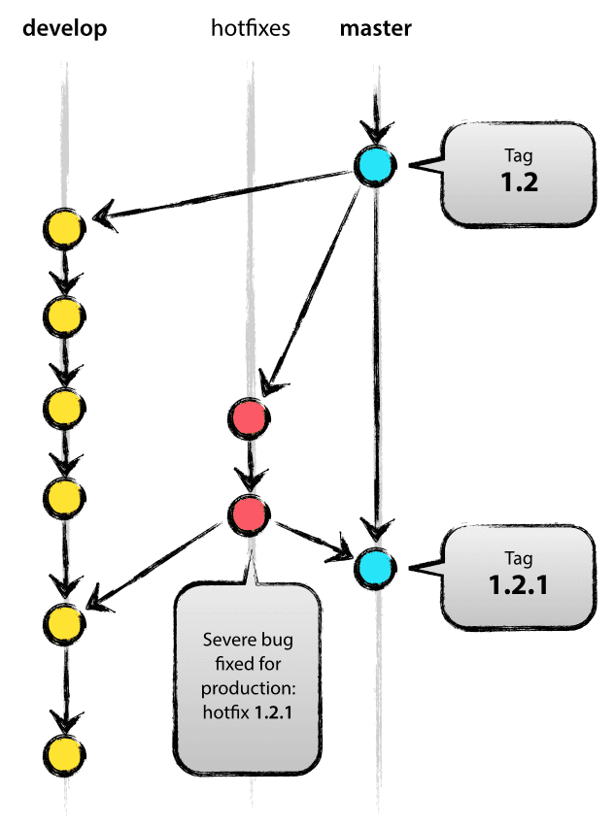
Bugs (& Hotfixes) Happen
Notes:
Hotfix merged to both branches

Slide 17
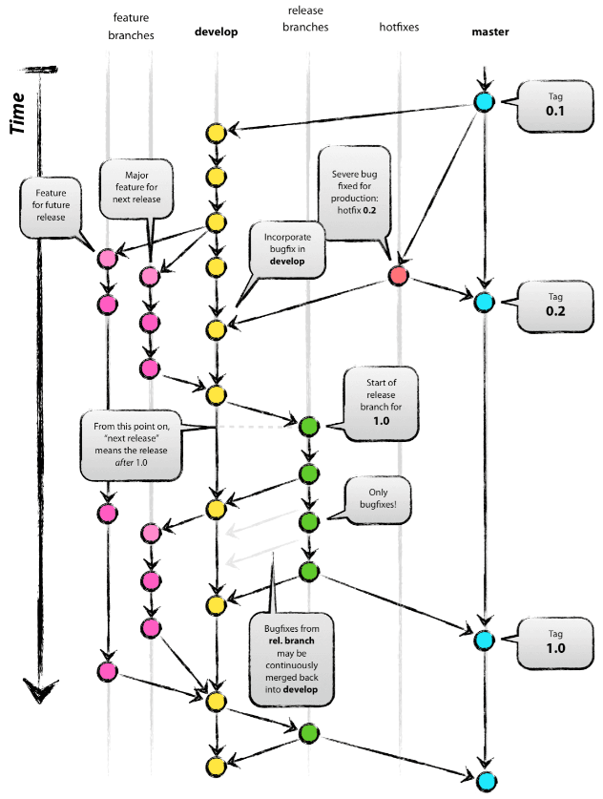
Picture of Good git Repo

Slide 18
Pull Request
Request a branch to be merged into another branch
Commonly a feature branch being merged into develop
Should involve a code review
Someone on the team who did not write the code reviews the contribution and approved/reject the change
If the change is approved it’s merged into the project
All pull requests should relate to a specific issue/task
Reference this issue in the pull request
Helps to organize and document contributions

Slide 19
Project Contributions
Create an issue describing the work you will complete
Issue must correspond to a user story
Create a feature branch
Commit and push code to this branch until the task is complete
Create a pull request to merge your code into your develop branch
In the description of the pull request, reference your issue with #<issue_number> in the description of the pull request

Slide 20
Open Source Contributions
When you’re not a contributer in the repository
No push access
Create an issue in the repository
In GitHub anyone can create issues on public projects
Fork the repository
Creates a copy of the repo that you own and control
Commit and push your code to your copy of the repo
When complete, create a pull request to the original repo
Dev team will review your code and decide if it should be merged into the project

Slide 21
Activity 1 (Due Midnight)
https://github.com/hartloff/CSE442-s19-Activity1
Create an issue in this repo
Fork the repo
Commit and push a contribution to your forked repo
Contribution must contain your UBIT (So it can be graded. I don’t know your GitHub id)
[This repo will be made private after the deadline so your UBIT is not leaked]
Create a pull request to merge your commit into my develop branch
In the description of the pull request, reference your issue with #<issue_number> in the description of the pull request
Example: https://github.com/hartloff/CSE442-s19-Activity1/pull/2

