Slide 1
Probability and Normal Distribution Meaning of probability Random variable and Expected values Properties of Normal distribution Standard Normal Distribution (Z) and normal curve Uses of Normal distribution
Foundation of mathematical theory of probability was laid by two French mathematicians B. Pascal (1623-62) and Pierre de Fermat(1601-65).
The word ‘probability’ or ‘chance’ is often used in day-to-day life to express uncertainty about happening an event.
In mathematics and statistics we try to make sensible numerical statements about uncertainty with the help of probability theories.
We can calculate numerical values of probabilities and expectations by applying certain methods.

Slide 2
Probability Defined
Probability of a given event is an expression of likelihood or chance of occurrence of an event.
Probability is a number which ranges from ‘0’ (zero) to ‘1’ (one).
Probability is ‘zero’ for an event which cannot occur and ‘one’ for an event certain to occur.

Slide 3
Importance of Probability
Probability models are very useful in making predictions.
Probability models are useful in all the studies that involve uncertainty.
Probability theory is being applied in the solution of social, economic, political problems in understanding social phenomena.

Slide 4
Classical Approach to Probability
Probability is the ratio of the number of ‘favourable’ cases to total number of equally likely cases.
If probability of occurrence of an event ‘A’ is denoted by P(A).
Number of favourable cases
P(A) = -------------------------------------
Total number of equally likely cases

Slide 5
Illustration:
Tossing a coin: probability of getting head is 1/2 and probability of getting tail is also1/2.
Rolling a dice: probability of getting even number i.e 2 or 4 or 6 is 3/6 or 1/2.

Slide 6
Illustration-2:
From a class containing 10 girls and 20 boys, a student is drawn at
random. What is the probability that the student selected is a girl ?
Number of favourable cases
p(A) = -------------------------------------
Total number of equally likely cases
Total number of students in the class= 10 + 20 = 30
10 1
p(A) = ----- = ---- = 0.33
30 3
What is the probability of not getting a girl student is ?

Slide 7
Calculation of probability
Random Experiment and Events
Experiment is an act which can be repeated under some
given conditions whose results depend on chance such as
tossing a coin or throwing a dice.
Events :The results of an experiment are called outcomes
or events.

Slide 8
Mutually Exclusive Events
Two events are said to be mutually exclusive when both the events
can not happen simultaneously in a single trial in other words, the
occurrence of any one of them prevents the occurrence of the
other.
P(AB) =0
Ex: Probability of getting head and tail in a single trial is zero. The
probability of attending both Data Science and statistics class on
the same day which are scheduled at the same time is ‘zero’.
P (Data Science class and Statistics class) = 0

Slide 9
Independent and Dependent Events
Independent Event – when outcomes of the first event does not effect the outcome of the other event then it is called independent event
Example: Tossing a coin twice, throwing a dice twice
Dependent Event - when outcomes of the first event effects the outcome of the other event then it is called dependent event
Example: drawing a card from pack of cards without replacing the card

Slide 10
Theorems of Probability
Addition Theorem
The addition theorem says that if two events A and B are mutually
exclusive (when both the events can not occur same time) the
probability of occurrence of either A or B is the sum of the individual
probability of A and B.
P (A or B) = P (A) + P (B)
Ex: There are 4 CSE students and 4 ECE students in a class of 32 students in Research Methodology course. If one student is drawn at random, what is the probability that the student is either from CSE discipline or from ECE discipline.
P (CSE or ECE) = P (CSE) + P (ECE)
= 4/32 + 4/32
= 8/32 = 1/4 = 0.25 i.e. 25 %

Slide 11
Multiplication Theorem
This theorem states that if two events A and B are independent,
the probability that they both will occur is equal to the product
of their individual probability.
Ex: If Probability of a student being taller P (A) = 0.4
Probability of being fair in colour P (B) = 0.3
Selecting a student at random who is tall and fair in colour is
P (Tall and Fair) = 0.4 X 0.3 = 0.12 i.e 12%
P (A and B) = P (A) x P (B)

Slide 12
Conditional Probability
The multiplication theorem explained above is not applicable
in case of dependent events.
Two events A and B are said to be dependent when B can
occur when A is known to have occurred or vice versa.
The probability attached to such an event is called the
conditional probability.
P (A and B) = P (A) x P (B/A)

Slide 13
Example: A class contains 12 Political Science students and 6 Sociology
students. Two students are drawn at random one after another without
replacement. Find the probability that both the students drawn are from
Sociology discipline?
Solution:
Probability of drawing Sociology student in the first attempt
P (A)= 6/12+6 =6/18 = 1/3 = 0.33
Probability of drawing the second Sociology student given that first was sociology
student
P (B/A) = 5/12+5 = 5/ 17 = 0.29
The probability that both the students drawn are from Sociology discipline
P (A and B) = P (A) x P (B/A)
= 6/18 x 5/17
= 1/3 x 5/17
= 5/51 = 0.098

Slide 14
Probability distribution
A probability distribution is a table that links each possible value that a
Random variable can assume with its probability of occurrence.
Discrete Probability Distributions
The probability distribution of a discrete random variable can always be
represented by a table.
For example, suppose you flip a coin two times.
This simple exercise can have four possible outcomes: HH, HT, TH, and TT.
Now, let the variable X represent the number of heads that result from the
coin flips.
The variable X can take on the values 0, 1, or 2; and X is a discrete
random variable.
The probability of getting 0 heads is 0.25; 1 head, 0.50; and 2 heads, 0.25.
Thus, the table is an example of a probability distribution for a discrete random variable.

Slide 15
The table below shows the probabilities associated with each possible
value of the X.
Number of heads, X | Probability, P(X)
0 | 0.25
1 | 0.50
2 | 0.25

Slide 16
Normal Distribution
The normal distribution refers to a family of continuous
probability distributions described by the normal equation.
Continuous Probability Distribution
If a random variable is a continuous variable, its probability distribution is called a continuous probability distribution.
The random variable may take any value between minus
infinity and plus infinity. But most of the probabilities are
concentrated within three standard deviations from the
mean.

Slide 17
The Normal Curve
The graph of the normal distribution depends on two factors - the mean
and the standard deviation.
The mean of the distribution determines the location of the center of the
graph, and the standard deviation determines the height and width of the
graph.
When the standard deviation is large, the curve is short and wide; when
The standard deviation is small, the curve is tall and narrow.
All normal distributions look like a symmetric, bell-shaped curve, as
shown below.
It is always symmetrical, with equal areas on both sides of the curve.

Slide 18
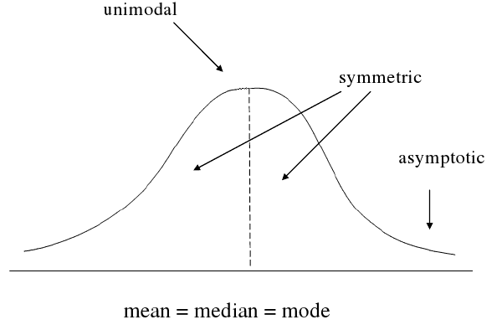
Normal Curve

Slide 19
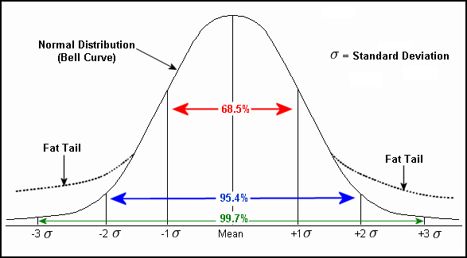
Normal Curve

Slide 20
Probability and the Normal Curve
The total area under the normal curve is equal to 1 (or 100%)
Every normal curve (regardless of its mean or standard deviation) conforms to the following "rule".
About 68% of the area under the curve falls within 1 standard deviation of the mean.
About 95% of the area under the curve falls within 2 standard deviations of the mean.
About 99.7% of the area under the curve falls within 3 standard deviations of the mean.
Clearly, given a normal distribution, most outcomes will be within 3
standard deviations of the mean.

Slide 21

Z Score
Any variable X following normal distribution with mean X – bar and
standard deviation S.D can be linearly transformed to the standard
normal distribution by subtracting mean and dividing by standard
deviation.
Z indicates how many standard deviations away from the mean
that the point X lies.
Z score is calculated to 2 decimal places.
Notes:
The relationship between the normal variable X and Z score is given by the Z score or standard score. Mu (μ) is the mean and sigma (σ) is the standard deviation of the population.

Slide 22
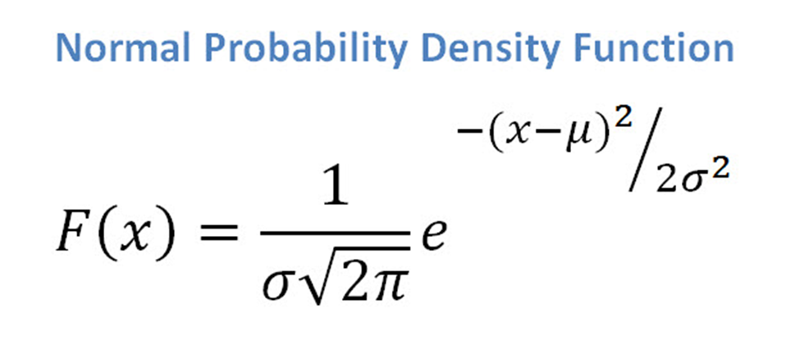

Slide 23
What are the uses of Normal Distribution?
The normal distribution is used in natural and behavioral sciences
and numerous other fields.
It is useful in describing the frequency of standardized test scores,
how many students earned particular scores, percentage of
migrants, rural workforce below or above certain level (adult
female population above certain heights or below certain heights)
etc.
The major use of Normal distribution is the role it plays in
statistical inference, hypothesis testing and to make decisions.

Slide 24
Diagram of Normal Distribution Curve
(z distribution)
-3 -2 -1 μ 1 2 3

Slide 25

50%
-3
-2
-1
0
1
2
3

Slide 26
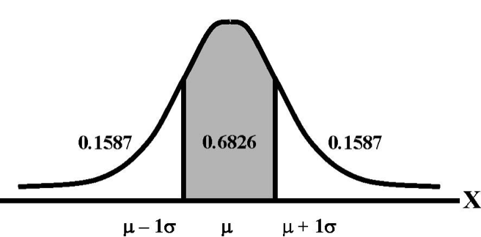
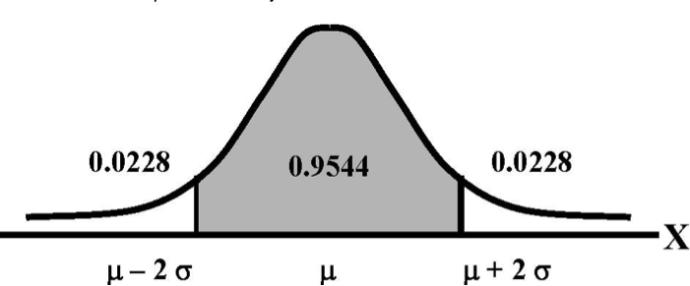
According to Chebyshev's Theorem

Slide 27
Exercises
Assuming the normal heart rate (H.R) in normal healthy
individuals is normally distributed with Mean = 70 and
Standard Deviation =10 beats/min

Slide 28
Exercise # 1
Then:
1) What area under the curve is above 80 beats/min?
Notes:
Now we know, Z =X-M/SD Z=? X=80, M= 70, SD=10 . So we have to find the value of Z. For this we need to draw the figure…..and find the area which corresponds to Z.

Slide 29
Diagram of Exercise # 1
This means that 15.87% of normal healthy individuals have a heart rate
above one standard deviation (greater than 80 beats per minute).
0.3413
0.1587

Slide 30
Exercise # 2
Then:
2) What area of the curve is above 90 beats/min?
Notes:
As in question, proceed by drawing the normal distribution curve and calculate the z value…….

Slide 31
Diagram of Exercise # 2
This means that 2.28% of normal healthy individuals have a heart rate
above two standard deviation (greater than 90 beats per minute).
0.4772
0.0228

Slide 32
Exercise # 3
Then:
3) What area of the curve is between
50-90 beats/min?

Slide 33
Diagram of Exercise # 3
-3 -2 -1 μ 1 2 3
0.9544

Slide 34
Exercise # 4
Then:
4) What area of the curve is above 100 beats/min?

Slide 35
Diagram of Exercise # 4
-3 -2 -1 μ 1 2 3
0.0013
This means that 0.13% of normal healthy individuals have a heart rate above three standard deviation (greater than 100 beats per minute).

Slide 36
Exercise # 5
5) What area of the curve is below 40 beats per min or above 100 beats per min?

Slide 37
Diagram of Exercise # 5
-3 -2 -1 μ 1 2 3
0.0013
0.0013
This means that 0.26% of normal healthy individuals have a heart rate below 40 beats per min or above 100 beats per min.
Notes:
In this question, we need to calculate Z1 and Z2. Therefore, Z1 =70-40/10, which is equal to 3. The z value of 3 is 0.015.
Similarly, the value of Z2 is 70-100/10 which is equal to -3. Thus, the value of z is 0.015
And so, Z1+Z2 is equal to 0.3%. But how do we interpret this value? Please see the solution/answer #5 slide for its interpretation.

Slide 38
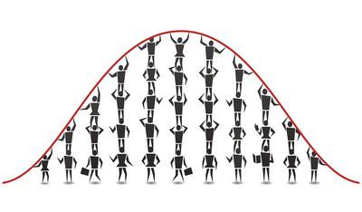
Real Life Examples of Normal Distribution
Heights of the population is the example of normal distribution. Most of the people in a specific population are of average height.
The number of people taller and shorter than the average height people is almost equal, and a very small number of people are either extremely tall or extremely short.
Several genetic and environmental factors influence height. Therefore, it follows the normal distribution.

Slide 39
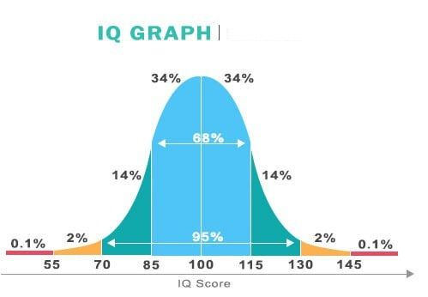
IQ

Slide 40
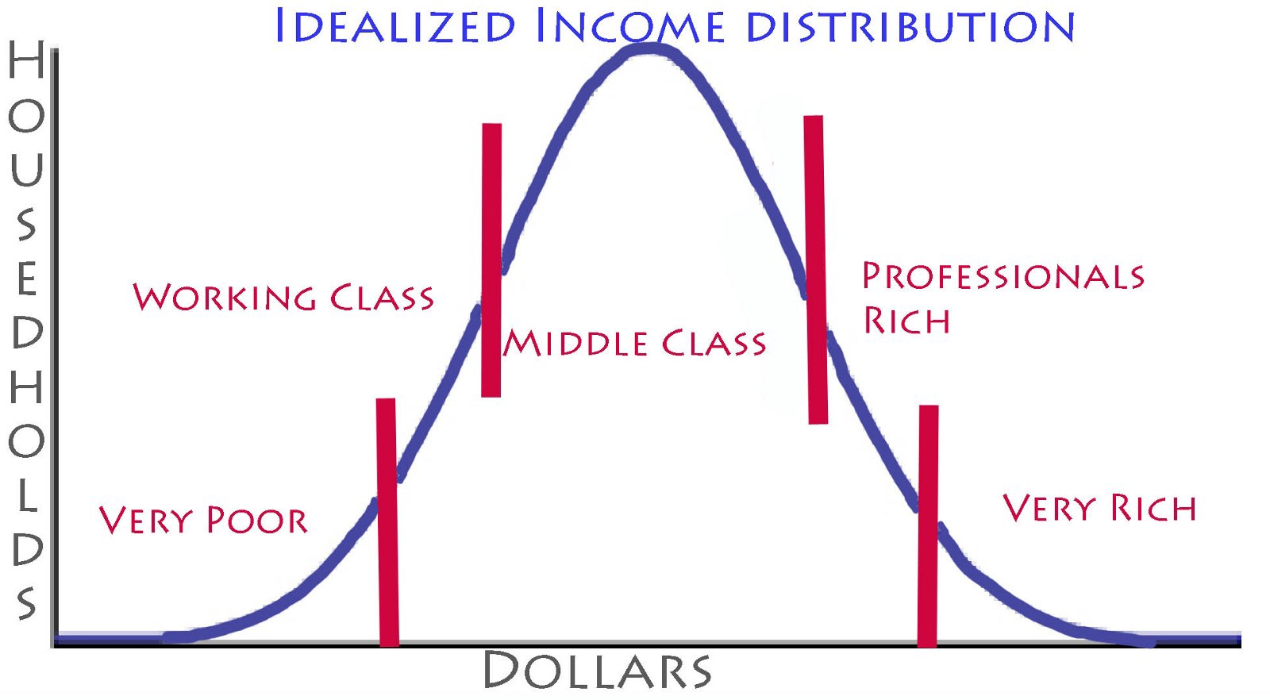
Income Distribution In Economy
We all are well aware of the fact that the middle-class population is a bit higher than the rich and poor population.
So, the wages of the middle-class population makes the mean in the normal distribution curve.

Slide 41
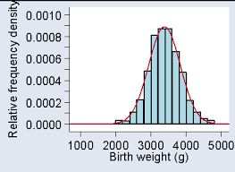
Birth Weight
The normal birth weight of a newborn range from 2.5 to 3.5 kg. The majority of newborns have normal birth weight whereas only a few percentage of newborns have a weight higher or lower than the normal. Hence, birth weight also follows the normal distribution curve.

Slide 42
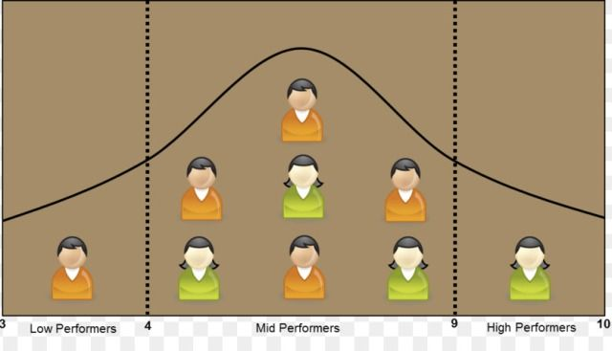
Student’s Average Report
In most cases, it follows the normal distribution curve. The number of average intelligent students is higher than most other students.

Slide 43
Thank you

