Slide 1
UNIT-V

Slide 2
PRIVACY
Cyber security refers to the measures taken to protect a computer or computer system against unauthorized access from a hacker.
On its most basic level, data privacy is a consumer’s understanding of their rights as to how their personal information is collected, used, stored and shared.
Data breaches can take place on both a large and small scale, but most people are probably more familiar with the bigger incidents. Every employer faces the reality that they could be the target of a network security breach.
A cybersecurity breach can jeopardize credibility and cost small businesses without cyber liability insurance thousands of dollars (or more) in damages, impacting customer service, productivity and reputation.

Slide 3
Data breaches are cyber security attacks that impact personal data and privacy.
Data privacy or information privacy is a branch of data security concerned with the proper handling of data – consent, notice, and regulatory obligations. More specifically, practical data privacy concerns often revolve around:
Whether or how data is shared with third parties.
How data is legally collected or stored.
Regulatory restrictions such as
GDPR,-General Data Protection Regulation
HIPAA, -Health Insurance Portability and Accountability Act
GLBA, or-Gramm-Leach-Bliley Act
CCPA.-California Consumer Privacy Act (CCPA)

Slide 4
The General Data Protection Regulation (EU) 2016/679 (GDPR) is a regulation in EU law on data protection and privacy in the European Union (EU) and the European Economic Area (EEA). It also addresses the transfer of personal data outside the EU and EEA areas.
The GDPR's primary aim is to give individuals control over their personal data and to simplify the regulatory environment for international business by unifying the regulation within the EU.
Superseding the Data Protection Directive 95/46/EC, the regulation contains provisions and requirements related to the processing of personal data of individuals (formally called data subjects in the GDPR) who are located in the EEA, and applies to any enterprise—regardless of its location and the data subjects' citizenship or residence—that is processing the personal information of individuals inside the EEA.

Slide 5
Health Insurance Portability and Accountability Act of 1996 (HIPAA)
The Health Insurance Portability and Accountability Act of 1996 (HIPAA) is a federal law that required the creation of national standards to protect sensitive patient health information from being disclosed without the patient’s consent or knowledge.
The US Department of Health and Human Services (HHS) issued the HIPAA Privacy Rule to implement the requirements of HIPAA. The HIPAA Security Rule protects a subset of information covered by the Privacy Rule.

Slide 6
The Gramm-Leach-Bliley Act of 1999 (GLBA) is a US federal law that includes rules that protect the privacy and security of personally identifiable financial information relating to individuals.
It repealed the Glass-Steagall Act (which was part of the U.S. Banking Act of 1933) which limited commercial bank’s ability to engage in investment banking and insurance underwriting and from affiliating or merging with investment banks, insurance companies, and security firms. The GLBA was updated in 2015 and significant changes were introduced.

Slide 7
What is Data Privacy
Data privacy or Information privacy is concerned with proper handling, processing, storage and usage of personal information. It is all about the rights of individuals with respect to their personal information.
The most common concerns regarding data privacy are:
Managing contracts or policies,
Applying governing regulation or law (like General Data Protection Regulation or GDPR),
Third-party management
Privacy, in general, is an individual’s right to freedom from intrusion and prying eyes or the right of the person to be left alone.
It is guaranteed under the constitution in many developed countries, which makes it a fundamental human right and one of the core principles of human dignity, the idea most people will agree about.
Any risk assessment conducted for the purpose of enhancing the privacy of individuals’ personal data is performed from the perspective of protecting the rights and freedoms of those individuals.

Slide 8
Data Privacy vs. Data Security
Organizations commonly believe that keeping sensitive data secure from hackers means they’re automatically compliant with data privacy regulations. This is not the case.
Data Security and data privacy are often used interchangeably, but there are distinct differences
Data Security protects data from compromise by external attackers and malicious insiders.
Data Privacy governs how data is collected, shared and used.
Consider a scenario where you’ve gone to great lengths to secure personally identifiable information (PII). The data is encrypted, access is restricted, and multiple overlapping monitoring systems are in place. However, if that PII was collected without proper consent, you could be violating a data privacy regulation even though the data is secure.

Slide 9
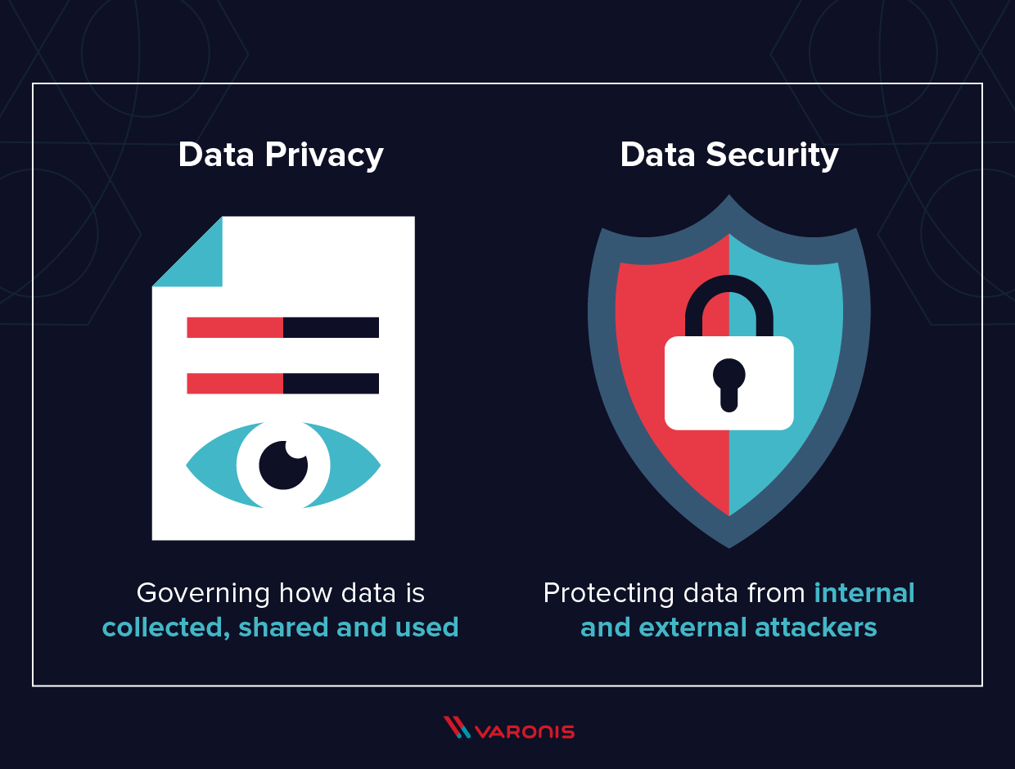

Slide 10
Data Privacy in Healthcare
While the EU has GDPR, one of the most prominent US data protection and privacy laws at the federal level is HIPAA, -Health Insurance Portability and Accountability Act a data privacy regulation that was put in place to safeguard patient personal health information
Healthcare providers have always been an attractive target for data breaches. In fact, health records are extremely valuable—approximately 10-20 times more valuable than credit card numbers. That’s why they should ensure they are compliant with HIPAA.
Even though Congress passed HIPAA in 1996, calls for even greater data privacy protection have increased with data breaches at an all-time high and the rate at which companies use and sell the data they collect on their patients rising fast.
Fortunately, in December 2000, the U.S. Department of Health and Human Services(HHS) issued the Privacy Rule to carry out HIPAA’s mandate to safeguard the privacy of individually identifiable health information.
If you’re curious how GDPR and HIPAA compare, keep in mind that GDPR covers an even broader scope than HIPAA and does not focus exclusively on health data. GDPR calls for protecting “sensitive personal data” which includes protecting health data. Bottom line: GDPR is comparable to HIPAA’s regulatory requirements.

Slide 11
Data Privacy for Financial Institutions
Another regulation that should be on your radar is the Gramm-Leach-Bliley Act (GLBA). The GLBA requires financial institutions to safeguard consumer financial data. To do this, leverage classification to quickly identify where your sensitive financial data is stored.
The benefits of achieving GLBA compliance is multi-fold. It reduces potential fines and reputational harm due to the unauthorized sharing or loss of sensitive financial data. Sure, the GLBA isn’t the same as the EU’s GDPR, but it won’t be long before America gets their own.

Slide 12
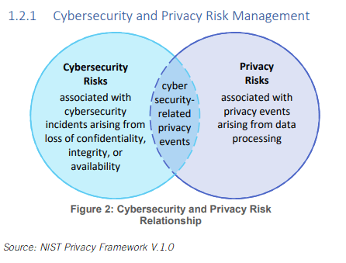

Slide 13
Data profiling is the process of examining, analyzing, and creating useful summaries of data.
The process yields a high-level overview which aids in the discovery of data quality issues, risks, and overall trends.
Data profiling produces critical insights into data that companies can then leverage to their advantage.

Slide 14
Why profile data?
Data profiling allows you to answer the following questions about your data.
Is the data complete? Are there blank or null values?
Is the data unique? How many distinct values are there? Is the data duplicated?
Are there anomalous patterns in your data? What is the distribution of patterns in your data?
Are these the patterns you expect?
What range of values exist, and are they expected? What are the maximum, minimum, and average values for given data? Are these the ranges you expect?

Slide 15
A data link is the means of connecting one location to another for the purpose of transmitting and receiving digital information (data communication).
It can also refer to a set of electronics assemblies, consisting of a transmitter and a receiver (two pieces of data terminal equipment) and the interconnecting data telecommunication circuit.
These are governed by a link protocol enabling digital data to be transferred from a data source to a data sink.

Slide 16
privacy policy is a statement or legal document (in privacy law) that discloses some or all of the ways a party gathers, uses, discloses, and manages a customer or client's data.
Personal information can be anything that can be used to identify an individual, not limited to the person's name, address, date of birth, marital status, contact information, ID issue, and expiry date, financial records, credit information, medical history, where one travels, and intentions to acquire goods and services.
In the case of a business, it is often a statement that declares a party's policy on how it collects, stores, and releases personal information it collects. It informs the client what specific information is collected, and whether it is kept confidential, shared with partners, or sold to other firms or enterprises.
Privacy policies typically represent a broader, more generalized treatment, as opposed to data use statements, which tend to be more detailed and specific.

Slide 17
The exact contents of a certain privacy policy will depend upon the applicable law and may need to address requirements across geographical boundaries and legal jurisdictions.
Most countries have their own legislation and guidelines of who is covered, what information can be collected, and what it can be used for.
In general, data protection laws in Europe cover the private sector, as well as the public sector. Their privacy laws apply not only to government operations but also to private enterprises and commercial transactions.
Privacy policy languages were designed to express the privacy controls that both organizations and users want to express. Most of the privacy policy languages were designed for specific purposes with specific features and characteristics.

Slide 18
Medical privacy or health privacy is the practice of maintaining the security and confidentiality of patient records.
It involves both the conversational discretion of health care providers and the security of medical records.
The terms can also refer to the physical privacy of patients from other patients and providers while in a medical facility, and to modesty in medical settings. Modern concerns include the degree of disclosure to insurance companies, employers, and other third parties.
The advent of electronic medical records (EMR) and patient care management systems (PCMS) have raised new concerns about privacy, balanced with efforts to reduce duplication of services and medical errors

Slide 19
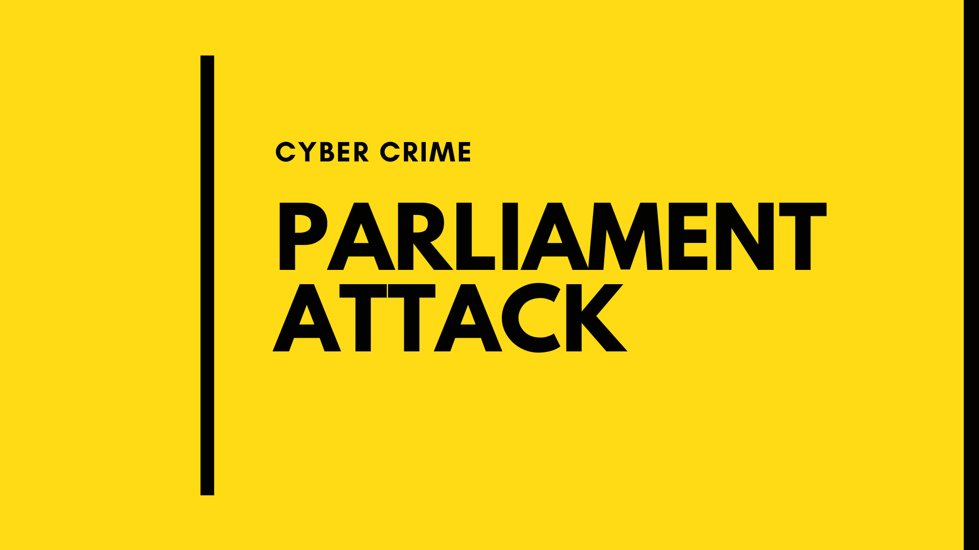
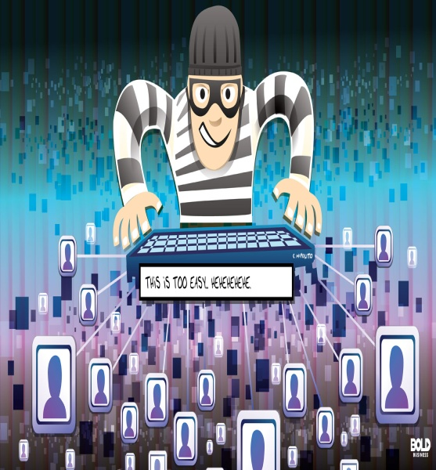

Slide 20
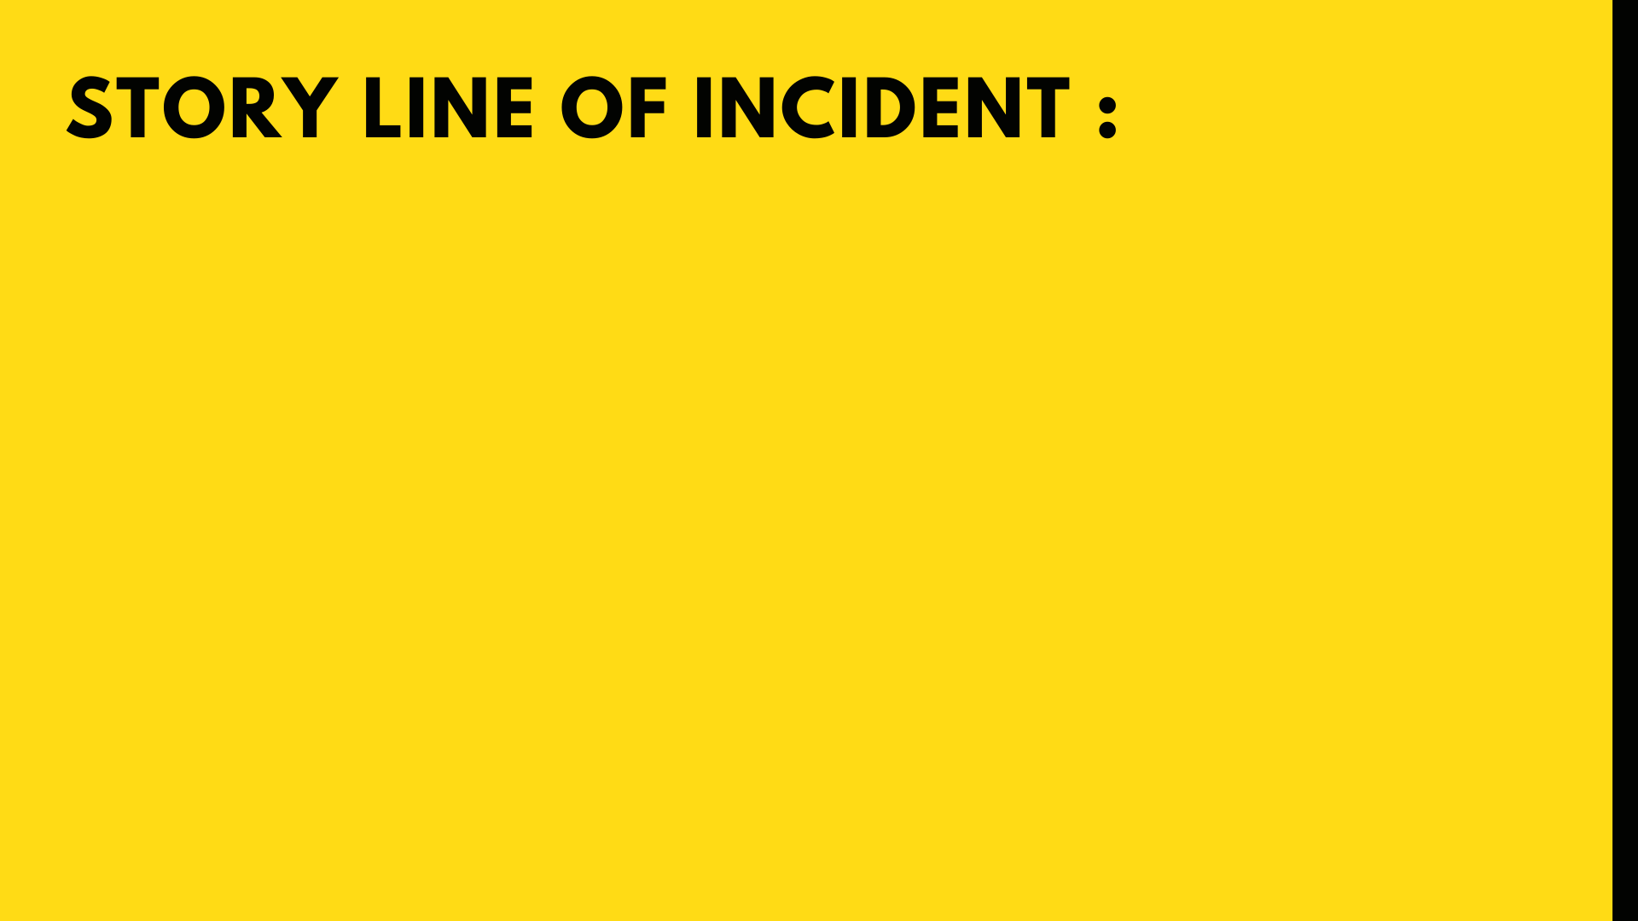
• A high profile attack by two Pakistani terrorists against building of Parliament of India took place on New Delhi on 13th December 2001
• The attack led to death of 12 people including a civilian and paved way to a military standoff between India and Pakistan.
• However , terrorists were caught and gunned off.

Slide 21
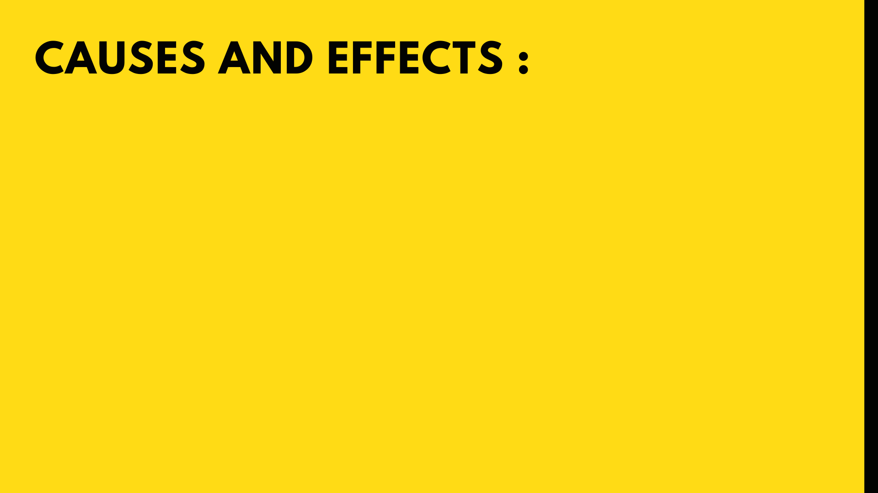
• BPRD , Hyd had handled this case.
• A laptop was recovered from terrorists who attacked the Parliament after gunning down by the police.
• Computer experts traced out the details and it was found that the laptop contained several proofs that affirmed motives of terrorists mainly
a. Sticker of ministry of Home that they created on laptop and affixed on their ambassador car to achieve entry into Parliament house.
b. Fake ID card that one of two terrorists was carrying with a government of emblem and seal.

Slide 22

INDIAN BANKS LOSE MILLIONS OF RUPEES

Slide 23
CAUSE OF CRIME
Bank heists have not gone out of fashion just yet, both as a cinematic trope, and also as a shortcut to riches. A total of 972 such incidents were reported in 2017-18, roughly three every day, according to data collated by the Reserve Bank of India (RBI).
India's financial systems are extremely vulnerable, because we still rely on international banking networks like Swift to make transactions. International gateways are open vectors of attack for India

Slide 24
India's Cosmos Bank loses $13.5 mln in cyber attack
Cyber criminals hacked the systems of India’s Cosmos Bank and siphoned off nearly 944 million rupees ($13.5 million) through simultaneous withdrawals across 28 countries over the weekend, the bank has told police.
The co-operative bank said unidentified hackers stole customer information through a malware attack on its automated teller machine (ATM) server, withdrawing 805 million rupees in 14,849 transactions in just over two hours on Aug. 11, mainly overseas.

Slide 25
Apart from the ATM withdrawals, the hackers transferred 139 million rupees to a Hong Kong-based company’s account by issuing three unauthorized transactions over the SWIFT global payments network, the bank said in a police complaint.
During the malware attack, a proxy switch was created and all the fraudulent payment approvals were passed by the proxy switching system, the bank said.
In 2016, unknown hackers stole more than $81 million from the Bangladesh central bank’s account with the Federal Reserve Bank Of New York. Investigators have made little progress in the case.
The banking sector lost a total of Rs 168.74 crore to organized crime directed at ATMs in the past three years. This includes figures for the first quarter of FY19. Between April and June 2018, 261 incidents were reported, entailing a loss of Rs 18.85 crore to banks.

Slide 26
However, in terms of the quantum of cash looted, there has been a slight improvement. From a high of Rs 65.3 crore in 2016-17, the amount of cash lost in ATM heists went down to Rs 44.49 in 2017-18. In the first quarter of the present financial year, 261 attempts at robbery have already been recorded, with the loss pegged at Rs 18.85 crore.
The most number of card frauds were targeted at ICICI Bank customers in 2017-18. As many as 348 cases were reported, wherein Rs 7 crore was embezzled. State Bank of India customers were defrauded to the tune of Rs 10 crore, in 144 reported cases.
However, the biggest fraud happened at City Union Bank, where Rs 32 crore was stolen in a single case.

Slide 27
Our detailed analysis of cyber-risk management by listed Indian banks shows that there is considerable divergence in the cyber-risk preparedness of Indian banks. While private-sector banks generally exhibit greater cyber maturity than the public-sector banks, there are numerous exceptions. The perception that smaller banks generally have lower levels of cyber-risk preparedness and, thereby, greater vulnerability, however, does not seem to be true.

Slide 28
OFFICIAL WEBSITE OF
MAHARASHTRA GOVERNAMENT
HACKED

Slide 29
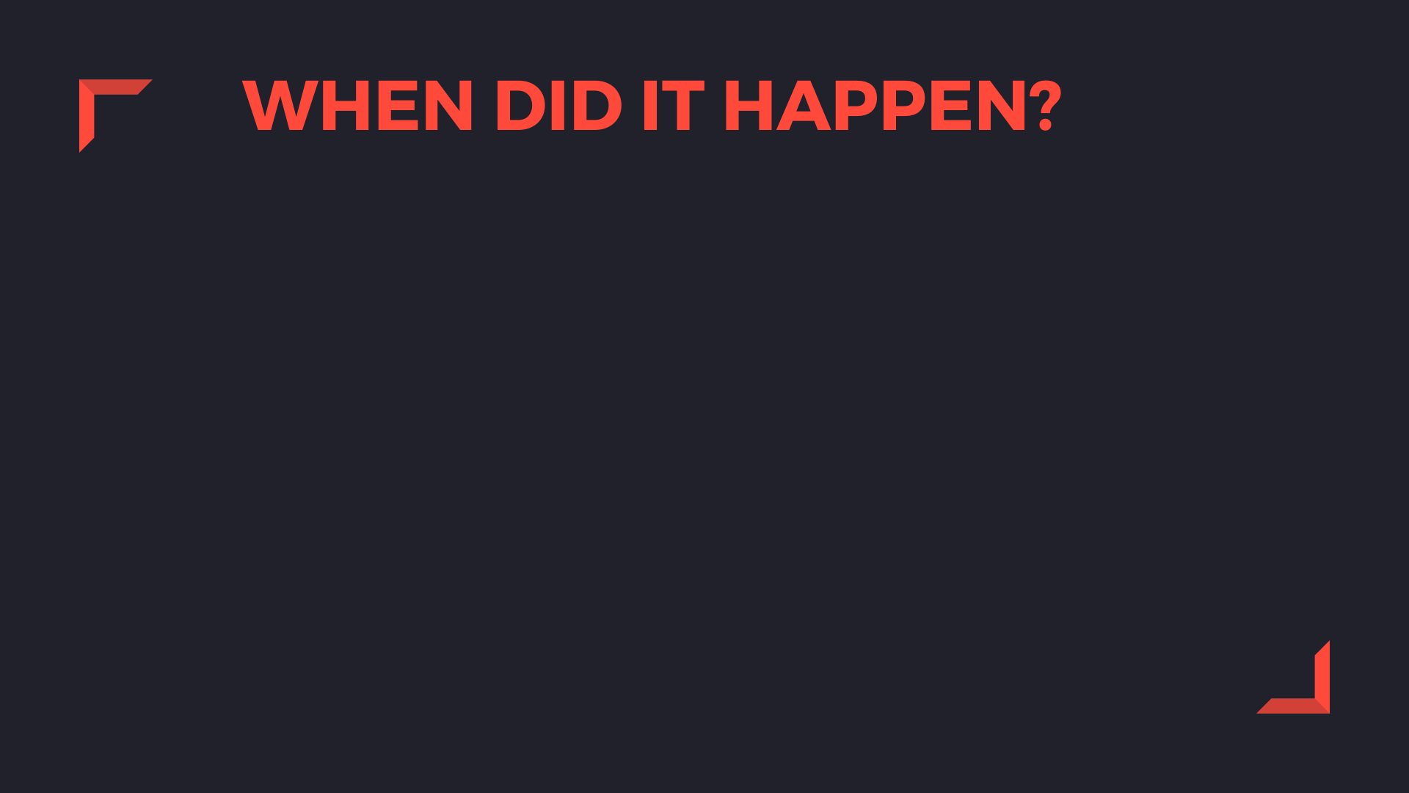
This is an incidence reported in September,2007.
The impacted website was http://www.maharashtragovernment.in
It is a citizen-friendly service based web portal of the BRIHANMUMBAI Municipal Corporation
The Maharashtra government’s official website was hacked which lead to the shutting down of www.Maharashtra.gov.in.

Slide 30

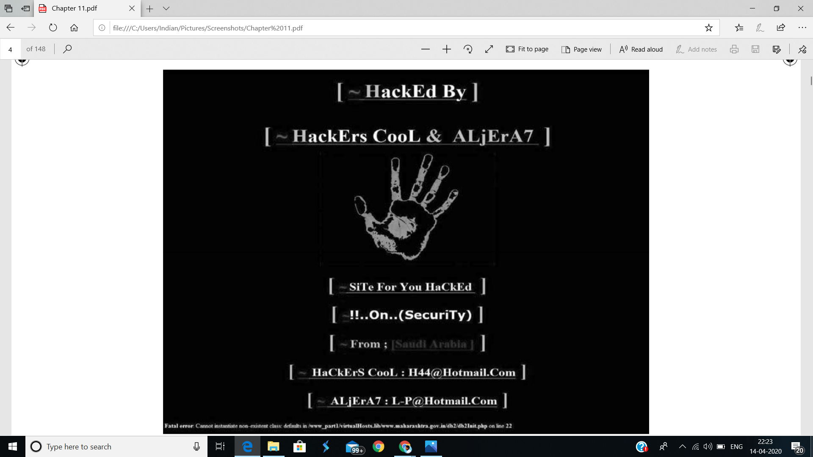
As per the reports , the site was attacked by a person or a group proclaimed as “COOLHACKER”.
The hacker left an imprint of a hand on the hacked website.
The IT Department has lodged an FIR with the police in an attempt to trace the culprit.
The Commissioner of police mentioned that the Hacker had posted some Arabic content on the website.
According to sources, hackers were suspected to be from Washington . But IT experts identified themselves as “Hackers Cool Al-jazera” and claimed they were based in Saudi Arabia.

Slide 31
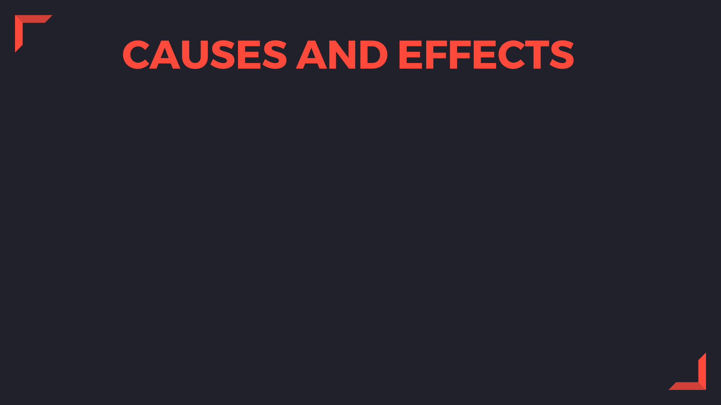
The state government website contained detailed information about Government Departments, Circulars, Reports, and other topics and also the website gets updated daily with various information on various government regulations and decisions, and support links to all government departments.
The state officials said that there was no data loss and there was no serious damage to the website. They said that they could only manage to damage the homepage of the website.

Slide 32
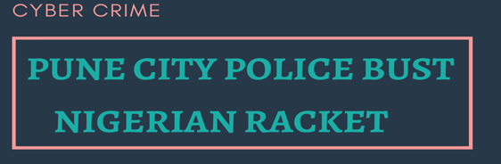

Slide 33
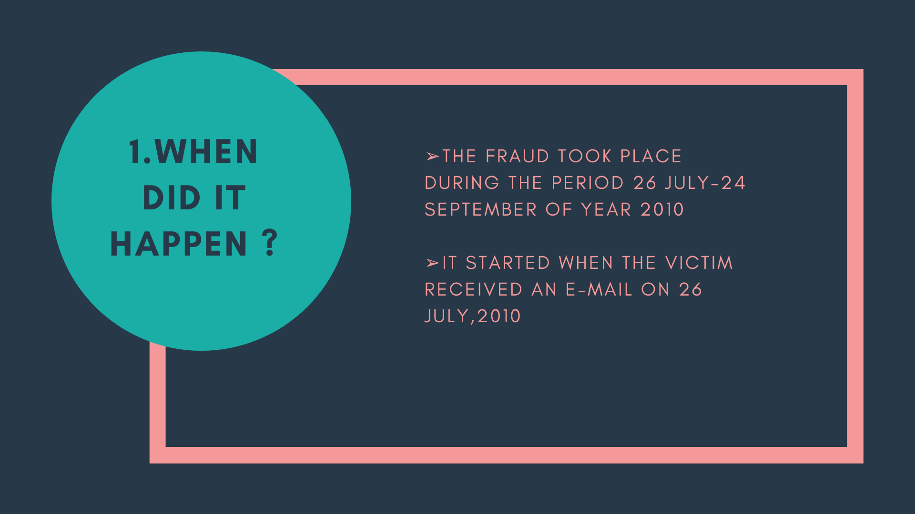

Slide 34
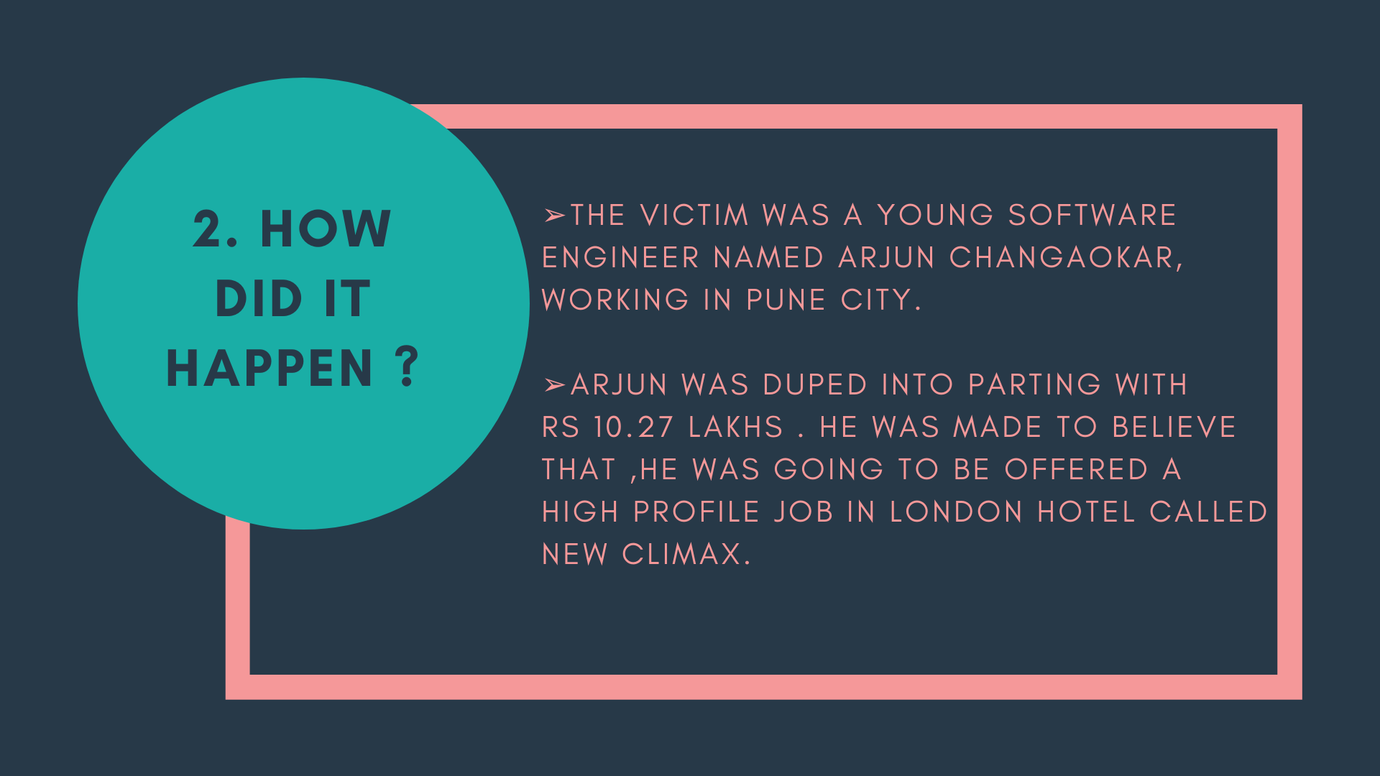

Slide 35
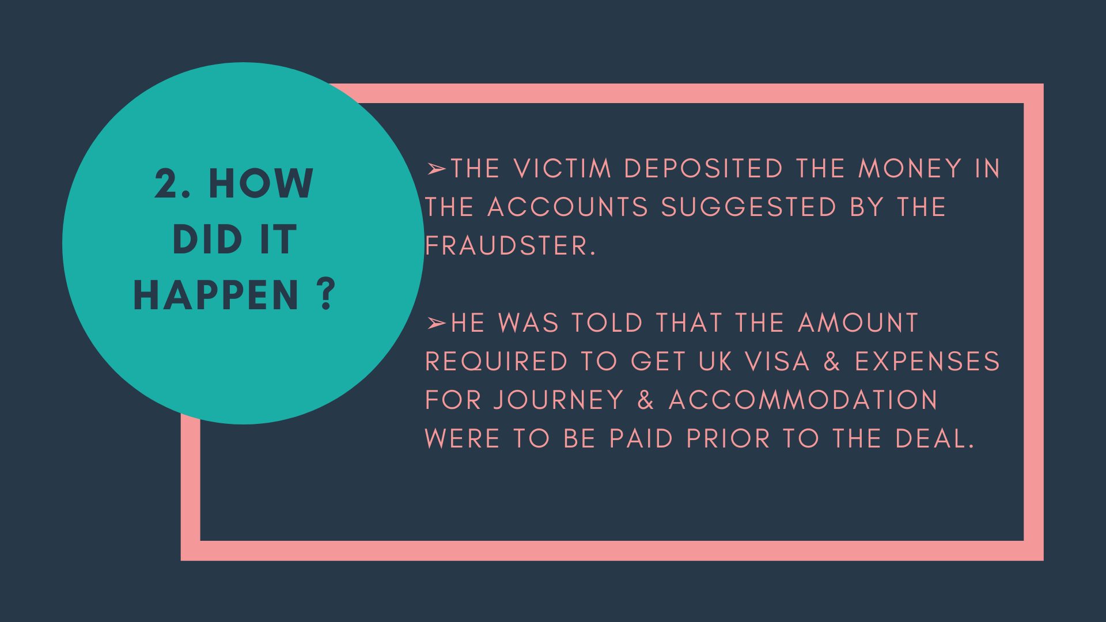

Slide 36
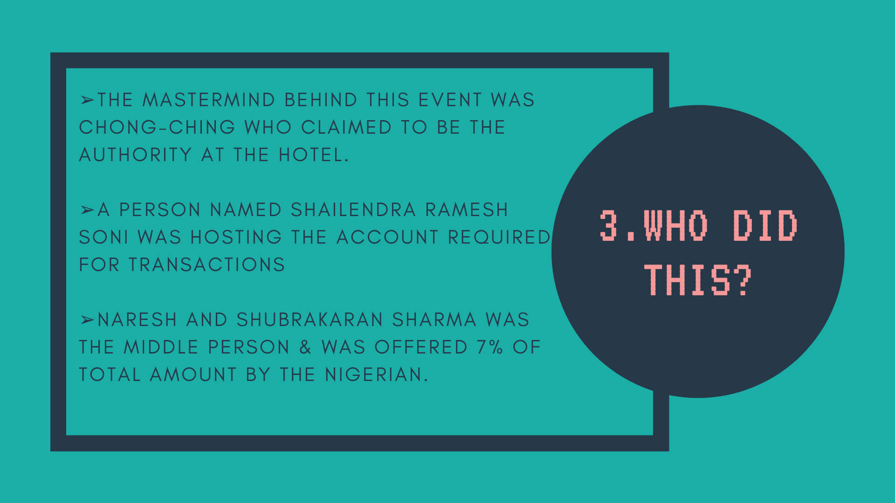

Slide 37
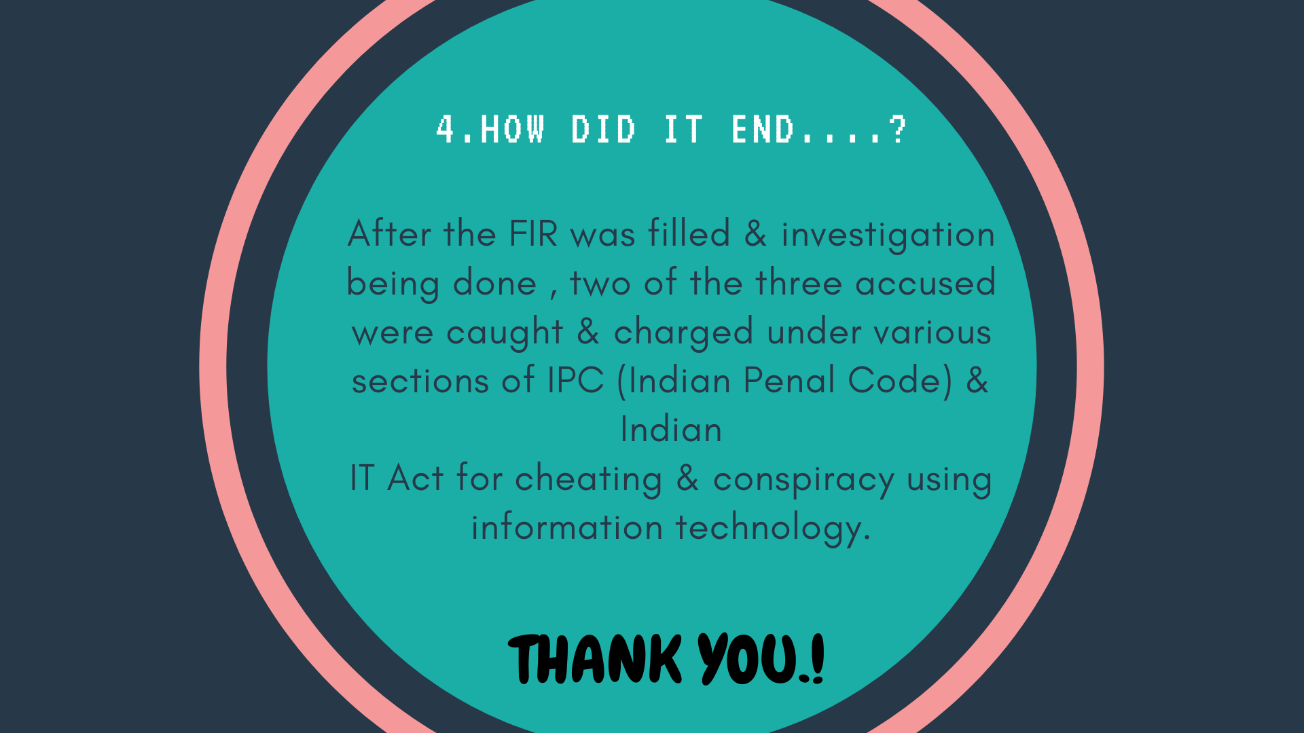

Slide 38
E-mail spoofing instances
1.What is e-mail spoofing?
2.Real-life Examples
3.How to stop e-mail spoofing
4.Conclusion
OUTLINE -

Slide 39
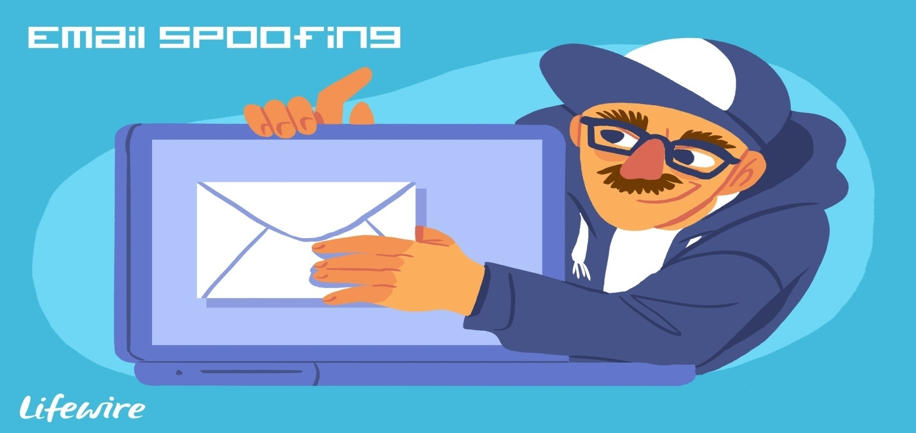
What is e-mail spoofing?
E-mail spoofing is the forgery of an e-mail header so that the message appears to have originated from someone or somewhere other than actual source.

Slide 40
Real-life Examples
For example, a spoofed email may pretend to be from a well-known shopping website, asking the recipient to provide sensitive data, such as a password or credit card number. Alternatively, a spoofed email may include a link that installs malware on the user's device if clicked.

Slide 41
How to stop e-mail spoofing
Keep antimalware software up to date.
Do not share private or financial information through email.
Avoid clicking suspicious links or downloading suspicious attachments.
Never enter sensitive information into the links that are not secure.

Slide 42
Conclusion
At the end, it is very hard to stop email spoofing attacks completely. Businesses must take action to stop them. Be alert of phishing attacks i.e, spam messages that link to false pages meant to appear like genuine website login pages.

