Slide 1
Data Recovery
Dr.K.Suresh Babu
Associate Professor of CSE
JNTUH School of Information Technology
JNT University Hyderabad

Slide 2
Data Recovery
Data recovery is the process in which highly trained engineers evaluate and extract data from damaged media and return it in an intact format.
Many people, even computer experts, fail to recognize data recovery as an option during a data crisis.
But it is possible to retrieve files that have been deleted and passwords that have been forgotten or to recover entire hard drives that have been physically damaged.

Slide 3
Data Back-up and Recovery
Back-up Obstacles
Back-up Window: The back-up window is the period of time when back-ups can be run. The back-up window is generally timed to occur during nonproduction periods when network bandwidth and CPU utilization are low.
Network bandwidth: If a network cannot handle the impact of transporting hundreds of gigabytes of data over a short period of time, the organization’s centralized backup strategy is not viable.
System throughput: Three I/O bottlenecks are commonly found in traditional backup schemes. These are
The ability of the system being backed up to push data to the backup server
The ability of the backup server to accept data from multiple systems simultaneously
The available throughput of the tape device(s) onto which the data is moved
Lack-of Resources: Many companies fail to make appropriate investments in data protection until it is too late.

Slide 4
The Future of Data Back-up
Successful data back-up and recovery is composed of four key elements:
The Backup Server
The Network
The Backup Window
The Backup Storage Device.

Slide 5
THE BACK-UP SERVER
The backup server is responsible for managing the policies, schedules, media catalogs, and indexes associated with the systems it is configured to back up.
The systems being backed up are called clients
The overall performance of a backup or recovery was directly related to the ability of the backup server to handle the I/O load created by the backup process.
Tape servers allow administrators to divide the backup tasks across multiple systems while maintaining scheduling and administrative processes on a primary or backup server. This approach often involves attaching multiple tape servers to a shared tape library, which reduces the overall cost of the system.
The new backup architecture implements a serverless backup solution that allows data to be moved directly from disk to tape, bypassing the backup server altogether. This method of data backup removes the bottleneck of the backup server completely.
However, the performance of serverless backup is then affected by another potential bottleneck— bandwidth.

Slide 6
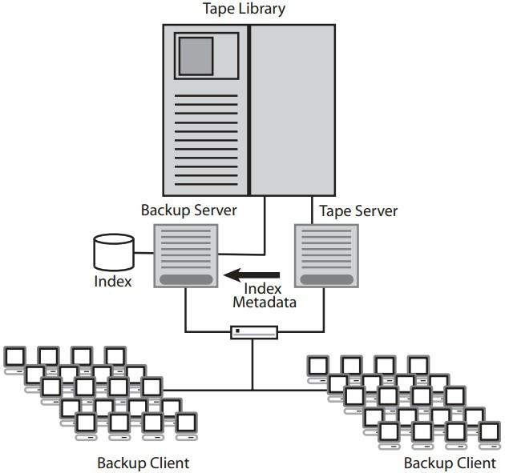
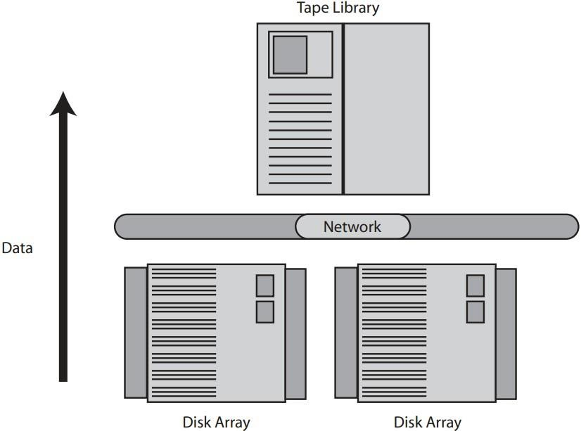
A backup using a shared tape library | A serverless backup system

Slide 7
THE NETWORK DATA PATH
Centralization of a data-management process such as backup and recovery requires a robust and available network data path. The movement and management of hundreds or thousands of megabytes of data can put a strain on even the best-designed networks.
An enterprise-class backup solution can distribute backup services directly to the data source, while at the same time centralizing the administration of these resources.
We can install a network path dedicated to the management and movement of data. This data path can be SCSI, Ethernet, ATM, fiber distributed data interface (FDDI), or fiber channel.
Creating a dedicated data path is the beginning of a storage area network (SAN).
SANs are quickly dominating the backup landscape, and applications such as serverless and LAN-less backup will continue to push this emerging technology forward.
Above Figure shows an example of a dedicated SAN topology.

Slide 8
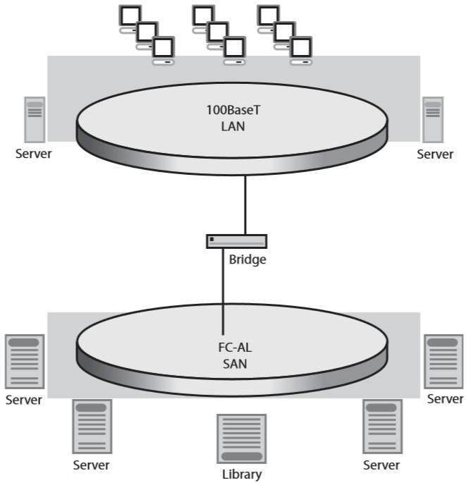
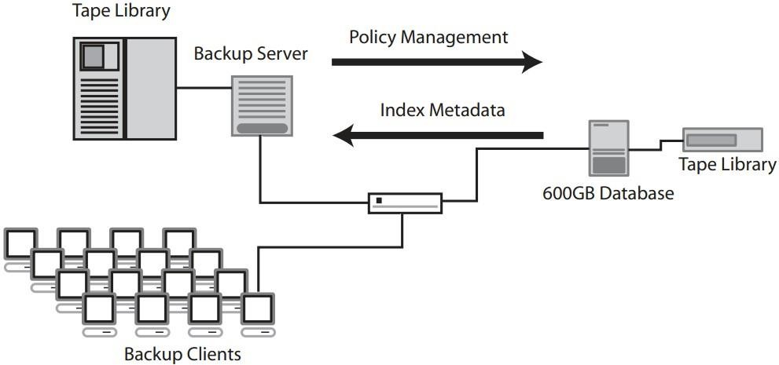
A LAN-less back-up using remote tape server | A storage are network using serverless back-up

Slide 9
THE BACK-UP WINDOW
A backup window defines how much time is available to back up the network.
Most companies are managing too much data to complete backup during these ever-shrinking backup windows
The backup-software community has developed a way to overcome the element of time by using incremental backup, block-level backup, image backups, and data archiving.
Incremental Backup
Incremental backups only transfer data that has changed since the last backup. On average, no more than 5% of data in a file server changes daily. That means an incremental backup may only require 5% of the time it takes to back up the entire file system.
Block-Level Incremental Backup
Rather than backing up entire files that have been modified since the last backup, only the blocks that have changed since the last backup are marked for backup.
Image Backups
This type of backup creates copies, or snapshots, of a file system at a particular point in time. Image backups are much faster than incremental backups and provide the ability to easily perform a bare bones recovery of a server without loading the operating systems, applications, and the like.
Data Archiving
Removing infrequently accessed data from a disk drive can reduce the size of a scheduled backup by up to 80%. Static data that has been archived is easily recalled when needed but does not add to the daily data backup requirements of the enterprise.

Slide 10
BACK-UP STORAGE DEVICES
The most expensive item in a back-up project is the back-up storage device.
Determining the tape format, number of tape drives, and how many slots are required is predicted on many variables.
For best suitable back-up storage device we have to consider Back-up windows, growth rates, retention policies, duplicate tape copies, and network and server throughputs.
Tape libraries are sized using two variables: the number of tape drives, the number of slots.
Tape libraries today are available with 5 to 50,000 slots and can support anywhere from 1 to 256 tape-drives. The following table compares several different tape technologies:
Technology | Capacity (Native/Compressed) | Max Transmission Rate (Native/Compressed)
Mammoth-2 | 60GB/150GB | 12 Mbps/30 Mbps
AIT-3 | 100GB/250GB | 12 Mbps/30Mbps
Super DLT | 110GB/220GB | 10 Mbps/20Mbps
LTO Ultrium | 340GB/680GB | 20 Mbps/40 Mbps

Slide 11
RECOMMENDED BACK-UP FEATURES
Data Interleaving: To back up multiple systems concurrently, the backup application must be able to write data from multiple clients to tape in an interleaved manner.
Remote Back-up: Many remote systems are exposed to unrecoverable data loss. A backup application should have a method to back up systems across a WAN or over dial-up connections
Global Monitoring: A robust backup application should be able to support reporting and administration of any backup system, regardless of location.
Performance: An enterprise backup application should be able to benchmark backup data rates exceeding one terabyte per hour.

Slide 12
The Role of Back-up in Data Recovery
There are many factors that affect back-up. For example:
Storage costs are decreasing: The cost per megabyte of primary (online) storage has fallen dramatically over the past several years and continues to do so as disk drive technologies advance.
Systems have to be on-line continuously: Because systems must be continuously online, the dilemma becomes that you can no longer take files offline long enough to perform backup.
The role of Back-up has changed: The role of backup now includes the responsibility for recovering user errors and ensuring that good data has been saved and can quickly be restored.
CONVENTIONAL TAPE BACK-UP IN TODAY’S MARKET
A typical tape management system consists of a dedicated workstation with the front-end interfaced to the network and the back-end controlling a repository of tape devices. The media server runs tape management software. It can administer backup devices throughout an enterprise and can run continuous parallel backups and restores.
An alternative to tape backup is to physically replicate or mirror all data and keep two copies online at all times. The advantage is that the data does not have to be restored, so there are no issues with immediate data availability.

Slide 13
ISSUES WITH TODAY’S BACK-UP
NETWORK BACKUP creates network performance problems. Using the production network to carry backup data, as well as for normal user data access, can severely overburden today’s busy network resources.
OFFLINE BACKUP affects data accessibility. The time that the host is offline for data backup must be minimized. This requires extremely high-speed, continuous parallel backup of the raw image of the data.
LIVE BACKUPS allow data access during the backup process but affect performance. The downside to the live backup is that it puts a tremendous burden on the host.
MIRRORING doesn’t protect against user error and replication of bad data. Fully replicated online data sounds great, albeit at twice the cost per megabyte of a single copy of online data.
NEW ARCHITECTURES AND TECHNIQUES ARE REQUIRED
Backup at extremely high speed is required. Recovery must be available at file level. The time that systems off-line for back-up must be eliminated.
Remote hot recovery sites are needed for immediate resumption of data access. Backup of critical data is still required to ensure against data errors and user errors.
To achieve effective backup and recovery, the decoupling of data from its storage space is needed.
It is necessary to develop techniques to journal modified pages, so that journaling can be invoked within the primary storage device, without host intervention.
Part of the primary storage area must be set aside for data to be backed up. This area must be as large as the largest backup block. We should have fast nonrandom restoration of critical data.

Slide 14
The Data Recovery Solution
1. SHRINKING EXPERTISE, GROWING COMPLEXITY
The complex systems that have evolved over the past 30 years must be monitored, managed, controlled, and optimized. But most of the bright young graduates this term haven’t had much exposure to mainframe concepts.
Backups often take place while an application is running. Application changes take place on the fly. If an outage occurs, the company stands to lose tens of thousands of dollars an hour.
FAILURES: Disk storage is more reliable than ever, but hardware failures are still possible. A simple
mistake can be made by an application programmer, system programmer, or operations person. Logic errors in programs or application of the wrong update at the wrong time can result in a system crash or, worse. Disasters do really occurs! Floods, tornadoes, earthquakes, tsunamis, and even terrorism can do strike. We must be ready.

Slide 15
BUDGETS AND DOWNTIME
We have fewer resources (people, processing power, time, and money) to do more work than ever before, and we must keep your expenses under control. Systems must remain available to make money and serve customers. Downtime is much too expensive to be tolerated.

Slide 16
RECOVERY: THINK BEFORE YOU BACK-UP
One of the most critical data-management tasks involves recovering data in the event of a problem. You must evaluate your preparations, make sure that all resources are available in usable condition, automate processes as much as possible, and make sure you have the right kind of resources.
Evaluate your preparation
If all of the resources (image copies, change accumulations, and logs) are available at recovery time, these preparations certainly allow for a standard recovery. Finding out at recovery time that some critical resource is missing can be disastrous!
Don’t let your resources fall through the cracks
Identifying different types of conditions is critical to ensuring a successful recovery. Checking your assets to make sure they’re ready should be part of your plan.
Automated Recovery
With proper planning and automation, recovery is made possible, reliance on specific personnel is reduced, and the human-error factor is nearly eliminated.
Data integrity and your business relay on building recovery job control language (JCL). In the event of a disaster, the Information Management System (IMS) recovery control (RECON) data sets must be modified in preparation for the recovery. Cleaning your RECON data sets can take hours if done manually, and it’s an error-prone process.
Make Recoveries Efficient
Multithreading tasks shorten the recovery process. Recovering multiple databases with one pass through your log data certainly will save time. Taking image copies, rebuilding indexes, and validating pointers concurrently with the recovery process further reduce downtime.
Take Back-ups
The first step to a successful recovery is the backup of your data. Your goal in backing up data is to do so quickly, efficiently, and usually with minimal impact to your customers. You might need only very brief out-ages to take instant copies of your data, or you might have intelligent storage devices that allow you to take a snapshot of your data. Both methods call for tools to assist in the management of resources.

Slide 17
4.4 BACK-UP AND RECOVERY SOLUTION
BMC software has developed a model called the Back-up and Recovery Solution (BRS) for the Information Management System (IMS) product.
4.4.1 Image Copy
BRS contains an Image Copy component to help manage your image copy process. BRS can take batch, on-line (fuzzy), or incremental image copies; Snapshot copies; or Instant Snapshot copies.
The Image Copy component of BRS offers a variety of powerful features: dynamic allocation of all input and output data sets, stacking of output data sets, high performance access methods (faster I/O), copying by volume, compression of output image copies, and database group processing--- all
while interfacing with DBRC and processing asynchronously.
4.4.2 Change Accumulation
The BRS Change Accumulation component takes advantage of multiple engines, large virtual storage resources, and high-speed channels and controllers that are available in many environments.
Use of multiple tack control block (TCB) structures enables overlapping of as much processing as possible, reducing both elapsed and CPU time.
4.4.3 Recovery
The BRS Recovery component, which functionally replaces the IMS Database Recovery utility for null- function (DL/I) databases and data-entry databases (DEDBs), allow recovery of multiple databases with one pass of the log and change accumulation data sets while dynamically allocating all data sets required for recovery.
BRS recovers multiple databases to any point in time. BRS can determine the best choice for a Point-in- Time (PIT) recovery. Full DBRS support includes:

Slide 18
RECOVERY MANAGER
Recovery Manager component lets you automate and synchronize recoveries across applications and databases by creating meaningful groups of related databases and creating optimized JCL to perform the recovery of these groups.
Recovery Manager component provides a positive response for the IMS commands that are used to deallocate and start your databases.
Recovery Manager component fully automates the process of cleaning the RECON data sets for restart following a disaster recovery.
Recovery Manager component also allows you to test your recovery strategy and notifies you when media errors have jeopardized your recovery resources.
POINTER CHECKING
BRS offers the capability to verify the validity of database pointers through the Concurrent Pointer Checking function for both full-function databases and Fast Path data-entry databases (DEDBs).
INDEX REBUILD
If indexes are ever damaged or lost, the Index Rebuild function of BRS allows you rebuild them rather than recover them.
RECOVERY ADVISOR
The Recovery Advisor component of BRS allows you to monitor the frequency of your image copies and change accumulations.
It helps you to determine whether all your databases are being backed-up.
By using any number of back-up and recovery tools available, you can better manage your world and be ready to recover!

Slide 19
Thank you

