Slide 1
Mathematics for Computer Science MIT 6.042J/18.062J
Euler’s Theorem

Slide 2
Euler φ function
φ(n) ::=
# k ∈ 0,1,…,n-1 s.t.
k rel. prime to n
[0,n)
has a (mod n)
inverse

Slide 3
Euler φ function
φ(n) ::= # k ∈ [0,n) s.t.
k rel. prime to n
φ(7) = 6
φ(12) = 4
1,2,3,4,5,6
0,1,2,3,4,5,6,7,8,9,10,11

Slide 4
Calculating φ
If p prime, everything in
[1,p) is rel. prime to p, so
φ(p) = p – 1

Slide 5
Euler φ function
φ(9)?
0,1,2,3,4,5,6,7,8
0,1,2,3,4,5,6,7,8
k rel. prime to 9 iff
k rel. prime to 3
3 divides every 3rd number
so, φ(9) = 9-(9/3) = 6

Slide 6
Calculating φ(p^{k})
0,1,...,p,...,2p,.....,p^{k}-p,...,p^{k}-1
0,1,...,p,...,2p,.....,p^{k}-p,...,p^{k}-1
p divides every pth number
p^{k}/p of these numbers
are not rel. prime to p^{k}

Slide 7
Calculating φ(p^{k})
so
φ(p^{k}) = p^{k} – p^{k}/p
– p^{k-1}

Slide 8
Calculating φ(a⋅b)
Lemma :
For a, b relatively prime,
φ(a⋅b) = φ(a)⋅φ(b)
pf: Pset 5. Another
way later by “counting.”

Slide 9
Calculating φ(a⋅b)
φ(12) = φ(3⋅4)
= φ(3)⋅φ(4)
= (3 - 1)⋅(2² - 2²⁻¹)
= 2⋅(4 - 2) = 4

Slide 10
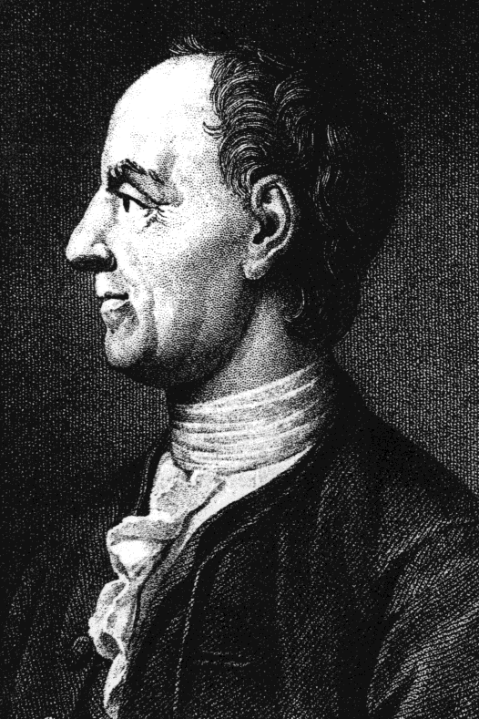
Euler’s Theorem
For k relatively
prime to n,
k^{φ(n)} ≡ 1 (mod n)

Slide 11
Fermat’s “Little” Theorem
special case:
k^{p-1} ≡ 1 (mod p)
for prime p
k ∊ [1,p)

Slide 12
Proof of Euler’s Theorem
n* ::=
{m∈[1,n)| m rel prime to n}
Note: m,k ∈ n* implies
m⋅k rel. prime to n
rem(mk,n) ∈ n*

Slide 13
Permuting n*
Lemma:
For k∈n*, the mapping
m → rem(km, n)
is a bijection from n* to n*
mult by k∈n*, permutes n*
lec 6W.13

Slide 14
permuting (mod 9)
φ(9) = 3²-3 = 6
9*=
 | 1 | 2 | 4 | 5 | 7 | 8

Slide 15
permuting (mod 9)
φ(9) = 3²-3 = 6
 | 1 | 2 | 4 | 5 | 7 | 8
2⋅ | 2 | 4 | 8 | 1 | 5 | 7
9*=
 | 1 | 2 | 4 | 5 | 7 | 8

Slide 16
permuting (mod 9)
φ(9) = 3²-3 = 6
9*=
 | 1 | 2 | 4 | 5 | 7 | 8
2⋅ | 2 | 4 | 8 | 1 | 5 | 7
7⋅ | 7 | 5 | 1 | 8 | 4 | 2

Slide 17
Proof of Euler’s Thm
say n*= {m₁,m₂,…,m_{s}}, k∈n*
none of
≡ (mod n) because k cancels
so each m_{i}k ≡ m_{j} (mod n)
for a unique m_{j.}
m₁k, m₂k, …, m_{s}k

Slide 18
Proof of Euler’s Thm
in particular,
m₁⋅m₂ ∙∙∙ ⋅m_{s}
≡ (m₁k)⋅(m₂k)∙∙∙(m_{s}k) (mod n)
now cancel the m_{i}’s

Slide 19
Proof of Euler’s Thm
in particular,
1
≡ ( k)⋅( k) ∙∙∙ ( k) (mod n)

Slide 20
Proof of Euler’s Thm
in particular,
1
≡ k^{s} (mod n)

Slide 21
Proof of Euler’s Thm
in particular,
1 ≡ k^{s} (mod n)
φ(n)
QED

Slide 22
Proof of Euler’s Thm
So

Slide 23
Proof of Euler’s Thm

Slide 24
Proof of Euler’s Thm

Slide 25
Proof of Euler’s Thm
But OK to cancel , so
1 ≡ k^{φ(n)} (mod n).
QED

Slide 26
Team Problems
Problems
1-4
Notes:
36

