Slide 1
IMPLIES

Slide 2
IMPLIES
The value of (P IMPLIES Q) is F iff
P is T and Q is F.
Truth Table for IMPLIES
P | Q | P IMPLIES Q
T | T | T
T | F | F
F | T | T
F | F | T
IMPLIES.2

Slide 3
A True Implication
(1=-1) IMPLIES (I am Pope)
We reasoned correctly to
reach the false conclusion

Slide 4
A True Implication
(1=-1) IMPLIES (I am Pope)
We reasoned correctly to
reach the false conclusion

Slide 5
A True Implication
(1=-1) IMPLIES (I am Pope)
We reasoned correctly to
reach the false conclusion
from the false hypothesis.

Slide 6
A True Implication
(1=-1) IMPLIES (I am Pope)
We reasoned correctly to
reach the false conclusion
from the false hypothesis.

Slide 7
A True Implication
(1=-1) IMPLIES (I am Pope)
The whole implication is true,
even though both conclusion
& hypothesis are false.

Slide 8
Proving Validity
Instead of truth tables,
can try to prove valid
formulas symbolically using axioms and deduction rules

Slide 9
modus ponens rule

Slide 10
Soundness
A sound rule preserves truth:
if all the antecedents are
true is some environment,
then so is the conclusion.

Slide 11
Soundness
modus ponens is sound:
if P is true,
and P IMPLIES Q is true,
then Q must be true,
―by truth table.

Slide 12
Other Applications
Java Logical Expressions:
OR
AND
if ((x>0) || (x <= 0 && y>100))

(more code)

Slide 13
Digital Logic

Slide 14
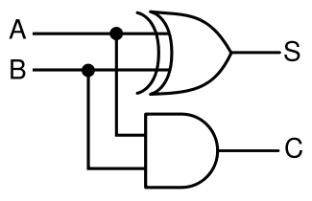
Application: Digital Logic
half adder
from http://en.wikipedia.org/wiki/Adder_(electronics)

Slide 15
Digital Logic
d
c_{in}
c_{out}
A
s
B
c
full adder
IMPLIES.15

