Slide 1
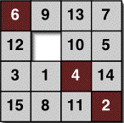
Mathematics for Computer Science MIT 6.042J/18.062J
State Machines

Slide 2
State machines
step by step processes
(may step in response
to input ―not today)

Slide 3
State machines
The state graph of a 99-bounded counter:
start state
0
1
2
99
overflow
States: {0,1,…,99, overflow}
Transitions:
0 ≤ i < 99
i
i+1
99
overflow
overflow
overflow

Slide 4

Die Hard
Picture source: http://movieweb.com/movie/diehard3/

Slide 5
Die Hard
Simon says: On the fountain, there should be 2 jugs, do you see them? A 5-gallon and a 3-gallon. Fill one of the jugs with exactly 4 gallons of water and place it on the scale and the timer will stop. You must be precise; one ounce more or less will result in detonation. If you're still alive in 5 minutes, we'll speak.

Slide 6

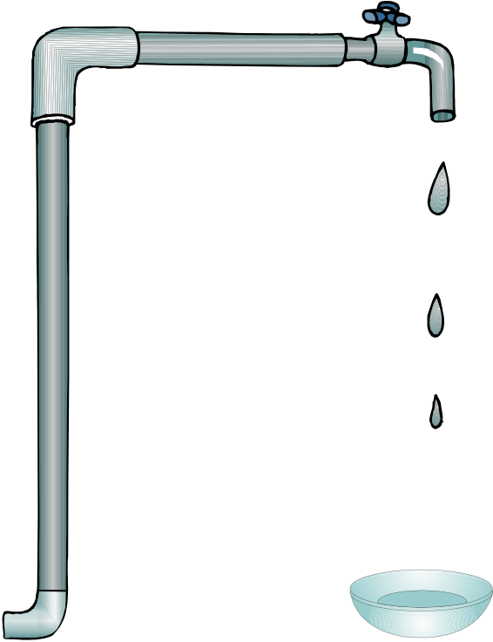
Die Hard
Supplies:
3 Gallon Jug
5 Gallon Jug
Water

Slide 7
Die Hard
Transferring water:
3 Gallon Jug
5 Gallon Jug

Slide 8
Die Hard
Transferring water:
3 Gallon Jug
5 Gallon Jug

Slide 9
Die hard state machine
State:
amount of water in jugs: (b,l)
0 ≤ b ≤ 5, 0 ≤ l ≤ 3
Start State: (0,0)

Slide 10
State machines
Die Hard Transitions:
1. Fill little jug: (b, l) → (b, 3) for l < 3
2. Fill big jug: (b, l) → (5, l) for b < 5
3. Empty little jug: (b, l) → (b, 0) for l > 0
4. Empty big jug: (b, l) → (0, l) for b > 0

Slide 11
State machines
5. Pour big jug into little jug
(i) If no overflow, then (b,l)→(0,b+l)
(ii) otherwise (b,l) →(b−(3−l),3)
6. Pour little jug into big jug. Likewise
b+l ≤ 3

Slide 12
Die Hard
Simon’s challenge:
Disarm the bomb by putting precisely 4 gallons of water on the scale, or it will blow up.
(You can figure out how)

Slide 13
Die Hard
Work it out now!

Slide 14
How to do it
Start with empty jugs: (0,0)
Fill the big jug: (5,0)
3 Gallon Jug
5 Gallon Jug

Slide 15
How to do it
Pour from big to little:
(2,3)
3 Gallon Jug
5 Gallon Jug

Slide 16
How to do it
Empty the little: (2,0)
3 Gallon Jug
5 Gallon Jug

Slide 17
How to do it
Pour from big to little: (0,2)
3 Gallon Jug
5 Gallon Jug

Slide 18
How to do it
Fill the big jug: (5,2)
3 Gallon Jug
5 Gallon Jug

Slide 19
How to do it
Pour from big to little:
(4,3)
3 Gallon Jug
5 Gallon Jug
Done!

Slide 20
Die Hard once and for all
What if have a 9 gallon jug instead?
3 Gallon Jug
5 Gallon Jug
9 Gallon Jug
Can you do it? Can you prove it?

Slide 21
Die Hard Once & For All
Supplies:
3 Gallon Jug
9 Gallon Jug
Water

Slide 22
Preserved Invariants
Die hard once and for all
preserved invariant:
P(state) ::= “3 divides the number of gallons in each jug.”

Slide 23
Preserved Invariants
Floyd’s Invariant Method
(just like induction)
Base case: Show P(start)
Preservation case: Show
if P(q) and , then P(r)
Conclusion: P holds for all reachable states, including final state (if any)
q
r

Slide 24
Die Hard Once & For All
Corollary: No state
(4,x) is reachable, so
Bruce Dies!

Slide 25

The Diagonal Robot
the robot is on a grid
y
2
1
0
x
0 1 2 3

Slide 26
The Diagonal Robot
it can move diagonally
y
2
1
0
x
0 1 2 3

Slide 27
The Diagonal Robot
can it get from (0,0) to (1,0)?
y
?
2
1
0
GOAL
x
0 1 2 3

Slide 28
Robot Preserved Invariant
NO!
preserved invariant:
P((x, y)) ::= x + y is even
move adds ±1 to both x & y,
preserving parity of x+y.
Also, P((0, 0)) is true.

Slide 29
Robot Preserved Invariant
So in all positions (x,y)
reachable from (0,0),
x + y stays even
But 1 + 0 = 1 is odd, so
(1,0) is not reachable

Slide 30
Floyd’s Invariant Principle
(induction for state machines)
Preserved Invariant, P(state):
if P(q) and , then P(r)
Conclusion: if P(start), then P(r)
for all reachable states r,
including final state (if any)
q
r

Slide 31
The Fifteen Puzzle
Explained!
--by similar reasoning
details in problem 2

Slide 32
Fast Exponentiation
compute a^{b} using registers X,Y,Z,R
X:= a; Y:= 1; Z:= b;
REPEAT:
if Z=0, then return Y
R:= remdr(Z,2); Z:= quotnt(Z,2)
if R=1,then Y:= X⋅Y
X:= X²

Slide 33
Fast Exponentiation
State Machine:
States ::=
start ::= (a,1,b)
transitions ::= (X,Y,Z) →
(X², Y , quotnt(Z,2)) if Z>0 is even
(X², X⋅Y, quotnt(Z,2)) if Z>0 is odd

Slide 34
Fast Exponentiation
Preserved Invariant: YX^{Z} = a^{b}
(X,Y,Z) → [Z>0 is odd]
(X²,X⋅Y,(Z-1)/2)
(X⋅Y)(X²)^{(Z-1)/2} =(X⋅Y)X^{Z-1}
=YX^{Z} = a^{b}

Slide 35
Partial Correctness
preserved invariant: YX^{Z} = a^{b}
at start
at end Z=0, so return
Y=YX⁰ = a^{b}

Slide 36
Fast Termination
at each transition
Z:= quotient(Z,2)
Z= b at start, so Z= 0
in ≤ log₂(b) transitions

Slide 37
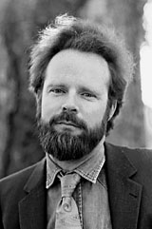
Robert W Floyd (1934−2001)
Eulogy by Knuth: http://www.acm.org/pubs/membernet/stories/floyd.pdf
Picture source: http://www.stanford.edu/dept/news/report/news/november7/floydobit-117.html

Slide 38
Derived Variables
A derived variable, v, is a function assigning a “value” to each state:
v: States → Values
If Vals = , say v is “ -valued”
or “nonnegative-integer-valued”

Slide 39
Derived Variables
Robot on the grid example:
States = ². Define the
sum-value, σ, of a state:
σ(x,y) ::= x+y
an -valued derived variable

Slide 40
Derived Variables
Called derived to distinguish from actual variables that appear in a program.
For robot Actual: x, y
Derived: σ

Slide 41
Derived Variables
Another derived variable:
π ::= σ (mod 2)
π is {0,1}-valued

Slide 42
Derived Variables
For Fast Exp, have (actual) variable Z.
Proof of termination:
Z is strictly decreasing &
natural number-valued

Slide 43
Derived Variables
Termination followed by
Well Ordering Principle:
Z must take a least value.
then the algorithm is stuck

Slide 44
Strictly Decreasing Variable
16
12
8
4
0
Goes down at
every step
State

Slide 45
Weakly Decreasing Variable
16
12
8
4
0
Down or constant
after each step
State

Slide 46
Diagonal Robot variables
σ: up & down all over the place
neither increasing
nor decreasing
π: is constant
both weakly increasing
& weakly decreasing

Slide 47
Weakly Decreasing Variable
(We used to call weakly
decreasing variables
“nonincreasing” variables.)

Slide 48
Weakly Decreasing Variable
OK terminology but remember:
nonincreasing is
NOT SAME as “not increasing:”

Slide 49
Termination using WOP on generalizes to strictly decreasing variables whose values are in any
well ordered set

Slide 50
Well ordered sets
Def. A set W of real numbers is well ordered iff it has
no infinite decreasing sequence
w₀>w₁>w₂>⋯>w_{n}>⋯

